Slide 1
Online Shopping System
Production teams
1. Peerapong Chompootepa 542115044
2. Worrasete Tansurat 542115056
3. Sarun Boontengchan 542115060

Slide 2
Software Requirement
Our system has 18 URS
79 SRS
Details
- Software requirement specification
- URS description
- Use case diagram

Slide 3
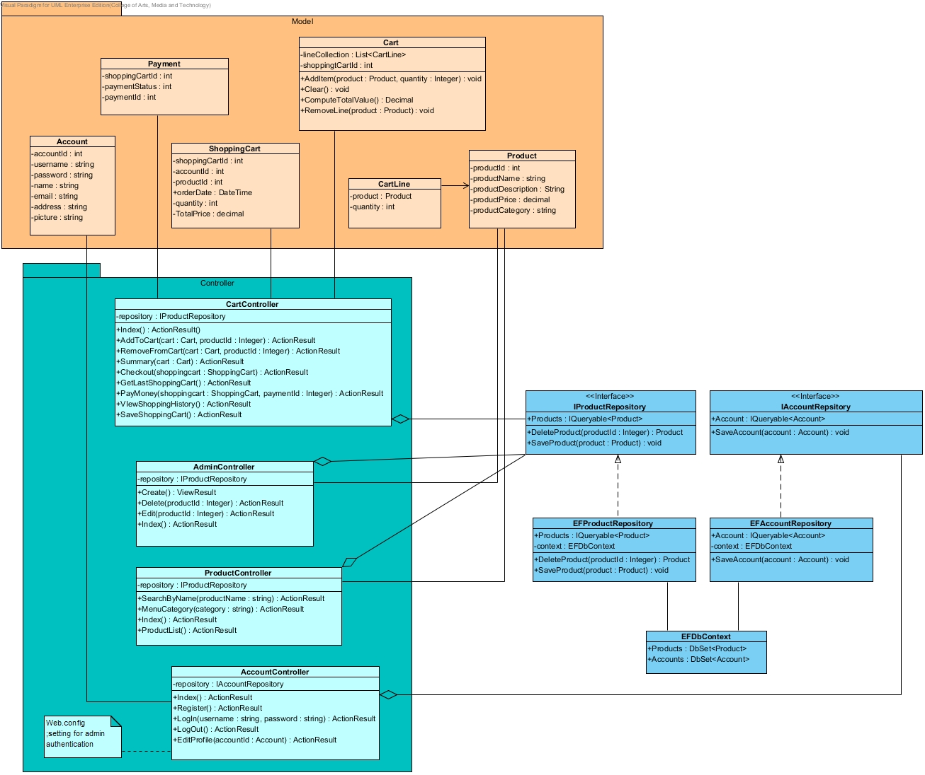
Software Design
Class Diagram
Method Design

Slide 4
Software Design
Sequence Diagram
SD-01-Admin log in
SD-02-Admin add product
SD-03-Admin edit product detail
SD-04-Admin remove product
SD-05-Admin see history
SD-06-Admin log out
SD-07-Customer Register

Slide 5
Software Design
Sequence Diagram
SD-08-Customer log in
SD-09-Customer update registration
SD-10-Customer browse the product catagory
SD-11-Customer search by product name
SD-12-Customer add product to cart
SD-13-Customer remove product in cart
SD-14-Customer check out

Slide 6
Software Design
Sequence Diagram
SD-15-Customer see history
SD-16-Save to continue buying
SD-17-Customer logout
SD-18-Customer continue shopping last time

Slide 7
Tracability
Tracability Matrix
URS - SRS
URS – Use case
URS - Class Diagram
URS – Sequence Diagram
Summary

Slide 8
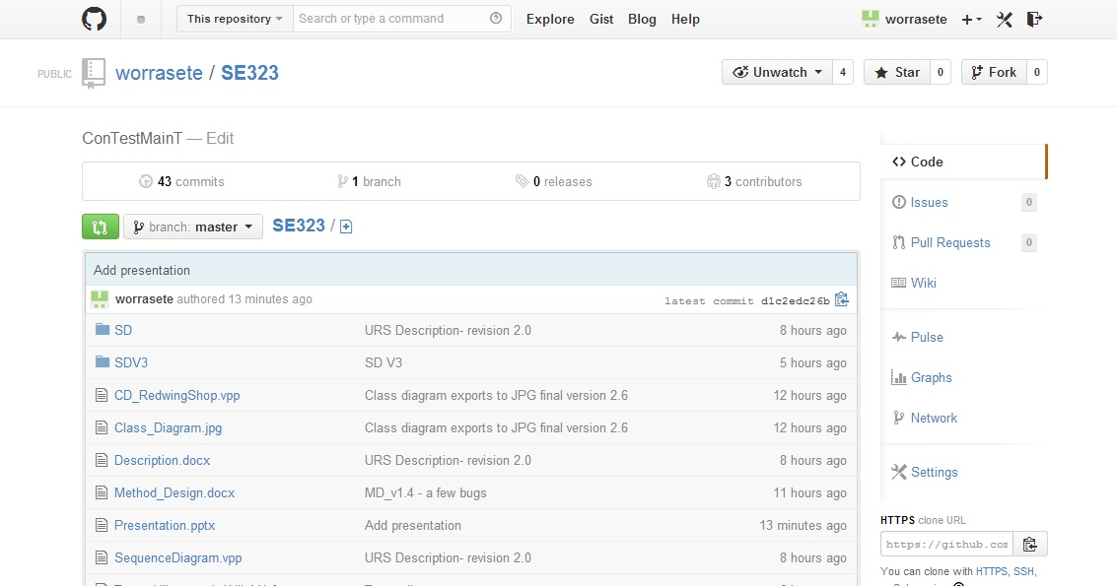
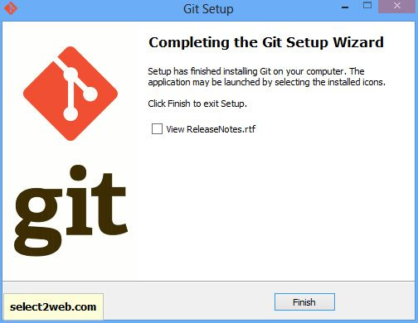
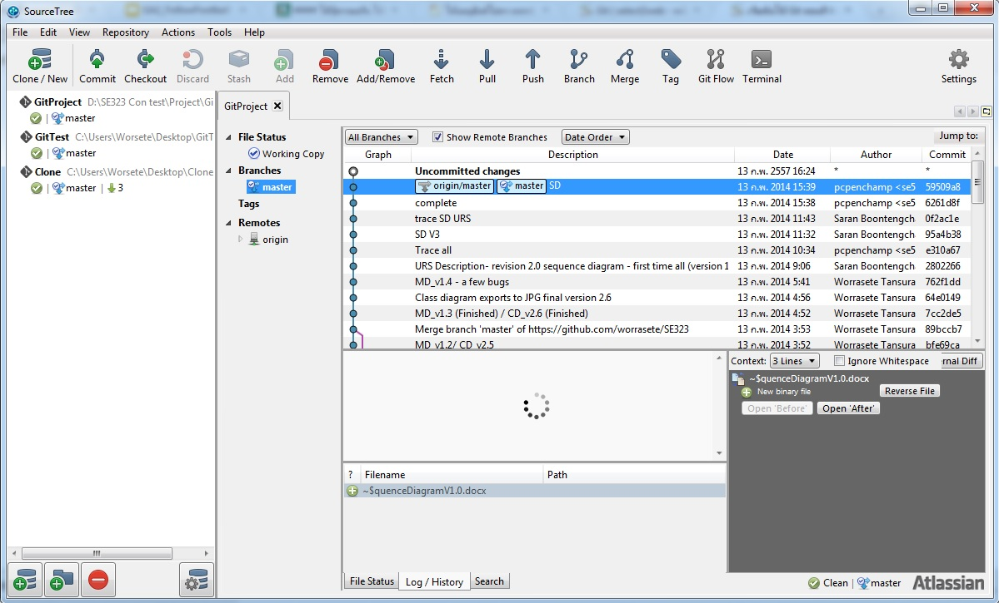
Version Control
We use …
Git tools
Git github.com
SourceTree (Git GUI) instead of command line

