Slide 1
TCS
Team Collaboration System for Mobility Water Monitoring

Slide 2
Water Monitoring Process

Slide 3
Problem
Water Monitoring Process

Slide 4
  The research center of the faculty of science (Chiang Mai university)
I-ANALY-S-T

Slide 5
The Problem occurred
I-ANALY-S-T

Slide 6
How to solve the problem?

Slide 7
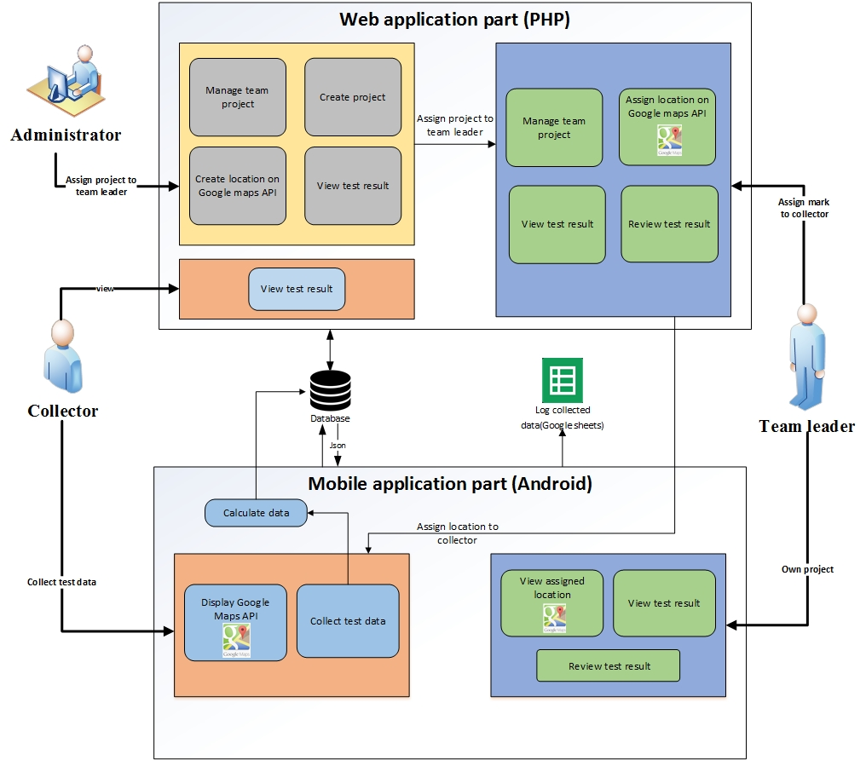
System Architecture

Slide 8
Technology Review

Slide 9
php
Technology Review
Open Source
Supported every operating system(Windows, Linux, ….)
Supported every browser (IE, Firefox, …)
Script language is easy to understand

Slide 10
Android
Technology Review

Slide 11
Google Maps
Technology Review

Slide 12
Google Spreadsheet
Technology Review

Slide 13
Development Tools Review

Slide 14
Eclipse with ADT
Development Tools Review

Slide 15
Development Tools Review
ADT Plug-in for Eclipse

Slide 16
Android SDK
Development Tools Review

Slide 17
Development Tools Review
JetBrains PhpStorm 7.1.31

Slide 18
XAMPP
Development Tools Review

Slide 19
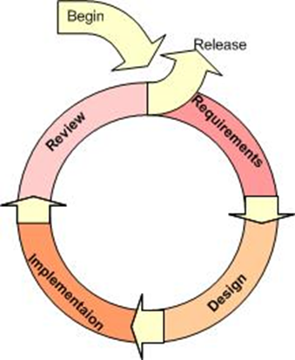
Iterative Model
Supports changing requirement
Can get the reliable user feed back
Can track the defects at early stages

Slide 20
Quality Standard
ISO29110 for Very Small Entity (VSE)
Very Small Entity (VSE) is defined as an entity (enterprise, organization, department or project) having up to 25 people. VSEs also develop and/or maintain software that is used in larger systems, therefore, recognition of VSEs as suppliers of high quality software is often required.

Slide 21
Project Plan

Slide 22
Aims and Objectives
The aim of this project is to develop the mobility water monitoring system in order to manage the team project and share test information to the working team.

Slide 23
Aims and Objectives
1.
jy
To create the central system support team collaboration
2.
To help managing project teams
3.
To help identifying the collectors responsibility

Slide 24
Aims and Objectives
4.
To help sharing all test results aggregated to the evaluation
5.
To be able to trace back the test result from the research center
6.
To reduce the time of working as a team

Slide 25
Deliverables

Slide 26
Limits
The internet connection is required for using this system and application.
Smart device, which are using Android OS.
User should have account for access to the system.
Website support only English language

Slide 27
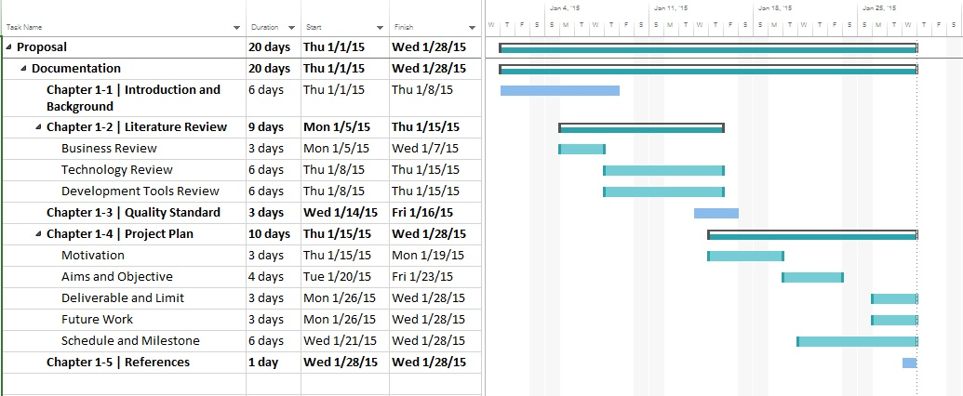
Schedule & Milestone

Slide 28
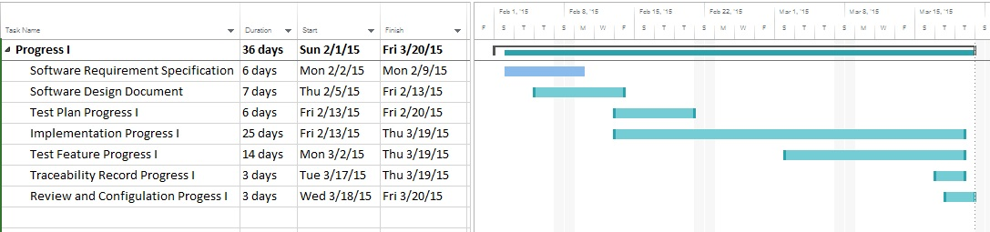
Schedule & Milestone
Progress Report 1
Feature 1: Authentication and member management system
Feature 2: Project management

Slide 29
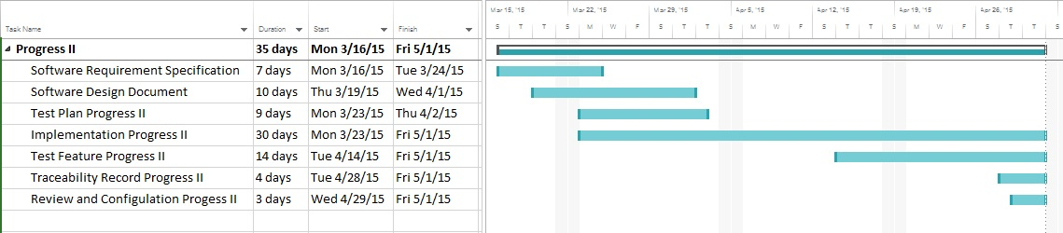
Schedule & Milestone
Progress Report 2
Feature 3: Project browsing
Feature 4: Map location management
Feature 5: Result presentation

Slide 30
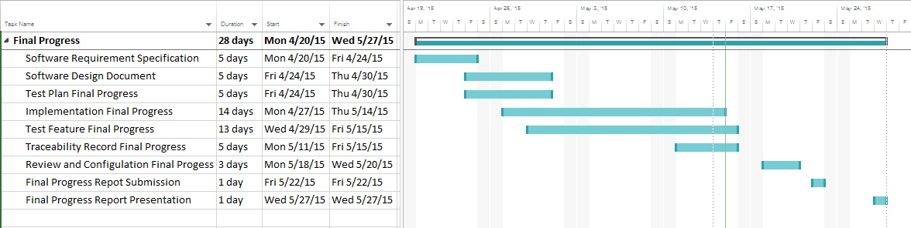
Schedule & Milestone
Progress Report 3
Feature 6: Messaging System
Feature 7: Extension of existing application

Slide 31
Future work
iOS

Slide 32
Q&A
THANK YOU

