Slide 1
TCS
Team Collaboration System for Mobility Water Monitoring
Project Proposal Presentation
  Mr. Peerapong Chompootepa 542115044
  Mr. Worrasete Tansurat 542115056
Project Advisor
  Ms. Siraprapa Wattanakul

Slide 2
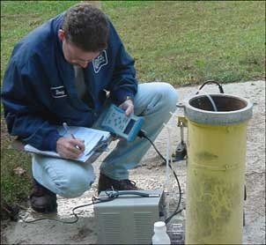
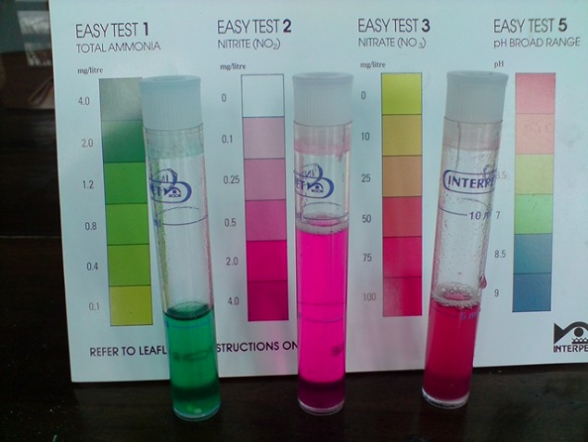
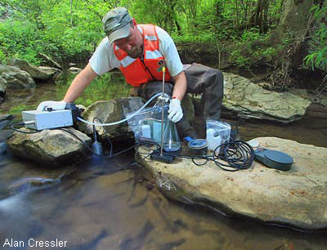
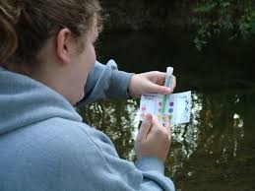
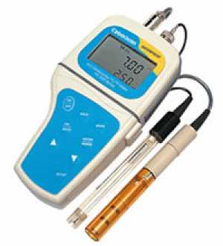
Water Monitoring Process
Recent way to test the parameter
Tools
Test chart

Slide 3
Standalone application
The Problems
I-ANALY-S-T
  Do not provide a traceability
  Cannot share the data instantly
  Cannot identify the collector
  Difficult to retest
BUT!!!!!
  Paper base (test result)
  Inconvenient tools of Water quality measurement

Slide 4
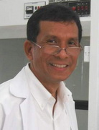
  The research center of the faculty of science (Chiang Mai university)
I-ANALY-S-T
  >>>The research center of the faculty of science
  (Chiang Mai university)
  >>>Developed a mobile application for chemical analysis regarding to water quality with the test kit
Prof. Dr. Kate Grudpan
  But >>>>

Slide 5
How to solve the problem?
Create central system
Controls project by the team leader
Identify the responsibility each of collectors
Calculate the water parameter on smartphone
Share the test result instantly
Trace back of water test evidence

Slide 6
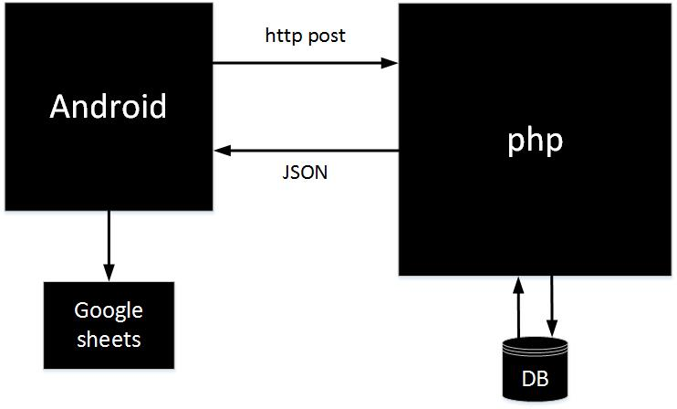
System Architecture

Slide 7
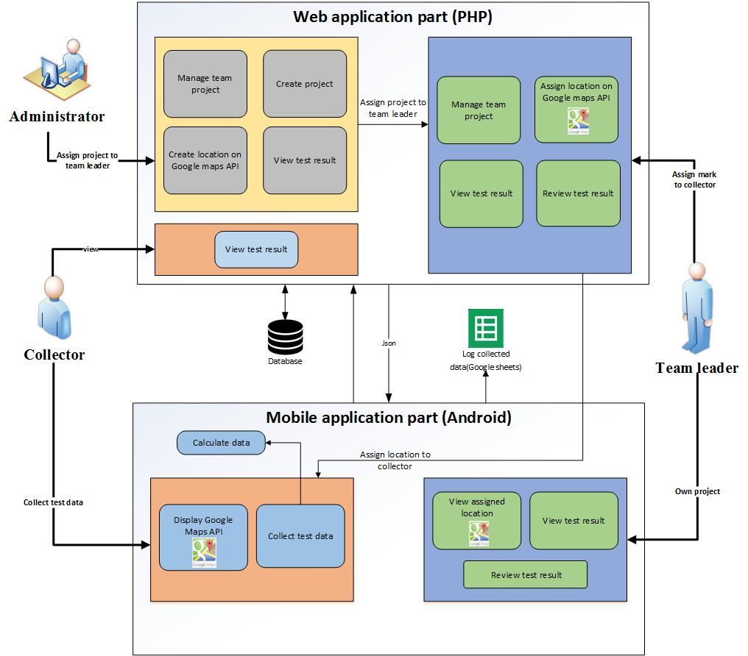
System Architecture

Slide 8
Technology Review

Slide 9

php
Technology Review
Open Source
Supported every operating system(Windows, Linux, ….)
Supported every browser (IE, Firefox, …)
Script language is easy to understand

Slide 10

Android
Technology Review
Free open source
An open source development platform for creating applications.
of tutorials and the Android plugin for Eclipse

Slide 11
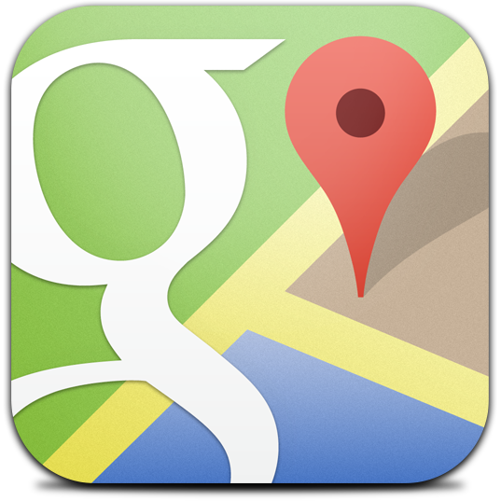
Google Maps
Technology Review
Supports calculating distance between locations
Working with Android SDK
Providing longitude and latitude

Slide 12

Google Spreadsheet
Technology Review
Easy to use likes MS Excel.
Can use the data to verify the history
by doing the traceability record

Slide 13
Development Tools Review

Slide 14

Eclipse with ADT
Development Tools Review
Open Source
Supported Android Development Tools

Slide 15
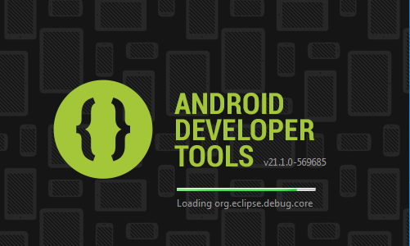
Development Tools Review
ADT Plug-in for Eclipse
Using Eclipse with the ADT plug-in for Android development offer some significant advantage, primarily through the tight integration of many of the Android build and debug tools into IDE

Slide 16
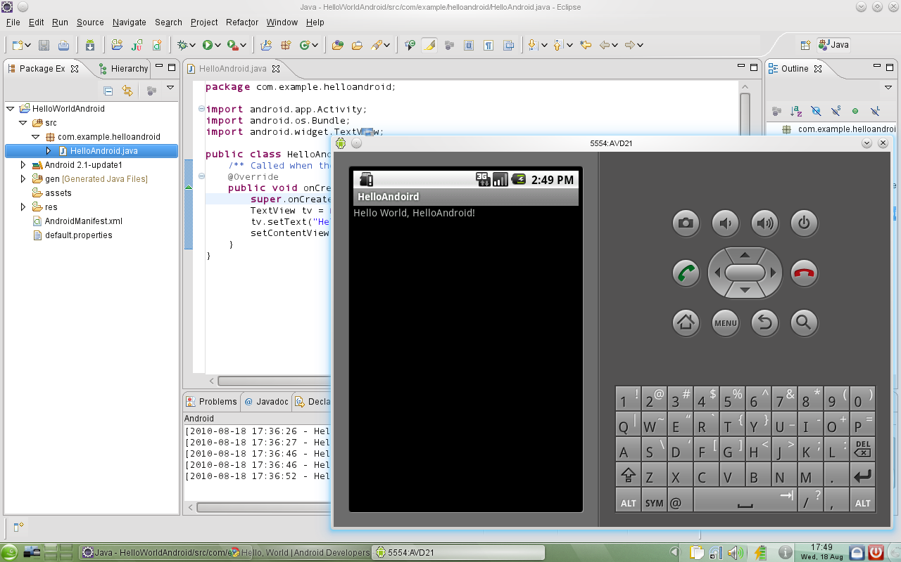
Android SDK
Development Tools Review
The programmer can use Android SDK to develop application and test it on the emulator which similar to the real Android phone

Slide 17

Development Tools Review
JetBrains PhpStorm 7.1.31
PhpStorm’s smart code editor provides excellent support for PHP

Slide 18

XAMPP
Development Tools Review
Free and easy to install, and no configuration is needed to make APACHE, PHP & MYSQL compatible with each other.

Slide 19
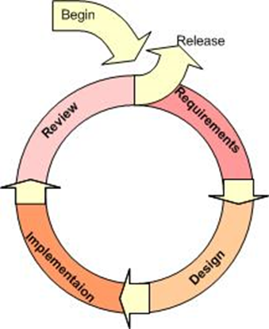
Iterative Model
Supports changing requirement
Can get the reliable user feed back
Can track the defects at early stages

Slide 20
Quality Standard
ISO29110 for Very Small Entity (VSE)
Very Small Entity (VSE) is defined as an entity (enterprise, organization, department or project) having up to 25 people. VSEs also develop and/or maintain software that is used in larger systems, therefore, recognition of VSEs as suppliers of high quality software is often required.

Slide 21
Project Plan

Slide 22
Aims and Objectives
The aims of this project is to develop the mobility water monitoring system in order to manage the team project and share test information to the working team.

Slide 23
Aims and Objectives
1.
jy
To create the central system support team collaboration
2.
To help managing project teams
3.
To help identifying the collectors responsibility

Slide 24
Aims and Objectives
4.
To help sharing all test results aggregated to the evaluation
5.
To be able to trace back the test result from the research center
6.
To reduce the time of working as a team

Slide 25
Feature
Deliverables
1
2
3
Authentication and member management system
Map location
management
Project management

Slide 26
Feature
Deliverables
4
5
6
Water parameter
calculation
Parameter result
tracing
Messaging system

Slide 27
Limits
The internet connection is required for using this system and application.
Smart devices using Android OS
Smartphone application cannot control the light and white balance of the camera.
Web service supports only English language.

Slide 28
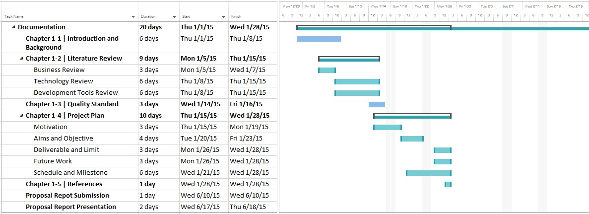
Schedule & Milestone
Project Proposal

Slide 29
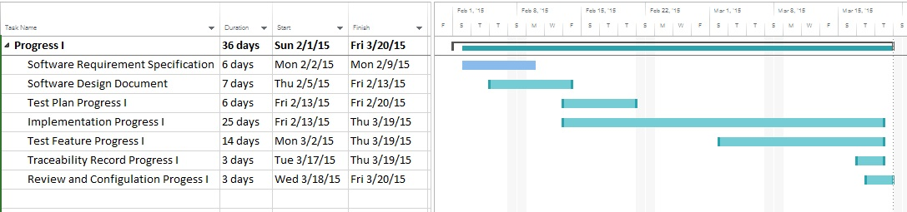
Schedule & Milestone
Progress Report 1
Progress Report 1
Feature 1: Authentication and member management system
Feature 2: Project management

Slide 30
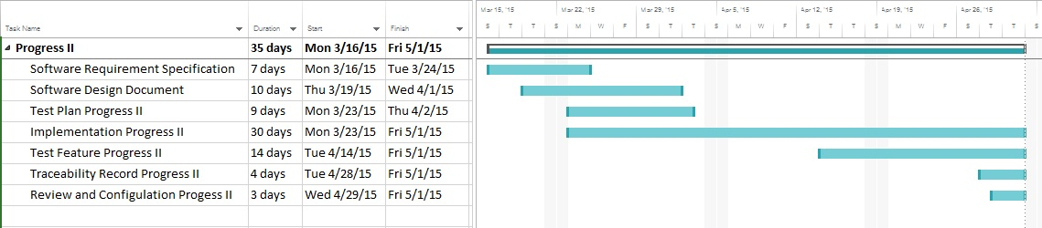
Schedule & Milestone
Progress Report 2
Progress Report 2
Feature 3: Map location management
Feature 4: Water parameter calculation

Slide 31
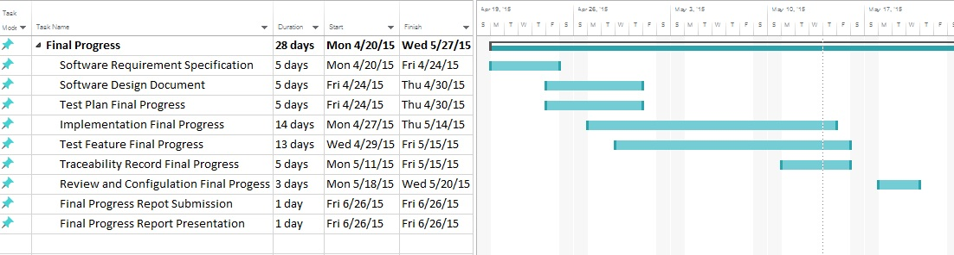
Schedule & Milestone
Progress Report 3
Progress Report 3
Feature 5: Parameter result tracing
Feature 6: Messaging system

Slide 32

Future work
iOS

Slide 33
Q&A
THANK YOU

Slide 34
