Slide 1
Intro to Research Data Management
21-NOV-2018 | G70 HAWKSHEAD
Michael Murphy
mmurphy@rvc.ac.uk

Slide 2
In an hour or so you will. . .
Know how to document and organise your data Be aware of the risk of poor data security and know how to store/transport your data safely and securely.
Understand the opportunities and benefits of sharing your research data.
Have set up a GitHub repository.
Have made a ‘deposit’ on a public data repository.
Be able to create and implement a suitable Data Management Plan for your research data.

Slide 3
Research data defined
The data, records, files or other evidence, irrespective of their content or form (eg in print, digital, physical or other forms), that comprise a research project’s observations findings or outcomes, including primary materials and analysed data (Monash University)
evidence that underpins the answer to the research question, and can be used to validate findings regardless of its form (e.g. print, digital, or physical). . . might be quantitative information or qualitative statements collected by researchers in the course of their work by experimentation, observation, modelling, interview or other methods, or information derived from existing evidence. Data may be raw or primary (e.g. direct from measurement or collection) or derived from primary data for subsequent analysis or interpretation (e.g. cleaned up or as an extract from a larger data set), or derived from existing sources where the rights may be held by others. (Concordat on Open Research Data, 2016)

Slide 4
Examples of research data
Photographs
Results from experiments
Government records
GIS data
Simulation data
Log data
Field notes
Software
Code
Interviews/ questionnaires
Tweets
Quantitative data
Metadata
Compiled data
Graphs/visualisations
Physical objects: e.g. bone/tissue/blood/etc samples
Information derived from samples
CT scans
R scripts
Blood/Tissue samples
Spreadsheets
MatLab
GraphPrism
Commercial data
Notes:
https://www.kaggle.com/davidwallach/financial-tweets

Slide 5
Categories of research data
Observational: data captured in real time that is usually unique and irreplaceable (remote sensing data, survey data, field recordings, sample data)
Experimental: data captured from lab equipment that is often reproducible (gene sequences, chromatograms, magnetic field data)
Models or simulation: data generated from test models where model and metadata may be more important than output data from the model.
Derived or compiled: resulting from processing or combining ‘raw’ data (text and data mining, compiled databases, 3D models)
Reference or canonical: a static or organic conglomeration or collection of datasets, probably published and curated (gene sequence databanks)

Slide 6
Research Data Management
The ‘organisation of data, from its entry to the research cycle through to the dissemination and archiving of valuable results.’
‘Digital curation’ - active management of data for as long as it continues to be of scholarly, scientific, research and/or administrative interest, with the aim of supporting reproducibility of results, reuse of and adding value to that data, managing it from its point of creation until it is determined not to be useful, and ensuring its long-term accessibility and preservation, authenticity and integrity.”

Slide 7
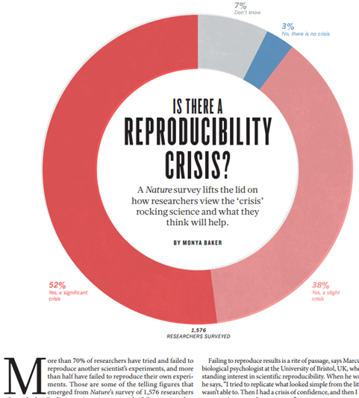
Policy context
‘open science’ initiatives: data curation, sharing, ideas of publicly funded research outputs being available publicly, journal policies
‘reproducibility crisis’: high profile instances of malpractice
Fraud
Failures of replication
Statistical fallacies
‘Information entropy’

Slide 8
Concordat on Open Data (10 principles)
Open access to research data is an enabler of high quality research, a facilitator of innovation and safeguards good research practice
Any restrictions on sharing must be justified and justifiable.
Associated costs are the responsibility of funders, institutions, researchers, publishers, etc.
Creators have right to reasonable first use.
Use of others’ data must be legal, ethical.
Planning starts at the beginning of a project.
Data curation is vital to make data (re)useful and to prepare it for preservation.
Data supporting publications should be accessible by the publication date.
Support for data management skills is the responsibility or funders, institutions, publishers, etc.
Regular reviews of policy and progress.

Slide 9
RVC policy (abridged)
The College is committed to the ethos of open access to research data, within the parameters of intellectual property protection and contractual requirements.
Responsibility for research data management and the creation of data management plan lies primarily with Principal Investigators (PIs) as part of their project management responsibilities.
All new research proposals must include research data management plans addressing data capture, management, integrity, confidentiality, retention, sharing and publication.
The College will provide mechanisms and services for storage, backup, registration, deposit and retention of research data assets, supporting future access after project completion.

Slide 10
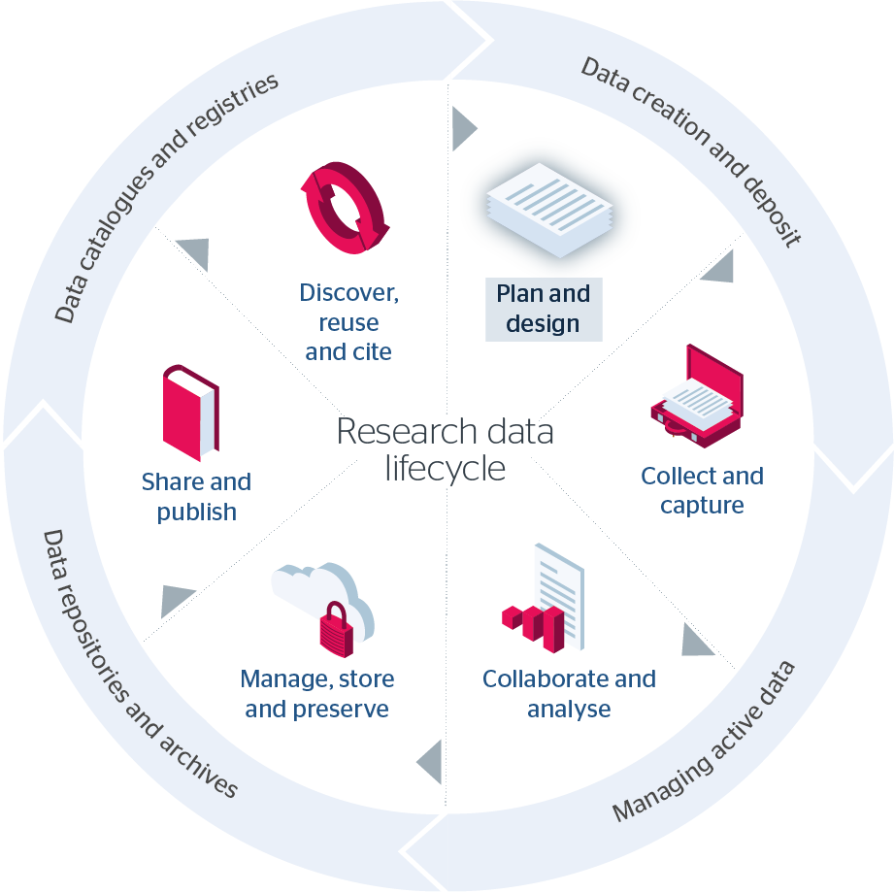
Research data lifecycle
Plan: design data collection strategy
Create: Collect and capture
Analyse: Collate, represent..
Store: Name, document, secure…
Publish: Deposit, license, describe
Preserve/curate: Long-term storage, destruction, etc.
Image credit: JiscRDM Toolkit: https://rdmtoolkit.jisc.ac.uk/research-data-lifecycle/ (CC-BY-ND)

Slide 11
1. Planning: things to consider
Data capture and storage in curation-friendly file formats (open formats where possible)
Recording sufficient information at the time of data capture
Documentation and metadata (what the data is, how it was collected, etc.)
Data storage on appropriate media (short, medium, long term)
Retention criteria, backup schedule, periodic reviews, etc.
Contributing guidelines (for collaborative projects): where to save, how to name, etc.
Think about long-term preservation of the data as early as possible

Slide 12
2. Create/collect
Think about the best ‘type’ of measurement during collection phase (record information in a way that makes it easier to understand later):
Nominal (e.g. race, sex)
Ordinal (e.g. education level, cancer stage)
Continuous (e.g temperature, blood pressure)
Stay consistent with formatting (e.g. ‘f’ vs. ‘female’, 2017-11-16 vs 16-Nov-17). Think of how the variable name suggests the input value (e.g. ‘Smoker/Non-smoker’ vs. ‘YES/NO’)
Broken leg” vs. “Fractured femur” – consistency in collection/recording of data makes it easier to store, to migrate, to analyse, to expose to machine learning, etc.
Is there a standard set of terminology for describing information (e.g. Clinical Data Interchange Standards Consortium (CDISC).)

Slide 13
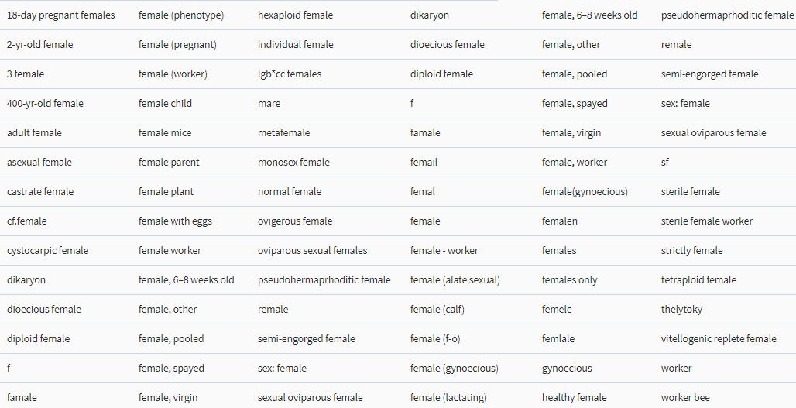
Values submitted in the ‘sex’ attribute for sequences and samples that all represent female [in European Nucleotide Archive]

Slide 14
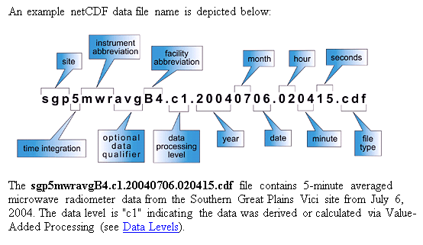
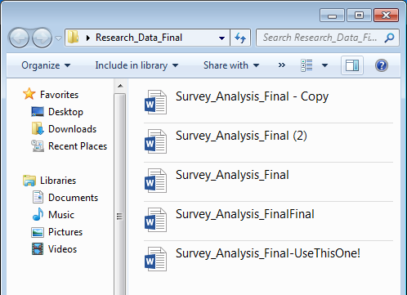
3. Manage/store: File naming
Adopt a convention with your research group.
Include dates.
Use hyphens or underscores not spaces e.g. day-sheet, day_sheet
File naming conventions might be prescribed by the nature of the data
Example from ARM Climate Research Facility https://www.arm.gov/policies/datapolicies/formatting-and-file-naming-protocols

Slide 15
File formats and software
Is a proprietary programme (e.g. MS Access) required to make use of the file? Is there a non-proprietary alternative?
.doc/.docx > .odf/.rtf
.ai/.psd > .tif
.xls > .csv
http://www.data-archive.ac.uk/create-manage/format/formats-table

Slide 16
3. File management: short, medium, long term
H: Drive : RVC storage – personal, secure, backed up, semi-mobile
Shared drive (e.g. O: or R: drive) : shared, secure, backed up, semi-mobile, allows collaboration among RVC members.
OneDrive : 1TB personal storage (limit on individual file size)
Good for sharing within and beyond the college (allows linking with rights management)
Not serviced by RVC IT staff (don’t make it your only storage spot)
Personal device storage (internal/external hard drive)
Use encryption (e.g. VeraCrypt) if storing secure data
Not a permanent storage solution
If your ‘active’ files and your back up files are in the same room they are not really backed up!!!

Slide 17
GitHub repository for collaborating
Create repository
Give its contents a licence
Create a readme file
Establish contributing guidelines and a code of conduct

Slide 18
4. Preparing data for publication and archiving
Use descriptive file names, with consistent formatting
Create structured file with essential information (e.g. XML file, README file, etc)
Include necessary supplementary information (e.g. readme file, codebook, software information, copies of questionnaire, etc.)
Choose file formats best suited for long term storage (if possible) : http://dpconline.org/our-work/bit-list

Slide 19
Different understandings of ‘open’
Sharing data is part of research practice: with future self, with research team/group, with collaborators beyond the institution
By request
Shared within a community
Linked to a publication (supplementary materials)
Open data in a repository
Compiled data (e.g. European Nucleotide Archive)

Slide 20
RVC storage specs
Secure storage HH and Camden.
Up to 2 hours of battery backup in each data centre.
500TB = 500,000GB Usable storage.
130TB allocated O:\Research_Storage and R:\Research_Storage (Access to authorised users ONLY).
Hourly backups (0000, 0600, 1200, 1800) (5 backup copies retained).
Daily backup 0010 (5 backup copies retained).
Weekly – Sundays 0015 (16 backup copies retained).
Long-term data retention on backup tape cartridges (10 years).
Data is also mirrored between HH and CM storage systems, on hourly basis.
2 virus scanning servers.

Slide 21
Metadata
A formal description of a dataset which conforms to a particular structure (describes content and context of a set of files)
DataCite Schema for the Publication and Citation of Research Data -http://doi.org/10.5438/0013 : a list of core metadata properties chosen for an accurate and consistent identification of a resource for citation and retrieval purposes
Discipline-specific metadata schema:
FAIRsharing.org (recommendations by funder, discipline, journal)
NIH Common Data Elements: https://www.nlm.nih.gov/cde/summary_table_1.html
DCC list: http://www.dcc.ac.uk/resources/metadata-standards

Slide 22
Description/documentation
Elements to capture:
Project information: research question/hypotheses, data capture and analysis methods, sampling frame used (e.g. geographic location and time period), instruments and measures used.
Description of individual files within the dataset: context in which it was created (e.g. geographic location and time period), audit trail of activities performed when capturing, processing, and analysing contained content, relationship between files and project as a whole, copyright claims and licencing info.
Codebook: information necessary to understand variables contains within the data, including variable description.

Slide 23
5. Publishing a dataset
Again: different types of sharing are possible
Shared within article
Shared on request
Shared in repository (publish/assign persistent ID)
RVC repository (researchdata@rvc.ac.uk).
Figshare (free commercial repository)
Zenodo (free public repository, EU funded/maintained)
Subject repositories: re3data https://www.re3data.org/

Slide 24
Tools and resources
ORCID: get yourself an ID @ orcid.org
GitHub: repository for active projects that supports collaboration + version control
Digital Curation Centre: online Data Management Plan tool
JiscRDM toolkit: https://rdmtoolkit.jisc.ac.uk/rdm-for-researchers/
RVC RDM site @ http://rvc.ac.uk/research/about/research-data-management
http://www.re3data.org/ : search or browse by subject
Let’s talk (mmurphy@rvc.ac.uk)

Slide 25
DMP : what to capture
Data types: estimate of the volume and type of data that you expect to generate (e.g. experimental measurements, models or images). BBSRC encourages researchers to outline all research data…
Data formats and metadata standards: metadata is ‘data about data’ or ‘cataloguing information’ that enables data users to find and/or use a digital output….briefly outline plans for documentation, both to meet your own needs (i.e. to ensure that you can find what you want, when you need it) and those of later users.
Secondary uses: describe the re-use potential of the dataset or model.
Data sharing: sharing via an appropriate, established repository is expected in research areas where such repositories exist…
Timeframe: when will you make data available? E.g. on publication of an article?

