Slide 1
Vizsgaremek Webshop
Készítették: Szeli Máté & Gyulai Gergő Zsolt & Nagy Dominik

Slide 2
Contents of this template
You can delete this slide when you’re done editing the presentation
Fonts | To view this template correctly in PowerPoint, download and install the fonts we used
Used and alternative resources | An assortment of graphic resources that are suitable for use in this presentation
Thanks slide | You must keep it so that proper credits for our design are given
Colors | All the colors used in this presentation
Icons and infographic resources | These can be used in the template, and their size and color can be edited
Editable presentation theme | You can edit the master slides easily. For more info, click here
For more info:
Slidesgo | Blog | FAQs
You can visit our sister projects:
Freepik | Flaticon | Storyset | Wepik | Videvo

Slide 3
Table of contents
01
02
03
04
Theory lesson
Features of the topic
You can describe the topic of the section here
You can describe the topic of the section here
Tips
Practical exercise
You can describe the topic of the section here
You can describe the topic of the section here

Slide 4

01
Theory lesson
You can enter a subtitle here if you need it

Slide 5
Introduction
Mercury is the closest planet to the Sun and the smallest one in the entire Solar System. This planet’s name has nothing to do with the liquid metal, since Mercury was named after the Roman messenger god. Mercury’s surface is filled with craters
Mercury takes a little more than 58 days to complete its rotation, so try to imagine how long days must be there! Since the temperatures are so extreme, albeit not as extreme as on Venus, Mercury has been deemed to be non-habitable for humans

Slide 6
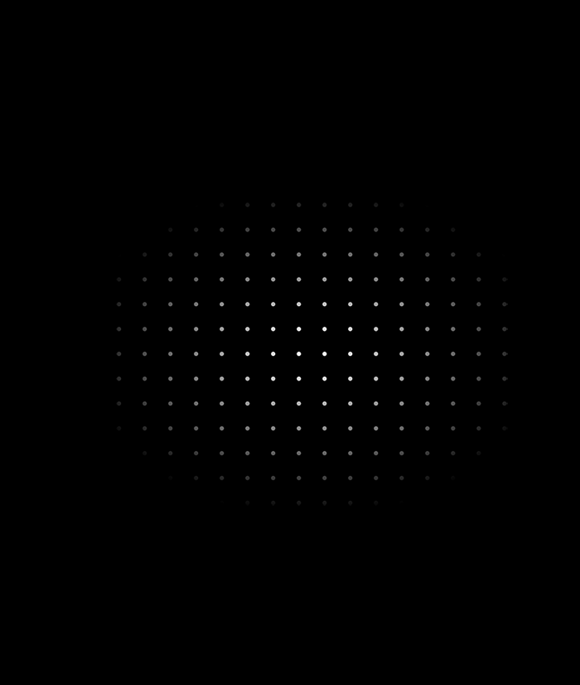
—Someone Famous
“This is a quote, words full of wisdom that someone important said and can make the reader get inspired”

Slide 7
Concepts
Mercury
Venus
Mercury is the closest planet to the Sun and the smallest one in the Solar System—it’s only a bit larger than the Moon
Venus has a beautiful name and is the second planet from the Sun. It’s hot and has a poisonous atmosphere

Slide 8
What is this topic about?
Mercury
Venus
Mars
It’s the closest planet to the Sun and the smallest in the Solar System
Venus has a beautiful name and is the second planet from the Sun
Despite being red, Mars is actually a cold place. It’s full of iron oxide dust

Slide 9
Features of the topic
Mars
Neptune
Despite being red, Mars is very cold
It’s the farthest planet from the Sun
Jupiter
Saturn
Jupiter is the biggest planet of them all
Saturn is a gas giant and has several rings

Slide 10



Examples
Mercury
Venus
Mars
It’s the closest planet to the Sun and the smallest in the Solar System
Venus has a beautiful name and is the second planet from the Sun
Despite being red, Mars is actually a cold place. It’s full of iron oxide dust

Slide 11
Recommendations
Mars
Venus
Neptune
Despite being red, Mars is very cold
Venus is the second planet from the Sun
Neptune is the farthest planet from the Sun
Mercury
Saturn
Jupiter
Mercury is the closest planet to the Sun
Saturn is a gas giant and has several rings
Jupiter is the biggest planet of them all

Slide 12

Image always reinforce
the concept
You can give a brief description of the topic you want to talk about here. For example, if you want to talk about Mercury, you can say that it’s the smallest planet in the entire Solar System

Slide 13
4,498,300,000
Big numbers catch your audience’s attention

Slide 14
9h 55m 23s
333,000
386,000 km
Jupiter’s rotation period
The Sun’s mass compared to Earth’s
Distance between the Earth and the Moon

Slide 15
Awesome words

Slide 16
Practical exercise - calculator
Objective:
Introduce participants to basic coding concepts by building a simple calculator
Instructions:
Open a Python development environment and write the following code:
# Simple Calculator
num1 = int(input("Enter the first number: "))
num2 = int(input("Enter the second number: "))
print("Sum:", num1 + num2)
print("Difference:", num1 - num2)
print("Product:", num1 * num2)
print("Quotient:", num1 / num2)
Run the program and experiment with different numbers
Observe the output

Slide 17
Brainstorm and idea generation
Mercury
It’s the smallest planet of them all
Earth
Venus
Venus is the second planet from the Sun
Power 1
Neptune
It’s the farthest planet from the Sun
Mars
Saturn
Saturn was named after a Roman god

Slide 18
Main topic and details
Mars
Neptune
Despite being red, Mars is very cold
It’s the farthest planet from the Sun
Jupiter
Saturn
Jupiter is the biggest planet of them all
It’s a gas giant and has several rings

Slide 19
Popular programming languages
01
Neptune
Mercury is the closest planet to the Sun and the smallest of them all
02
Venus
Venus has a beautiful name and is the second planet from the Sun
03
Earth
Earth is the third planet from the Sun and the only one that harbors life in the Solar System
04
Saturn
Saturn is a gas giant and has several rings. It’s composed mostly of hydrogen and helium

Slide 20
Sequences
Saturn is composed of hydrogen and helium
Mercury is the closest planet to the Sun
Jupiter was named after a Roman god
First
Next
Next
Next
Next
Last
Despite being red, Mars is very cold
Earth is the third planet from the Sun
Venus has extremely high temperatures

Slide 21
Classification
Mars | Venus | Mercury | Jupiter
Small Red Cold Rocky | Small Hot Dry Volcanic | Small Hot Rocky Cratered | Large Cold Gassy Striped
Mars is full of iron oxide dust | Venus has high temperatures | Mercury is quite a small planet | Jupiter is a huge gas giant

Slide 22
Cause and effect
Mars
Venus
Problem
Despite being red, Mars is very cold
Venus is the second planet from the Sun
Mercury
Saturn
Solution
Mercury is the closest planet to the Sun
Saturn is a gas giant and has several rings

Slide 23
Question and answer
Question
Is Mercury the closest planet to the Sun and the smallest one in the Solar System? Note that it’s a bit larger than the Moon
Answer
Venus has a beautiful name and is the second planet from the Sun. It’s hot and has a poisonous atmosphere

Slide 24
Step-by-step coding
01
02
03
04
Earth
Mercury
Jupiter
Saturn
It’s the only planet known to harbor life
Mercury is the closest planet to the Sun
Jupiter is the biggest planet of them all
Saturn was named after a Roman god

Slide 25
Parts and whole
The whole objective
Parts of the object
What happens if the parts are missing?
Mercury is the closest planet to the Sun and the smallest one in the entire Solar System
Mercury
Jupiter
Venus
Mars
Earth
Saturn
Mercury
Earth is the third planet from the Sun and the only one that harbors life in the Solar System
What’s the function of the parts?
Jupiter is a gas giant and the biggest planet in the Solar System

Slide 26
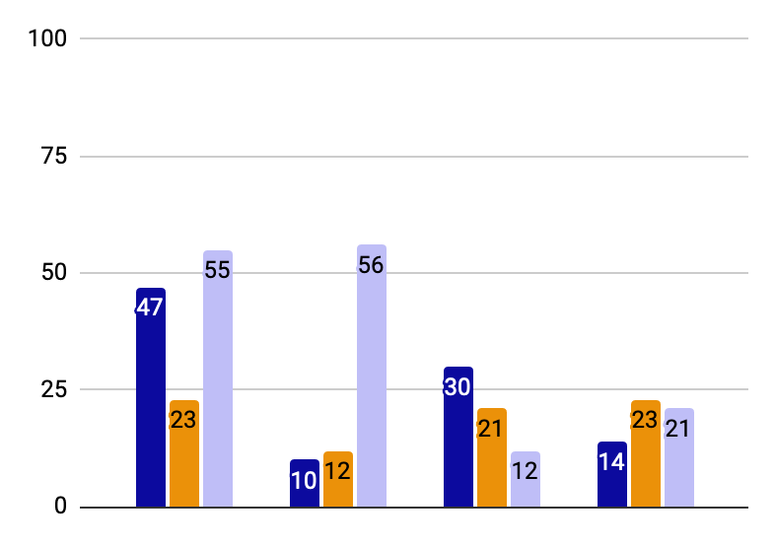
You can use this graph
Mercury
Mercury is the closest planet to the Sun
Jupiter
Jupiter is the biggest planet of them all
Saturn
Saturn was named after a Roman god
Follow the link in the graph to modify its data and then paste the new one here. For more info, click here

Slide 27
This is a map
USA
Russia
Despite being red, Mars is very cold
Neptune is the farthest planet from the Sun
India
China
Jupiter is the biggest planet of them all
Saturn is a gas giant and has several rings

Slide 28
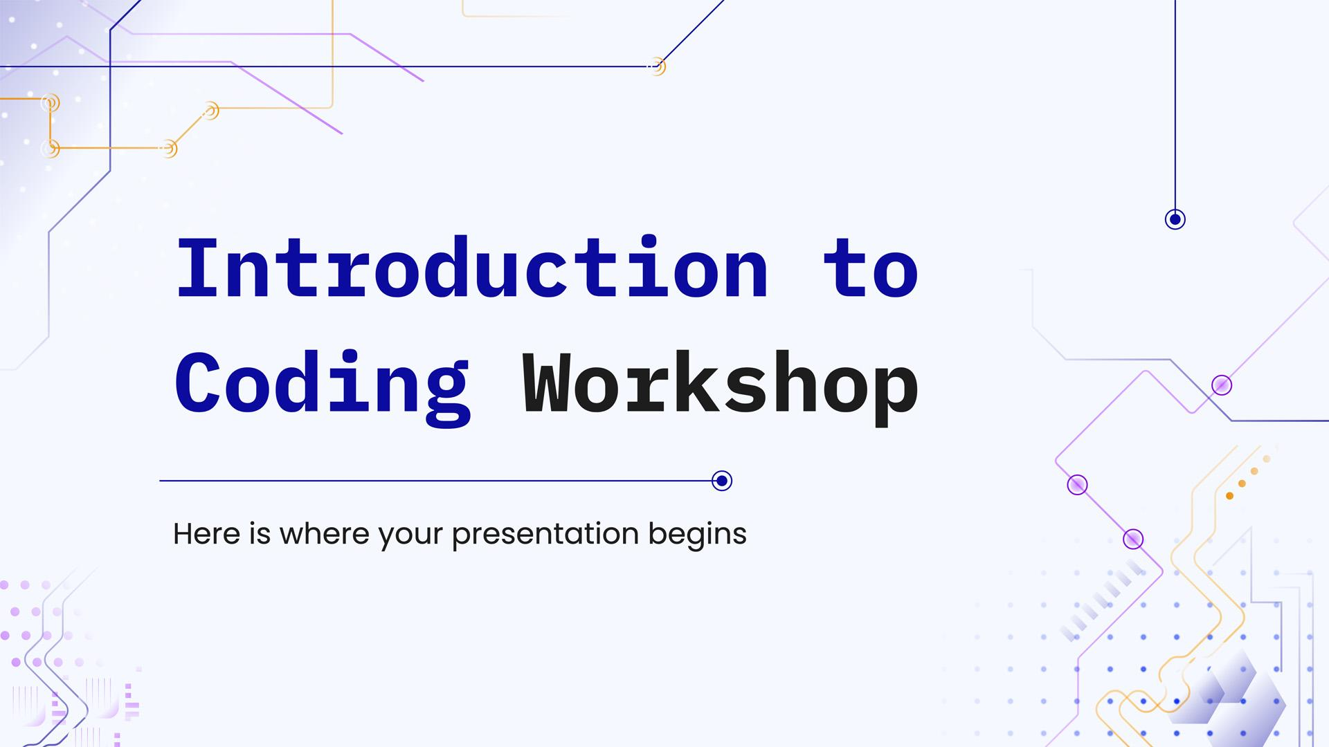
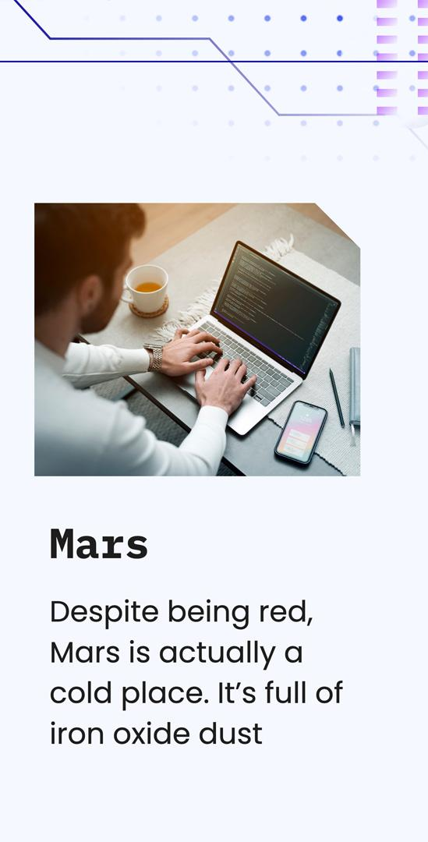
Mockups
You can replace the images on the screen with your own work. Just right-click on them and select “Replace image”

Slide 29
Icon pack

Slide 30
Alternative resources
Here’s an assortment of alternative resources whose style fits that of this template:

Slide 31
Resources
Did you like the resources in this template? Get them for free at our other websites:
Photos:
Medium shot man working on laptop
Group of friends planning a trip in a cafe
Medium shot man working on laptop
Side view of men working on laptops at the office
Lifestyle of woman in the office
Secretary working on laptop
Vectors:
Abstract gradient circuit board background
Icon pack:
Icon Pack: Coding | Lineal

Slide 32
Vizsgaremek Webshop
Készítették: Szeli Máté & Gyulai Gergő Zsolt & Nagy Dominik

