Slide 1
Database System Labs - Prepare
Notes:
可以分两次课来做之

Slide 2
Objectives
DBMS Installation:
Server (MySQL), Client (MysqlWorkbench)
DBMS Login using super user
Install Python3.13 and Pycharm
Connect MySQL using python
Notes:
可以分两次课来做之

Slide 3
Install mysql db server and client

Slide 4
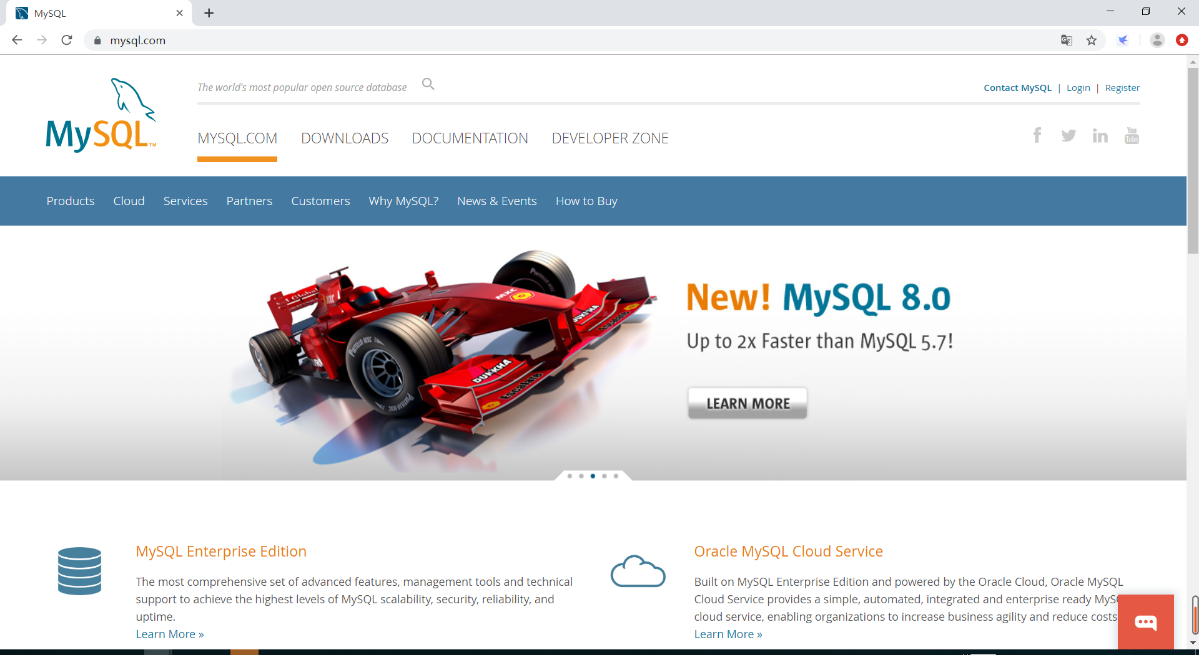
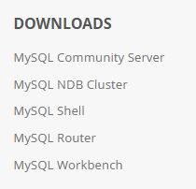
Labs Prepare
mysql
https://www.mysql.com/
MySQL 8.0
MySQL Community Edition (GPL)

Slide 5
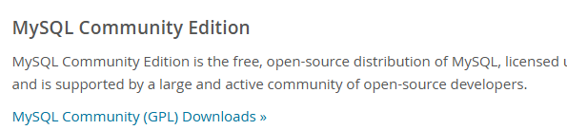
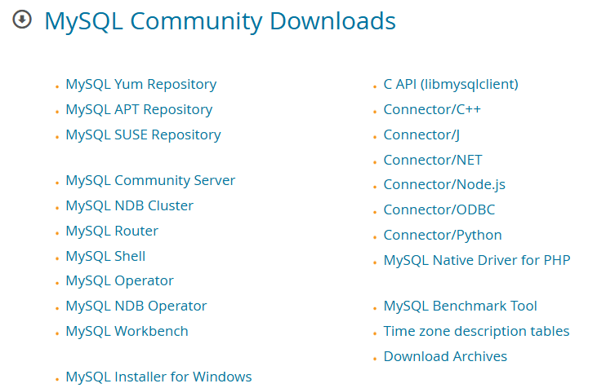
Labs Prepare
mysql
https://www.mysql.com/downloads/
MySQL 8.0
MySQL Community Edition (GPL)
Server & Client & Connectors
MySQL Installer for Windows

Slide 6
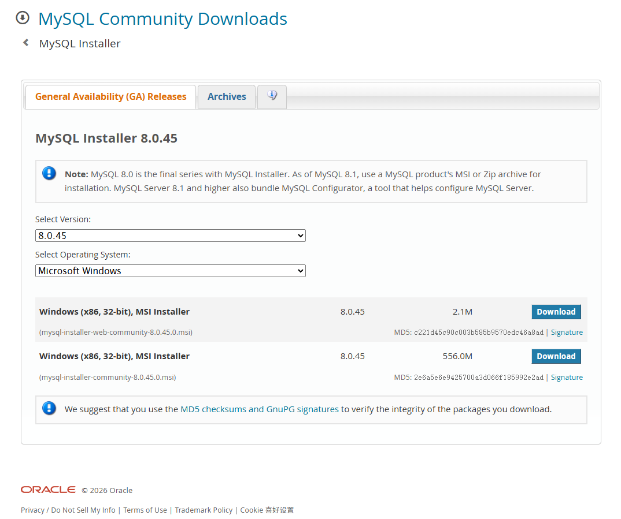
downloads
https://dev.mysql.com/downloads/installer/

Slide 7
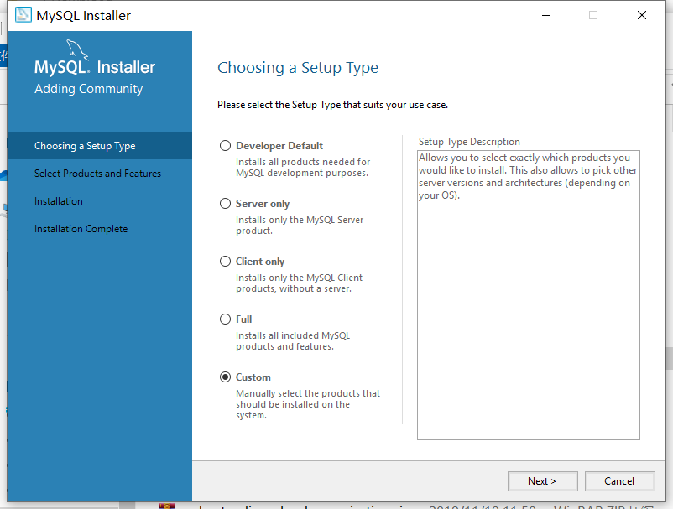
MYSQL Install

Slide 8
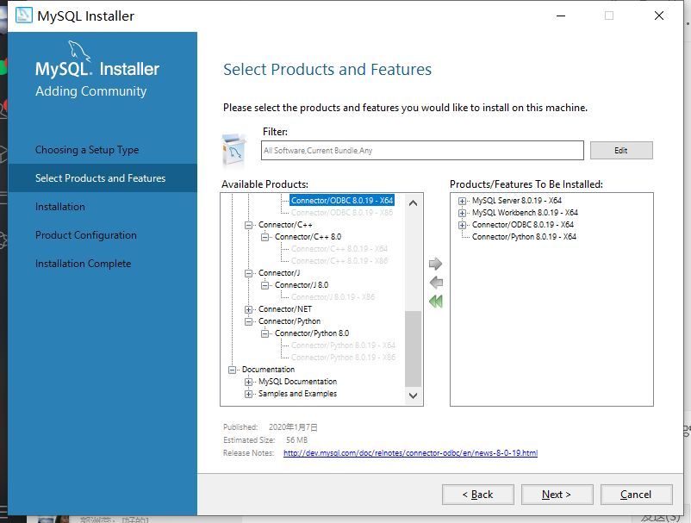
MYSQL Install

Slide 9
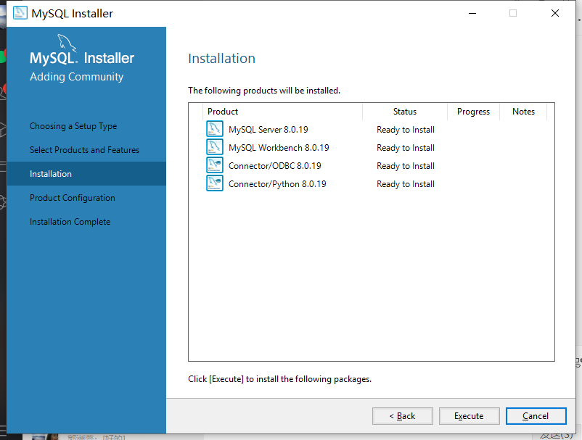
MYSQL Install

Slide 10
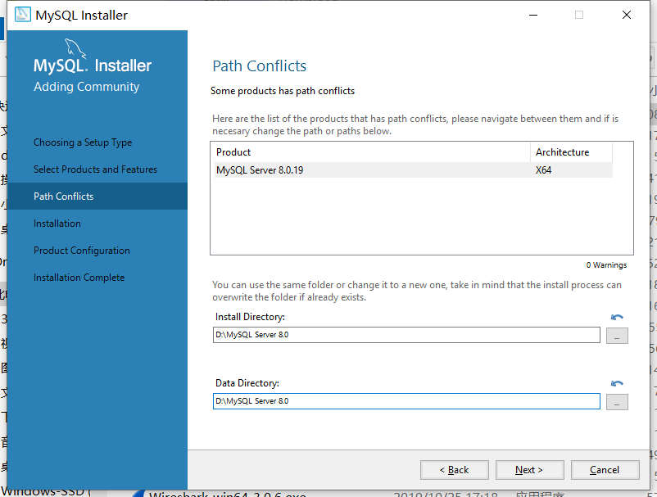
MYSQL Install

Slide 11
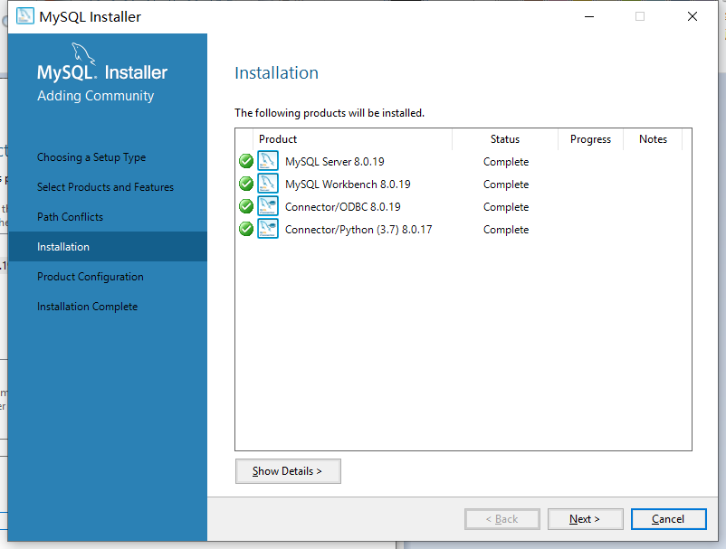
MYSQL Install

Slide 12
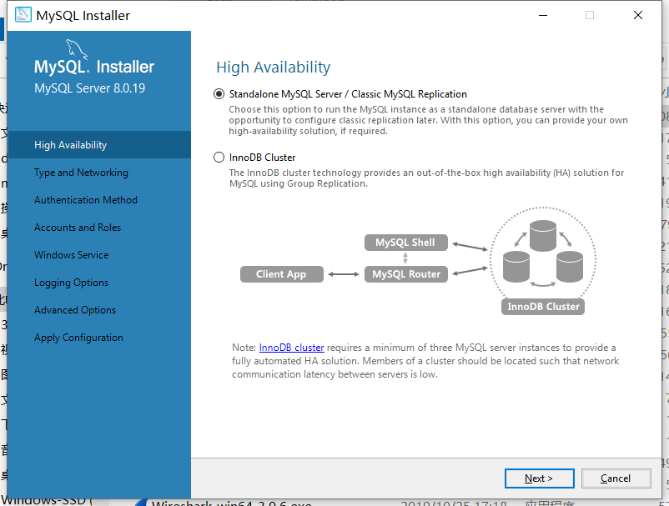
MYSQL Install

Slide 13
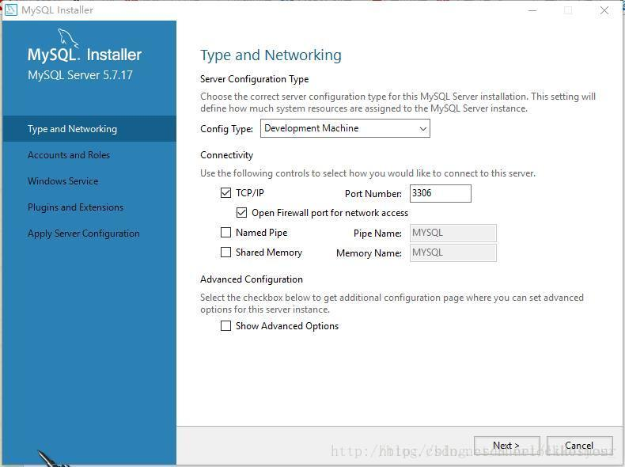
MYSQL Install

Slide 14
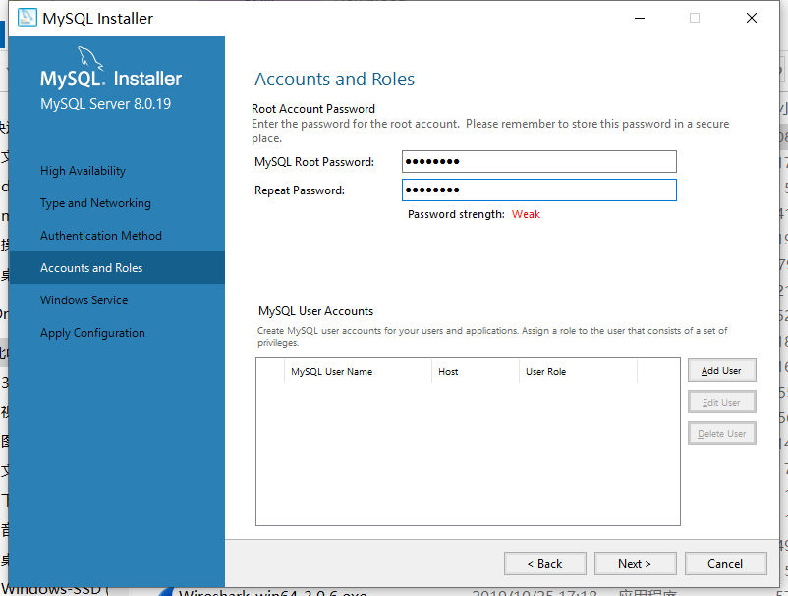
MYSQL Install

Slide 15
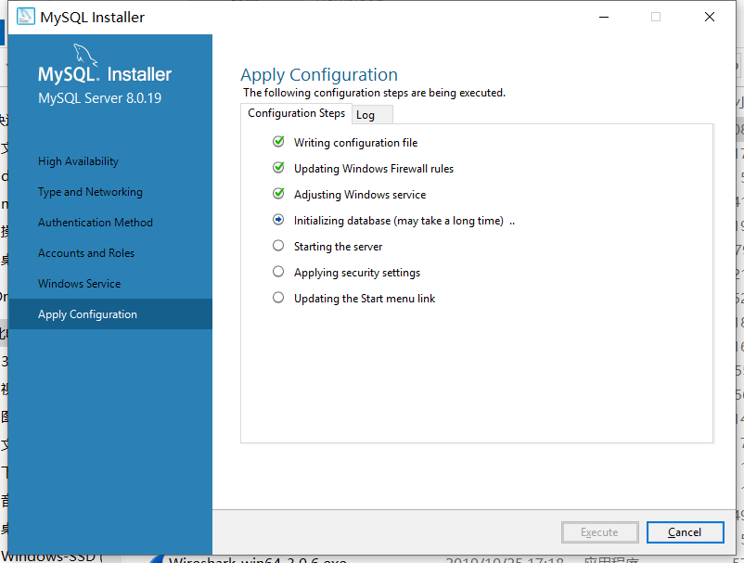
MYSQL Install

Slide 16
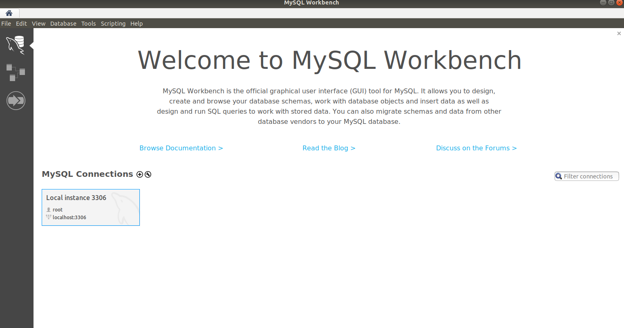
MYSQL: GUI Client Application
Notes:
mysql-workbench
sudo apt-get install mysql-workbench

Slide 17
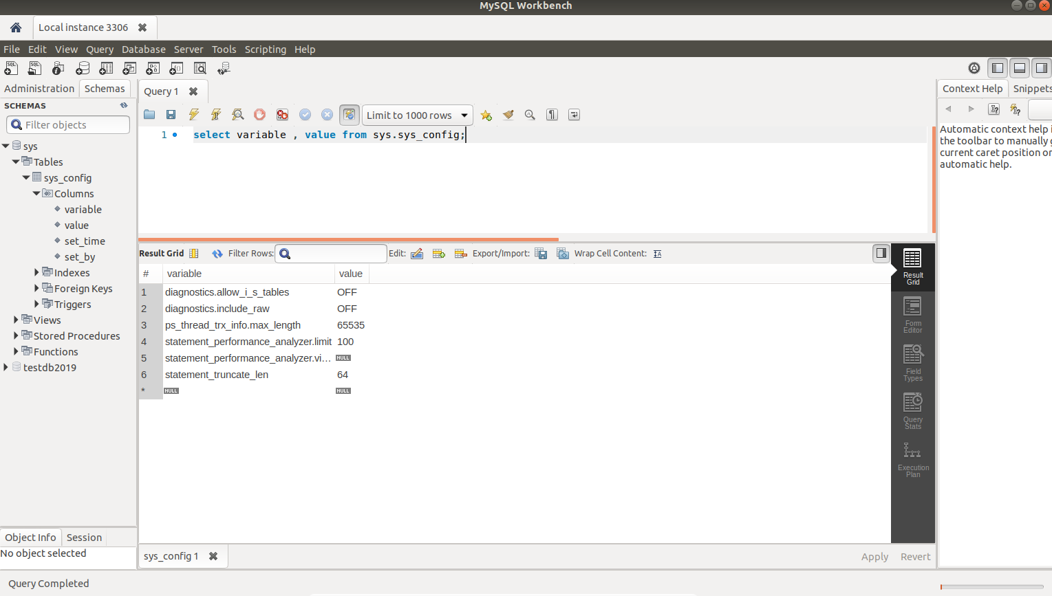
MYSQL: GUI Client Application
Notes:
mysql-workbench
sudo apt-get install mysql-workbench

Slide 18
Install Python3 and Pycharm

Slide 19
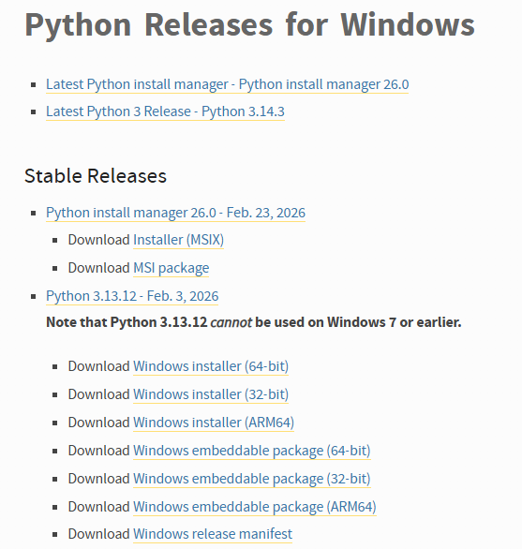
Labs Prepare
python
https://www.python.org/downloads/windows/
Download
Install

Slide 20

Labs Prepare
pycharm
https://www.jetbrains.com/pycharm/
Download
Install

Slide 21
Connect MySQL using python

Slide 22
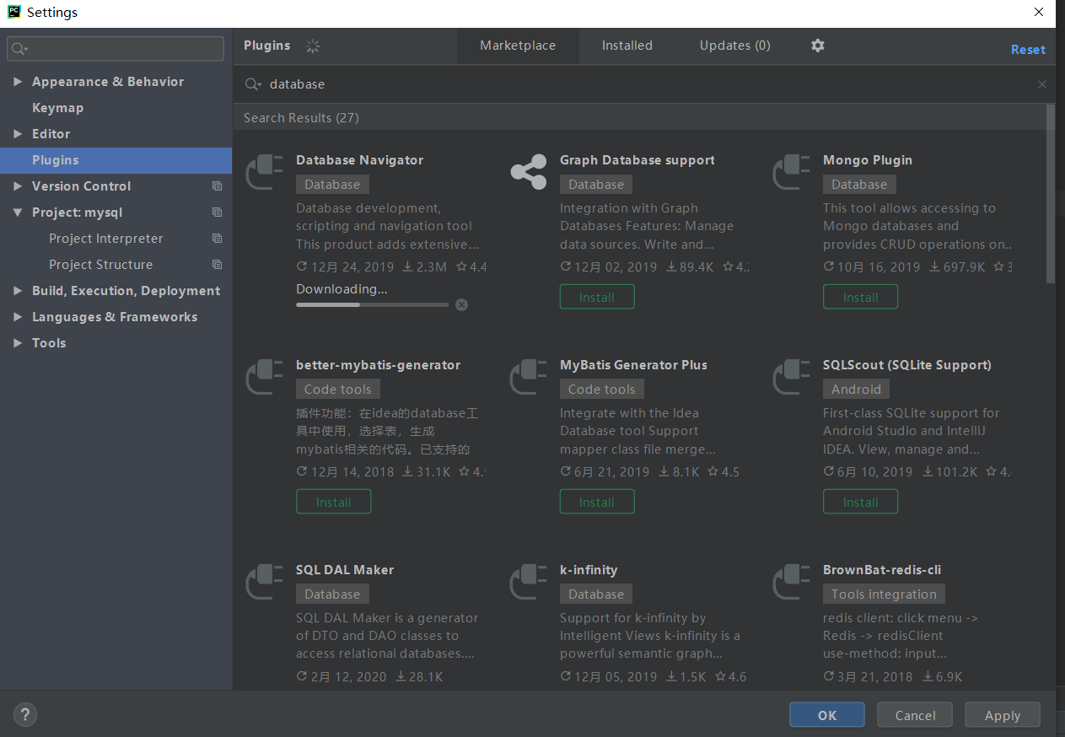
PyCharm
Add reference
PyMySQL
Pip install PyMySQL

Slide 23
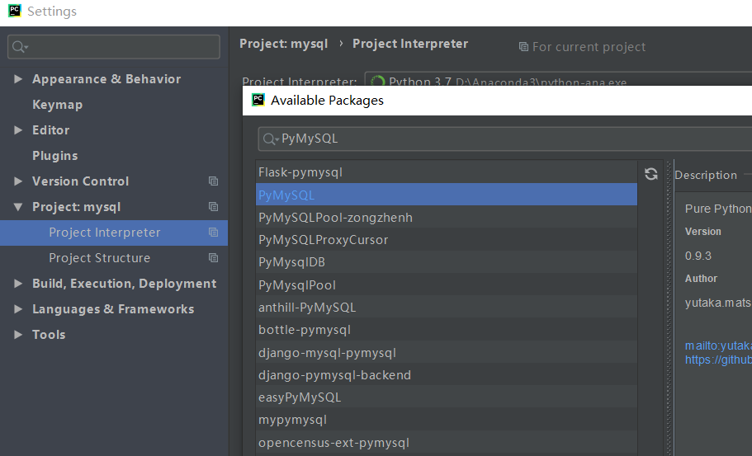
PyCharm
Add reference
PyMySQL
Pip install PyMySQL

Slide 24
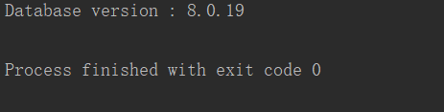
connection
import pymysql
conn=pymysql.connect(host='localhost',user='root',password=‘123',database='sys',charset='utf8')
cursor=conn.cursor()
sql = 'select version()'
cursor.execute(sql)
retdat = cursor.fetchall()
for row in retdat:
print(row[0])
cursor.close()
conn.close()

