Slide 1


溯源乳业匠心，共研绿色未来
小组成员：黄子豪，张天译，林子媛，吕旭靖

Slide 2
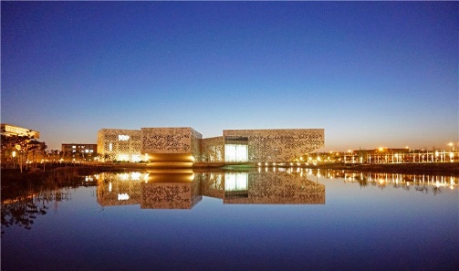
CONTENT
实践选题
准备方案
行程安排
预期结果
实践意义

Slide 3
Overview
Method
Procedure
Exploration
Conclusion
研究概述
Research Overview

Slide 4
主题概述
Research Overview
Unified fonts make reading more fluent.
Theme color makes PPT more convenient to change.Adjust the spacing to adapt to Chinese typesetting, use the reference line in PPT.
Theme color makes PPT more convenient to change.Adjust the spacing to adapt to Chinese typesetting, use the reference line in PPT. Theme color makes PPT more convenient to change.Adjust the spacing to adapt to Chinese typesetting, use the reference line in PPT.

Slide 5
选题背景
Research Overview
TEXT
Theme color makes PPT more convenient to change.Adjust the spacing to adapt to Chinese typesetting, use the reference line in PPT.
TEXT
Theme color makes PPT more convenient to change.Adjust the spacing to adapt to Chinese typesetting, use the reference line in PPT.
Theme color makes PPT more convenient to change.Adjust the spacing to adapt to Chinese typesetting, use the reference line in PPT.
TEXT

Slide 6
研究意义
Research Overview
Theme color makes PPT more convenient to change.Adjust the spacing to adapt to Chinese typesetting, use the reference line in PPT. Theme color makes PPT more convenient to
Theme color makes PPT more convenient to change.Adjust the spacing to adapt to Chinese typesetting, use the reference line in PPT. Theme color makes PPT more convenient toTheme color makes PPT more convenient to change.Adjust the spacing to adapt to Chinese typesetting,
Theme color makes PPT more convenient to change.Adjust the spacing to adapt to Chinese typesetting, use the reference line in PPT. Theme color makes PPT more convenient toTheme color makes PPT more convenient to change.Adjust the spacing to adapt to Chinese typesetting,

Slide 7
Overview
Method
Procedure
Exploration
Conclusion
方法工具
Research Method

Slide 8
理论依据
Research Method
Theme color makes PPT more convenient to change.Adjust the spacing to adapt to Chinese typesetting, use the reference line in PPT. Theme color makes PPT more convenient to change.Adjust the spacing to adapt to Chinese typesetting, use the reference line in PPT.
Research Method
Research Method
Research Method
Research Method

Slide 9
Theme color makes PPT more convenient to change.Adjust the spacing to adapt to Chinese typesetting, use the reference line in PPT.
Theme color makes PPT more convenient to change.Adjust the spacing to adapt to Chinese typesetting, use the reference line in PPT.
研究假设
Theme color makes PPT more convenient to change.Adjust the spacing to adapt to Chinese typesetting, use the reference line in PPT.

Slide 10
方法工具
Research Method
Theme color makes
Theme color makes PPT more convenient to change.Adjust the spacing to adapt to Chinese typesetting, use the reference line in PPT.
40%
40%
51%
67%
Theme color makes
TEXT HERE
Theme color makes PPT more convenient to change.Adjust the spacing to adapt to Chinese typesetting, use the reference line in PPT.
Supporting text here
Supporting text here Supporting text
Supporting text here Supporting text here

Slide 11
Overview
Method
Procedure
Exploration
Conclusion
研究过程
Research Procedure

Slide 12
实施阶段
Research Procedure
Research Procedure
Research Procedure
Research Procedure
Theme color makes PPT more convenient to change.Adjust the spacing to adapt to Chinese typesetting, use the reference line in PPT.
Theme color makes PPT more convenient to change.Adjust the spacing to adapt to Chinese typesetting, use the reference line in PPT.
Theme color makes PPT more convenient to change.Adjust the spacing to adapt to Chinese typesetting, use the reference line in PPT.

Slide 13
主题概述
Research Overview
Theme color makes PPT more convenient to change.Adjust the spacing to adapt to Chinese typesetting, use the reference line in PPT.
Theme color makes PPT more convenient to change.Adjust the spacing to adapt to Chinese typesetting, use the reference line in PPT.
Theme color makes PPT more convenient to change.Adjust the spacing to adapt to Chinese typesetting, use the reference line in PPT.

Slide 14
Overview
Method
Procedure
Exploration
Conclusion
问题探讨
Research Exploration

Slide 15
Theme color makes PPT more convenient to change.Adjust the spacing to adapt to Chinese typesetting, use the reference line in PPT.
Theme color makes PPT more convenient to change.Adjust the spacing to adapt to Chinese typesetting, use the reference line in PPT.
Theme color makes PPT more convenient to change.Adjust the spacing to adapt to Chinese typesetting, use the reference line in PPT.
Theme color makes PPT more convenient to change.Adjust the spacing to adapt to Chinese typesetting, use the reference line in PPT.
Theme color makes PPT more convenient to change.Adjust the spacing to adapt to Chinese typesetting, use the reference line in PPT.
Theme color makes PPT more convenient to change.Adjust the spacing to adapt to Chinese typesetting, use the reference line in PPT.
正反观点

Slide 16
主要问题
Theme color makes
Theme color makes PPT more convenient to change.Adjust the spacing to adapt to Chinese typesetting, use the reference line in PPT.
Theme color makes PPT more convenient to change.Adjust the spacing to adapt to Chinese typesetting, use the reference line in PPT.
Theme color makes PPT more convenient to change.Adjust the spacing to adapt to Chinese typesetting, use the reference line in PPT.

Slide 17
Unified fonts make reading more fluent.
30,000K
50,000K
60,000K
80,000K
Text here
Text here
Text here
Text here
Copy paste fonts. Choose the only option to retain text.
…...
Copy paste fonts. Choose the only option to retain text.
…...
Copy paste fonts. Choose the only option to retain text.
…...
Copy paste fonts. Choose the only option to retain text.
…...

Slide 18
Overview
Method
Procedure
Exploration
Conclusion
研究结论
Research Conclusion

Slide 19
￥1901
￥890
￥789
Text here
Text here
Text here
Copy paste fonts. Choose the only option to retain text.
……
Copy paste fonts. Choose the only option to retain text.
……
Copy paste fonts. Choose the only option to retain text.
……
Copy paste fonts. Choose the only option to retain text.
……

Slide 20
假设检验
Research Conclusion
Copy paste fonts. Choose the only option to retain text.
……
Copy paste fonts. Choose the only option to retain text.
……
Copy paste fonts. Choose the only option to retain text.
……

Slide 21
结果归纳
Research Overview
Theme color makes PPT more convenient to change.Adjust the spacing to adapt to Chinese typesetting, use the reference line in PPT. Theme color makes PPT more convenient to change.Adjust the spacing to adapt to Chinese typesetting, use the reference line in PPT.
Theme color makes PPT more convenient to change.Adjust the spacing to adapt to Chinese typesetting, use the reference line in PPT. Theme color makes PPT more convenient to change.Adjust the spacing to adapt to Chinese typesetting, use the reference line in PPT.

Slide 22
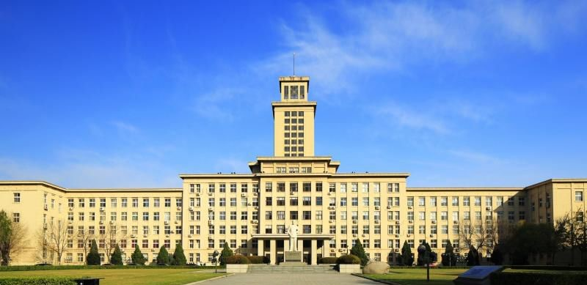

南开大学PPT模板
海湾同学社
海湾同学社

