Slide 1
LUXURY WEDDINGS & EVENTS · DESIGN TO DELIVERY
SPARK PLANNERS
in association with TentnMore Event Planners
Designing unforgettable celebrations — plan · design · film · execute.
COMPANY PROFILE & SERVICES

Slide 2
WHO WE ARE
We don't just plan weddings
We bring your unique love story to life. Every detail reflects your personality, style and dreams — so you can manage nothing and enjoy every single moment.
Spark Planners pairs design-led, technology-enabled planning with TentnMore's full-service execution across Delhi/NCR and destinations nationwide. From first concept to the final frame, one accountable team owns your celebration.
Design-led
Every element drawn to scale before it is built.
Full-service
Décor, films, catering, logistics — under one roof.
On the ground
Seasoned Delhi/NCR execution, calm and flawless.
Spark Planners · in association with TentnMore

Slide 3
THE PARTNERSHIP
Two studios, one seamless team
Spark Planners
TentnMore Event Planners
DESIGN & TECHNOLOGY
EXECUTION & HOSPITALITY
Architecture-grade design of venue, mandap, décor and lighting — drawn to scale, previewed in 3D, and presented as client-ready boards. In-house films capture every moment.
Delhi/NCR's full-service event house: vendors, fabrication, catering, logistics and on-ground delivery, with a proven portfolio across weddings, parties and corporate events.
Spark Planners · in association with TentnMore

Slide 4
WHAT WE DO
Full-service, end to end
Planning & Coordination
Ceremonies & Functions
Design, Décor & Florals
Catering, Menu & Cake
Films & Photography
Entertainment & Choreography
Guest Experience & Logistics
Beyond Weddings
Spark Planners · in association with TentnMore

Slide 5
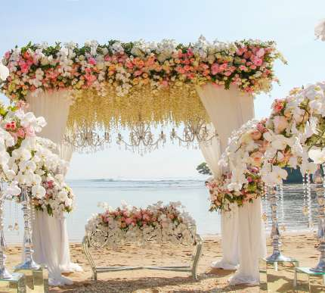
PLANNING & COORDINATION
From scouting to seamless logistics
Destination Wedding Scouting
Breathtaking backdrops countrywide, with guest travel, stay and local legal compliance handled by our concierge.
Wedding Venue Selection
Ideal spaces matched to you, virtual or in-person site visits, and negotiated premium rates with optimised layouts.
Event Timeline
A master blueprint with minute-by-minute schedules and built-in buffers to keep every vendor team in sync.
Logistics, Hospitality & Transport
A premium fleet, airport welcome desks, luggage-tagged check-ins and 24/7 on-site guest support.
Spark Planners · in association with TentnMore

Slide 6
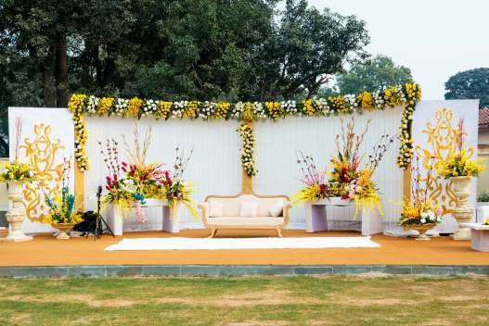
CEREMONIES & FUNCTIONS
Every ritual, beautifully staged
Proposal Planning
Bespoke surprise concepts with secret locations, hidden cameras, music, flowers and flawless timing.
Mehandi · Haldi · Sangeet
Sacred family rituals with festive, high-octane energy, bold palettes and interactive stalls like lac bangles and chaat.
Wedding & Reception
Serene ceremony altars, grand couple entries, and a seamless flow from speeches to after-party.
Choreography
Routines tailored to your skill level, energetic family mashups and stage blocking under the lights.
Spark Planners · in association with TentnMore

Slide 7
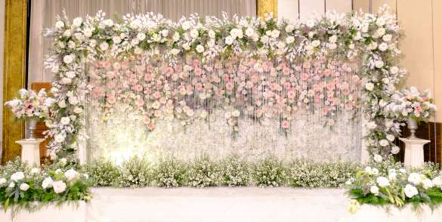
DESIGN, DÉCOR & FLORALS
Visual storytelling, drawn to scale
Wedding Décor for All Functions
Custom-fabricated stages and backdrops, immersive smart lighting, and premium linens, drapes and carpets.
Flowers & Bouquets
Massive floral installations from rare, farm-sourced blooms, plus bouquets, boutonnieres, garlands and scent design.
Wedding Invitation
Custom stationery suites, interactive digital websites, real-time RSVP tracking and gourmet invite hampers.
Spark Planners · in association with TentnMore

Slide 8
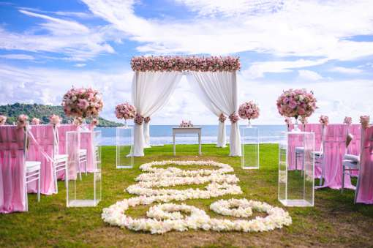
CATERING, MENU & CAKE
A dining experience to remember
Catering & Wedding Menu
Bespoke multi-cuisine menus shaped through private chef tastings, live theatre food stations, and full vegan, gluten-free and allergy care.
Wedding Cake
Edible sugar-art masterpieces matched to your dress, premium fillings, dramatic reveals, cupcakes and dessert tables.
Spark Planners · in association with TentnMore

Slide 9
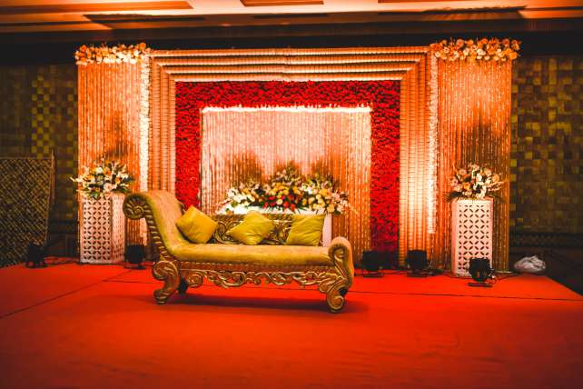
FILMS, ENTERTAINMENT & GUEST EXPERIENCE
The day, captured and celebrated
Photography & Cinematography
Top-tier storytellers for editorial pre-wedding shoots, movie-quality films and fast quick-preview delivery.
Entertainment
Premium live acts — DJs, brass bands, acoustic duos — plus magicians, flash mobs, photo booths and 360° cameras.
Artist & Celebrity Management
A-list musicians, actors and hosts with full technical, rider, green-room and private-security handling.
Favours & Gifts
Luxury takeaway tokens and local souvenirs, custom-monogrammed packaging and curated welcome baskets.
Spark Planners · in association with TentnMore

Slide 10
BEYOND WEDDINGS
Celebrations of every kind
Birthday Party Decorations
Corporate Event Management
Sparkling, colourful set-ups that turn any milestone into a stunning, memorable celebration for the whole family.
Complete corporate planning — styling, theming, entertainment and audio-visual — delivered end to end, on brief and on time.
Also: cocktail evenings · bachelor & bachelorette parties · anniversaries · private soirées.
Spark Planners · in association with TentnMore

Slide 11
OUR EDGE
Powered by a Wedding Operating System
What you approve is exactly what we build. Every Spark celebration is planned on a connected design platform — not sketched on napkins.
156
1,441
4,539
17
design surfaces
knowledge nodes
linked relations
board pages
• AI design co-pilot for ideas & options
• 3D / CAD studios for true-to-scale design
• Board Composer for client-ready presentations
• Vedi & Muhurat intelligence built in
Spark Planners · in association with TentnMore

Slide 12
HOW WE WORK
From first call to final frame
01
Discover
02
Design
03
Plan
Vision, guest count, dates, budget.
Venue, mandap, décor and lighting to scale.
Vendors, timeline, logistics and muhurat.
04
Produce
05
Film
06
Celebrate
Fabrication, crews, call sheets, delivery.
Pre-wedding through full wedding film.
We run the day; you live it.
Spark Planners · in association with TentnMore

Slide 13
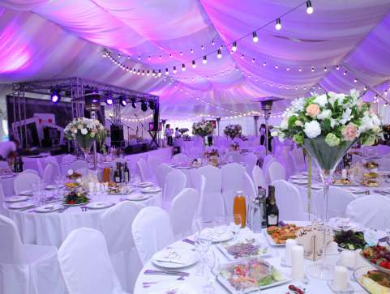
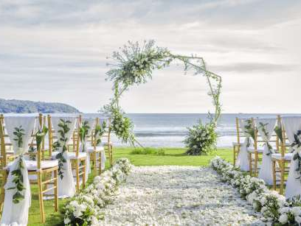

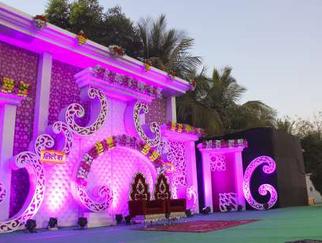
SELECTED WORK
Recent celebrations
Spark Planners · in association with TentnMore

Slide 14
WHY US
The wow factor, end to end
“We aim to provide every detail touch to your rituals and imbibe the wow factor — to make it look simple yet elegant.”
One team. One accountable plan. A flawless, unforgettable celebration from start to finish.
Spark Planners · in association with TentnMore

Slide 15
Let's create your story
SPARK PLANNERS · Sanjeeta Khaira
in association with TentnMore Event Planners
tentnmore@gmail.com · +91 95402 30027 · www.tentnmore.in

