Slide 1
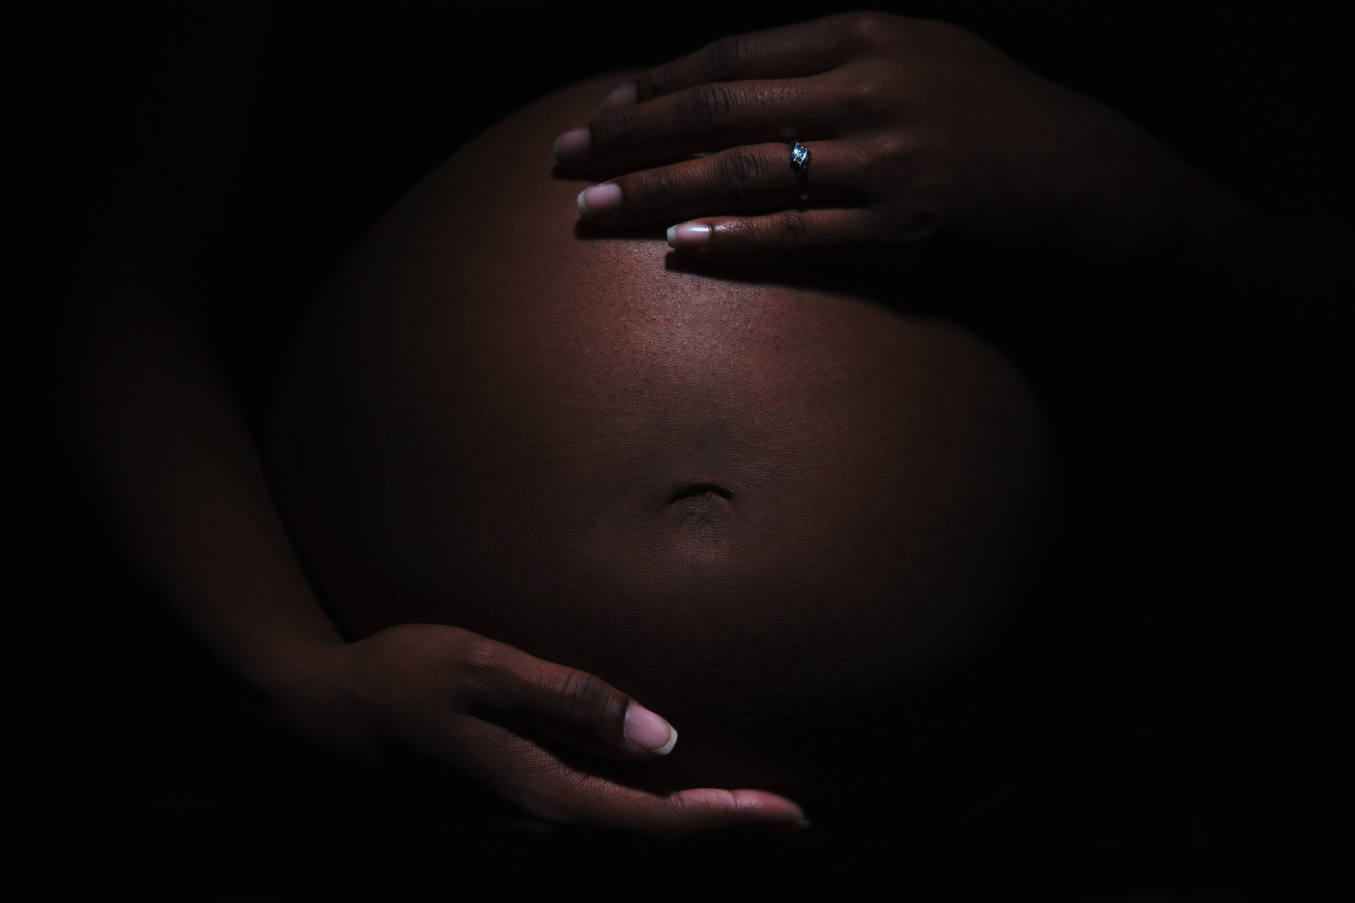
1
…the risk approaches 90% in children of those HBsAg + mothers who do not receive HB immunoglobulin and HBV vaccine at birth.
The transmission can occur while the baby is in utero, at birth or after delivery.
2
3
4
Mother-to-child transmission
5
6
7

Slide 2

This was thought to be rare; but some data from Taiwan has confirmed the fact that infected fathers of children born to HBV negative mothers do get HBV infection.
The mechanism is thought to be close contact of the unprotected infants with the infected blood and body fluids of the fathers.
2
3
4
Paternal transmission
5
6
7

Slide 3
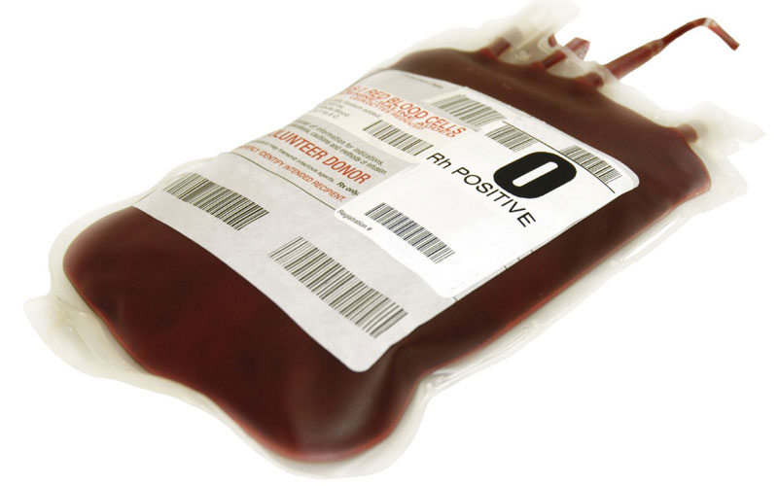
This has now largely reduced since commencement of pretransfusion screening for HBV.
HBV discovered in 1965
Pre transfusion screening - 1986
3
4
Transfusion of infected blood
5
6
7

Slide 4


Unvaccinated sexual partners of HBV infected persons can acquire the infection – either men who have sex with men, or man and woman.
4
Sexual transmission
5
6
7

Slide 5

Intravenous drug use, acupuncture, tattooing, and body piercing have also been associated with transmission of HBV by equipment that are contaminated with HBV-infected blood.
Percutaneous inoculation
5
6
7

Slide 6
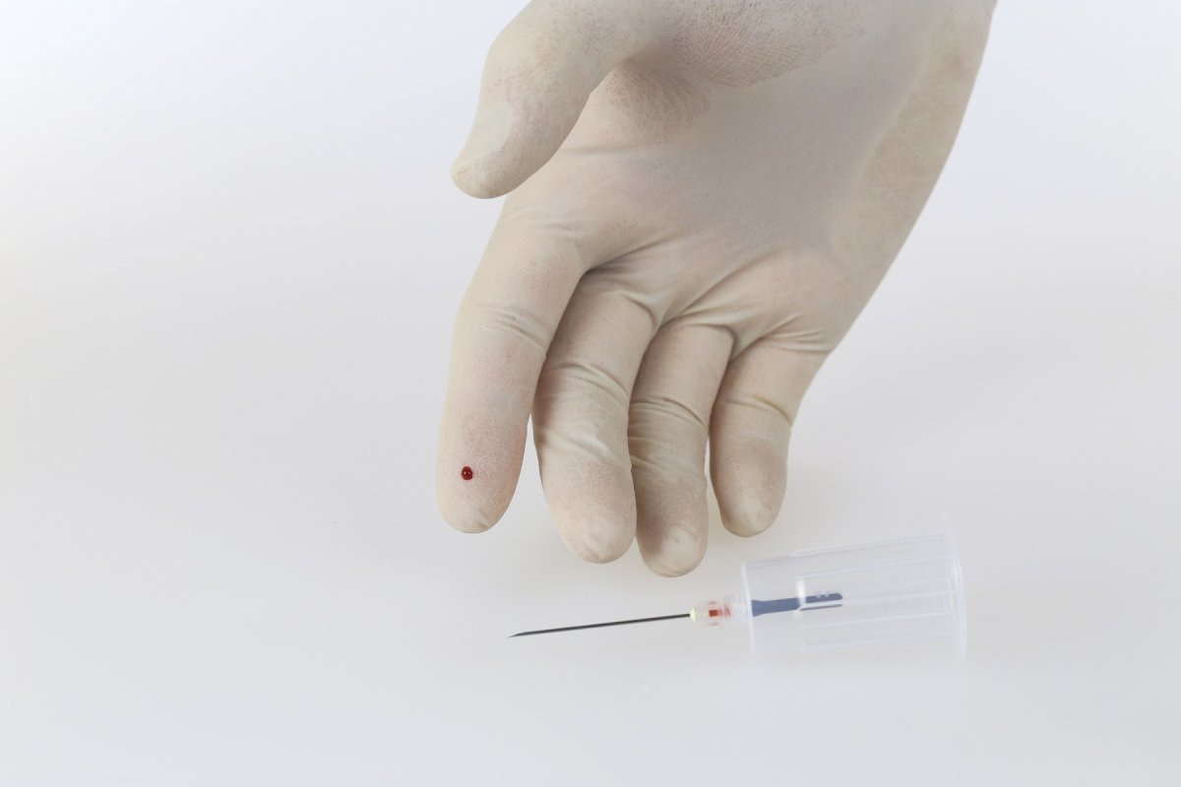
This refers to transmission of HBV within the health care setting - via contaminated instruments or an accidental needle stick injuries.
Nosocomial transmission
6
7

Slide 7
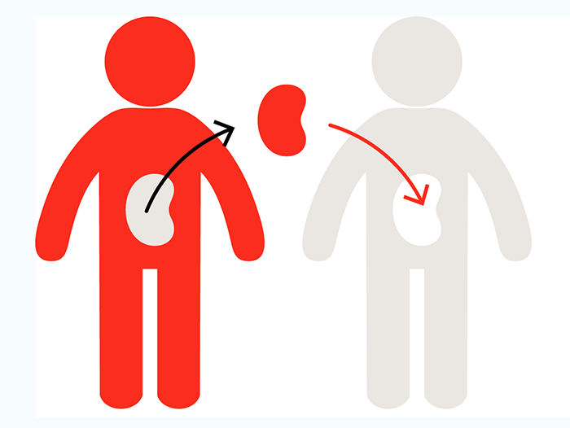
When an organ from an HBV positive individual is transplanted, or one from a patient with isolated HB c Ab patient, the recipient risks being infected by HBV
Transplant recipients
7

Slide 8
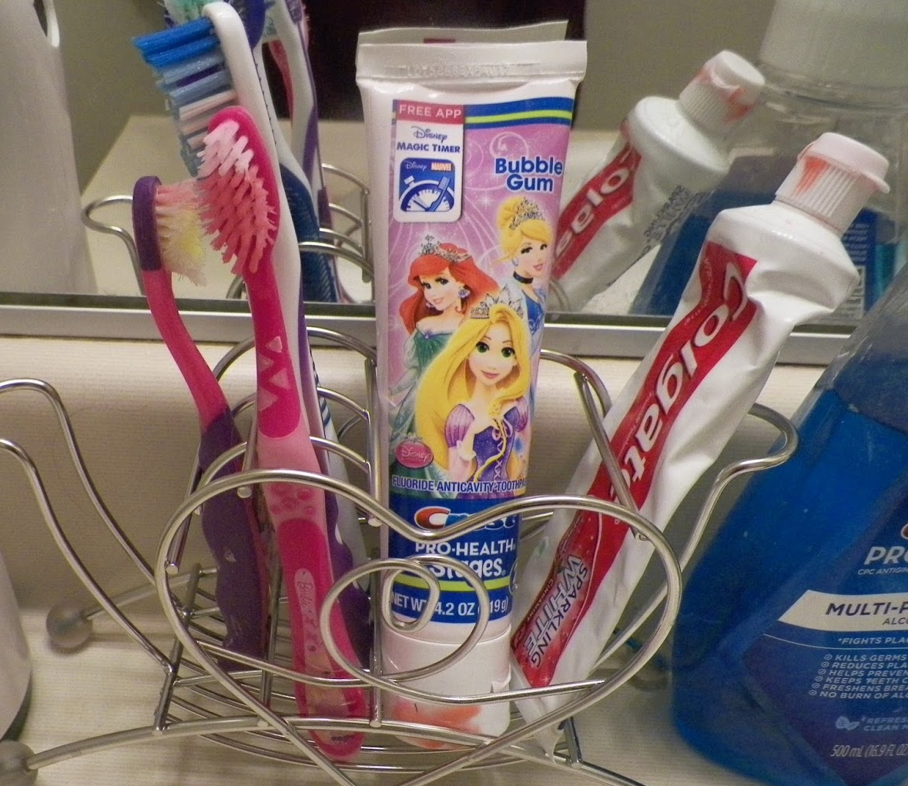
An 8th Point!
Transmission can occur via exposure to household articles that have been contaminated with blood, such as toothbrushes, razors, and toys since HBV can survive outside the body for up to 7 days.

