Slide 1

PREVENTION
….
Pre-exposure vaccination
Post-exposure vaccination
Special situations

Slide 2
PREVENTION
….
Pre-exposure prophylaxis
– Universal vaccination of babies and those that are not immune to HBV and are at high risk of exposure or a poor disease outcome

Slide 3
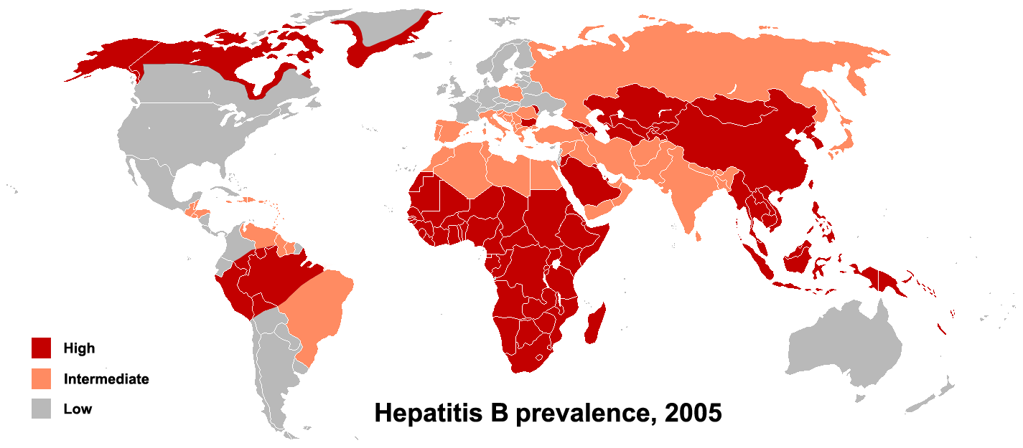
Slide 7
Slide 6
Slide 5
Slide 4
Slide 3
Slide 2
People living in HBV endemic regions of the world (practically difficult)
1

Slide 4
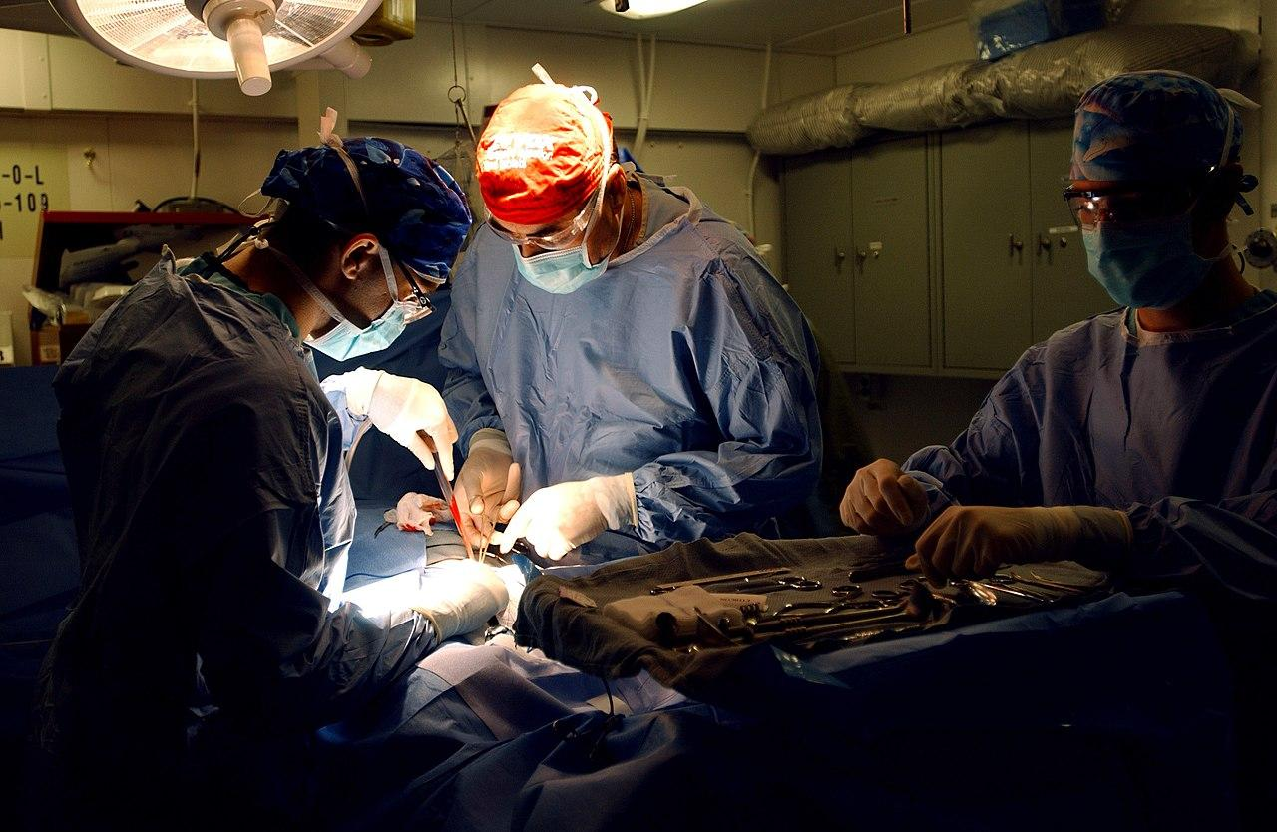
Slide 7
Slide 6
Slide 5
Slide 4
Slide 3
Slide 2
Slide 1
health care personnel
This Photo by Unknown Author is licensed under CC BY-SA

Slide 5
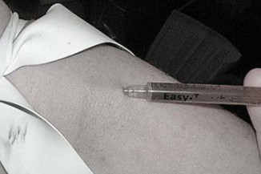
Slide 7
Slide 6
Slide 5
Slide 4
Slide 3
Slide 2
injection drug users
Slide 1

Slide 6
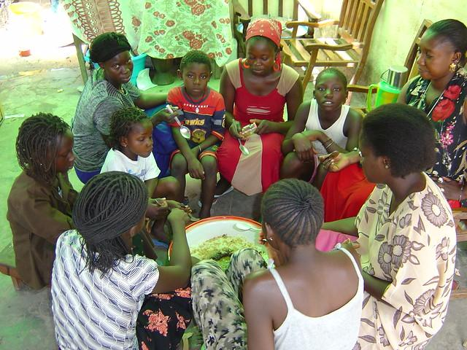
Slide 7
Slide 6
Slide 5
Slide 4
Slide 3
Slide 2
household contacts of hepatitis B surface antigen [HBsAg]-positive patients
Slide 1

Slide 7

Slide 7
Slide 6
Slide 5
Slide 4
Slide 3
Slide 2
men who have sex with men
Slide 1

Slide 8

Slide 7
Slide 6
Slide 5
Slide 4
Slide 3
Slide 2
human immunodeficiency virus [HIV]-infected patients
Slide 1

Slide 9
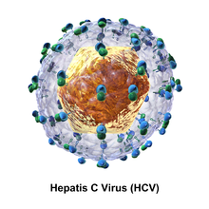
Slide 7
Slide 6
Slide 5
Slide 4
Slide 3
Slide 2
hepatitis C virus -infected patients
Slide 1

Slide 10
Post-exposure vaccination – Examples of these include needle stick injuries and mucosal exposures to blood or infectious secretions of patients who is known to be HBsAg positive or whose HBsAg status is unknown
PREVENTION
….

Slide 11
Special Situations
Prevention of mother to child transmission
Reducing sexual transmission
Health care providers
Percutaneous routes
Transplant recipients
PREVENTION
….

