Slide 1

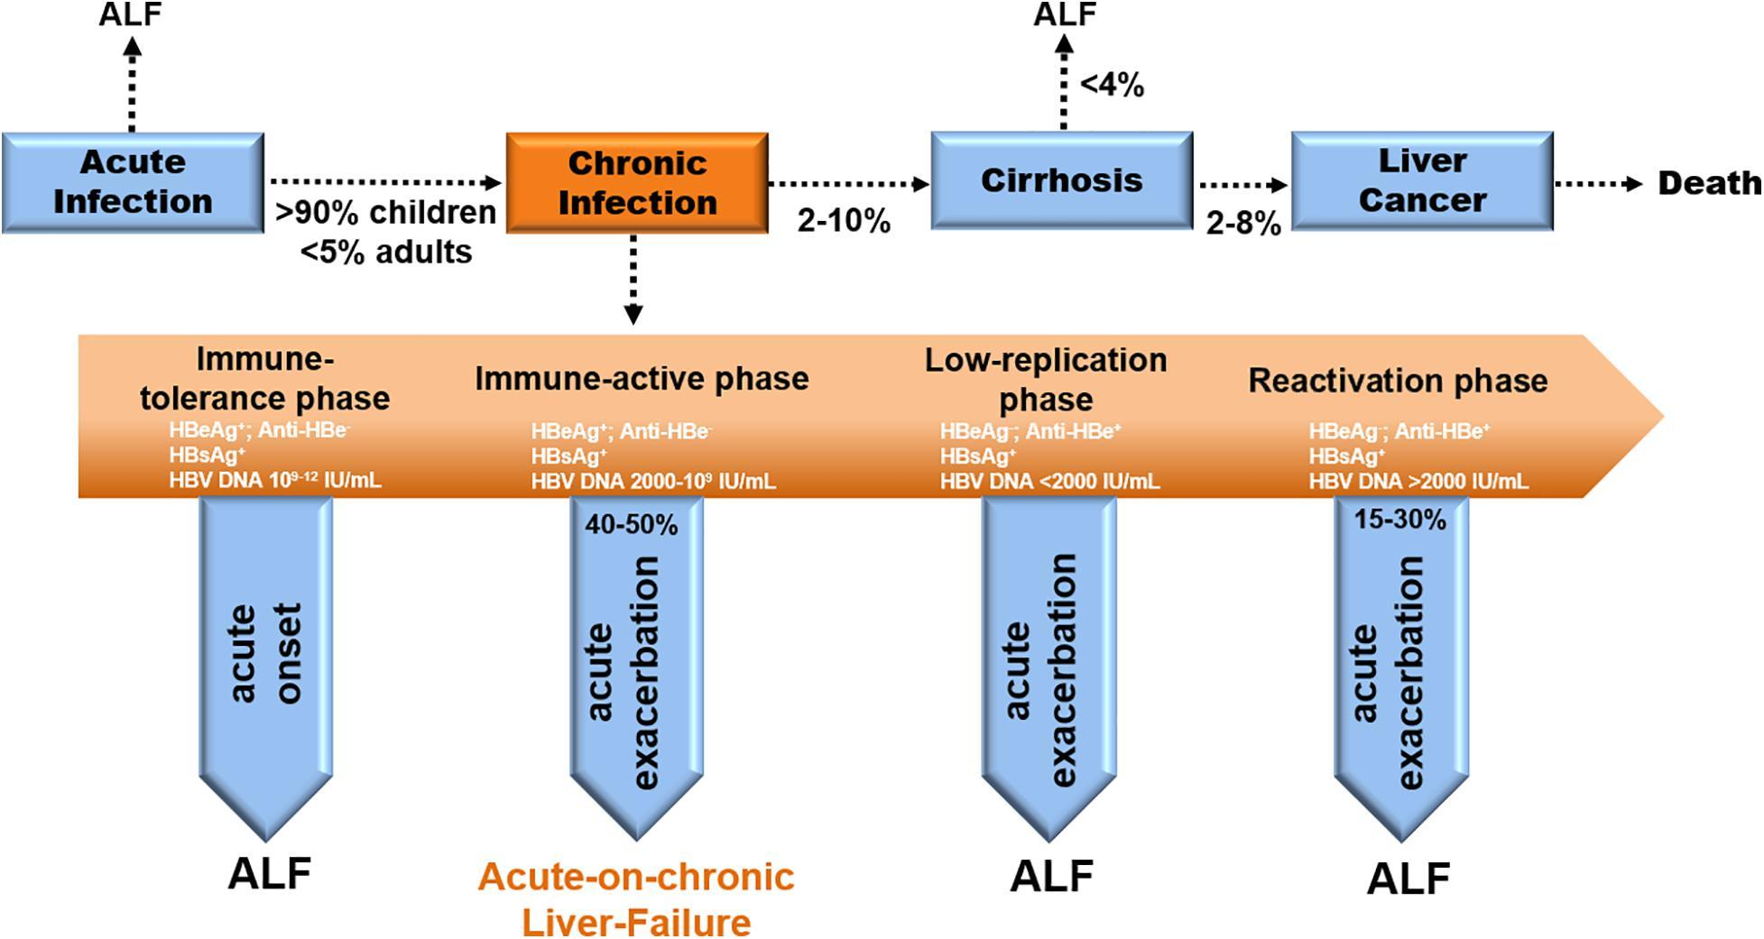
Outcome of acute HBV infection
90 percent for a perinatally acquired infection would go on to have chronic HBV infection
20 - 50% of those who acquired the infection between 1 and 5yrs develop chronic HBV
Adults – 5%
SYMPTOMS & SIGNS – MANIFESTATIONS & NATURAL HISTORY
….

Slide 2
Treatment for acute HBV
Treatment for acute HBV is mainly supportive
SYMPTOMS & SIGNS – MANIFESTATIONS & NATURAL HISTORY
….

Slide 3
Hospital management is based on
Coagulopathy, deep jaundiced or encephalopathy
elderly age at first infection
have significant comorbidities
cannot tolerate oral intake
have poor social support systems
SYMPTOMS & SIGNS – MANIFESTATIONS & NATURAL HISTORY
….

Slide 4
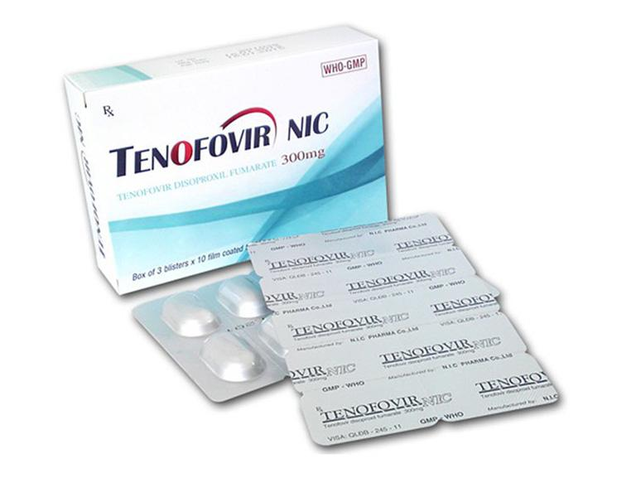
Antiviral therapy is not indicated, except in a few cases of fulminant hepatic failure, but which should be stopped once the patient has become negative to HBsAg
SYMPTOMS & SIGNS – MANIFESTATIONS & NATURAL HISTORY
….

Slide 5



What we have learned
HBV is a viral infection that causes acute and chronic diseases
Transmission of HBV in developing countries is most often horizontal, whilst it is via sexual routes in the West
Acute HBV presents more dramatically than chronic HBV
HBV treatment is supportive and rarely needs antiviral agents

