Slide 1
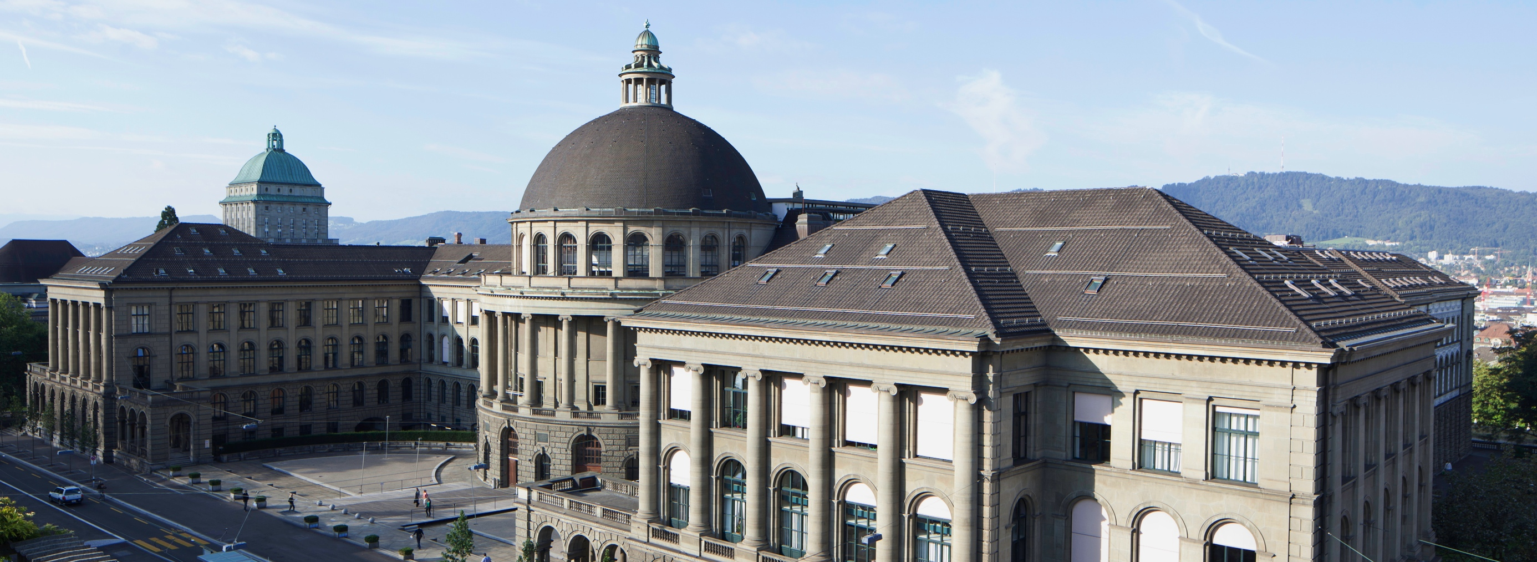
Bachelor Thesis Presentation on 3D Depth Sensors on Mobile Devices
Acquisition, Calibration and 3D Reconstruction

Slide 2
Motivation
3D Reconstruction
First mobile depth sensor
Powerful mobile devices
Notes:
Microsoft Photosynth, chateau d’chillon, city reconstruction seattle

Slide 3
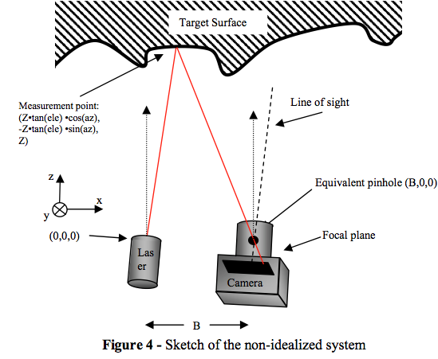
Depth Sensors
Infrared structured light projector
Structure Sensor

Slide 4
Data Acquisition
On iOS with Structure SDK
Simultaneously record from sensor and camera

Slide 5
Demo
Data Acquisition

Slide 6
Calibration
Pinhole model
Single camera calibration
Stereo calibration

Slide 7
Depth and Color Combination
Depth re-projection

Slide 8
Camera Motion
Motion Estimation using SVO
Semi-direct method

Slide 9
Scale Estimation
SVO in arbitrary coordinate system
Need absolute coordinates
Formula

Slide 10
3D Reconstruction
Fastfusion
Volumetric mapping

Slide 11
Demo
3D Reconstruction

Slide 12
Depth Acquisition Integration

Slide 13
Future Work

Slide 14
Thank you for your attention.
?

