Slide 1
CYBER SECURITY BASICS PROJECT
BY: JOEL AGBOIKE

Slide 2
SECTION 1 — LINUX PRACTICAL
Task 1 — User and Directory Information
Assignment
Display your current working directory.
2. Display the current logged-in user.
3. List files in the current directory.

Slide 3
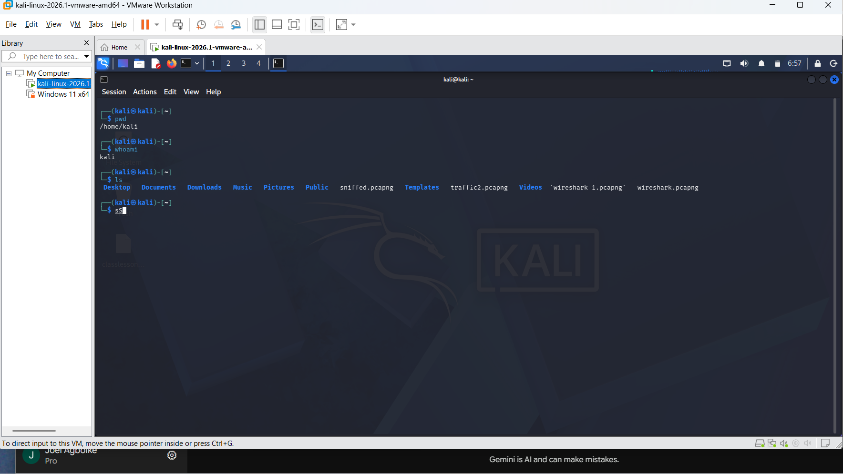
1,2&3

Slide 4
Task 2 — Directory Navigation
Assignment
1. Move into a directory.
2. Return to the previous directory.
3. Move into another directory.
4. List the files inside it.

Slide 5
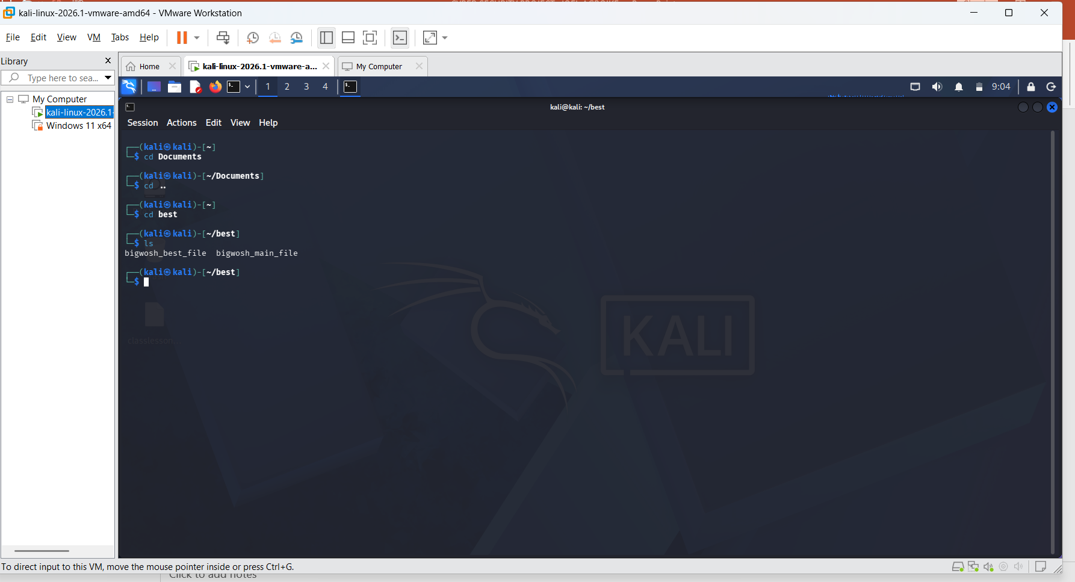
1,2,3&4

Slide 6
Task 3 — File and Folder Creation
Assignment
1. Create a folder for a project.
2. Create multiple files inside the folder.
3. Display detailed file information.
4. Display hidden files.

Slide 7
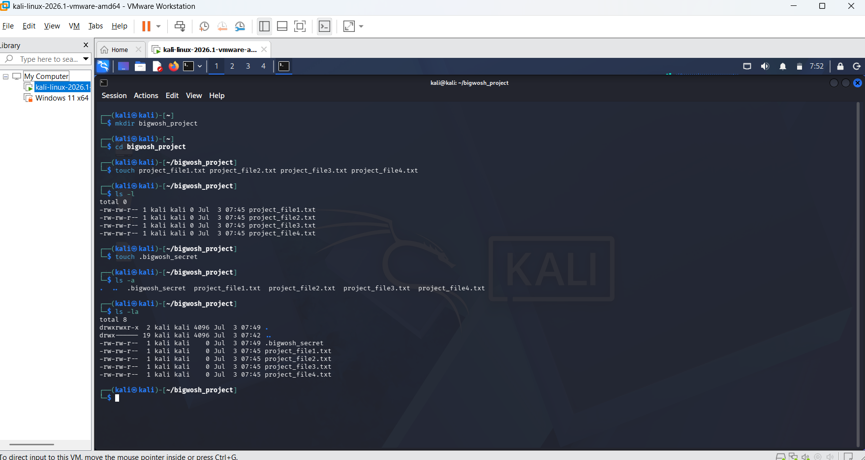
1,2,3&4

Slide 8
Task 4 — Viewing File Content
Assignment
1. Create a text file.
2. Add multiple lines into the file.
3. Display the full content.
4. Display only the beginning of the file.
5. Display only the end of the file.
6. Open the file

Slide 9
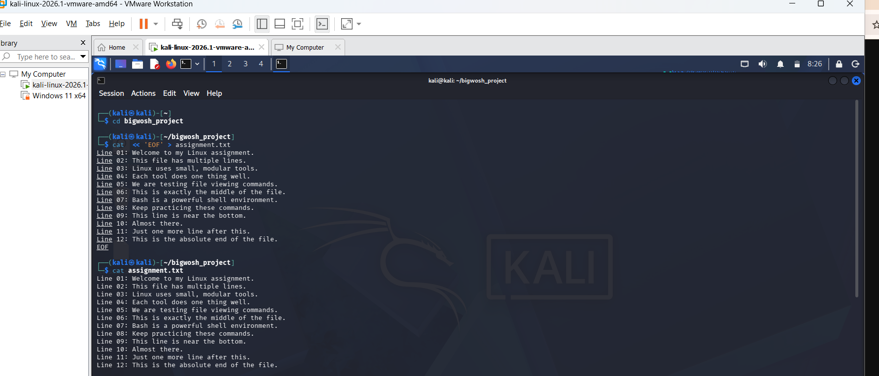
1,2&3

Slide 10
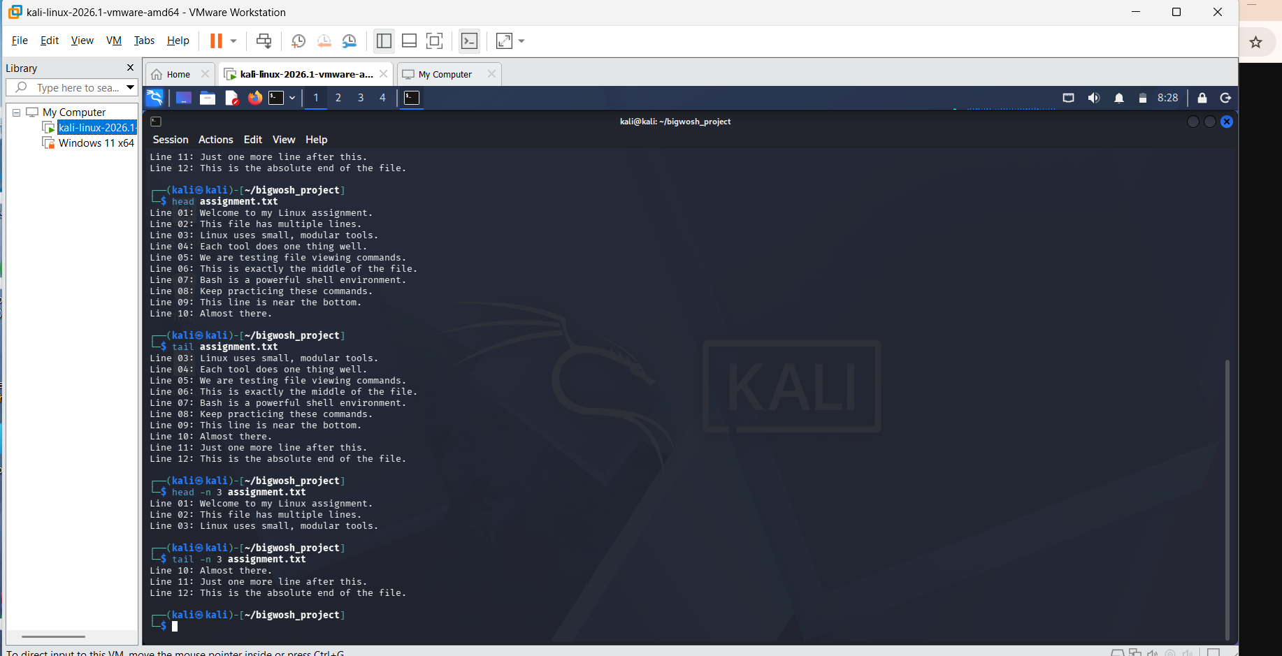
4&5

Slide 11
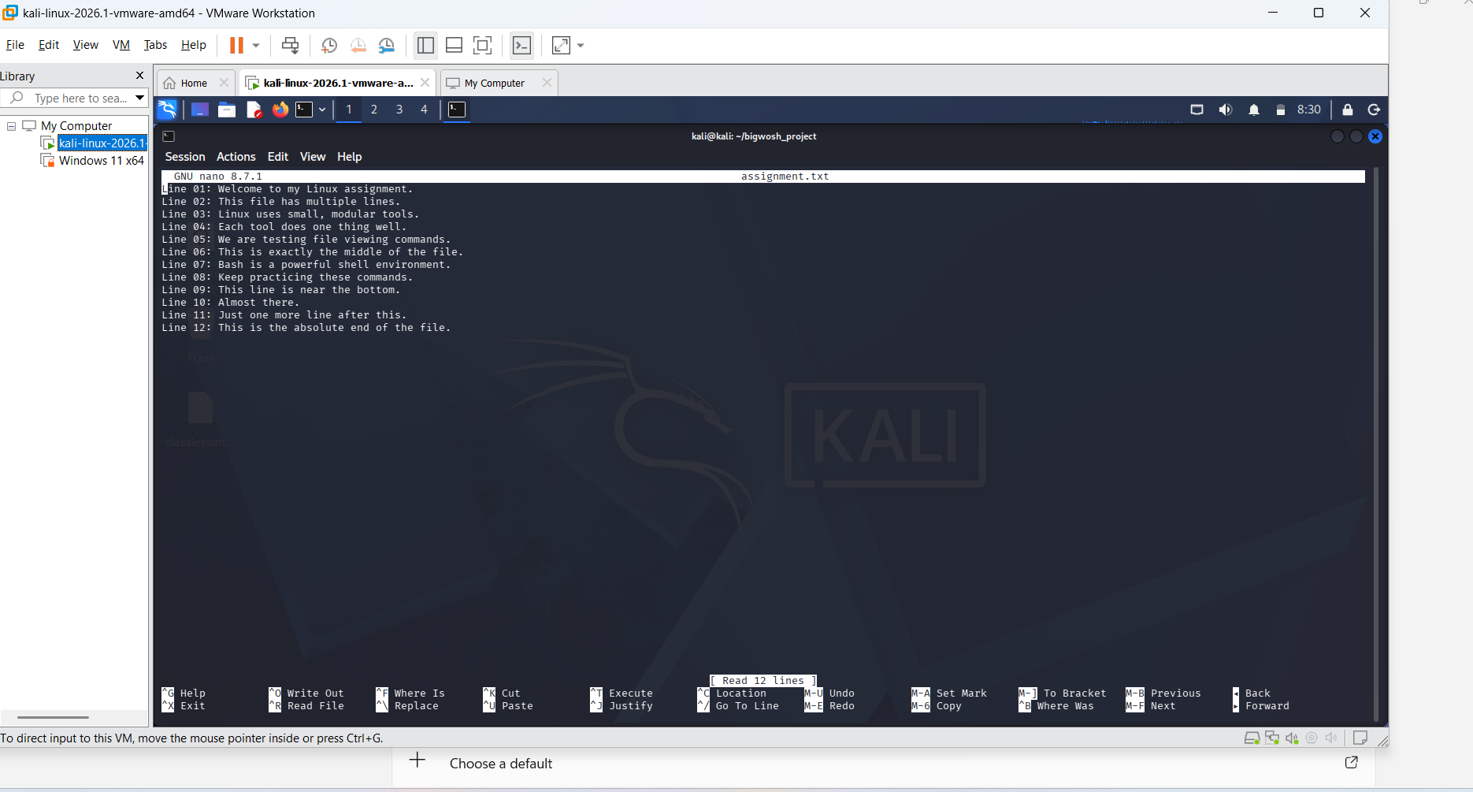
6 using; nano assignment.txt

Slide 12
NB:
I used; cat << 'EOF' > assignment.txt
cat: This command normally reads files, but when used alone, it reads whatever you type directly
into the terminal.
> assignment.txt: This redirects the output. Instead of spitting your text back out onto the screen,
it sends it straight into a file named assignment.txt.
<<: This is the Heredoc operator. It tells the shell: "Get ready, input stream coming up!“
'EOF': This is your custom stop sign. You are telling Linux, "Keep recording everything I type until
you see a line that contains exactly this word."

Slide 13
Why use EOF? Can it be any word?
Yes! EOF is just an industry-standard convention. Linux doesn't care what the word is, as long as the starting word matches the ending word perfectly.
For example, this works exactly the same way:
cat << ‘WOSH' > recipe.txt
Flour
Sugar
Eggs
WOSH
The moment you hit Enter on that final WOSH or EOF line, Linux realizes you are done, closes the file,
and hands control of the terminal back to you.
Again: The Quotes Matter
You might have noticed I put single quotes around the first 'EOF'. Here is why that matters:
With Quotes ('EOF'): Linux treats everything you type 100% literally. If you type $USER,
it writes literally $USER into the file.
Without Quotes (EOF): Linux will actually evaluate variables on the fly. If you type $USER,
it will secretly swap that out for your actual account username inside the file before saving it.

Slide 14
Task 5 — Searching Inside Files
Assignment
Create a file containing multiple usernames.
2. Search for a specific username.
3. Combine commands

Slide 15
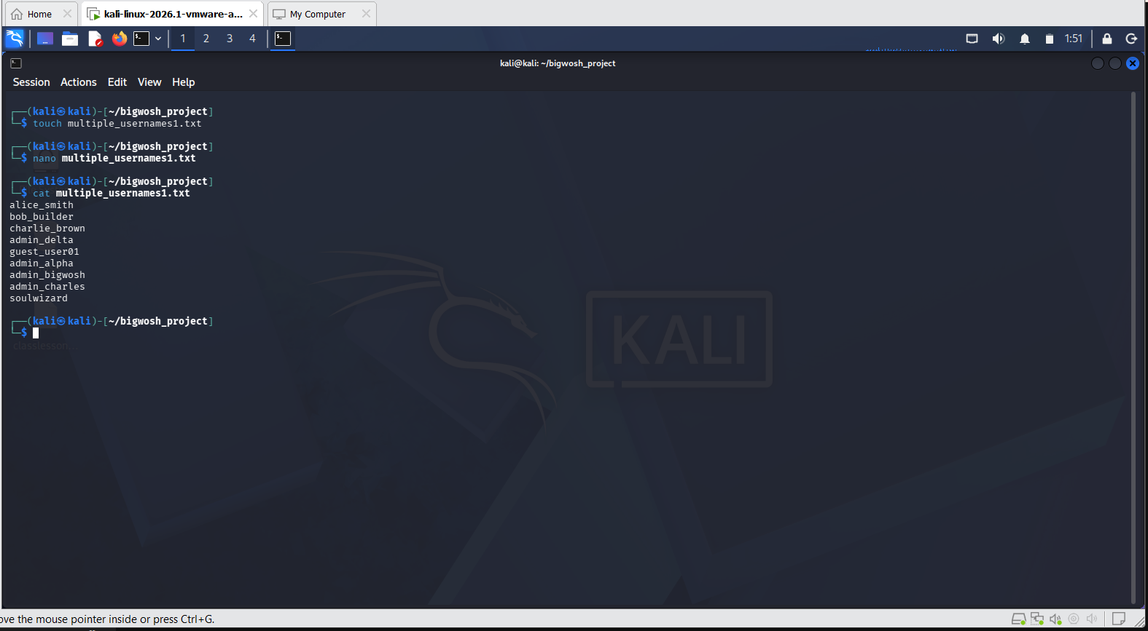
1

Slide 16
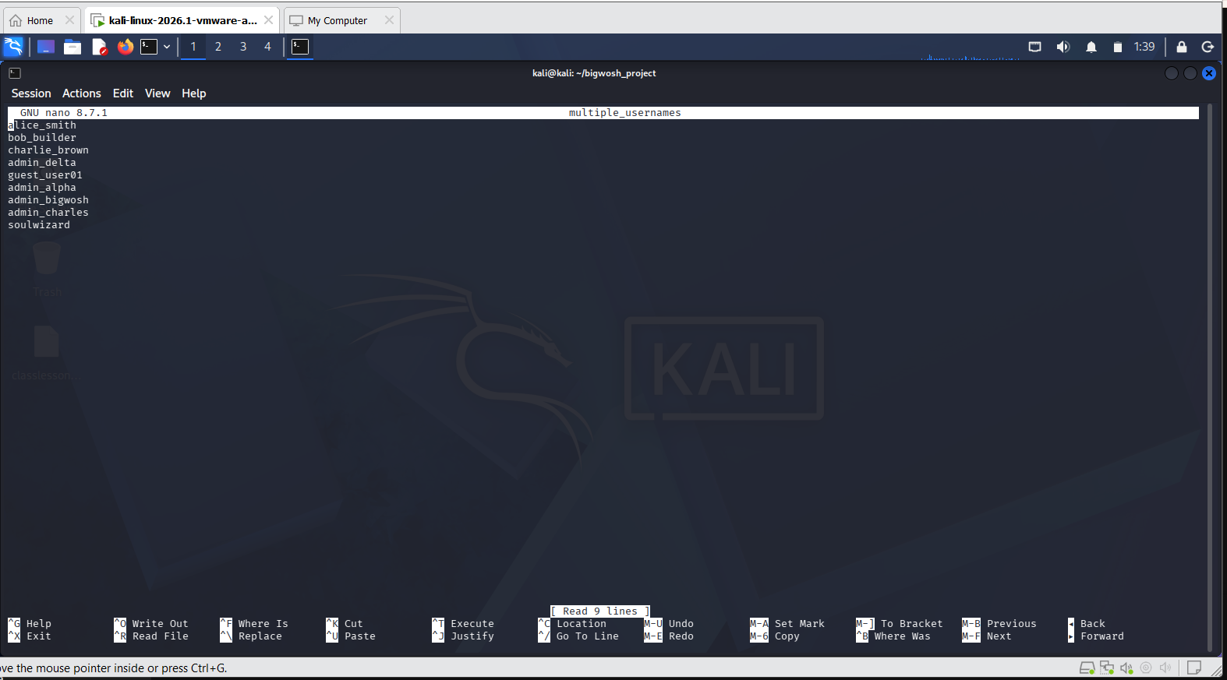
nano multiple_usernames1.txt

Slide 17
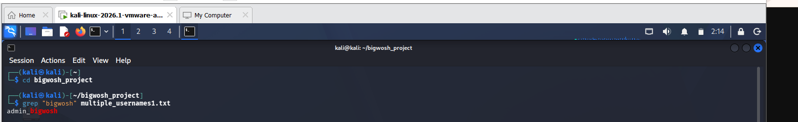
2. Search for a specific username
To search for a specific pattern inside a file, we use grep (globally search for a regular expression and print). Now, let’s look for “bigwosh":

Slide 18
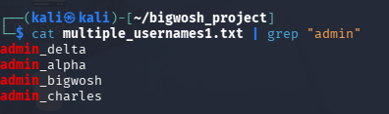
3. Combine commands (Piping)
In Linux, "combining commands" almost always means using the pipe operator (|). it grabs the output of the first command and shoves it directly into the input of the second command.
Approach A: The Classic Pipeline (View and Filter)
Instead of telling grep to read the file directly, you can use cat to output the text and pipe it into grep to filter for any username containing "admin":

Slide 19
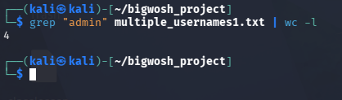
Approach B: The Pro Pipeline (Filter and Count)
If you want to look even sharper, combine grep with wc -l (word count, lines flag) to count exactly how many system admins are in that file:

Slide 20
Task 6 — Searching for Files and Directories
Assignment
1. Create multiple files and folders.
2. Search for a specific file.
3. Search for a specific folder.

Slide 21
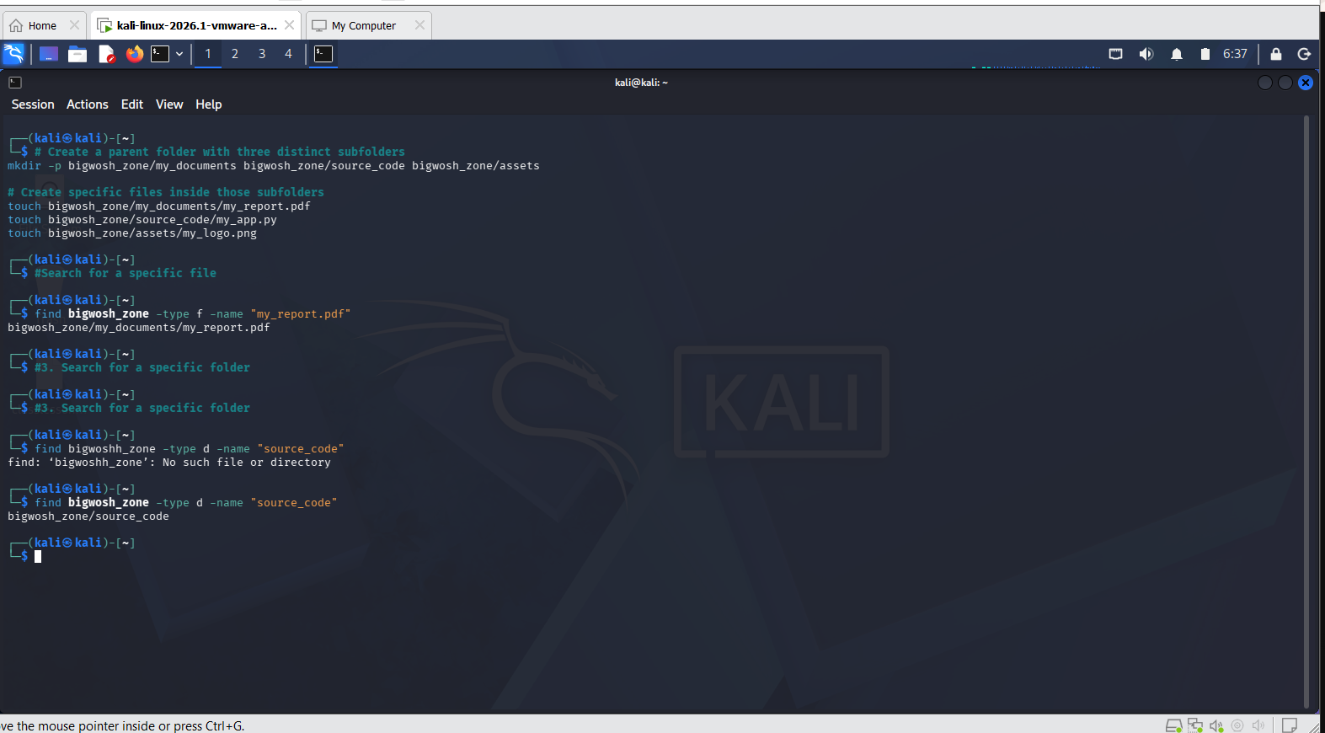
1,2&3

Slide 22
Task 7 — Copying and Moving Files
Assignment
1. Copy a file into another folder.
2. Rename a file.
3. Move a file into another directory.

Slide 23
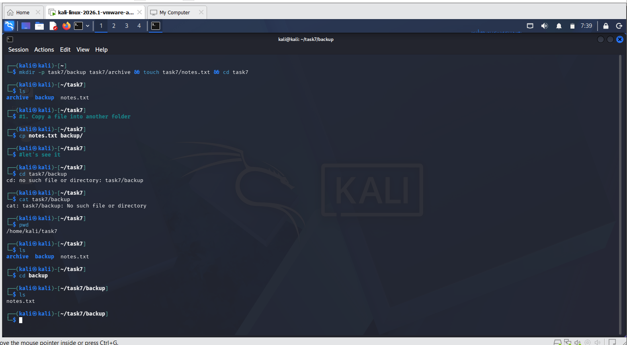
1 cp notes.txt backup/

Slide 24
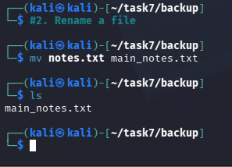
2. Rename a file
In Linux, there is no separate "rename" command. Instead, you use the mv (move) command.
Think of renaming as moving a file from an old name to a new name in the exact same location:
mv notes.txt main_notes.txt

Slide 25
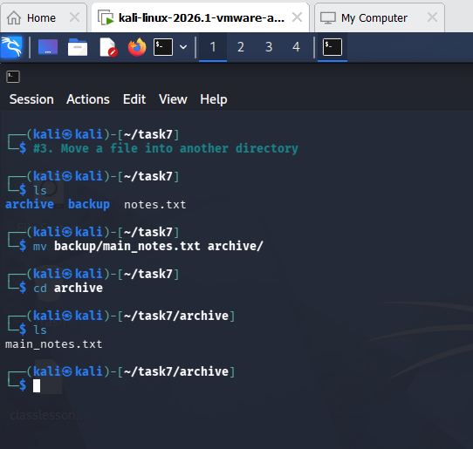
3. Move a file into another directory
We use the exact same mv command to actually relocate a file into a completely different folder.
Again, specify the file first, then the target destination:
mv backup/main_notes.txt archive/

Slide 26
Task 8 — Removing Files and Folders
Assignment
Delete a file.
2. Delete an empty folder.

Slide 27
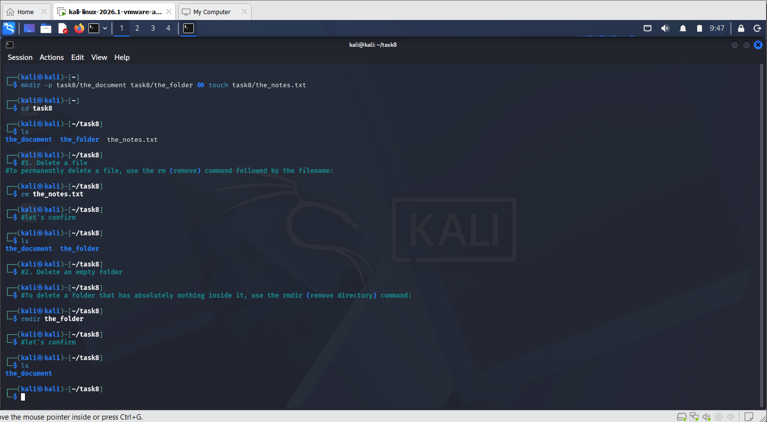
1&2

Slide 28
Task 9 — File Editing
Assignment
1. Create a note using nano.
2. Save the file.
3. Exit the editor.

Slide 29
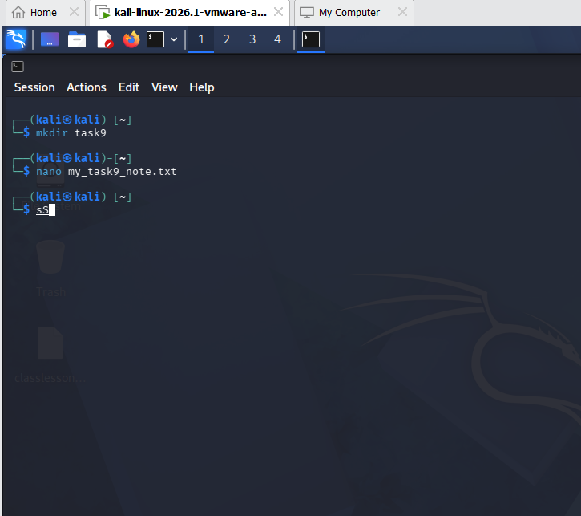
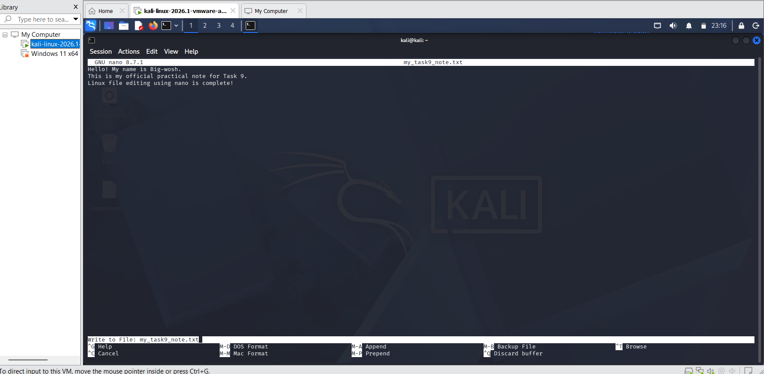
Save the file
Inside nano, you use keyboard shortcuts to save (also called "Writing Out" the file).
Press Ctrl + O (the letter 'O').
Press Enter on your keyboard to confirm.
Exit the editor
Now that your work is safely saved, you can leave the editor and return to your normal command prompt:
Press Ctrl + X.
The workspace will close instantly, and you'll be right back where you started.

Slide 30
Task 10 — File Permissions
Assignment
View its permissions.
2. Create a file.
3. Change the permissions.
4. Verify the changes.

Slide 31
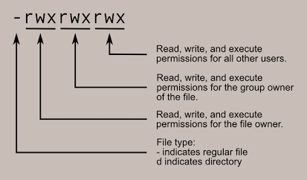
Understanding file permissions trips up a lot of people because the output looks like a random string of dashes and letters. To make this task easy, we will use the chmod (change mode) command.
Before we start, keep this visual reference in mind when looking at your terminal output:
Linux Permission Structure Breakdown

Slide 32
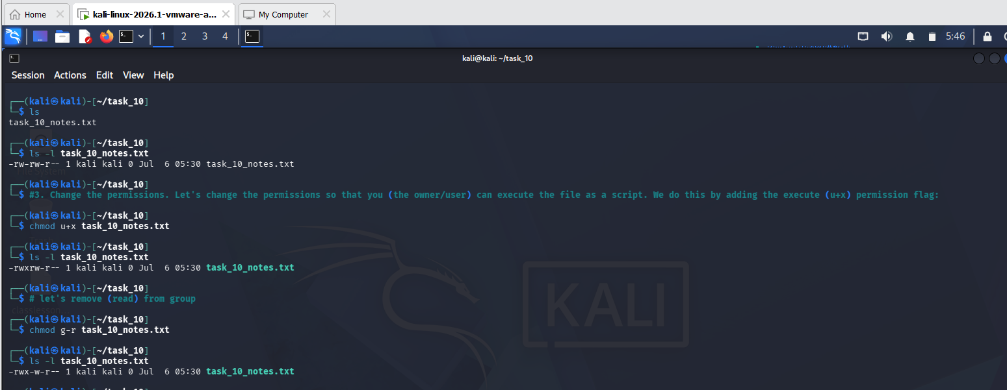
1,2,3&4 chmod g+w filename.txt chmod g-r filename.txt chmod g-r filename.txt
# Add execute to the user, add write to the group, and strip all rights from others chmod u+x,g+w,o-rwx filename.txt
You can also target multiple categories with the same permission at once. For example,
to give both the user and the group execute permissions:
chmod ug+x filename.txt

Slide 33
Task 11 — Manual Pages
Assignment
Open the manual page for ls.
2. Open the manual page for grep.
3. Identify at least one option from each command.

Slide 34
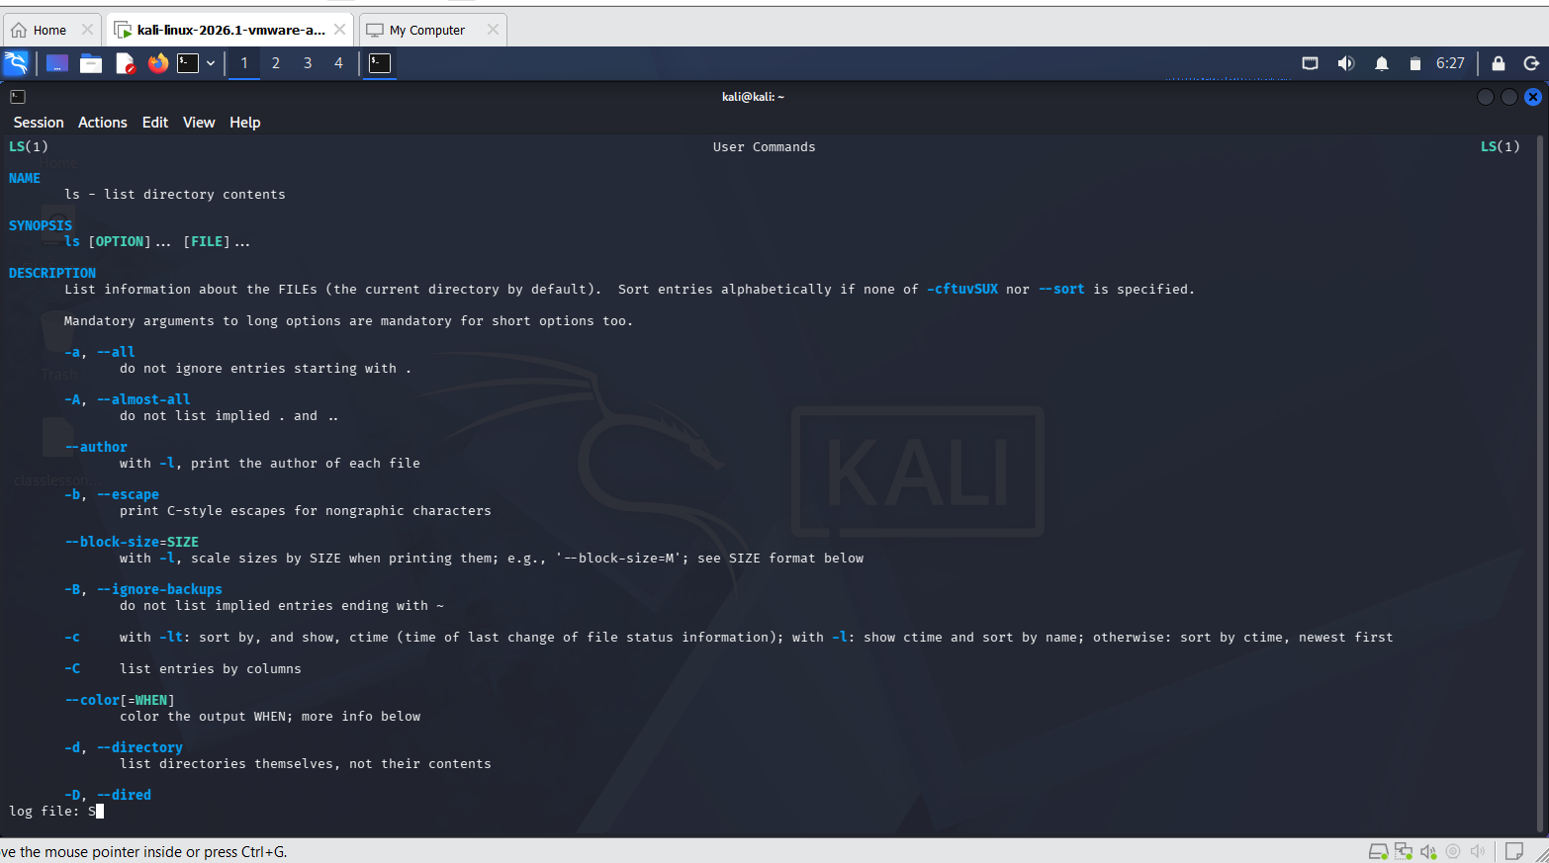
1. Open the manual page for ls
To view the official system manual and documentation for the list command, run: man ls press “q” to quit and it goes back to the previous page

Slide 35
What man ls Is All About
Everyone learns ls on day one to see their files. But man ls shows you that ls is actually a highly powerful formatting tool.
The manual explains how to change how files are displayed, sorted, and filtered. For example, if you open it, you discover hidden switches to:
Sort files by size so the biggest files appear at the top.
Sort files by the exact second they were last modified (great for finding a file you just downloaded).
Display files in a comma-separated list instead of columns.
In short: man ls is about moving from "just looking at files" to organizing and filtering how you view your filesystem.

Slide 36
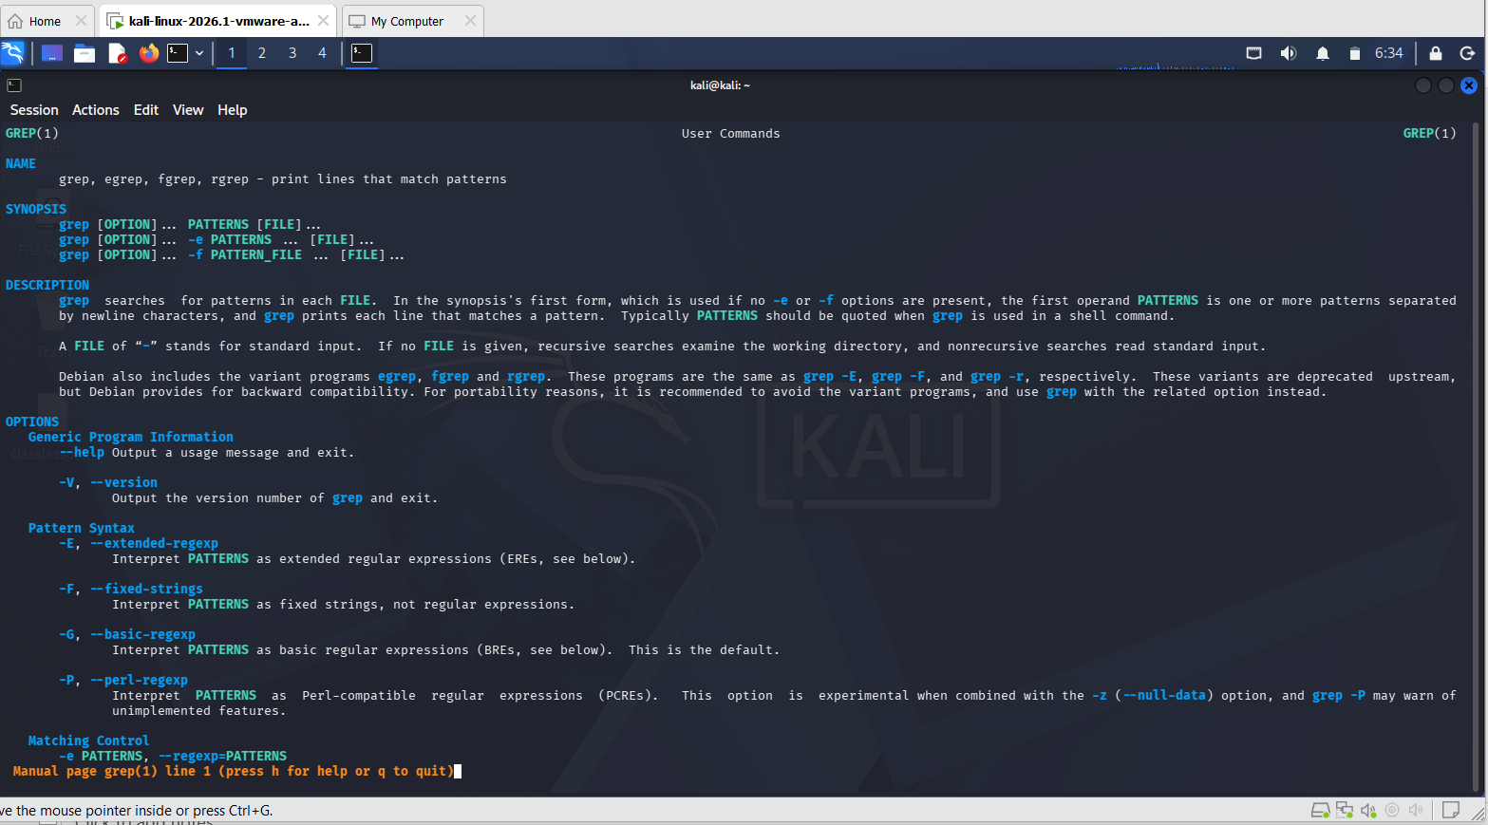
2. Open the manual page for grep
To view the comprehensive documentation for the global regular expression search tool, run: man grep press “q” to quit and go backto the previous page

Slide 37
What man grep is about.
grep is one of the most powerful tools in all of Linux, and its manual page is legendary because it reads almost like a mini programming guide.
Because grep is used to hunt down text inside massive data streams, man grep explains all the deep logic switches available to you. By reading it, you learn how to:
Search not just one file, but a whole directory tree of thousands of files at once (Recursive search).
Invert your search (show me every single line except lines containing the word "error").
Count occurrences of a word across multiple system logs without actually opening the files.
Why developers use man instead of Googling
While Google is great, the man pages have three massive advantages:
Version Accuracy: They show you exactly how the tool behaves on your specific machine right now, not an updated version someone wrote about on a blog.
No Internet Required: If you are working on a secure server or an offline data center, man is always there.
The Hidden Feature: Inside any manual page, you can press the forward slash key (/), type a keyword, and hit Enter to instantly search inside the instruction manual itself!

Slide 38
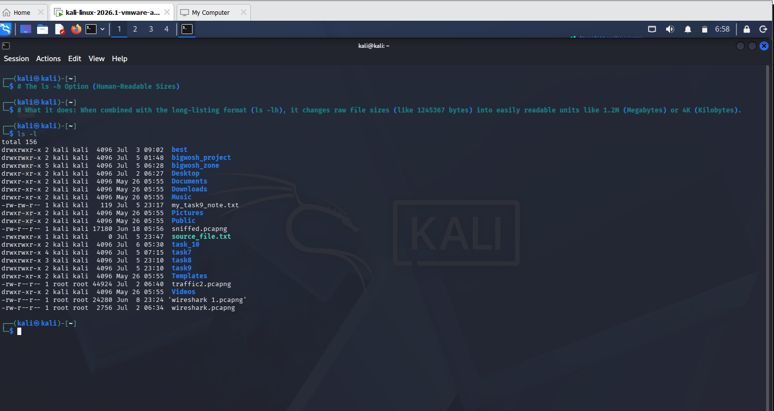
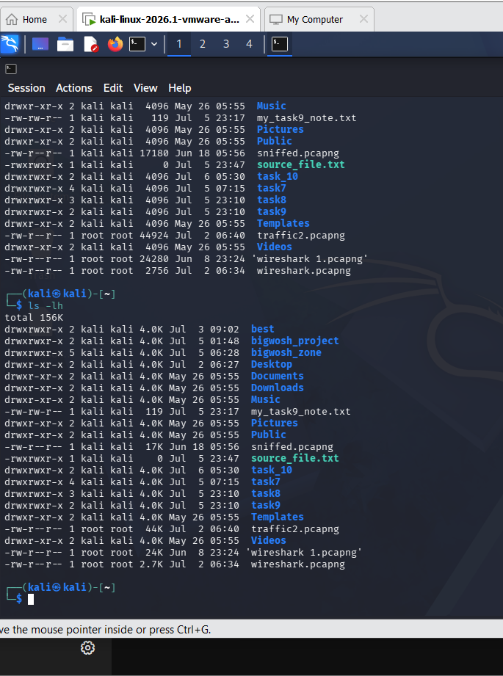
3. Identify at least one option from each command.
The ls -h Option (Human-Readable Sizes)

Slide 39
For grep: The grep -i Option (Ignore Case-Sensitivity)
Linux is fiercely case-sensitive. If you use standard grep to search for the word "admin", it will completely skip over lines that contain "Admin" or "ADMIN". If you are looking through system logs for errors, missing a capitalized word could be disastrous.
The Fix
The -i flag forces grep to ignore case completely. It treats uppercase and lowercase letters exactly the same.
See it in the next slide →→

Slide 40
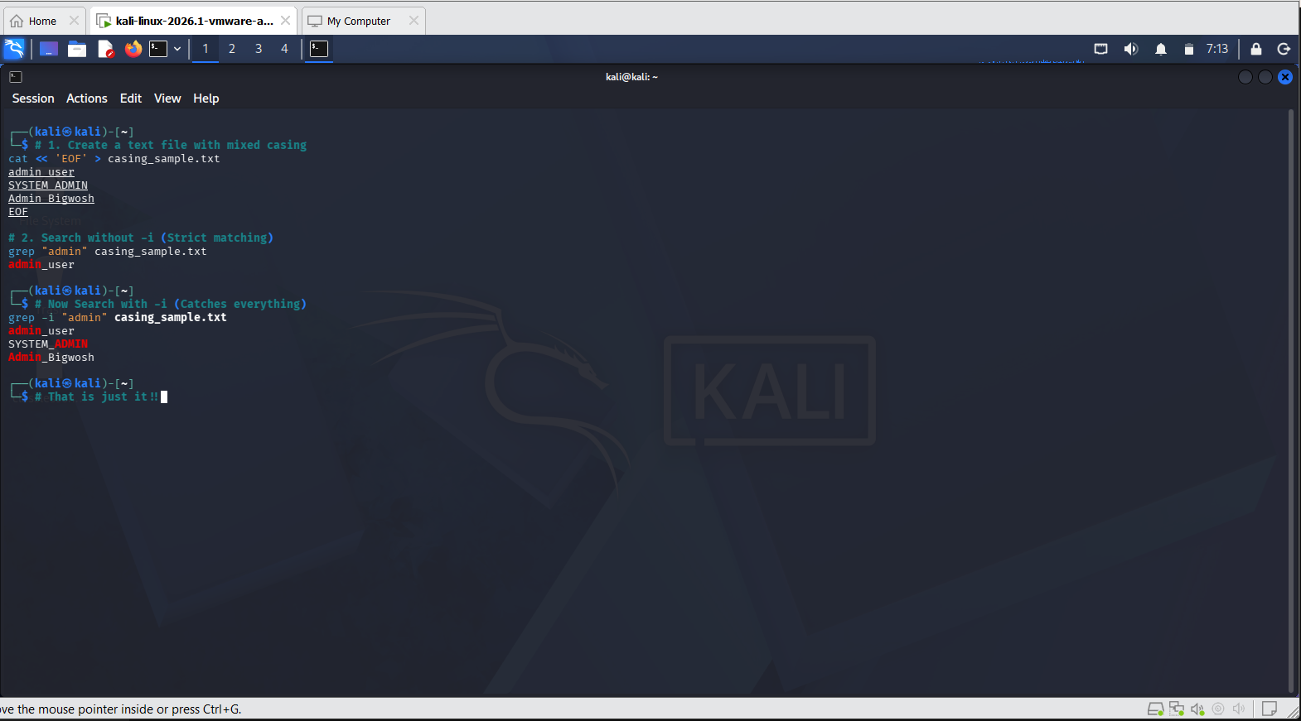

Slide 41
SECTION 2 — SQL PRACTICAL ASSIGNMENT
Task 1 — Display Records
Assignment
Display all records from a table.

Slide 42
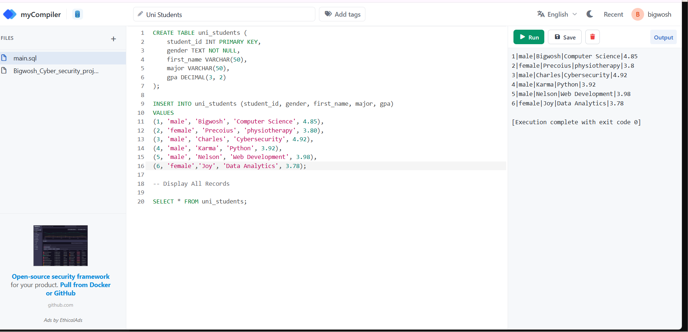

Slide 43
Task 2 — Display Specific Columns
Assignment
Display selected columns from a table.

Slide 44
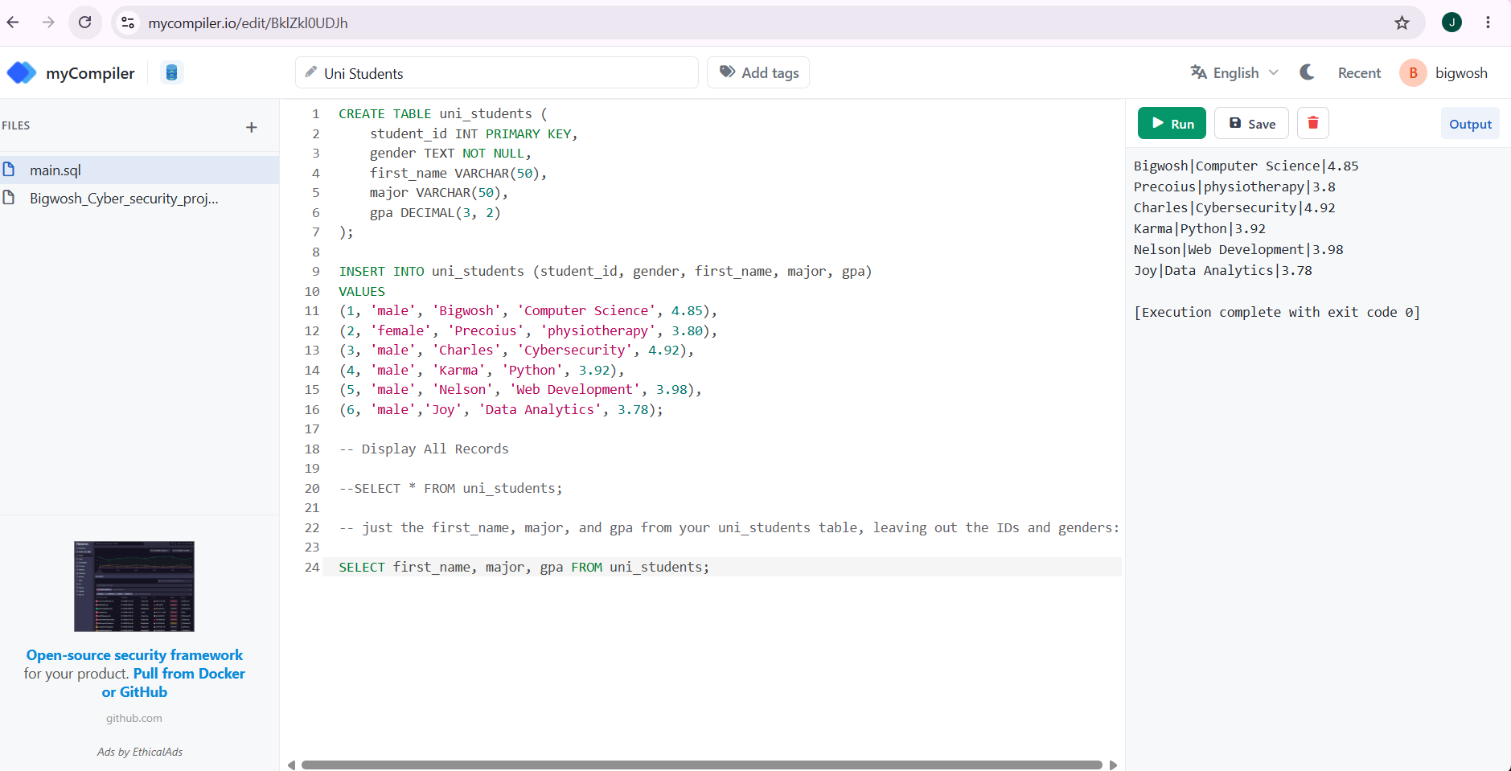
just the first_name, major, and gpa from uni_students table, leaving out the IDs and genders:

Slide 45
Task 3 — Describe a Table
Assignment
Display the structure of a table.

Slide 46
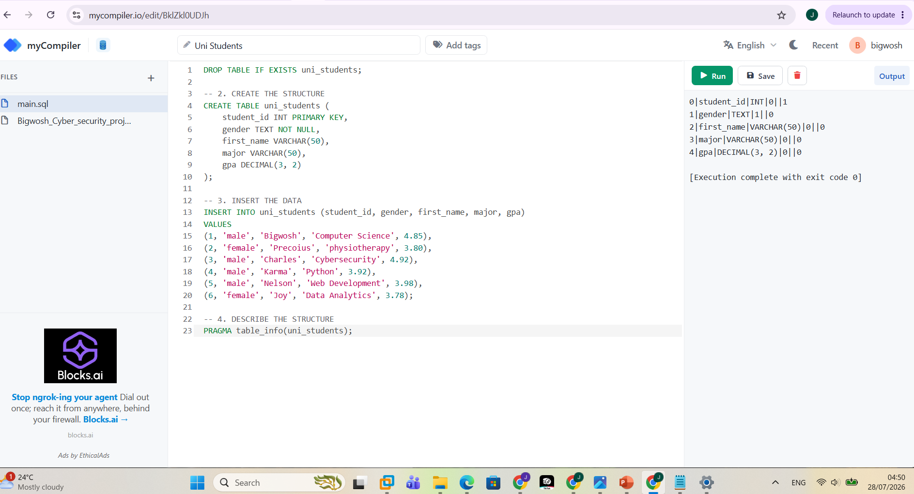
DESCRIBE THE STRUCTURE
PRAGMA table_info(uni_students);

Slide 47
Task 4 — Filtering Records
Assignment
1. Display records greater than a value.
2. Display records equal to a value.
3. Display records less than a value.

Slide 48
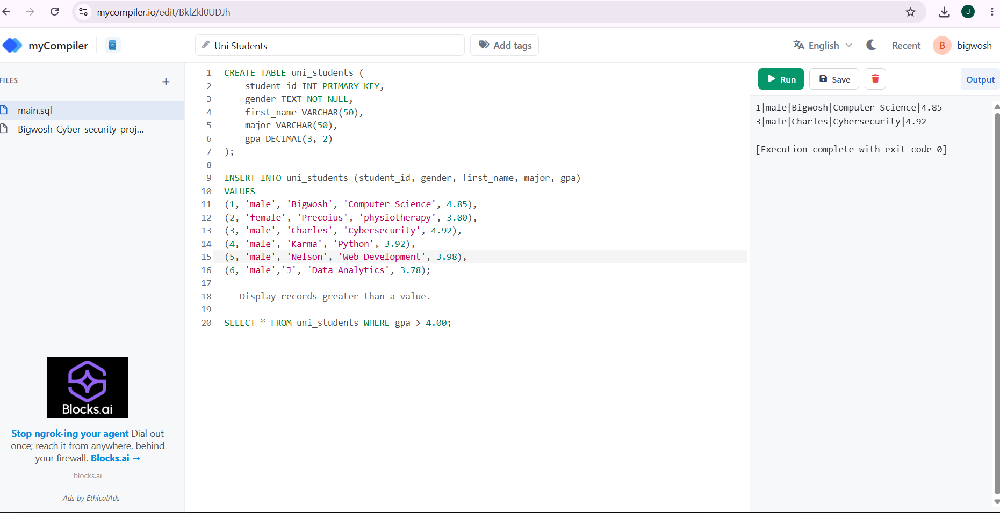
1. Display records greater than a value (>)
This query filters out anyone with a GPA lower than or equal to 4.00, showing only your top-performing students.

Slide 49
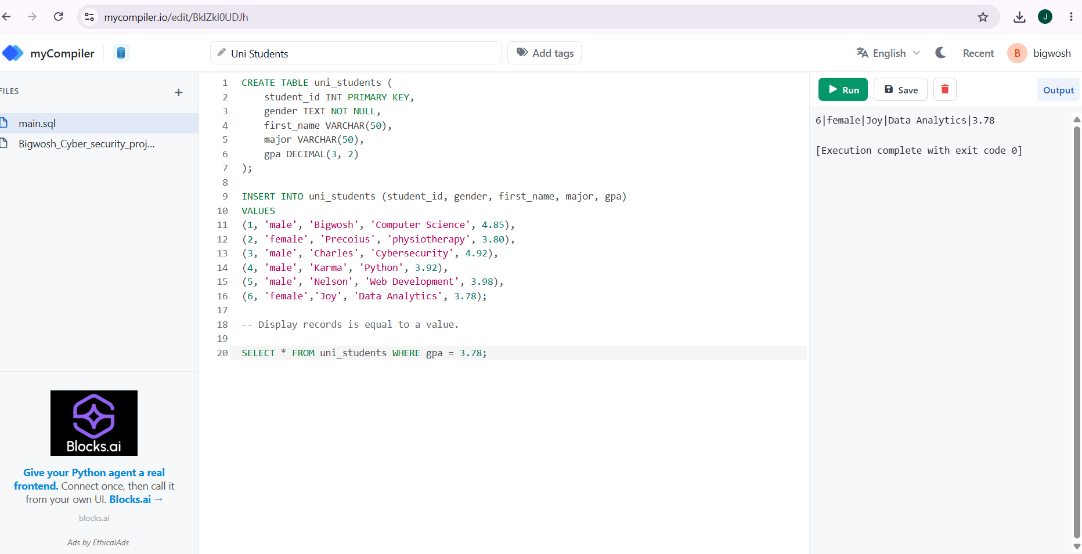
2. Display records equal to a value (=)
This query looks for an exact match. Let's pull up the record for the exact GPA of 3.78.

Slide 50
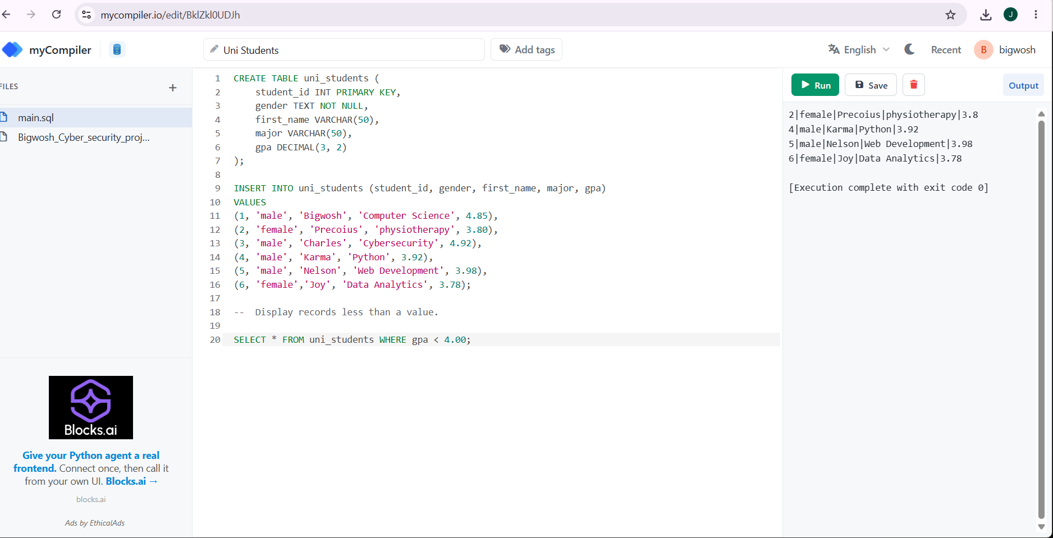
3. Display records less than a value (<)
This query finds all students whose GPA falls below the 4.00 threshold.

Slide 51
Task 5
Assignment
Display records matching multiple conditions.

Slide 52
AND and OR
To handle multiple conditions in SQL, I expanded my WHERE clause using logical operators. The two most important operators are AND and OR.
AND: Requires both conditions to be completely true for a row to show up.
OR: Requires at least one of the conditions to be true.
Here is how I applied both to my uni_students table. →

Slide 53
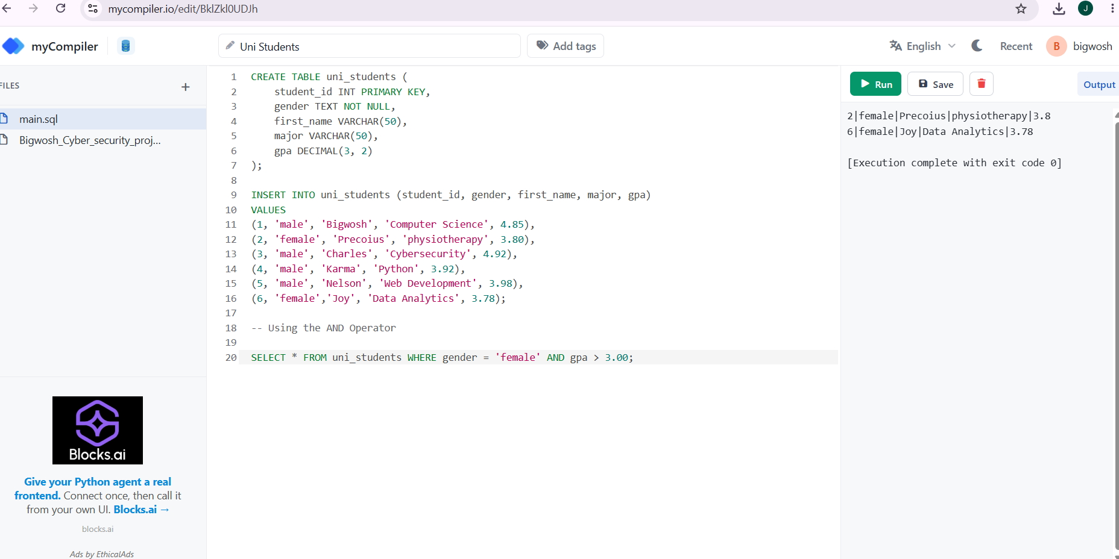
Using the AND Operator
As you can see, the gender is ‘female’ and the gpa is > 3.00. So, it displayed the result upon running it.

Slide 54
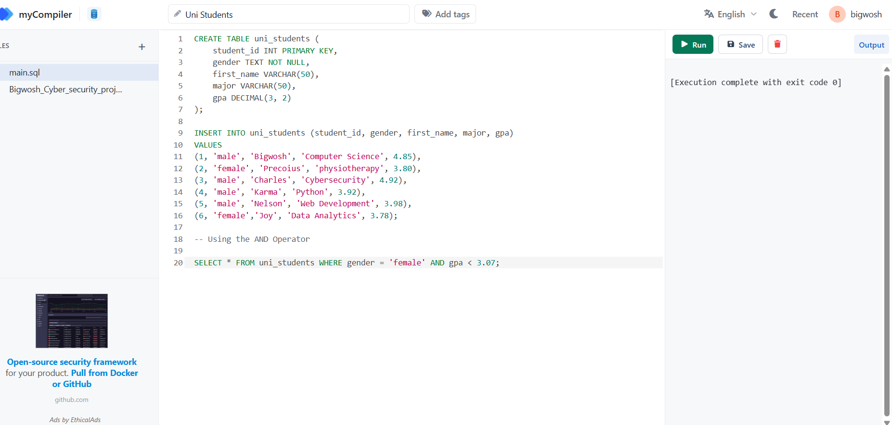
Using the AND Operator
No result showed because one is correct and the other isn’t, by using AND operator, both must be correct.
There is a gender ‘female’ but, there is no gpa < 3.07

Slide 55
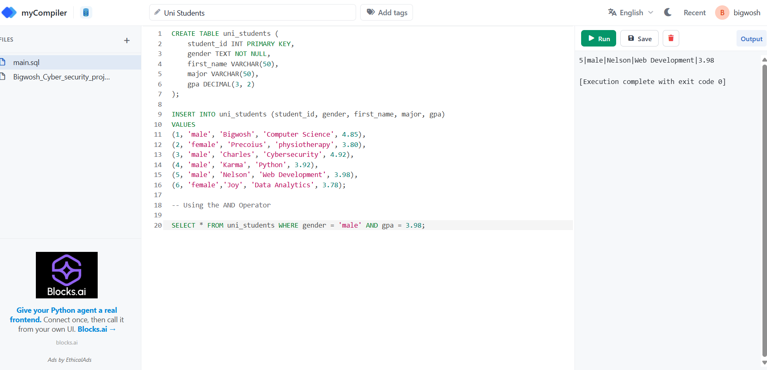
Using the AND Operator
Here, there is a match and it showed the result upon running it.

Slide 56
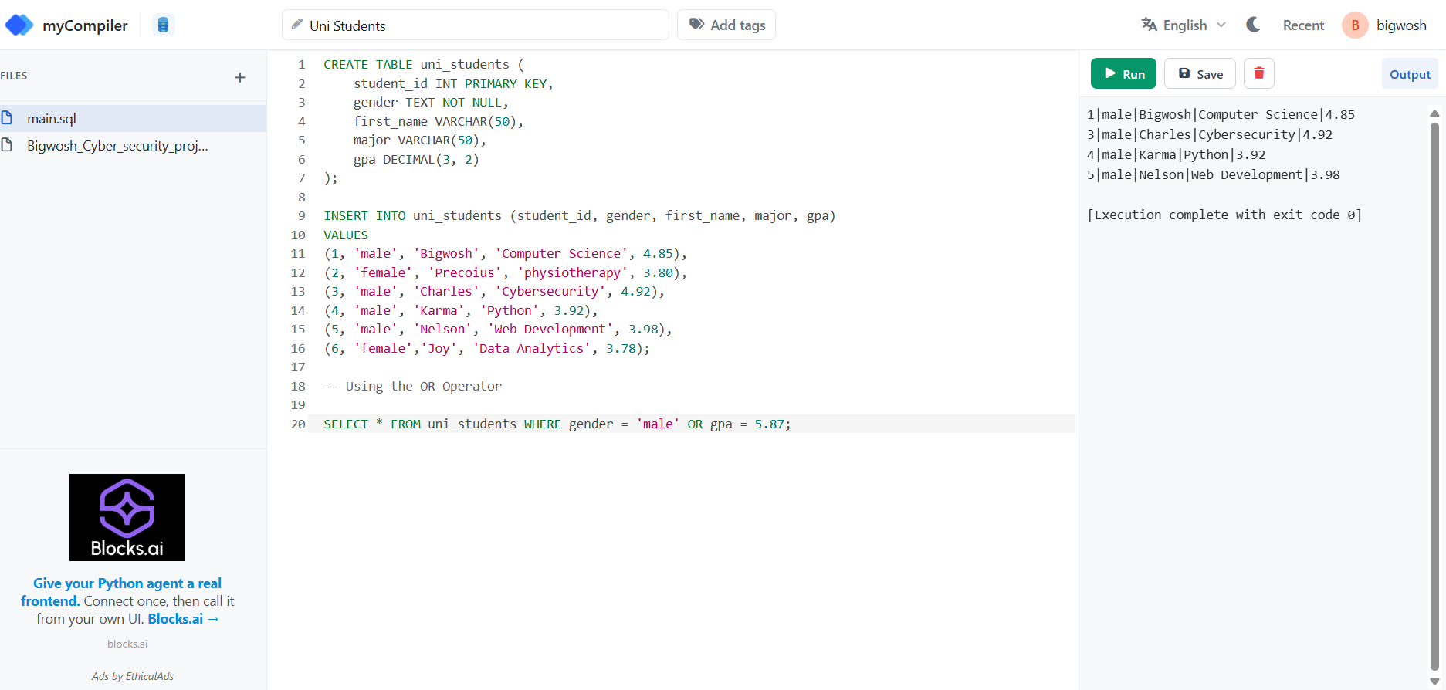
Using the OR Operator
Here, if one is correct and the other isn’t is would work because of the OR operator.
There is a gender ‘male’ but there is no gpa that is = 5.87. So, it worked and displayed the result.

Slide 57
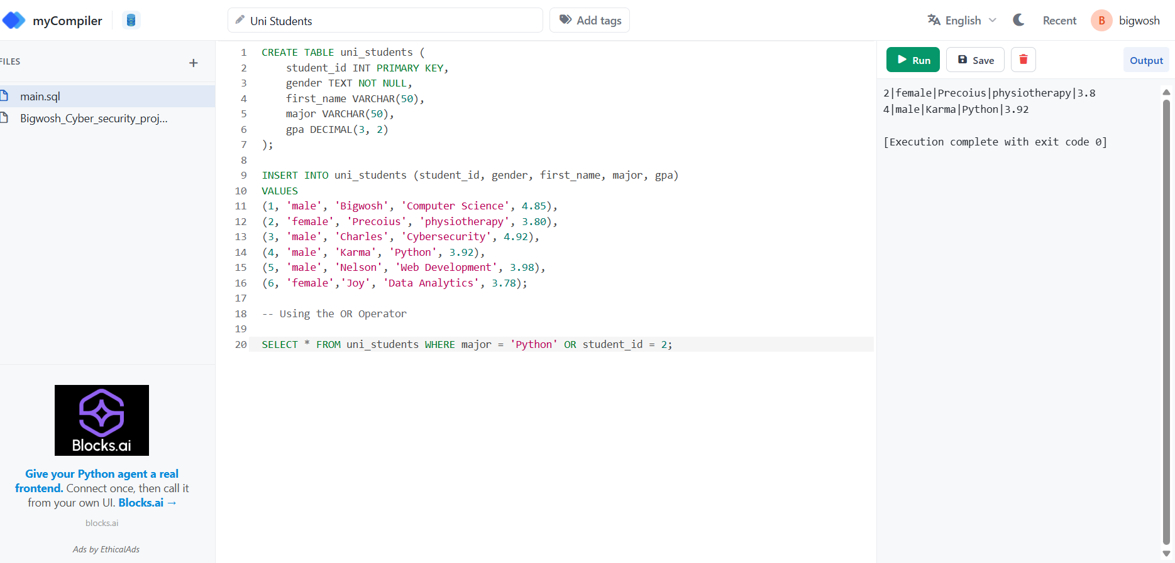
Using the OR Operator
Same thing here, it showed the result of the specified major and the specified ID found in the table.

Slide 58
Task 6
Assignment
Display records matching either of two conditions.

Slide 59
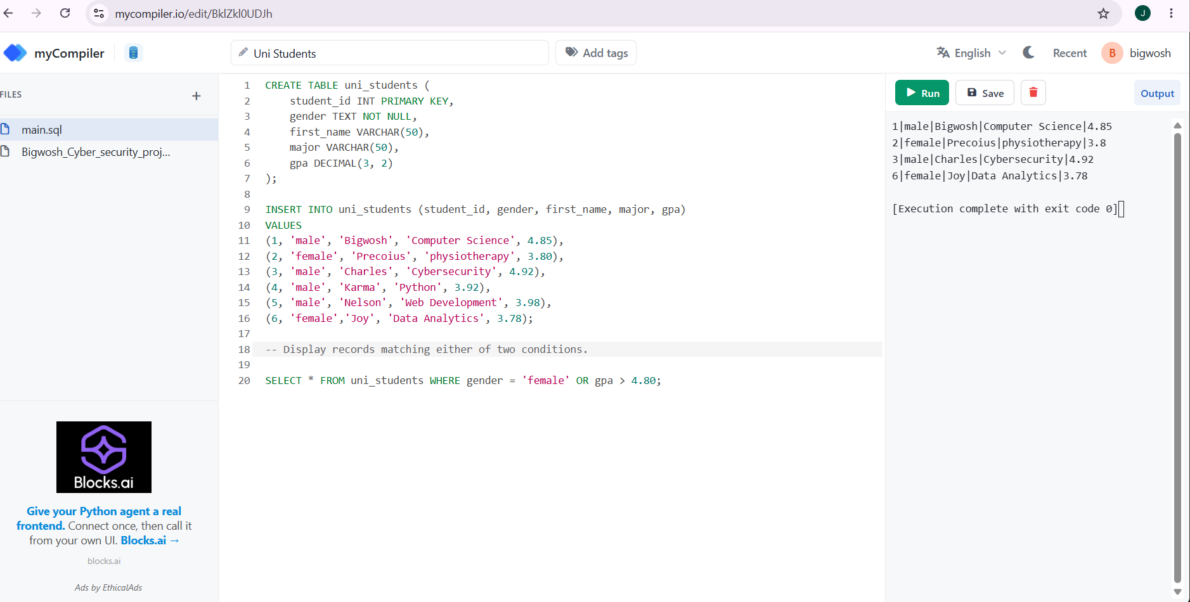
Display records matching either of two conditions.

Slide 60
Using: SELECT * FROM uni_students WHERE gender = 'female' OR gpa > 4.80;
The database engine scans the table like a checklist. Here is exactly why certain rows make the cut:
Bigwosh: Is he female? No. Is his GPA > 4.80? Yes (4.85). (MATCH — Included)
Precoius: Is she female? Yes. (MATCH — Included immediately, SQL doesn't even need to check her GPA)
Charles: Is he female? No. Is his GPA > 4.80? Yes (4.92). (MATCH — Included)
Karma & Nelson: Are they female? No. Are their GPAs > 4.80? No. (FAILED — Hidden)
Joy: Is she female? Yes. (MATCH — Included)

Slide 61
Task 7
Assignment
Display records excluding a condition.

Slide 62
Not equal to
To exclude a specific condition in SQL, you tell the database to look for everything except a particular value. You do this using the Not Equal To operator, which can be written in two ways depending on your preference:
!= (Most common in modern programming)
<> (The traditional SQL standard)
Alternatively, you can use the NOT keyword before a condition. Let's look at how to apply this to the uni_students table for Task 7 →

Slide 63
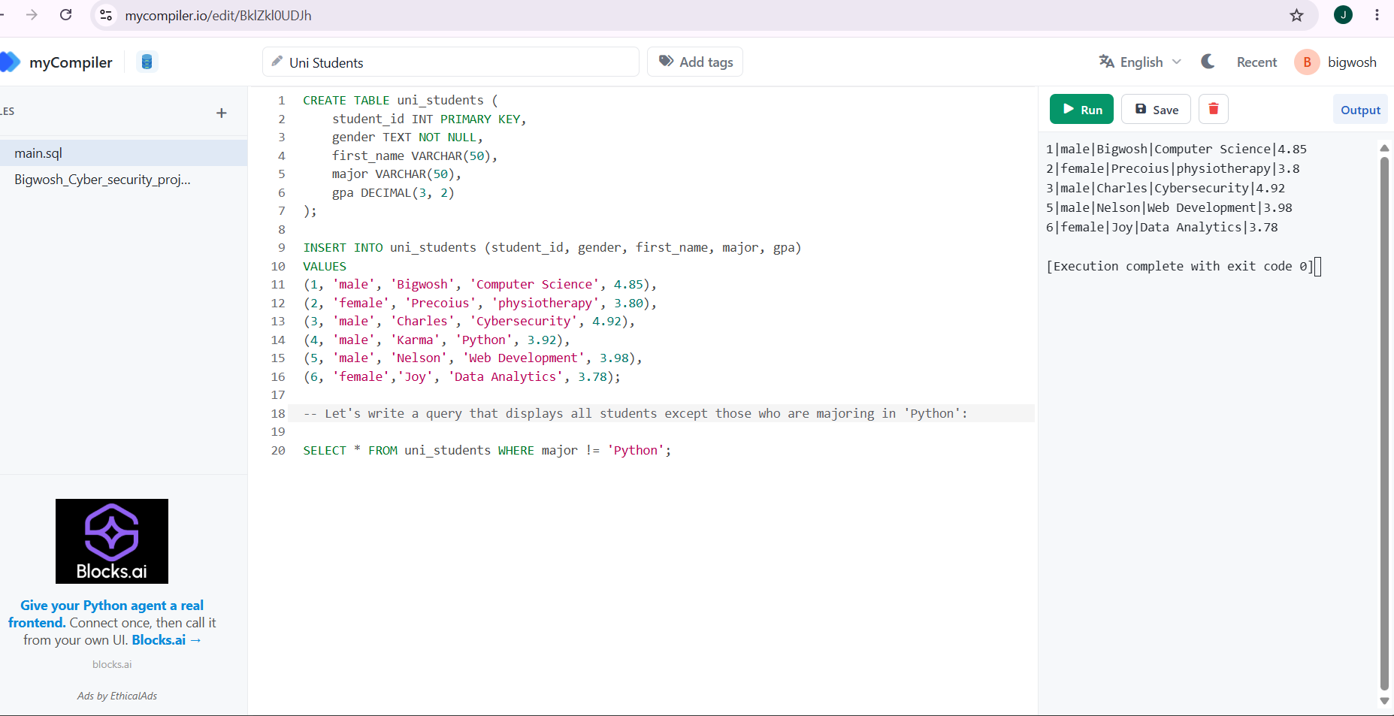
Let's display all students except those who are majoring in 'Python’: using (!=)

Slide 64
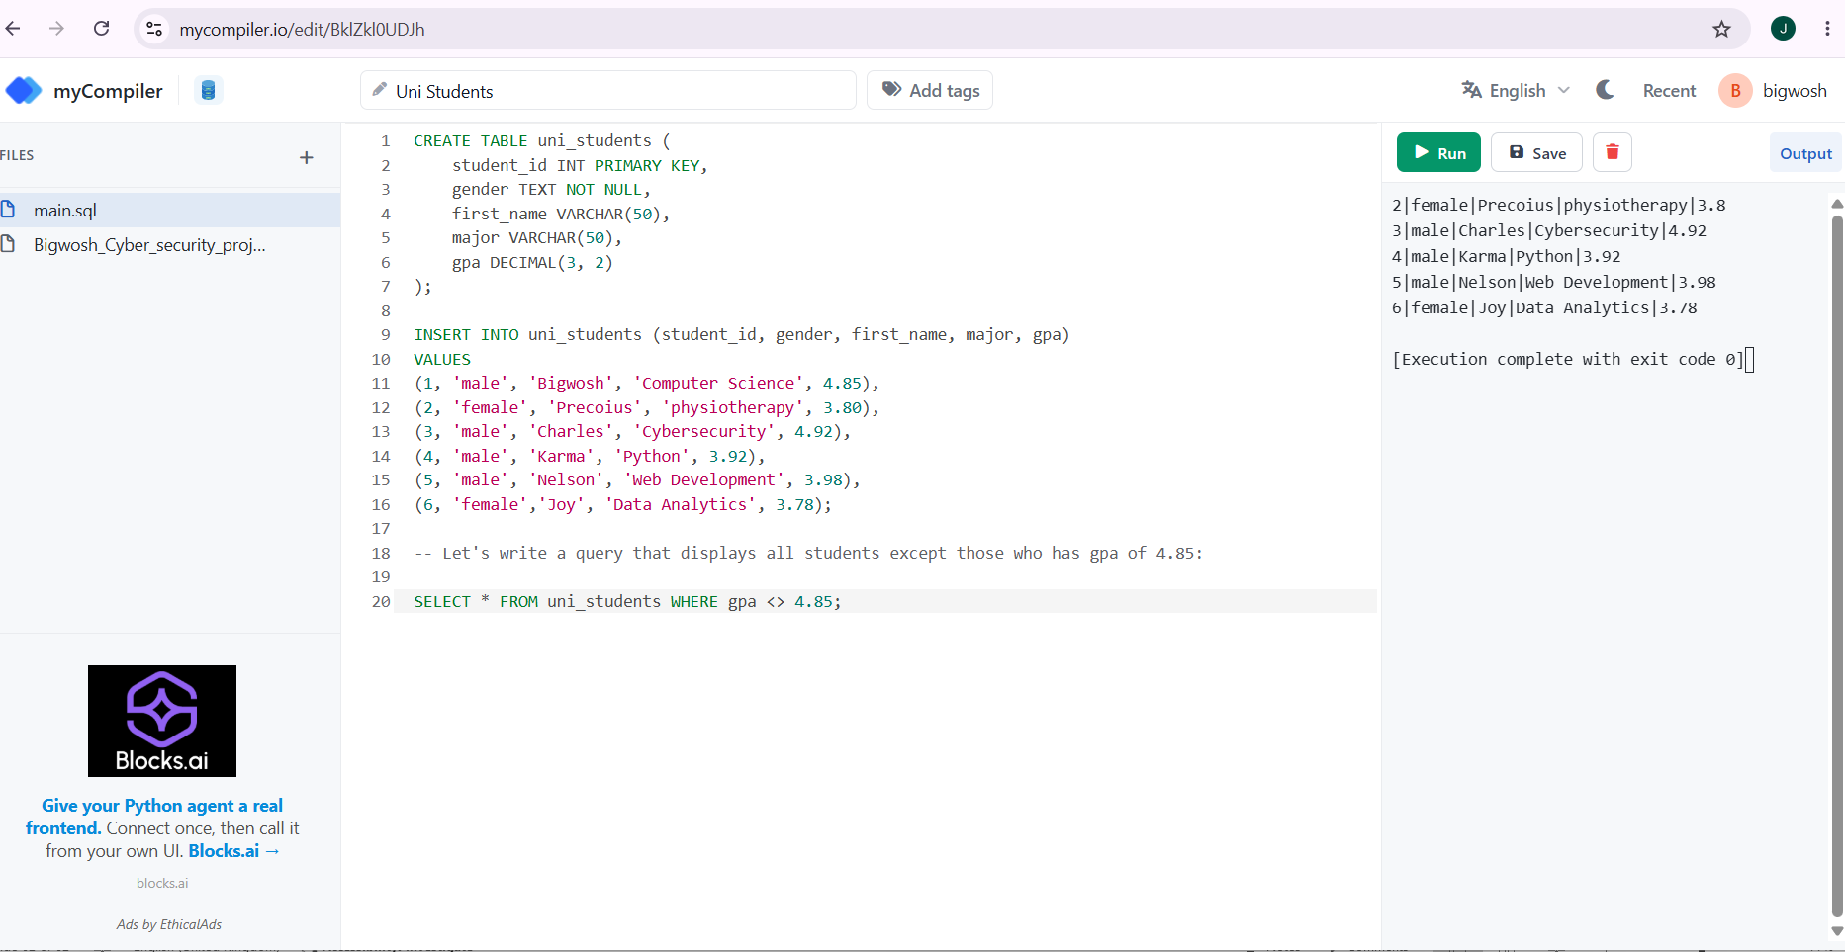
Using <>
It exempted the student who has the gpa of 4.85

Slide 65
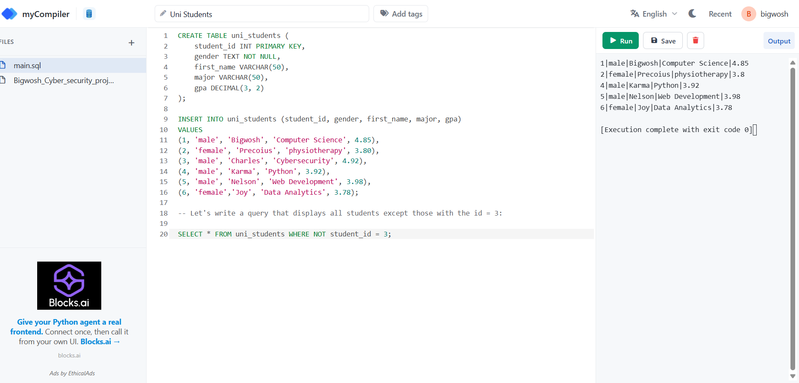
Using NOT
It displayed all except the student with the ID = 3

Slide 66
SECTION 3 — WIRESHARK PRACTICAL
Task 1
ASSIGNMENT
Packet Capture

Slide 67
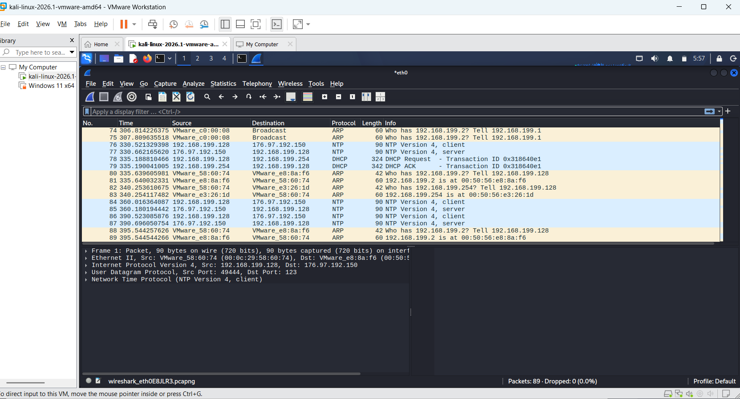
Packet capturing

Slide 68
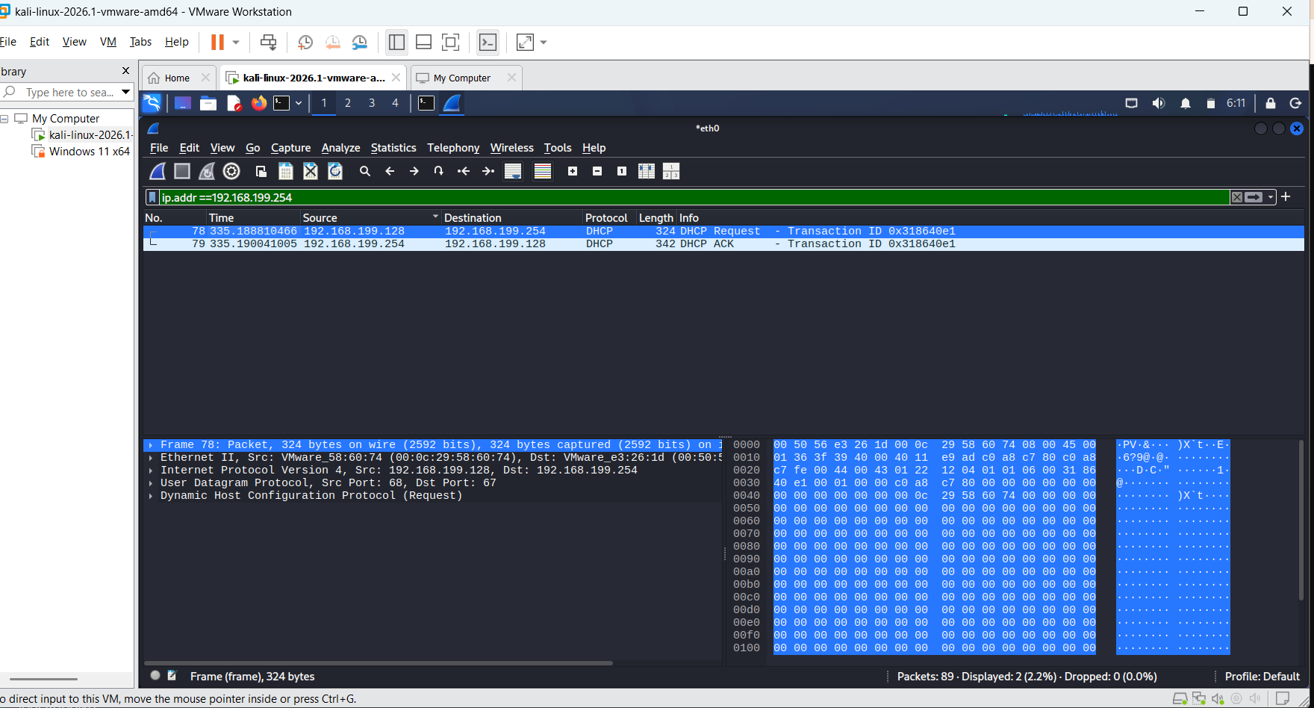
Task 2
Ip address filtering

Slide 69
Task 3 — Protocol Filtering
Assignment
Filter TCP traffic.
2. Filter DNS traffic.
3. Filter HTTP traffic.

Slide 70
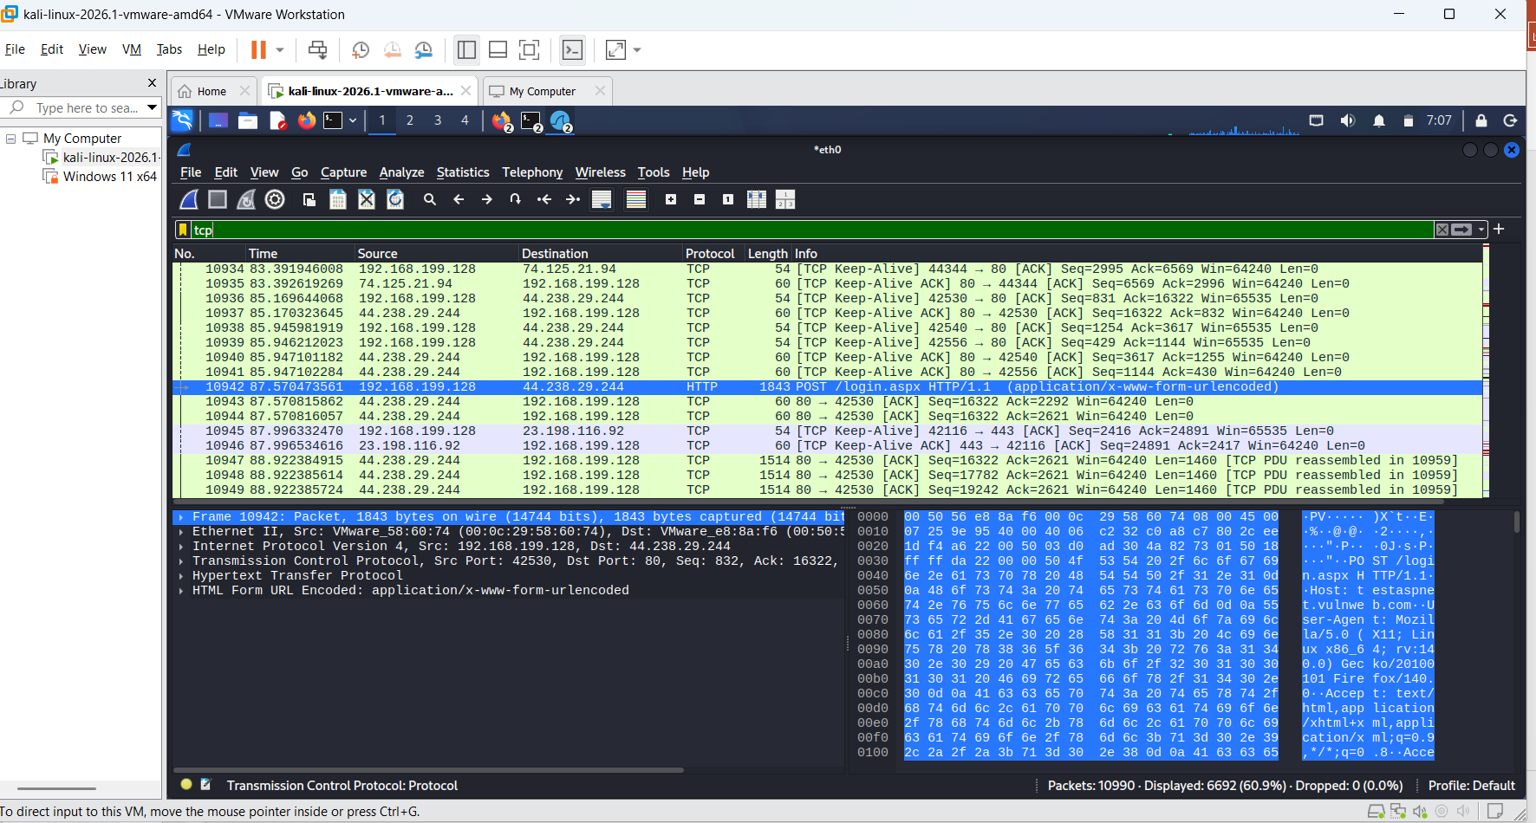
1. Filter tcp traffic

Slide 71
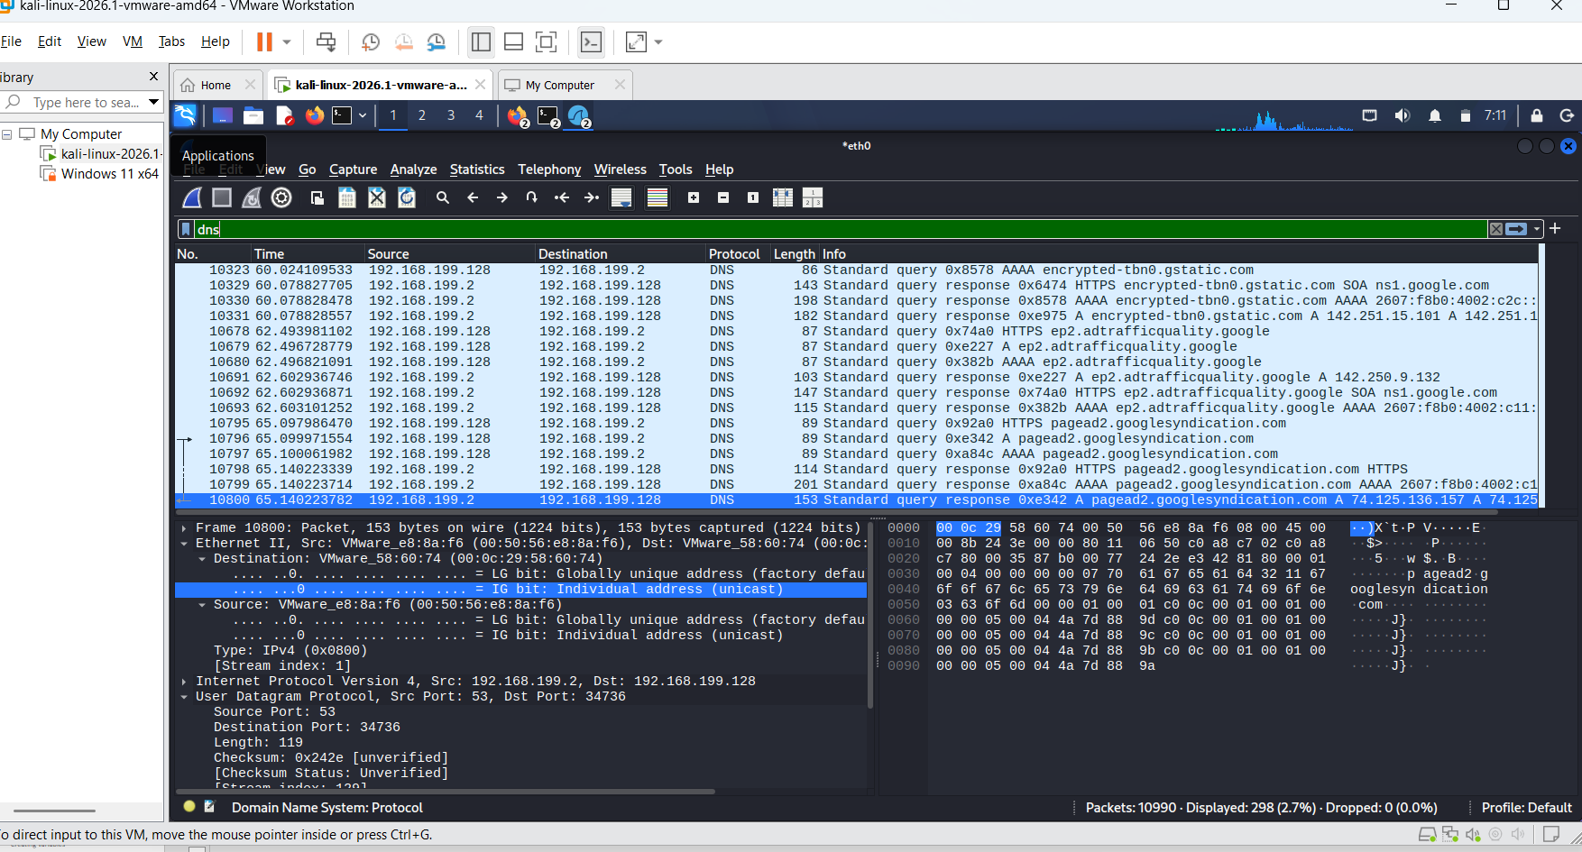
2. Filtering dns

Slide 72
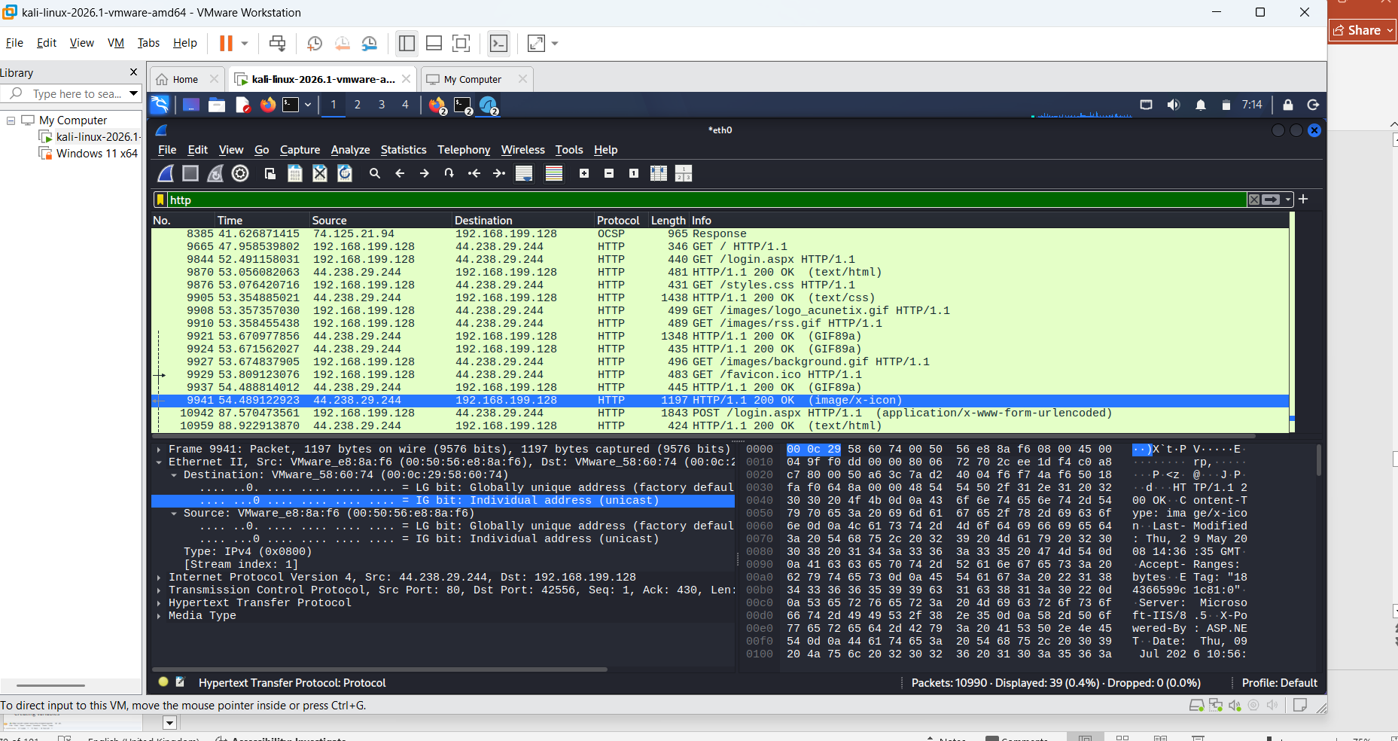
3. Filtering http

Slide 73
Task 4 — MAC Address Filtering
Assignment
Filter packets using a MAC address.

Slide 74
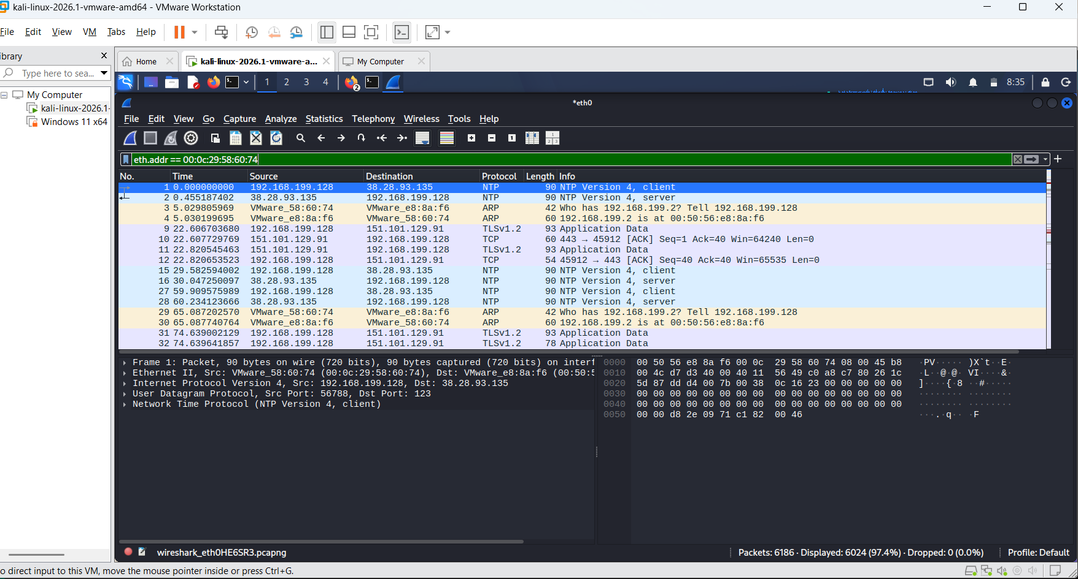
Task 4 — MAC Address Filtering

Slide 75
SECTION 4 — TCPDUMP PRACTICAL
Task 1 — Packet Capture
Assignment
Capture packets using tcpdump.

Slide 76
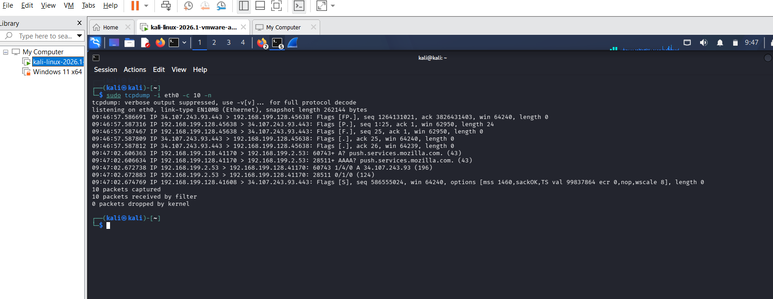
Breakdown of the flags: sudo: Required to run tcpdump, as packet sniffing requires administrative privileges.
-i <interface_name>: Specifies the network interface to listen on.
-c 10: Limits the capture to 10 packets (so your terminal doesn't overflow).
-n: Prevents the tool from trying to resolve IP addresses to domain names (which makes the capture faster and clearer). sudo tcpdump -i eth0 -c 10 -n

Slide 77
Task 2 — Interface Capture
Assignment
Capture traffic on a specific interface.

Slide 78
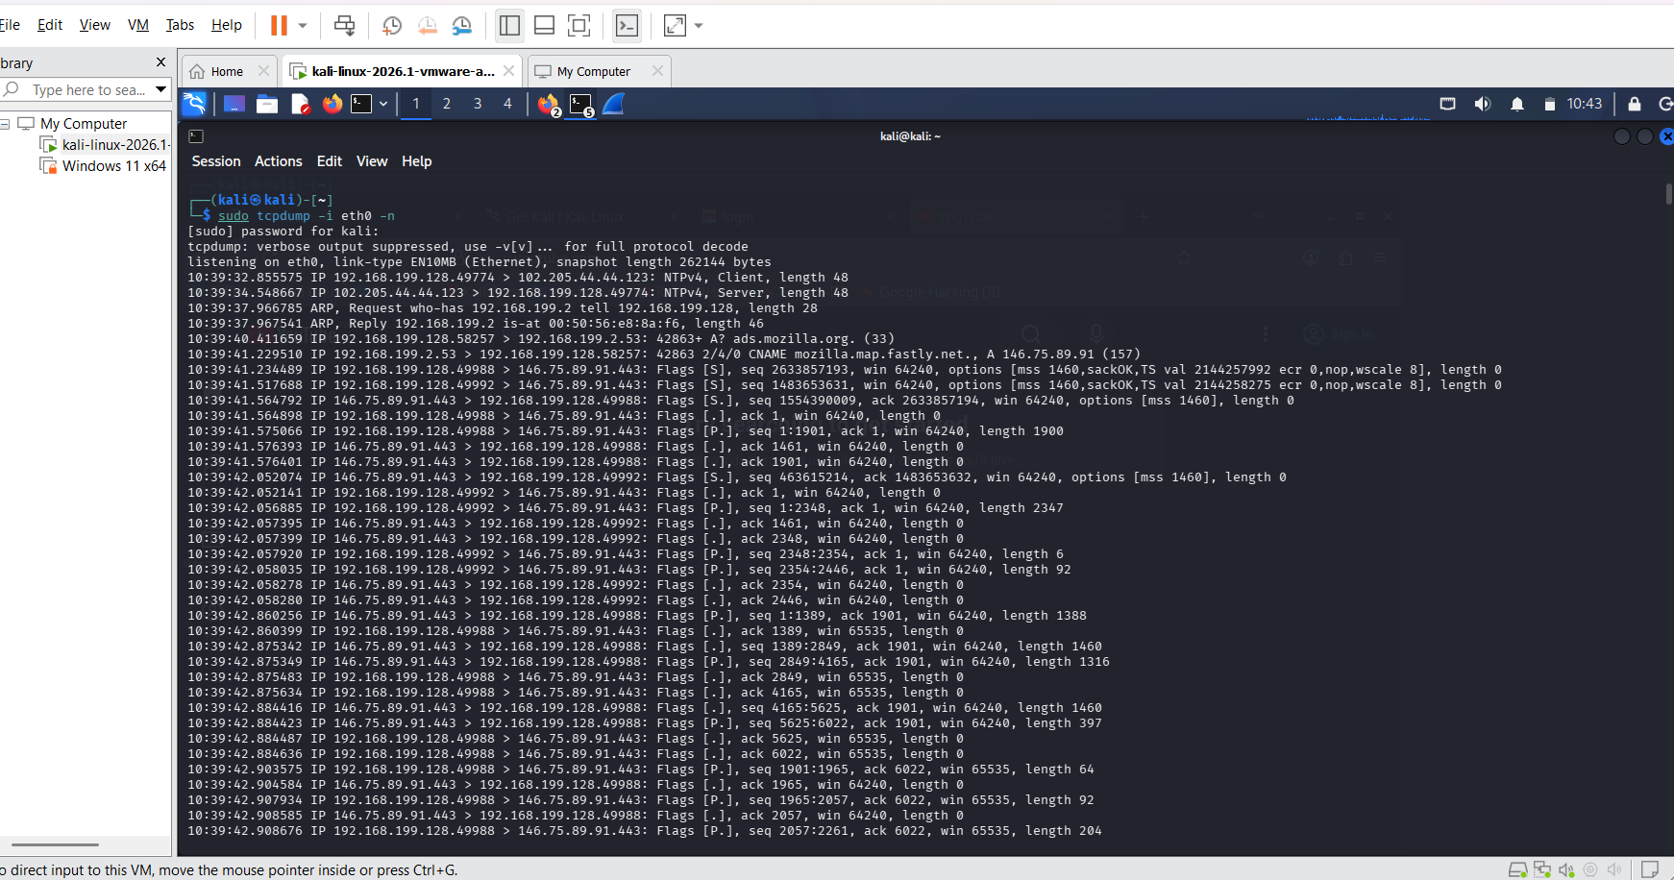
The reason task 1 and task 2 feel like the same task is because, in a real-world scenario, you rarely capture packets without specifying an interface, so they are often taught back-to-back.
I decided not to capture only 10, and that is why I removed the from the code. Instead of sudo tcpdump -i eth0 -c 10 –n , I used sudo tcpdump -i eth0 –n .
If I wnat toi save it ], I would use: sudo tcpdump -i eth0 -w lab_capture.pcap

Slide 79
Task 3 — IP Address Filtering
Assignment
Capture traffic from a specific IP address.
save the captured file and open it using wireshark

Slide 80
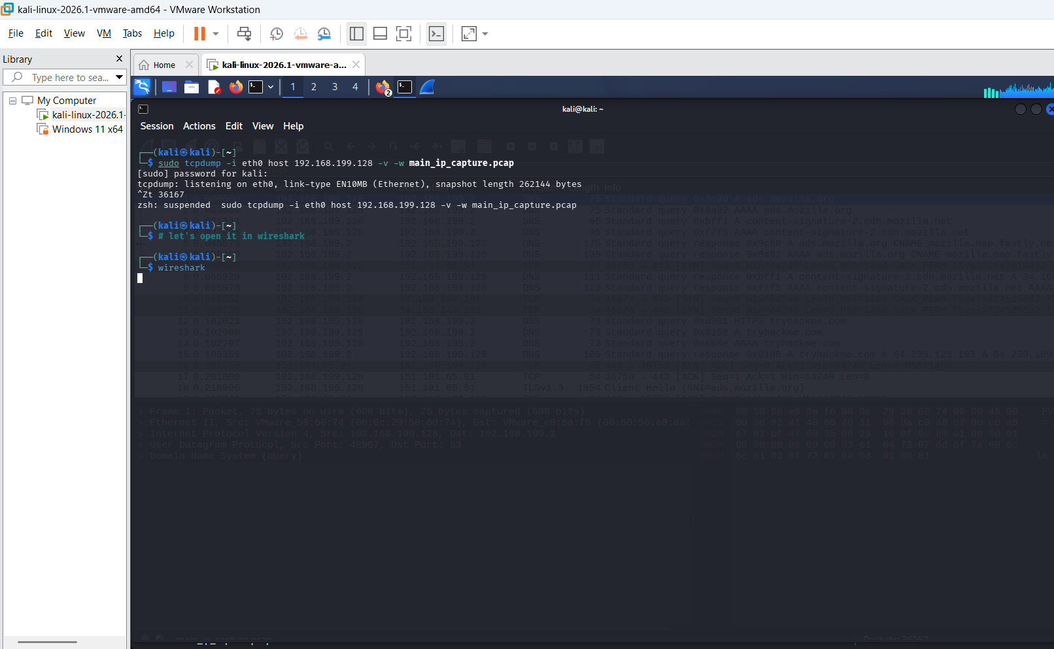
Capturing traffic from a specific IP address, and saving the captured file.

Slide 81
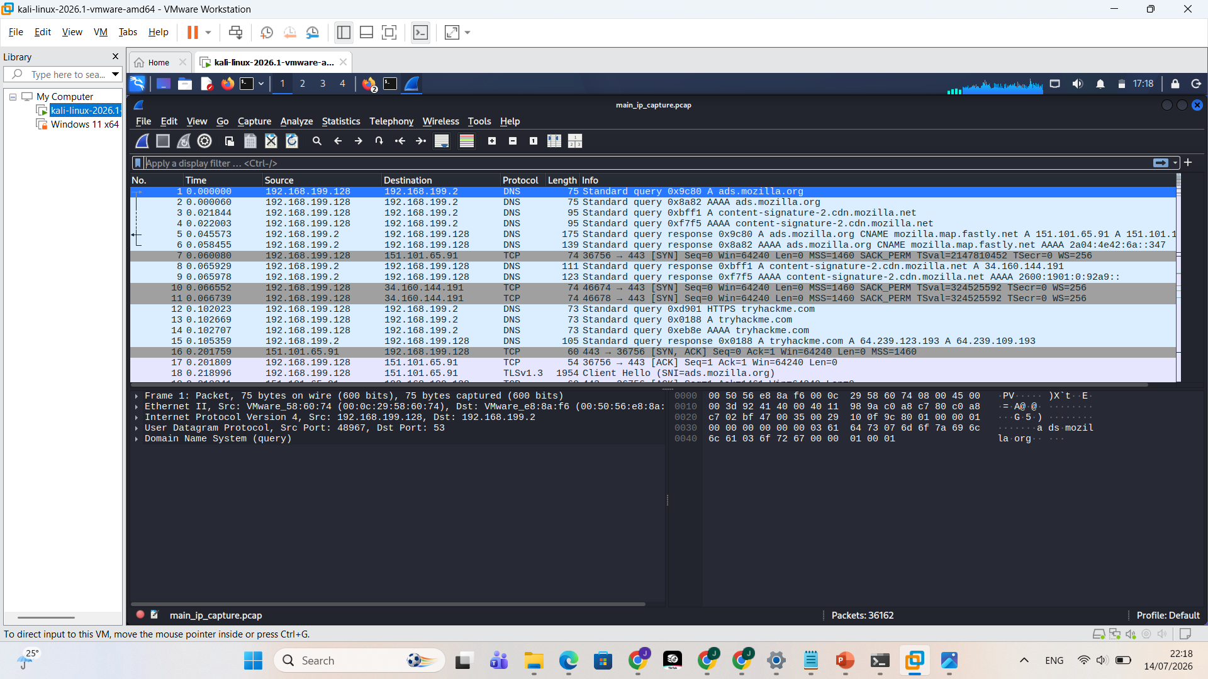
opening it using wireshark

Slide 82
SECTION 5 — PYTHON PRACTICAL
PART A — DATA TYPES AND VARIABLES
Task 1 — Variables and Data Types
Assignment
Create variables to store:
1. Name
2. Age
3. Height
4. Student status

Slide 83

Creating variables

Slide 84
Task 2 — Lists and Tuples
Assignment
Create a list containing favorite foods.
2. Create a tuple containing weekdays.
3. Display both.

Slide 85

1,2&3

Slide 86
Task 3 — Dictionary
Assignment
Create a dictionary containing:
1. Name
2. Age
3. Department

Slide 87

Creating a dictionary

Slide 88

Accessing them individually

Slide 89
PART B — CONDITIONAL STATEMENTS
Task 4 — If Statement
Assignment
Create a program that checks whether a number is positive.

Slide 90

Conditional statements are the "decision-makers" of your code. An if statement acts like a gatekeeper: it checks a condition, and if that condition is true, it lets the code inside the block run. If it’s false, it simply skips it.
Here is the code to check if a number is positive:
The Colon (:): Always remember to put a colon at the end of your if statement line. It tells Python, "The condition is done, here comes the code to run if it's true."
Indentation: The print statement is pushed over (indented) by four spaces. This indentation is mandatory in Python—it tells the computer that this specific line belongs inside the if block.

Slide 91
Task 5 — If, Elif and Else
Assignment
Create a grading system using conditions.

Slide 92

if-elif-else if: The first check. elif: Short for "else if." It checks a new condition only if the previous conditions were False. else: The "catch-all." It runs if none of the previous conditions were met.

Slide 93
PART C — LOOPS
Task 6 — For Loop and Range
Assignment
Display numbers from 1 to 10 using a loop.

Slide 94

A ‘for’ loop allows you to repeat a block of code multiple times without writing the same line over and over.
In Python, the for loop is almost always paired with the range() function. This is where most students get tripped up, so pay close attention to the "stop" value!

Slide 95
Understanding the "Range" Mystery
start (1): This is where you begin.
stop (11): This is where the loop stops before reaching the number
.
  If you type range(1, 10), your output will stop at 9.
  If you type range(1, 11), Python counts: 1, 2, 3, 4, 5, 6, 7, 8, 9, 10... and then it hits 11 and stops.

Slide 96
Task 7 — While Loop
while loop
Assignment
Display numbers from 1 to 5 using a while loop.

Slide 97

To ensure your while loop works perfectly every time, always check for these three specific parts:
Initialization (count = 1): You must define your starting point before the loop begins.
The Condition (count <= 5): This acts as the gatekeeper. The loop checks this every time it loops back to the top. If the condition evaluates to False, the loop stops immediately.
The Increment (count += 1): You must provide a way for the condition to eventually become False. By adding 1 to count each time, we eventually hit 6, which makes the condition count <= 5 False—and that is what cleanly breaks the loop.

Slide 98
Task 8 — Break Statement
Assignment
Stop a loop when a specific condition is met.

Slide 99

The break statement is your "emergency exit" button for loops. When Python hits a break command, it immediately stops the loop, throws away any remaining iterations, and moves on to the next section of your code.
Think of it as a circuit breaker—the moment a specific condition is met, the power is cut to the loop completely.

Slide 100
Task 9 — Infinite Loop
Assignment
Create a simple infinite loop.

Slide 101

An infinite loop occurs when the condition in a while statement never becomes false. It is the coding equivalent of a hamster on a wheel—it will keep running and running until the computer runs out of memory or you manually force it to stop.
To stop an infinite loop: Press Ctrl + C on your keyboard. This sends a KeyboardInterrupt signal to Python, forcing it to kill the process immediately.

Slide 102
PART D — FUNCTIONS
Task 10 — Functions
Assignment
Create a function that displays a welcome message.

Slide 103

Functions are the building blocks of professional programming. Instead of writing the same code over and over again, you wrap that code inside a "container" called a function. Whenever you need that code to run, you just call the function by its name.

Slide 104
Task 11 — Arguments and Return Statement
Assignment
Create a function that accepts two numbers and returns the result.

Slide 105

Using a return statement makes your function useful because it allows the function to "hand back" a value that you can use later in your code.
The Big Difference: print vs. return print() is just for humans. It puts text on the screen so you (the user) can see what's happening. The program itself cannot "capture" the data printed to the screen. return is for the computer. It takes the output of the function and makes it available to be used in calculations, stored in variables, or passed into other functions.

Slide 106
PART E — REGULAR EXPRESSIONS
Task 12 — Regular Expression Search
Assignment
Search for a word inside a sentence using regular expressions.

Slide 107

To search for a word, we use re.search(). This function scans through the string and returns a match object if the pattern is found, or None if it isn't.

Slide 108
Why it equals 82:
The letter 'I' is at position 0.
The first space is position 1.
The letter 'a' is at position 2.
...and if you keep counting, including every space and punctuation mark as a character, you will land on the ‘B' of “Big-wosh" at index 82.

Slide 109
Task 14 — Character Type Symbols
Assignment
Find all digits inside a sentence.
2. Find all words inside a sentence.

Slide 110

To find all occurrences of a pattern, we move from re.search() to re.findall(). This function scans the entire string and returns a list containing every match it finds.
To perform these tasks, we need to introduce Regex Metacharacters—special symbols that represent types of characters rather than literal text.

Slide 111
Breaking Down the Symbols
The r before the quote (e.g., r'\d+') stands for "raw string." It tells Python to treat backslashes as literal characters, which is standard practice in Regex to avoid confusion.
\d (Digit): Matches any single number from 0 to 9.
\w (Word character): Matches any letter (a-z, A-Z), any digit (0-9), or the
underscore (_).
+ (Quantifier): This is the "greedy" part.
  If you searched for \d without the +, Python would return ['2', '0', '2', '6', '1', '2'...] (every single digit separately).
  With the +, Python grabs all consecutive characters that fit the criteria. So, it grabs "2026" as a single block instead of four separate numbers.

Slide 112
NB:
[a-zA-Z]: This is a specific instruction. You are explicitly telling the engine:
"Only give me characters that fall between 'a' and 'z' or 'A' and 'Z'."
It ignores 0-9 because they are not inside those brackets.
A Quick Reference for your notes:
Pattern | What it matches
\w | Alphanumeric (Letters, Numbers, Underscore) — Broad
[a-zA-Z] | Only Alphabetic (Letters only) — Precise
[0-9] | Same as \d (Numbers only)

Slide 113
BONUS CHALLENGE
QUESTION 1:
You are a security analyst investigating whether sensitive information is being transmitted in plaintext on a network.
Show how plaintext protocols transmit data across a network and how packet analysis tools can observe that traffic.
Tools requred:Netcat (nc), Telnet, and Wireshark
EXPECTATION:
1. Screenshot of Netcat listener
2. Screenshot of Telnet connection
3. Screenshot of Wireshark Follow TCP Stream
One-page explanation of findings
EXPLAIN:
Why was the username visible?
Why was the password visible?
What makes Telnet insecure?
Which protocol should be used instead of Telnet?
How does encryption protect transmitted data?

Slide 114

Screenshot of Netcat listener &
Screenshot of Telnet connection

Slide 115

Screenshot of Wireshark Follow TCP Stream

Slide 116
One page explanation
1. Why were the username and password visible?
Telnet is a plaintext protocol. It does not perform any data transformation before sending information over the network. When you type "admin," your computer breaks that word into binary bits and sends them exactly as they are. Because there is no layer of encryption (no scrambling of the data), any "sniffing" tool—like Wireshark—that sits between the client and the server can simply reassemble those bits into human-readable text.

Slide 117
2. What makes Telnet insecure?
Telnet is considered "insecure by design" for three primary reasons:
Lack of Confidentiality: All data (including credentials and commands) is sent in cleartext. Anyone on the same network segment can view it.
Lack of Integrity: There is no mechanism to ensure that the data hasn't been modified in transit. A Man-in-the-Middle (MitM) attacker could inject commands into your session.
Lack of Authentication: Telnet does not verify that the server you are connecting to is actually the one you intended to reach, making it vulnerable to spoofing.

Slide 118
3. Which protocol should be used instead?
SSH (Secure Shell) is the industry standard replacement for Telnet.
SSH provides the same terminal access functionality as Telnet but wraps the entire connection inside an encrypted tunnel.
A packet capture of a properly established SSH session should not reveal the session's plaintext commands or password; the captured payload is protected by encryption.

Slide 119
4. How does encryption protect transmitted data?
Encryption uses mathematical algorithms to scramble data using a "key."
The Process: With SSH, the client and server negotiate cryptographic algorithms and establish session keys as part of SSH's own protocol handshake. SSH does not generally use TLS/SSL as its underlying transport.
The Result: Before the data leaves your network card, it is encrypted. During transit, it is unreadable. Only the recipient, who possesses the matching key, can "unlock" the data and turn it back into readable plaintext.
The Analogy: If Telnet is like sending a postcard (anyone can read the back), SSH is like sending a letter inside a steel safe. Even if the mailman steals the safe, they cannot read the contents without the key.

Slide 120
QUESTION 2A:
Create a function that determines whether a number is positive, negative, or zero.

Slide 121

This function uses simple conditional logic to evaluate the number and return the appropriate classification.
This one below is where I tried the number -1 and it showed that it is negative because it is less than 0.

Slide 122

This one below is where I tried the number 2, and it showed that it is positive because it is greater than 0.

Slide 123

This one below is where I tried the number 0 and it showed that it is Zero because the number is to 0 itself.

Slide 124
This code uses Conditional Logic (the if-elif-else structure) to make a decision.
Defining the Function (def check_number(n):): You are creating a reusable tool called check_number. You feed it a value n, and it holds onto it until it's time to process it.
The First Check (if n > 0:): The computer checks if your number is greater than zero. If true, it stops everything else and returns "Positive.“
The Second Check (elif n < 0:): If the first check failed, it checks if the number is less than zero. If true, it returns "Negative.“
The "Default" Case (else:): If the number is neither greater nor less than zero, the only mathematical option left is that it is zero. The else statement catches this automatically without needing to check it again.

Slide 125
QUESTION 2B:
Create a password checker.
Requirements:
Continue asking for a password until the correct password is entered.
Count the number of attempts.

Slide 126

Part B: Password Checker
This script uses a while loop to repeatedly prompt the user for input. The attempts counter increments each time the user fails to provide the correct password, ensuring they are tracked accurately.
Below is an example of a wrong password and the outcome.

Slide 127

Here is another example, but as the password is correct, it displayed “Access Granted!” and also the number of times it was attempted.
attempts += 1: This updates your counter every time the loop runs.
while True: This creates an infinite loop that continues until the break command is triggered by the correct password.

Slide 128
This code uses Iterative Logic (a loop) to repeat a task until a specific condition is met.
Initialization (attempts = 0): Before the loop starts, you must set your counter to zero. If you don't do this, the computer won't know where to start counting.
The Infinite Loop (while True:): This is the engine. It tells the computer: "Keep doing the code inside here forever, until I specifically tell you to break.“
User Input: The code pauses and waits for the user to type something.
The Counter (attempts += 1): This happens after the user types something. It adds 1 to the previous total. This is crucial for tracking how many times the user failed.
The "Gatekeeper" (if user_input == correct_password:):
  If correct: The break command is triggered, which kills the while True loop immediately.
  If incorrect: The code prints an error and the loop restarts from the beginning (back to the input line).

Slide 129
This is the End of my Project
Name: JOEL AGBOKE

