Slide 1
Location && Sensor
朱荣飞

Slide 2
Location services
Locationmanager
central component of the location framework
provides APIs to determine location and bearing of the underlying device

Slide 3
Query for the list of all LocationProviders for the last known user location
Register/unregister for periodic updates of the user's current location from a location provider
Register/unregister for a given Intent to be fired if the device comes within a given proximity of a given lat/long.

Slide 4
Challenges in Determining User Location
Multitude of location sources
User movement
Varying accuracy

Slide 5
Requesting Location Updates
receive location updates from the LocationManager by calling requestLocationUpdates()
LocationListener
GPS_PROVIDER, NETWORK_PROVIDER

Slide 6
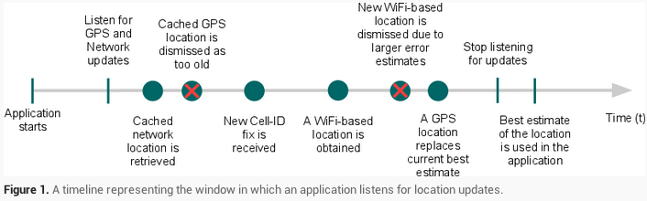
Getting a fast fix with the last known location
getLastKnownLocation(String)

Slide 7
sensor
Motion sensors
accelerometers, gravity sensors, gyroscopes, and rotational vector sensors
Position sensors
orientation sensors, magnetometers
Environmental sensors
air temperature and pressure, illumination, and humidity

Slide 8
Hardware-based sensors
directly measuring specific environmental properties
Software-based sensors
derive their data from one or more of the hardware-based sensors

Slide 9
Sensor Framework
SensorManager
Sensor
SensorEvent
SensorEventListener

Slide 10
Identifying Sensors and Sensor Capabilities
determine whether a specific type of sensor exists on a device by using the getDefaultSensor() method
getResolution()，getMaximumRange() ，getPower()， getVendor()，getVersion()

Slide 11
Monitoring Sensor Events
A sensor‘s accuracy changes
A sensor reports a new value

Slide 12
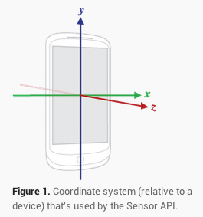
Sensor Coordinate System

Slide 13
Best Practices for Accessing and Using Sensors
Unregister sensor listeners
Don't block the onSensorChanged() method
Avoid using deprecated methods or sensor types
Verify sensors before you use them
Choose sensor delays carefully

Slide 14
Motion sensors
Accelerometer
An acceleration sensor measures the acceleration applied to the device, including the force of gravity
Accelerometers use the standard sensor coordinate system
Gravity Sensor

Slide 15
Gyroscope
The gyroscope measures the rate or rotation in rad/s around a device's x, y, and z axis
Linear Accelerometer
Rotation Vector Sensor

Slide 16
Position sensor
Orientation Sensor
Azimuth, Pitch, Roll
Geomagnetic Field Sensor
Proximity Sensor

Slide 17
Environment sensors
Light, Pressure, and Temperature Sensors
Humidity Sensor

Slide 18
谢谢！

