Slide 1
2nd-week-1
Gradient Descent

Slide 2
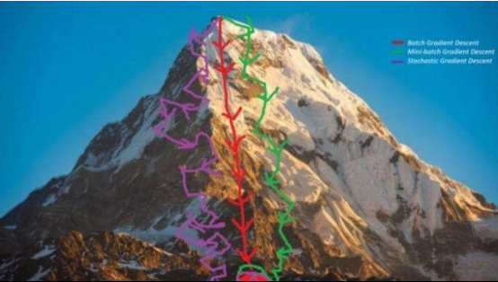
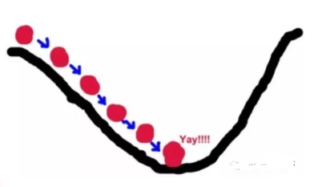
Have you ever climbed a mountain? What's the fastest way down the mountain?

Slide 3
Agenda
Gradient Descent - brief GD
Example
Exercise
Three types of GD
Homework

Slide 4
What's the GD
Gradient descent(GD) method, also known as the fastest descent method.
It was given by the famous mathematician Cauchy in 1847.

Slide 5
What's the GD
The basic idea
Suppose we climb a mountain. If we want to get to the top of the mountain fastest, we should go up the steepest part of the mountain.That's where the mountain changes the most.
Similarly, if you start at any point and you need to search the fastest to get the maximum value of the function, then you should also search in the direction where the function changes the fastest.

Slide 6
What's the GD
What's the fastest way to change the function?
The gradient of the function.

Slide 7


The GD
If the function is unary, the gradient is the derivative of the function.
If it is a binary function, the gradient is defined as:

Slide 8
The GD
If the minimum point of the function is to be found, then the direction of the negative gradient should be found. This method is called gradient descent method.
To search for the minimum point C, the search direction must be increased to x at point A, which is opposite to the gradient direction at point A.Search must be conducted in the direction of x decrease at point B, which is opposite to the gradient at point B.In short, to search for a minimum, you must search in the direction of the negative gradient.

Slide 9
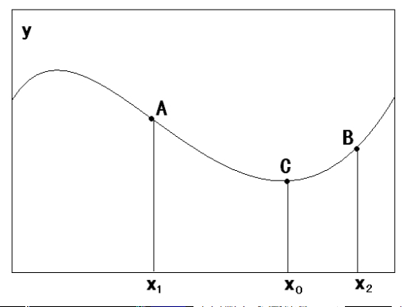
The GD

Slide 10
Gradient descent method
Suppose the function y=f(x₁,x₂...X_{n}) has only one minimum.
The initial parameter given is X₀=(x₁₀,x₂₀..., x_{n0}).
How do I search from this point to find the minimum point of the function?

Slide 11


Methods
https://blog.csdn.net/google19890102/article/details/17842831
S1: Set a smaller random positive value η,ε。
S2:Obtain each partial derivative at the current position:
S3: To modify the parameter value of the current function, the formula is as follows:
S4. If the parameter change is less than ε , exit;
Otherwise, return S2.
η is Learning rate, ε is accuracy.

Slide 12
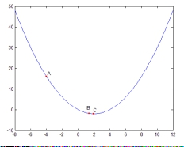
Example1
For any initial starting point, let's set x0=-4 and use the gradient descent method to find the minimus of the function y=x²/2-2x.

Slide 13


Solution
(1) First, two parameters are given
(2) Calculate the derivative
(3) Calculate the current derivative value
(4) Modify the current parameters

Slide 14


Solution
(5) Calculate the current derivative value
(6) Modify the current parameters
(7) Calculate the current parameters
(8) Modify the current parameters

Slide 15

Solution
(9) Calculate the current derivative value
(10) Modify the current parameters
(11)At this point, the change satisfies the termination condition, and the algorithm ends.

Slide 16
Exercise1
For any initial starting point, let's set x0=-4 and use the gradient descent method to find the minimus of the function y=x².

Slide 17
Solution
(1) First, two parameters are given
(2) Calculate the derivative
(3) Calculate the current derivative value
(4) Modify the current parameters

Slide 18
Solution
(5) Calculate the current derivative value
(6) Modify the current parameters
(7) Calculate the current parameters
(8) Modify the current parameters

Slide 19
Solution
(9) Calculate the current derivative value
(10) Modify the current parameters
(11)At this point, the change satisfies the termination condition, and the algorithm ends.

Slide 20
1.梯度下降GD 做数学题，手工做
Python 实现，调整两个参数，体会什么是调参。
2. 一元线性回归 梯度下降
https://blog.csdn.net/oracle8090/article/details/125956091
什么是随机GD，批量GD，小批量GD
一元线性回归，多元线性回归
逻辑回归
KNN
Kmeans
贝叶斯
MF矩阵分解

Slide 21
3 Types of GD Algorithms
Batch gradient descent
Stochastic gradient descent
Mini batch gradient descent
一元线性回归
anaconda 清华镜像

Slide 22
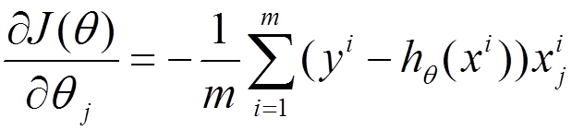
Batch gradient descent
The Batch gradient Descent is an iteration to train all the samples, which is an endless iteration. The solution idea of the whole algorithm can be expressed as:
(1) Take the partial derivative of J(Theta) with respect to theta, and get the gradient corresponding to each theta:

Slide 23
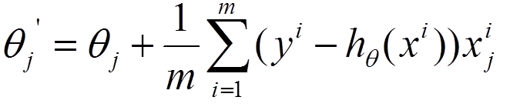
Batch gradient descent
(2) To minimize the risk function, update each Theta according to the negative direction of the gradient of each parameter, Theta:
(3) It can be noted from the above formula that it can obtain a global optimal solution, but every iteration step needs to use all the data of the training set. If M is large, then you can imagine the iteration speed of this method!! So, this introduces another method, stochastic gradient descent.

Slide 24
Stochastic gradient descent
To accelerate the convergence speed and solve the problem that large amounts of data cannot be inserted into memory at one time, the stochastic Gradient Descent (SGD) is put forward. The idea of SGD is to train only one sample at a time to update the parameters. Specific implementation ideas:

Slide 25
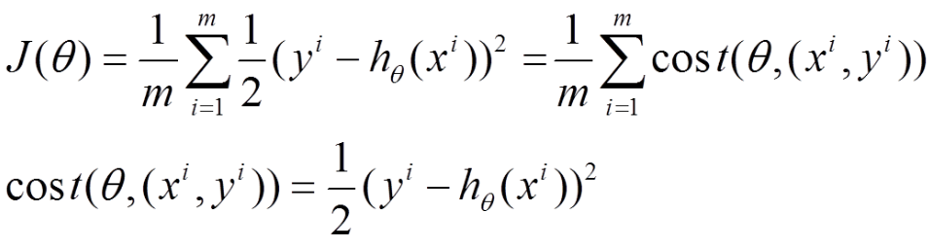
Stochastic gradient descent
(1) The above risk function can be written in the following form. The loss function corresponds to the granularity of each sample in the training set, while the above batch gradient descent corresponds to all the training samples:

Slide 26
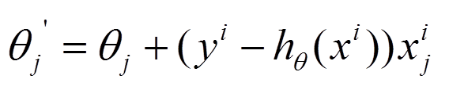
Stochastic gradient descent
2) The loss function of each sample, obtain the corresponding gradient by taking the partial derivative of Theta, to update Theta:

Slide 27
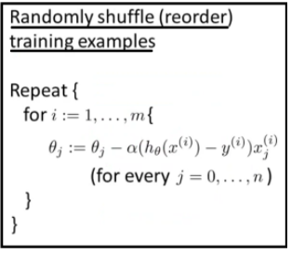
Stochastic gradient descent
To accelerate the convergence speed and solve the problem that large amounts of data cannot be inserted into memory at one time, the stochastic Gradient Descent (SGD) is put forward. The idea of SGD is to train only one sample at a time to update:

Slide 28
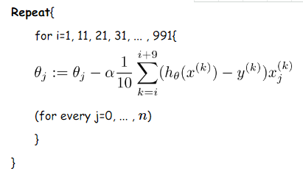
Mini batch gradient descent
Mini-batch gradient Descent is the compromise plan for the Batch gradient and stochastic Gradient Descent, that is, a part of the samples are used to update the parameters each time.

Slide 29
Mini batch gradient descent
Let's say we use 10 samples per parameter update (different tasks are completely different, just to give you an example)
Update the pseudocode as follows:

Slide 30
Homework
Giving the details of the process using the gradient descent method int the notebook.
y = 0.5 * (x-0.25) ** 2
inital value:
η=0.500
ε=1e-10

Slide 31
Questions and Comments?
Thank you!!

