Slide 1
第5章 约束满足问题

Slide 2
复习
1 博弈搜索
2 Minimax算法：
（１）当轮到MIN走步的结点时，MAX应考虑最坏的情况（因此，f(p)取极小值）。
（２）当轮到MAX走步的结点时，MAX应考虑最好的情况（因此，f(p)取极大值）。
3 Alpha-Beta算法：

Slide 3
约束满足问题（ Constraint Satisfaction Problems ，CSP）
What is CSP? CSP examples
Backtracking search for CSPs
Problem structure and problem decomposition
Local search for CSPs

Slide 4
何谓CSP？
使用要素化表示来描述状态：一组变量，每个变量有自己的值。当每个变量都有自己的赋值同时满足所有关于变量的约束时，问题就得到了解决。这类问题称为约束满足问题，简称CSP
Notes:
约束满足问题包含三个成分：

Slide 5
CSP and Standard Search
Standard search problem:
state is a “black box”---any old data structure that supports goal test, eval, successor
CSP:
state is defined by variables X_{i} with values from domain D_{i}
goal test is a set of constraints specifying allowable combinations of values for subsets of variables
Allows useful general-purpose algorithms with more power than standard search algorithms

Slide 6
CSP Example: Map Coloring
Northern
Territory
Western
Queensland
Australia
South
Australia
New South Wales
Victoria
V
a
riables
W
A
N
T
Q
N
S
W
V
S
A
T
Tasmania
,
,
,
,
,
,
Domains D_{i} = { red,green,blue}
Constraints: adjacent regions must have different colors
e.g., WA 6= NT (if the language allows this), or
(WA,NT) ∈ {(red,green),(red,blue),(green,red),(green,blue),...}

Slide 7
Solutions are assignments satisfying all constraints, e.g.,
{WA=red,NT =green,Q=red,NSW =green,V =red,SA=blue,T =green}
Northern
Territory
Western
Queensland
Australia
South
Australia
New South Wales
Victoria
Tasmania

Slide 8
Constraint Graph
Binary CSP: each constraint relates at most two variables
Constraint graph: nodes are variables, arcs show constraints
NT
Q
WA
SA
NSW
V
Victoria
T
General-purpose CSP algorithms use the graph structure to speed up search. E.g., Tasmania is an independent subproblem!

Slide 9
Varieties of CSPs
Discrete variables finite domains; size d ⇒ O(d^{n}) complete assignments
e.g., Boolean CSPs, incl. Boolean satisfiability (NP-complete) infinite domains (integers, strings, etc.)
e.g., job scheduling, variables are start/end days for each job
need a constraint language, e.g., StartJob1 + 5 ≤ StartJob3
linear constraints solvable, nonlinear undecidable
Continuous variables
e.g., start/end times for Hubble Telescope observations
linear constraints solvable in poly time by LP methods

Slide 10
Varieties of Constraints
Unary constraints involve a single variable,
e.g., SA ≠ green
Binary constraints involve pairs of variables,
e.g., SA ≠ WA
Higher-order constraints involve 3 or more variables,
e.g., cryptarithmetic column constraints
Preferences (soft constraints), e.g., red is better than green often representable by a cost for each variable assignment
→ constrained optimization problems

Slide 11
Example: Cryptarithmetic
TWO
F
T
U
W
R
O
+TWO
=FOUR
X
3
X
2
X
1
Variables: F T U W R O X1 X2 X3
Domains: {0,1,2,3,4,5,6,7,8,9}
Constraints alldiff(F,T,U,W,R,O)
O + O = R + 10 · X1, etc.

Slide 12
Real-World CSPs
Assignment problems： e.g., who teaches what class
Timetabling problems： e.g., which class is offered when and where?
Hardware configuration
Spreadsheets
Transportation scheduling
Factory scheduling
Floorplanning
Many real-world problems involve real-valued variables

Slide 13
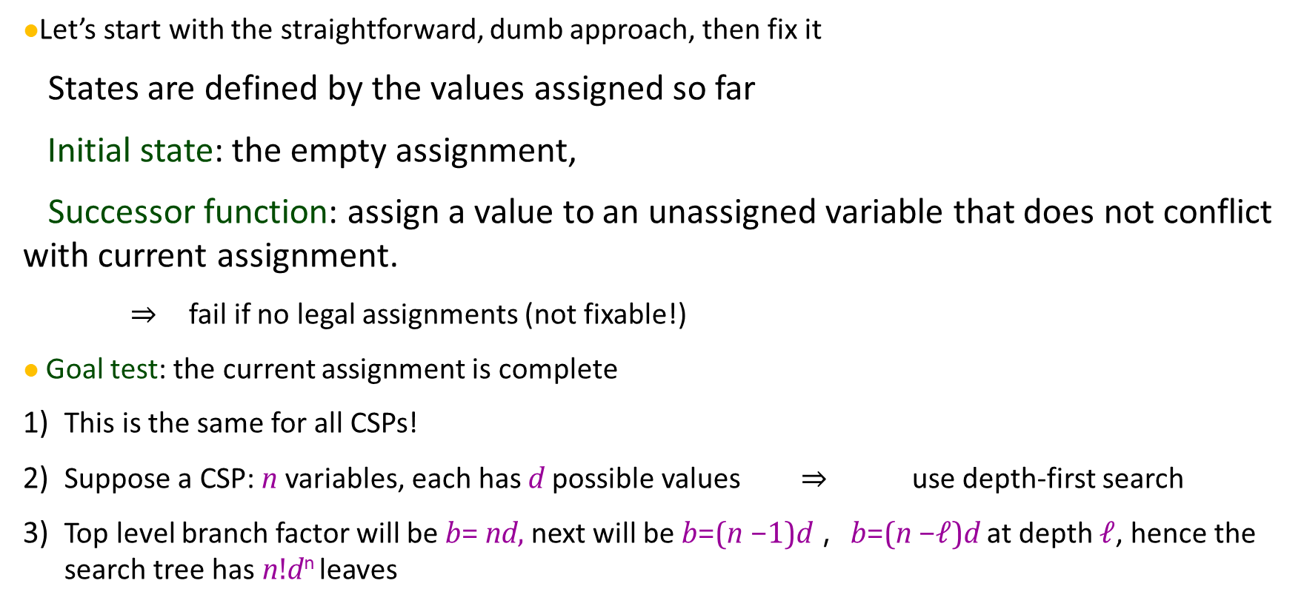
Standard Search Formulation (incremental)
Let’s start with the straightforward, dumb approach, then fix it
States are defined by the values assigned so far
Initial state: the empty assignment,
Successor function: assign a value to an unassigned variable that does not conflict with current assignment.
⇒ fail if no legal assignments (not fixable!)
Goal test: the current assignment is complete
This is the same for all CSPs!
Suppose a CSP: n variables, each has d possible values ⇒ use depth-first search
Top level branch factor will be b= nd, next will be b=(n −$1$)d ，b=(n −$ℓ$)d at depth $ℓ$, hence the search tree has n!d^{n} leaves

Slide 14
Backtracking Search
Variable assignments are commutative, i.e.,
[WA=red then NT =green] same as [NT =green thenWA=red]
Only need to consider assignments to a single variable at each node
⇒ b=d and there are d^{n} leaves
Depth-first search for CSPs with single-variable assignments is called backtracking search
Backtracking search is the basic uninformed algorithm for CSPs
Can solve n-queens for n≈25

Slide 15
Backtracking-Search Algorithm
function Backtracking-Search(csp) returns solution/failure return Recursive-Backtracking({},csp) function Recursive-Backtracking(assignment,csp) returns soln/failure if assignment is complete then return assignment var←Select-Unassigned Variable(Variables[csp],assignment,csp) for each value in Order-Domain-Values(var,assignment,csp) do if value is consistent with assignment given Constraints[csp] then add {var = value} to assignment result←Recursive-Backtracking(assignment,csp) if result = failure then return result remove {var = value} from assignment return failure
Notes:
演示算法-8 回溯搜索算法
前面合理但是非常弱智的假设忽略了所有CSP的一个共性：可交换性。如果行动的先后顺序对结果没有影响，那么问题就是可交换的。 因为CSP给变量赋值的时候不需要考虑赋值的顺序，所以CSP是可交换的。比如澳大利亚地图着色问题，WA，NT；或NT，ＷＡ并不影响结果。
所以只需要考虑搜索树每个结点的单一变量，比如SA=R， SA=G， SA=B。不用SA=x, WA =y, NT =z…这样选择。所以叶节点就是d个了。
Backtracking Search 回溯搜索：它每一层只为一个变量选择一个赋值，没有合法的赋值的时候，就回溯。下面请看后面的图。

Slide 20
Improving Backtracking Efficiency
General-purpose methods can give huge gains in speed:
Which variable should be assigned next?
In what order should its values be tried?
Can we detect inevitable failure early?
Can we take advantage of problem structure?

Slide 21
Minimum Remaining Values (MRV)
Choose the variable with the fewest legal values

Slide 22
Minimum Remaining Values (MRV)
Tie-breaker among MRV variables
Degree heuristic:
choose the variable with the most constraints on remaining variables

Slide 23
Minimum Remaining Values (MRV)
Given a variable, choose the least constraining value:
the one that rules out the fewest values in the remaining variables
Allows 1 value for SA
Allows 0 values for SA
Combining these heuristics makes 1000 queens feasible

Slide 24
Idea: Keep track of remaining legal values for unassigned variables
Terminate search when any variable has no legal values
WA NT Q NSW V SA T

Slide 25
Idea: Keep track of remaining legal values for unassigned variables
Terminate search when any variable has no legal values
WA NT Q NSW V SA T

Slide 26
Idea: Keep track of remaining legal values for unassigned variables
Terminate search when any variable has no legal values
WA NT Q NSW V SA T

Slide 27
Idea: Keep track of remaining legal values for unassigned variables
Terminate search when any variable has no legal values
WA NT Q NSW V SA T

Slide 28
Constraint Propagation
Forward checking propagates information from assigned to unassigned variables, but doesn’t provide early detection for all failures:
NT
Q
WA
SA
NSW
WA NT Q NSW V SA T
V
Victoria
T
NT and SA cannot both be blue!
Constraint propagation repeatedly enforces constraints locally

Slide 29
Arc Consistency
Simplest form of propagation makes each arc consistent
X → Y is consistent iff for every value x of X there is some allowed y

Slide 30
Arc Consistency
Simplest form of propagation makes each arc consistent
X → Y is consistent iff for every value x of X there is some allowed y

Slide 31
Arc Consistency
Simplest form of propagation makes each arc consistent
X → Y is consistent iff for every value x of X there is some allowed y
If X loses a value, neighbors of X need to be rechecked

Slide 32
Arc Consistency
Simplest form of propagation makes each arc consistent
X → Y is consistent iff for every value x of X there is some allowed y
If X loses a value, neighbors of X need to be rechecked
Arc consistency detects failure earlier than forward checking
Can be run as a preprocessor or after each assignment

Slide 33
Arc Consistency Algorithm
function AC-3(csp) returns the CSP, possibly with reduced domains inputs: csp, a binary CSP with variables {X1, X2, ..., X_{n}} local variables: queue, a queue of arcs, initially all the arcs in csp while queue is not empty do (X_{i}, X_{j})←Remove-First(queue) if Remove-Inconsistent-Values(X_{i}, X_{j}) then for each X_{k} in Neighbors[X_{i}] do add (X_{k}, X_{i}) to queue function Remove-Inconsistent-Values(Xi, Xj) returns true iff succeeds removed←false for each x in Domain[X_{i}] do if no value y in Domain[X_{j}] allows (x,y) to satisfy the constraint X_{i} ↔ X_{j} then delete x from Domain[X_{i}]; removed←true return removed
O(n²d³), can be reduced to O(n²d²) (but detecting all is NP-hard)
Notes:
演示算法-9 弧相容（ Arc Consistency， AC，弧一致）算法。如果CSP中某值域中的所有取值满足该变量的所有二元约束，则称此变量是弧相容的。例如 Y=X^2, X和Y都是一定范围的整数， 则：<(X, Y), {(0,0), (1,1), (2,4)}> X 值域 0， 1， 2， Y值域：0 , 2，4，CSP就是弧相容的。AC-3作者Mackworth， -3的意思是这是他设计的AC算法的第三个版本假设有 n 个变量,且每个变量有 d个取值可能
(each arc can be queued only d times, n^2 arcs (at most), checking one arc is O(d^2)) so time complexity: can be reduced to O(n²d²)

Slide 34
Problem Structure
NT
Q
WA
SA
NSW
V
Victoria
T
Tasmania and mainland are independent subproblems

Slide 35
Problem Structure contd.
Suppose each subproblem has c variables out of n total,且每个变量有 d个取值可能
Worst-case solution cost is n/c · d^{c}, linear in n
E.g., n=80, d=2, c=20
2⁸⁰ = 4 billion years at 10 million nodes/sec
4 · 2²⁰ = 0.4 seconds at 10 million nodes/sec

Slide 36
Tree-Structured CSPs
A
E
B
D
C
F
Theorem: if the constraint graph has no loops, the CSP can be solved in O(nd²) time
Compare to general CSPs, where worst-case time is O(d^{n})
This property also applies to logical and probabilistic reasoning

Slide 37
Algorithm for Tree-Structured CSPs
Choose a variable as root, order variables from root to leaves such that every node’s parent precedes it in the ordering
A
E
B
D
A
B
C
D
E
F
C
F
For j from n down to 2, apply RemoveInconsistent(Parent(X_{j}),X_{j})
For j from 1 to n, assign X_{j} consistently with Parent(X_{j})

Slide 38
Nearly Tree-Structured CSPs
Conditioning: instantiate a variable, prune its neighbors’ domains
NT
NT
Q
Q
WA
WA
SA
NSW
NSW
V
V
Victoria
Victoria
T
T
Cutset conditioning: instantiate (in all ways) a set of variables such that the remaining constraint graph is a tree
Cutset size c ⇒ runtime O(d^{c} · (n − c)d²), very fast for small c

Slide 39
Iterative Algorithms for CSPs
Hill-climbing, simulated annealing typically work with “complete” states, i.e., all variables assigned
To apply to CSPs:
allow states with unsatisfied constraints operators reassign variable values
Variable selection: randomly select any conflicted variable
Value selection by min-conflicts heuristic:
choose value that violates the fewest constraints
i.e., hillclimb with h(n) = total number of violated constraints

Slide 40
Example: 4-Queens
States: 4 queens in 4 columns (4⁴ = 256 states)
Operators: move queen in column
Goal test: no attacks
Evaluation: h(n) = number of attacks
h = 5 h = 2 h = 0

Slide 41
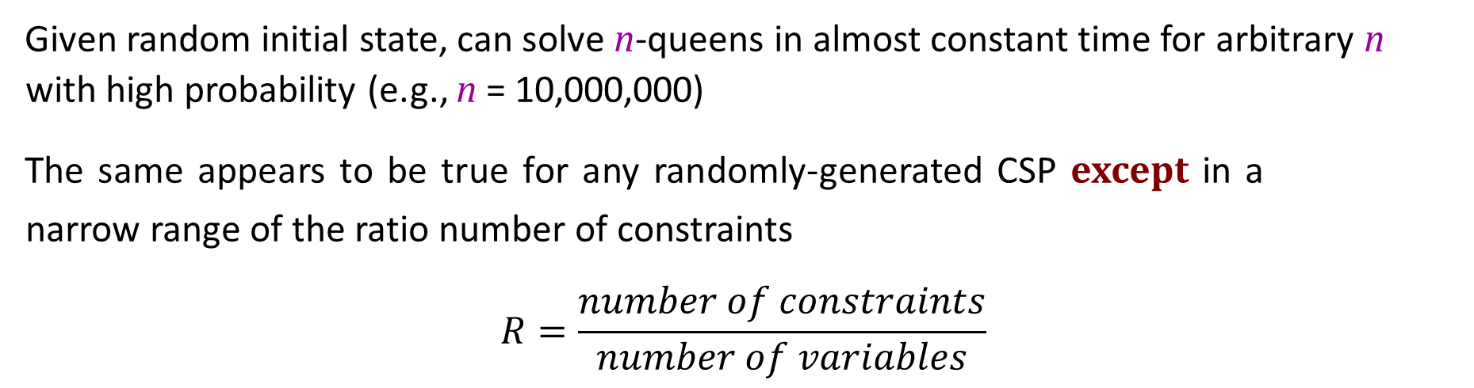
Performance of Min-Conflicts
Given random initial state, can solve n-queens in almost constant time for arbitrary n with high probability (e.g., n = 10,000,000)
The same appears to be true for any randomly-generated CSP except in a narrow range of the ratio number of constraints
$$R=\frac{number of constraints}{number of variables}$$
CPU
time
R
critical

Slide 42
Summary
CSPs are a special kind of problem:
states defined by values of a fixed set of variables
goal test defined by constraints on variable values
Backtracking = depth-first search with one variable assigned per node
Variable ordering and value selection heuristics help significantly
Forward checking prevents assignments that guarantee later failure
Constraint propagation (e.g., arc consistency) does additional work to constrain values and detect inconsistencies
The CSP representation allows analysis of problem structure
Tree-structured CSPs can be solved in linear time
Iterative min-conflicts is usually effective in practice

Slide 43
参考文献信息
本课件部分内容的编写参考了如下学者的教材和课件，在此感谢原著者。
朱福喜，
Stuart J. Russell,
Nikita Kitaev
Sheila McIlraith
Faheim Bacchus
Andrew Moore
Hojjat Ghaderi
Craig Boutillier
Jurgen Strum
Shaul Markovitch

