Slide 1
Module 1 – Discovery
Notes:
So let’s talk about our approach and discovery. Before you know the skills or even if you are a skill master, if you do not know your data then you are going to have a difficult time.

Slide 2


Who are we?
VanArsdel
Manufactures and sells sporting goods
Has invested heavily in R&D for products for customers
Sales come from its own manufactured products and other manufactures
Sells directly to consumers nationwide & international
The Request
The CMO wants a sales & market share analysis
What product categories and segments show recent trends
What product segments are meeting our Budget goals?
How well do VanArsdel’s products sell compared to 3rd Party?
How do we perform nationwide vs. international for our products?
Notes:
So let’s start with who are we and what are we dealing with?
We work at a company named VanArsdel – they manufacturer and sell sporting goods. They sell 3rd party and their own. They have lately (CMO) have been investing in Research & development for the products they create; The marketing team proved that customers are looking for certain types of products based on their own life style.
We are on the Data Analyst at the company – we work with the Marketing & Sales department.
The product team needs to know what to focus their time on, and the CMO wants to see where VanArsdel has the greatest opportunity.
Not only this, but it cost more to sell 3rd Party products outside the US – how does nationwide vs. Int. compare?

Slide 3
Where do we Start? Ask the Right Questions
Start with answering basic questions about your project
What Data do we need?
What fields and tables are required to answer the questions?
What Data do we have?
What do I have currently have that is relevant to this project?
What Data do we transform?
What data do I need to optimize to be in the correct shape?
Notes:
So know we know the challenge, where the heck do we start?
Any solution or Report you work always begins with getting data. With this in mind, you should ALWAYS ask and answer 3 basic questions before you start on any visual.
This applies even if you know the data and have been working with the same data for years. Each request and solution is different.
What Data do we need? Always document what fields and data you must have.
What are the main metrics, values, and fields that you will be reporting on? What do you need to help describe your data (rolling up, grouping)?
What Data do we have? Where does is the data coming from?
Once you know what you need and how you need it, you can begin to acquire the right sources. What about the formats/types of it? Does it work?
What Data do we transform?
If you do not have what you need originally, this is where we start so we can create or remodel and get what we need.

Slide 4
What Data do we Need?
Small Group Time! Get together and document the needed tables/columns, etc.
What am I counting or aggregating?
Include what aggregations (measures) and facts needed
Transactions
Revenue
Cost
How do we Describe the Data?
Include what dimensions and attributes that must describe the “facts” and be able to roll up into
by Month
by Customer
By GEO
Notes:
So let’s do this together – based on the scope of the project, get into groups of about XX to write down what you think you need.
Make sure to document both what are the Facts (counting or aggregating) and what dimensions you need (what describes the facts).

Slide 5
What Data do we Need – Exercise
Document the following:
What do I need aggregate or count?
What is required to describe and provide granularity to my facts?
The Request
The CMO wants a sales & market share analysis
How well do VanArsdel’s products sell compared to 3rd Party?
How do we perform nationwide vs. international for our products?
What product categories and segments show recent trends
How do we compare this year vs. last year?

Slide 6
What Data do we Have?
Explore the Data! (USSales Folder)
Import the data into a new Power BI Model
What is the source of the data?
What is the formats?
What is the current shape?
How does this match with what we Need?
What am I counting?
What am I describing?
What is missing or is the wrong shape?
Notes:
Ok – with the basis of what you need, let’s start by importing the data.
We have 2 files. A Sales file in CSV and a Dimension file as Excel Workbook.
Go through it and see if this goes back what you need.

Slide 7
What Data do we Have - Exercise
Dimensions
Product Table
ProductID
Category (missing data)
Price (not number) Product (Not Split)
GEO - sheet
As sheet – not clean
Wrong Data types
Manufacturer – sheet
Not right layout (columns)
Sales
Facts
Units
Revenue
Dimensions
ProductID
Date
Zip
ManufacturerID
Notes:
The Sales file is just US, and we see the following:
ProductID, Date, Zip, ManufacturerID for our dimensions.

Slide 8
What Data do we Transform?
What transformations are needed?
One file is a CSV (Sales transactions or Fact Table)
We need to describe sales by Product (category, type), Manufacturer, GEO
The BI_Dimension excel file has multiple worksheets…
What to fix
How do we format Product?
How do we format Manufacturer?
GEO?
Notes:
Ok, so now that we have explored what we have, we know that we need to optimize the shape of some the data.

Slide 9
Ask the Right Questions
What Data do we need?
Product Sales that contain information on location, date, manufacturer, product details
What Data do we have? (USSales Folder)
Sales table (sales.csv) & Dimension Excel file
Current Shape is wrong for some dimension files
What Data do we transform?
Reshape Manufacturer file to have unique ID
Optimize Product table to be able to report
Fix GEO table to match to Sales Zip

Slide 10
Questions?

Slide 11
MODULE 1b:
Basic Data Modeling

Slide 12
MODULE OBJECTIVES
Objectives:
Understand the basic architecture of PBI Desktop
Understand Power BI modeling terminology

Slide 13


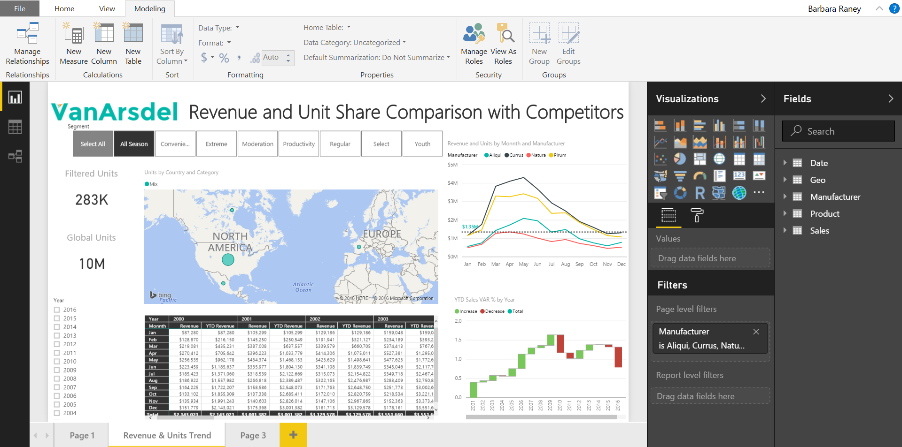
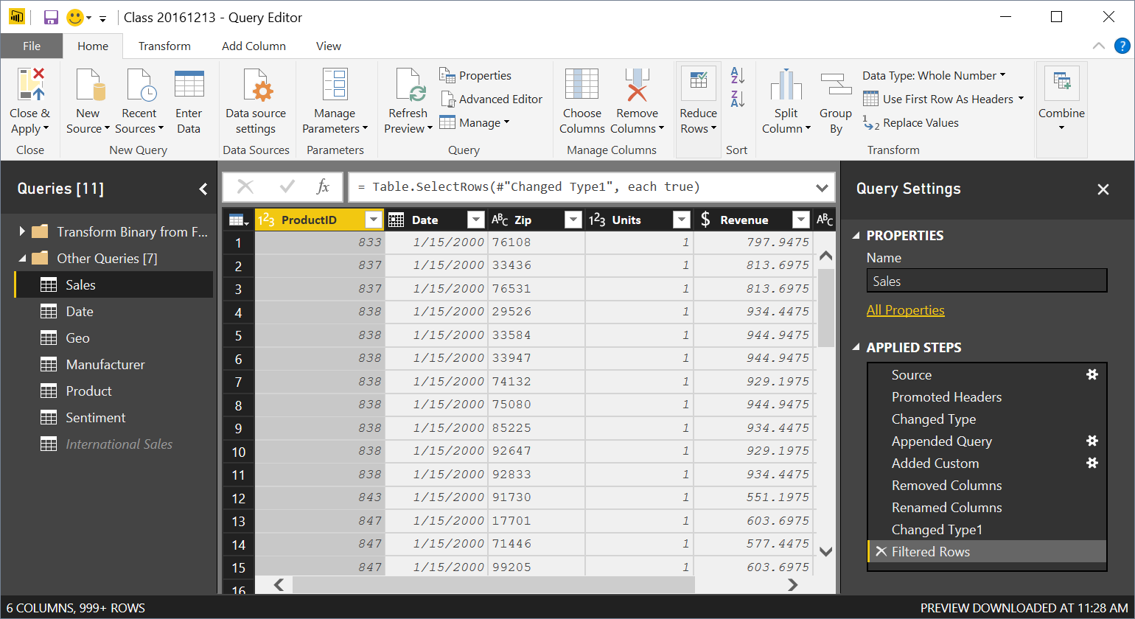

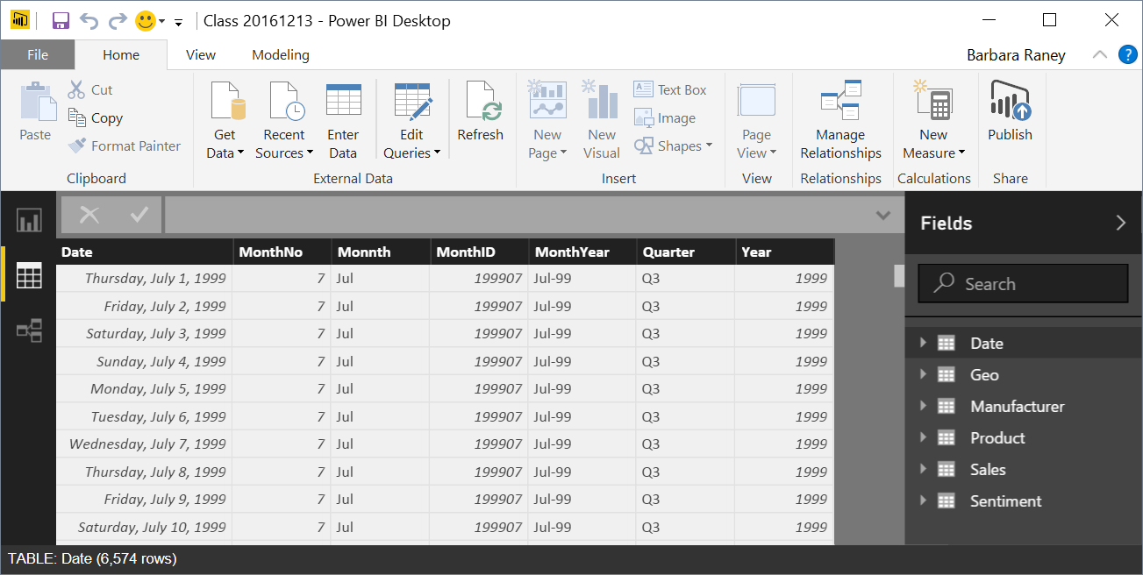
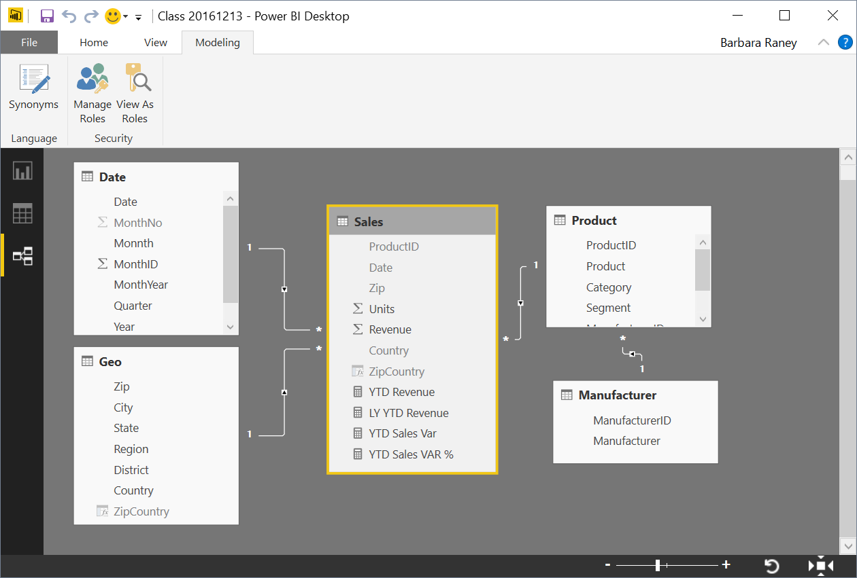


Power BI Desktop Data Flow
Data Sources
Power BI Desktop file (.PBIX)
Report
Create Visuals
Close & Apply
Close: Closes Query Editor
Apply: Loads data from sources to Data Model
Data
View Tables
Query Editor
Data Source Connections
Data Transformations
(Prep data for Data Model)
Relationships
See how Tables relate to each other
Notes:
This slide builds automatically.
Depicts the data flow for Power BI Desktop along with what is in a PBIX file.
Note all the data sources that can be pulled into Query Editor.
Note the different views (Report, Data, Relationships) once all of the data is pulled in.

Slide 14
What is a Data model?
Improves understandability of the data
Increases performance of dependent processes and systems
Increases resilience to change
Why is it important to have a Good Data model?
Notes:
In a good Data Model, the model can assume that column types are homogeneous (as they are strongly typed). This is different from Excel, where any given cell in a spreadsheet can contain different data types.

Slide 15
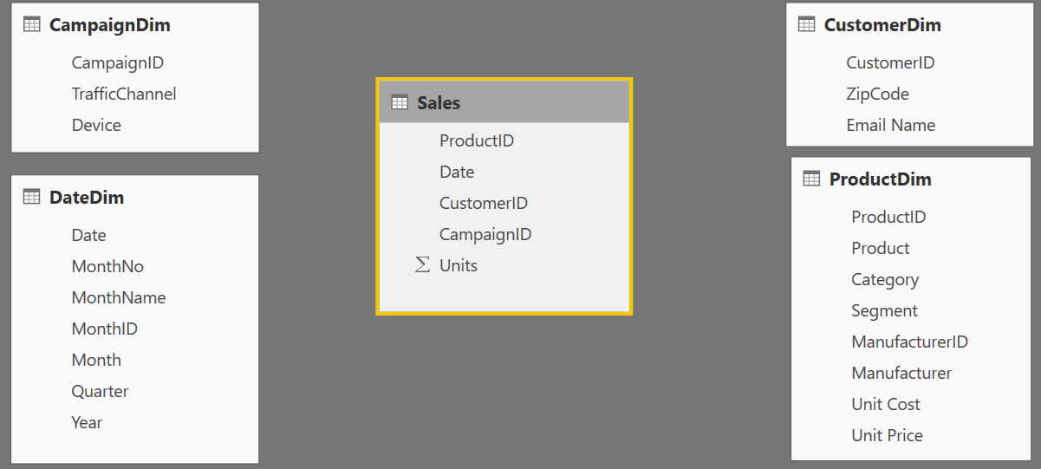
Components of a data model – Fact Table
Basic Data Modeling
Fact
Table
Fact Table
Contains Measures (or items to be aggregated) of a business process Examples:
Transactions
Sales Revenue
Units
Cost
Measures are usually sliceable.
Examples:
By Month, By Customer
Notes:
The items that are math will be our facts: Actual & Budget Revenue Units and Cost
Possibly use a finance example: the Fact would be the general ledger, the dimensions would hold the account lists / descriptions.

Slide 16
Components of a data model – Dim Table
Basic Data Modeling
Dim
Table
Dim
Tables
Dim
Table
Dim
Tables
Dim Table
A Dim (or Dimension) table contains descriptive attributes that define how a fact should roll up.
Examples:
By month,
By Customer, By Geo
Notes:
The BY’s will be the dimensional attributes that we will use to describe the facts.

Slide 17

Components of a data model - Relationships
Basic Data Modeling
Relationships
Connection between a 2 tables (usually fact & Dim tables) using columns from each
3 kinds of Relationships
1 to Many
1 to 1
Many to Many
(with a bridge table)
Relationships
Relationships
Notes:
A Relationship is analogous to how an Excel VLOOKUP function brings two tables together
Can observe which side is the many (*) and which is the one (1) - CARDINALITY
When you draw the relationship, Desktop does several heuristic things
It checks that one side of the relationship is the “One” and the other is the “Many”
Directions of Relationship
Uni-directional are created by default and allows filters to get passed from attribute (dim) table to the Fact
Bi-Directional relationship allow you to pass filters in both directions
This is different than Many to Many
There is a significant performance penalty for Bi-Directional filtering

Slide 18
Data Model Brings Facts and Dimensions Together
Basic Data Modeling
Type of Data Models
Star Schema
Snowflake Schema
Flat or Denormalized
Note: This is not an exhaustive list, but are the most common model types used by Power BI.

Slide 19
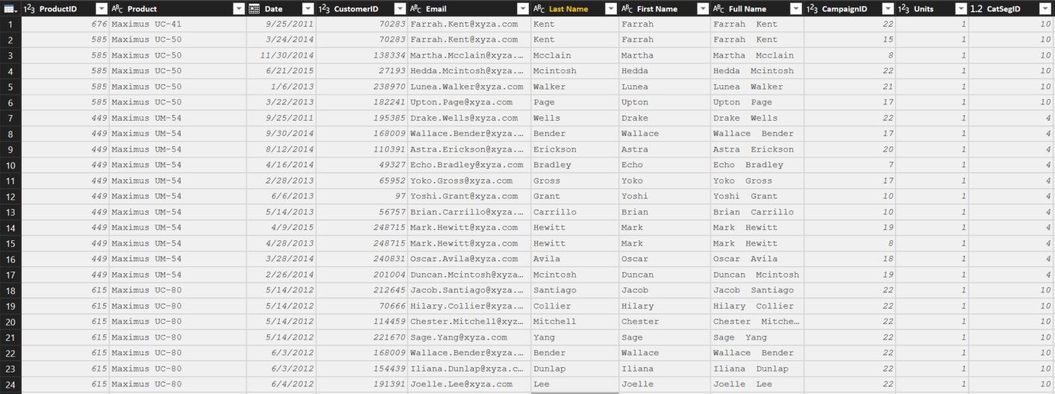
Flat or Denormalized schema
Basic Data Modeling
All attributes for model exist in a single table
Highly inefficient
Model has extra copies of data > slow performance
Size of a flat table can blow up really quickly as data model becomes complex
Notes:
Depending on students, you may want to mention that Power Query can easily create this type of schema – which actually can be beneficial when reporting data using Tableau.
I sometimes call this one the “Kitchen sink” schema.

Slide 20
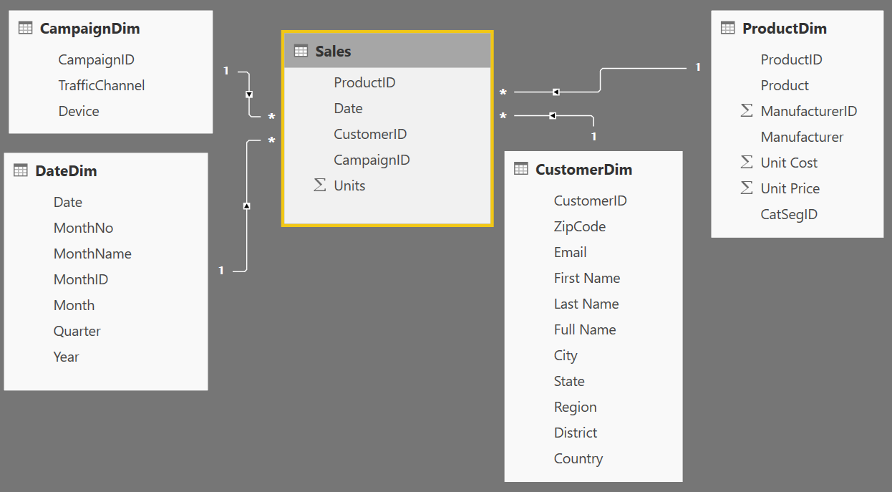
Star Schema
Basic Data Modeling
1
Many
1
1
Fact table in the middle
Surrounded by Dims
Looks like a ‘Star’
Fact table is the “Many” side of the (one to many) relationship
Notes:
By extracting the repeated attributes to dimension tables, you are lowering the amount of memory required by the data model.

Slide 21
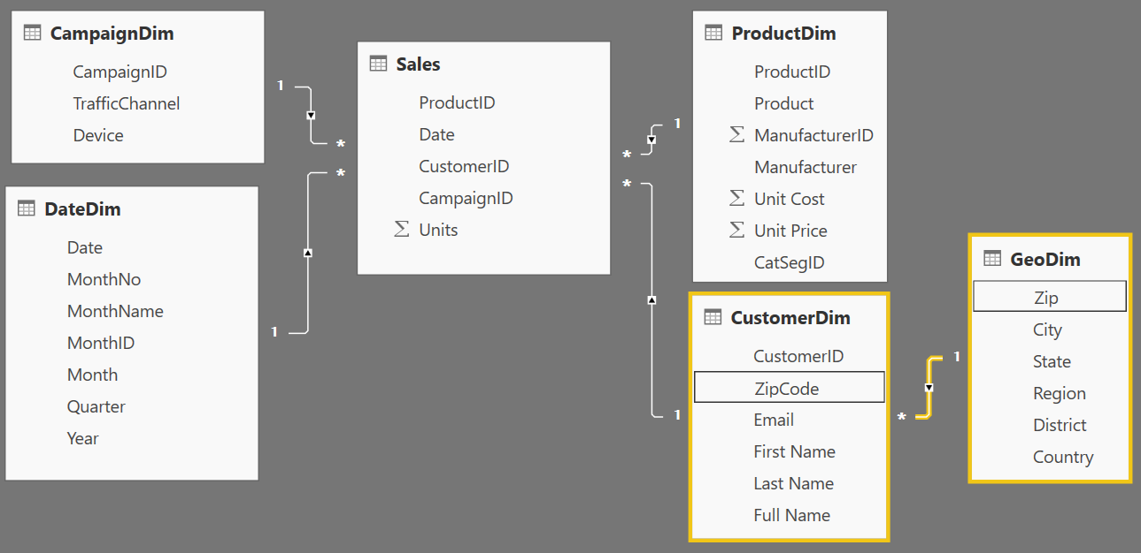
Snowflake Schema
Basic Data Modeling
Center is a Star schema
Fact table in middle
Surrounded by Dims
Dims “snowflake” off of other Dims
If you have many, it looks like a ‘Snowflake’
Dim or Fact tables can be the “Many” side of the relationship
Dims
Facts
Dims
Flake
Snowflake
Notes:
“Snowflaking” off tables can be very beneficial when your dimensions have several repeating attributes that can be extracted to their own table.
So the CustomerDIM would be like the kitchen sink schema if you didn’t branch the Zip off to a GeoDim and have to repeat the city, state, region, etc over and over again making this less efficient.

Slide 22
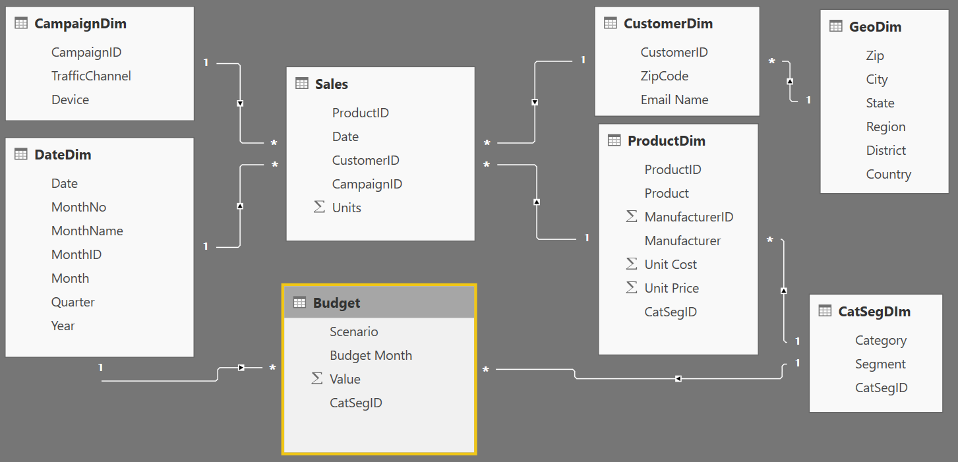
Granularity & Multiple Fact
Basic Data Modeling
Grain (granularity) measures the level of detail in a table
Example:
One row per order or per Item
Daily or Monthly date grain
If your facts have very different granularities, split them into Multiple Fact tables & connect them to shared dimensions at the lowest common granularity.
SalesFact (Daily by Product)
BudgetFact (Monthly by Product Category & Product Segment)
Notes:
Keep in mind, your measures (calculations) should be placed on a fact table, but it really does not matter which one. The key is that measures should not be placed on dimension tables. If students want more detail on Why, send them to the DAX class for more detailed discussion.
When you have a fact at the Month grain, like budget, you can create a calculated column which holds the first (or last) day of the month to use in creating the relationship. One of the key takeaways is that what you slice by all come from your attribute (Dim) tables

Slide 23
Data Types
Numeric Data Types
Whole Number
Decimal Number
Fixed Decimal Number (Floating point stored as integer)
Boolean
Date/Time Data Types
Date – Internally stored as an integer
Time – Internally stored as a fraction between 0 and 1
Date Time
Other Data Types
Text
Any – You should never see this in a data model. Bad things can happen!!
Set your Data Types in the Query Editor
Set your Data Formats ($ %, etc) in the Data Model
Pro Tip: Data type is different from data format
Notes:
Data Types are how data is stored, as opposed to Data Formats which are how data are displayed
Discuss the difference between Fixed Decimal (Currency) and Decimal (which has floating decimal)
Fixed Decimal is 19.4 – 19 places to left of decimal and 4 to the right, which allows for proper processing of pennies. Best for Currency numbers.
Decimal can be less efficient when the data has excessive precision
Discuss splitting DateTime into Date and Time columns so that they compress better
Fixed Decimal numbers – stored like whole number uses less memory than Decimal

Slide 24
Designing good data models
Star Schema – Go to structure for most Data Models
RAM is precious !!!!!
Some Tips and tricks to save RAM and increase speed of model
If a fact table contains an ID field which is unique for each record, remove it
Ex. Transaction ID
Sort columns before bringing them into a Power BI data model
Change all of the ANY data types to an appropriate Data Type
Notes:
* When the file is closed – it is saved to the hard disc
When opened, the DB is stored in RAM (Approx 60% of machine’s available RAM)
Hard Disk has mechanical parts - read/writes are slower
In-Memory – read/writes are faster
RAM is precious, and the PowerBI team uses many techniques to compress data
In the Service, datasets are limited to 1 GB.

Slide 25
KNOWLEDGE CHECK
What allow tables in the data model to “talk” to one another?
Relationships
2. What type of schema has all attributes for model in a single table?
Denormalized or “Flat” – Kitchen Sink
3. When would you use multiple Fact tables
Multiple Reasons
Different Time Grains
Different dimensional attributes
One dimension at different grain: Product v. Product Category
Facts are sourced from different systems with different refresh cadences.
Notes:
Relationships
Denormalized or “Flat” – the Kitchen Sink Schema
Multiple Reasons
Different Time Grains
Different dimensional attributes
One dimension at different grain: Product v. Product Category
Facts are sourced from different systems with different refresh cadences.

