Slide 1
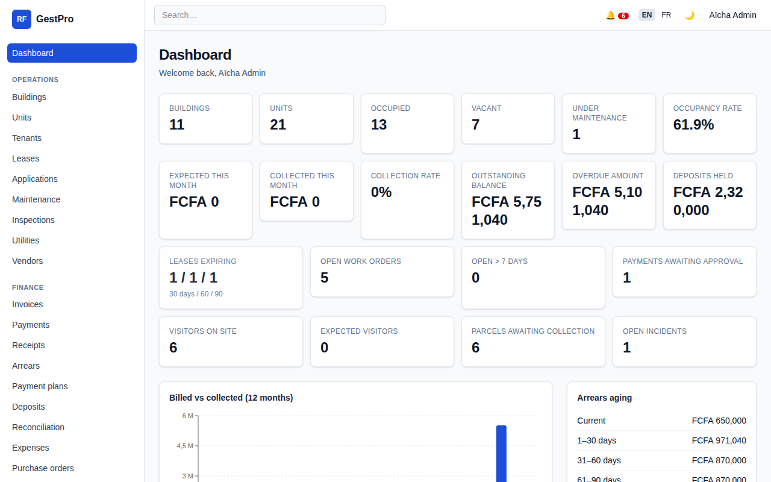
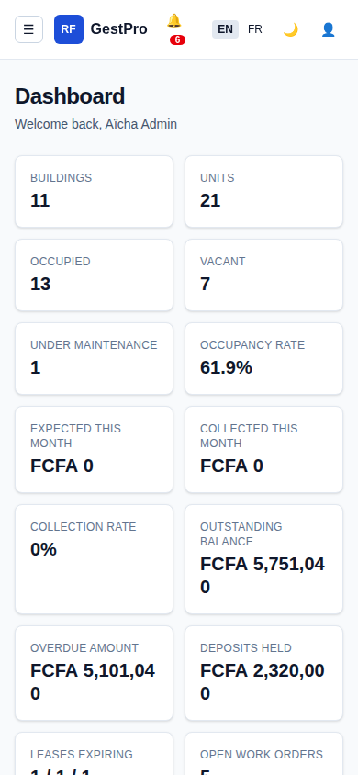
BOUQUET INNOVATION
GestPro
Property and rental management, finally under control.
Rents, receipts, tenants, maintenance and reporting in one secure web application. Built for landlords, property managers, agencies and residences.
Sales presentation | Douala, Cameroon | support@bouquet-innovation.net
Notes:
Open with the name and one sentence: GestPro is the application that puts rent collection and building operations under control.

Slide 2




Managing rentals on paper and spreadsheets costs you money
The same four problems come up in almost every conversation we have with owners and managers.
Rent slips through the cracks
Paper receipts, zero traceability
No visibility for the owner
Disputes and lost trust
Late tenants are noticed weeks later. Nobody knows exactly who owes what, since when.
Carbon-copy booklets get lost, altered or duplicated. Cash is collected but never fully reconciled.
Occupancy, collections and expenses live in someone's head. Monthly statements take days to assemble.
Tenant says they paid, cashier says they did not. Deposits are returned on guesswork.
GestPro | Bouquet Innovation
2
Notes:
Ask the audience which of the four problems hurts most. Most managers recognise all four.

Slide 3
GestPro gives you one source of truth
Every building, tenant, invoice, payment and repair in a single bilingual application, accessible from any browser.
1
See everything at a glance
Occupancy, expected vs collected rent, arrears ageing, open work orders and visitors on site on one dashboard.
2
Collect with confidence
Automatic monthly invoices, numbered receipts that cannot be altered, and reminders that go out on time.
3
Run the whole operation
From rental applications to maintenance, concierge desk and owner statements, with a role for every person involved.
Manager dashboard, live figures in FCFA
GestPro | Bouquet Innovation
3
Notes:
Dashboard is real. Point at expected vs collected and arrears ageing.

Slide 4
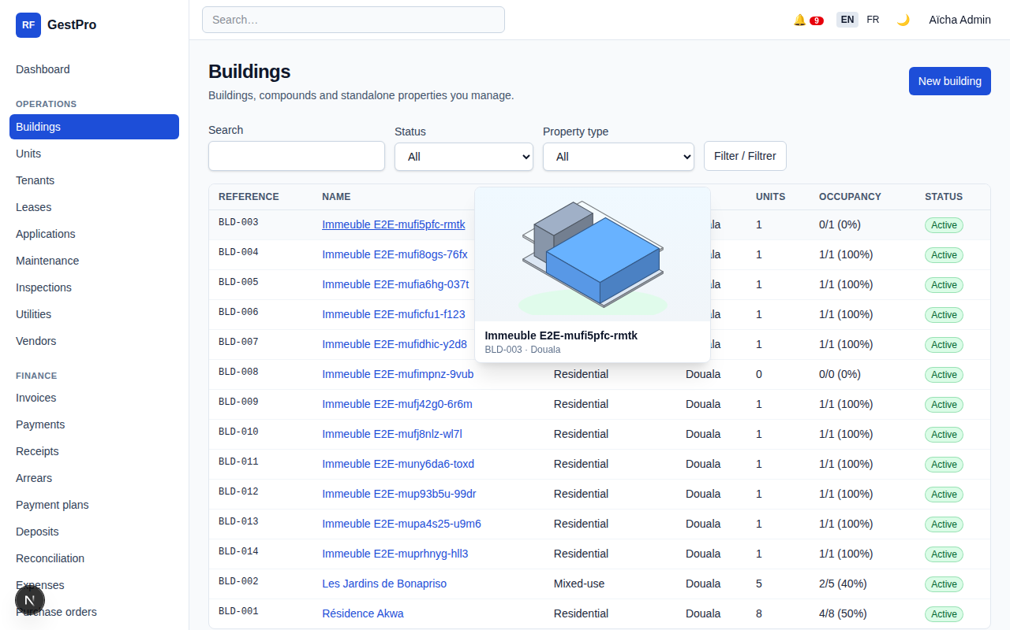
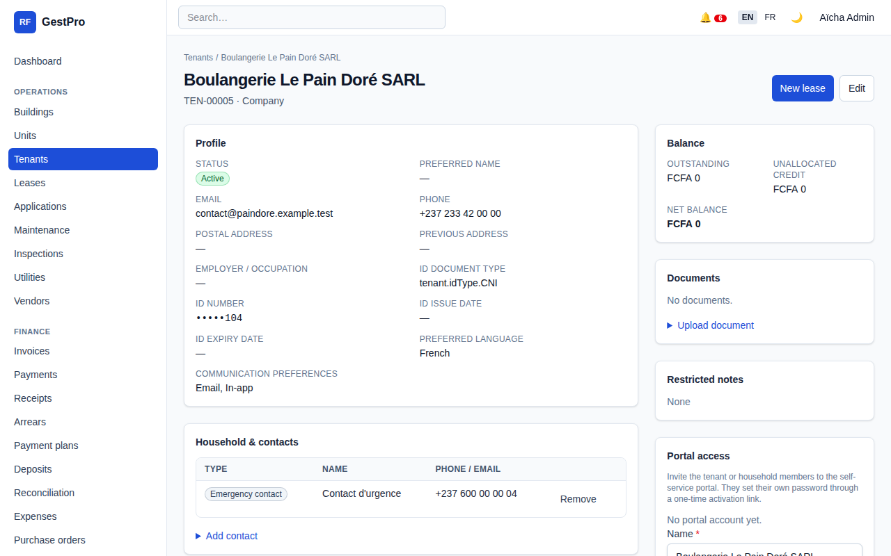
Your portfolio, structured the way it really is
Buildings, blocks, floors and units of every kind, with the people and contracts attached to them.
Apartments, studios, shops, offices, houses and rooms, each with its own status and rent
Tenant files with contacts, documents and complete history
Leases with rent schedules, security deposits and renewal alerts at 30, 60 and 90 days
Rental applications and screening before a key is handed over
Hover any building link to preview it instantly
Buildings list with hover preview
Tenant file
GestPro | Bouquet Innovation
4

Slide 5
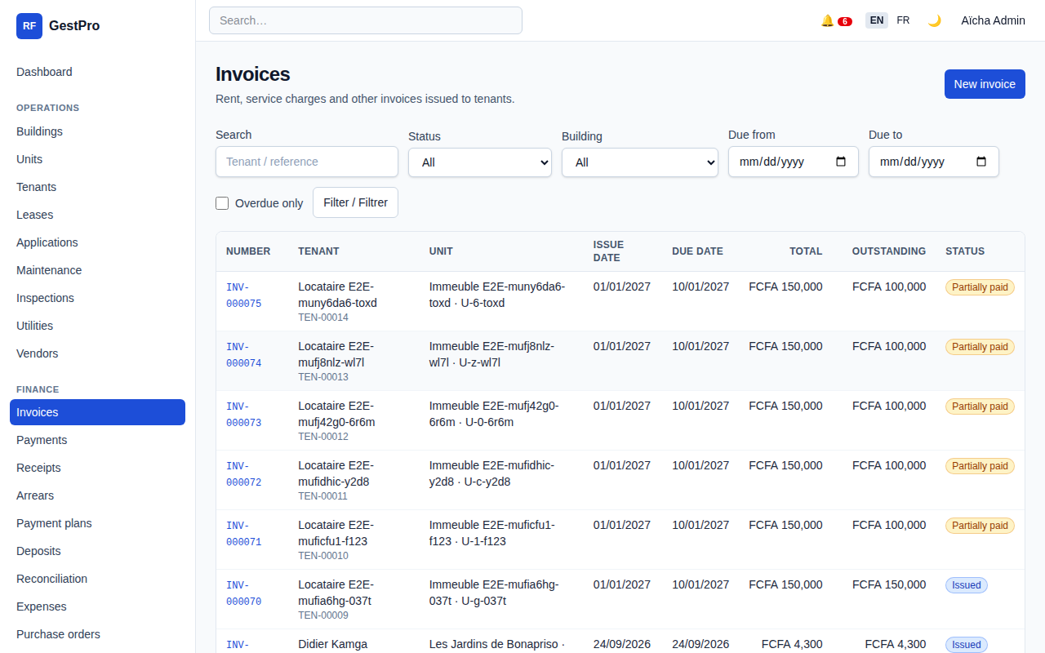
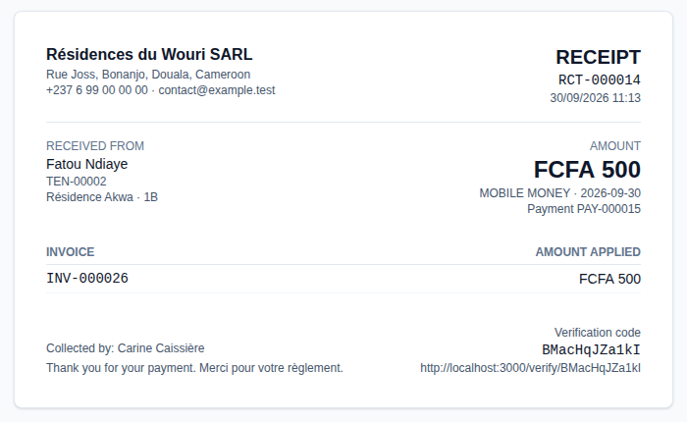
Rent collection without the arguments
Invoices go out by themselves. Every franc that comes in leaves a trace.
Automatic monthly invoices per lease, with utilities and late fees when applicable
Cash, mobile money, bank transfer or cheque, recorded by cashiers in seconds
Immutable, sequentially numbered receipts with a verification code, printable as PDF
Reversals only with approval; payment plans and deposit deductions documented
Bank reconciliation, expenses, purchase orders and recurring charges
Invoice register
GestPro | Bouquet Innovation
Numbered receipt
5

Slide 6
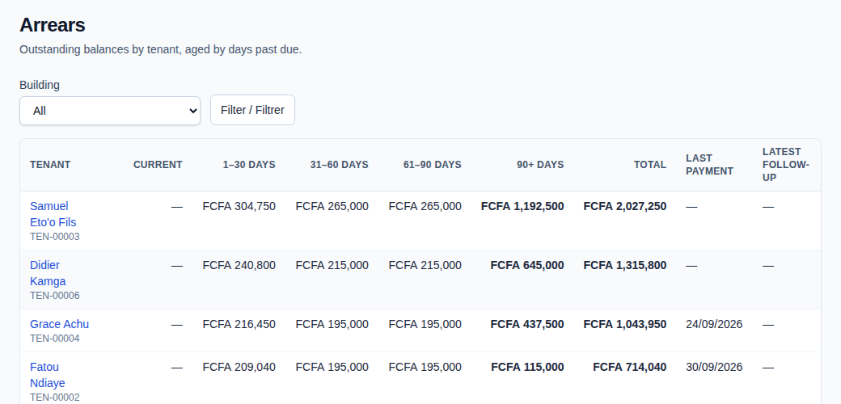
Arrears are visible before they become losses
Who owes, how much, for how long, and what was done about it.
Arrears ageing per tenant and per building, filtered in one click
Reminder notices and email notifications, with the follow-up date kept on file
Late fees applied by rule, not by memory
Payment plans for tenants who need time, tracked to the last instalment
Security deposits held, deducted and refunded with a clear statement
Arrears ageing report
1-30
31-60
61-90
90+
days
days
days
days
GestPro | Bouquet Innovation
6

Slide 7
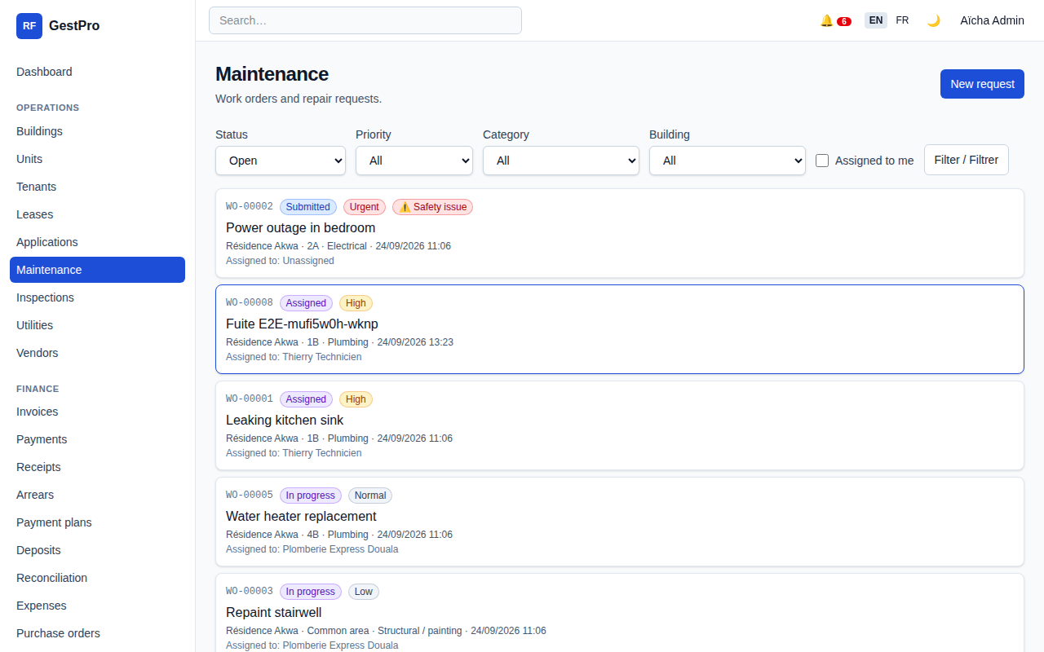
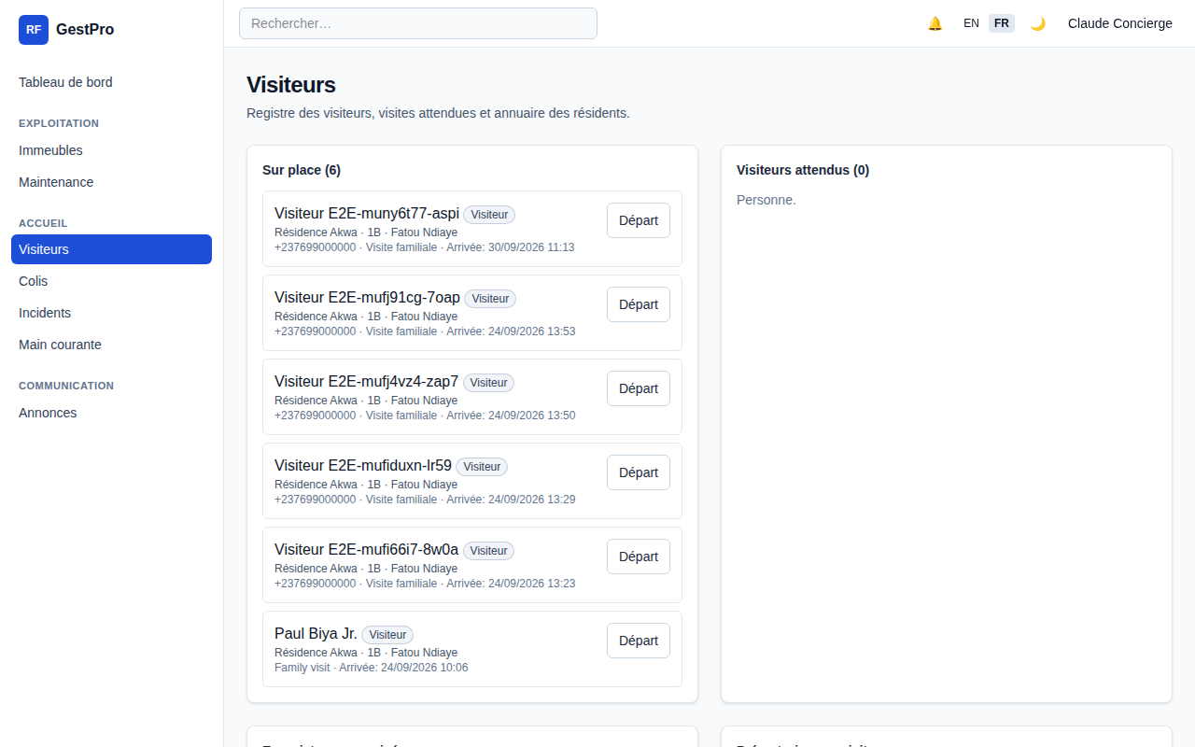
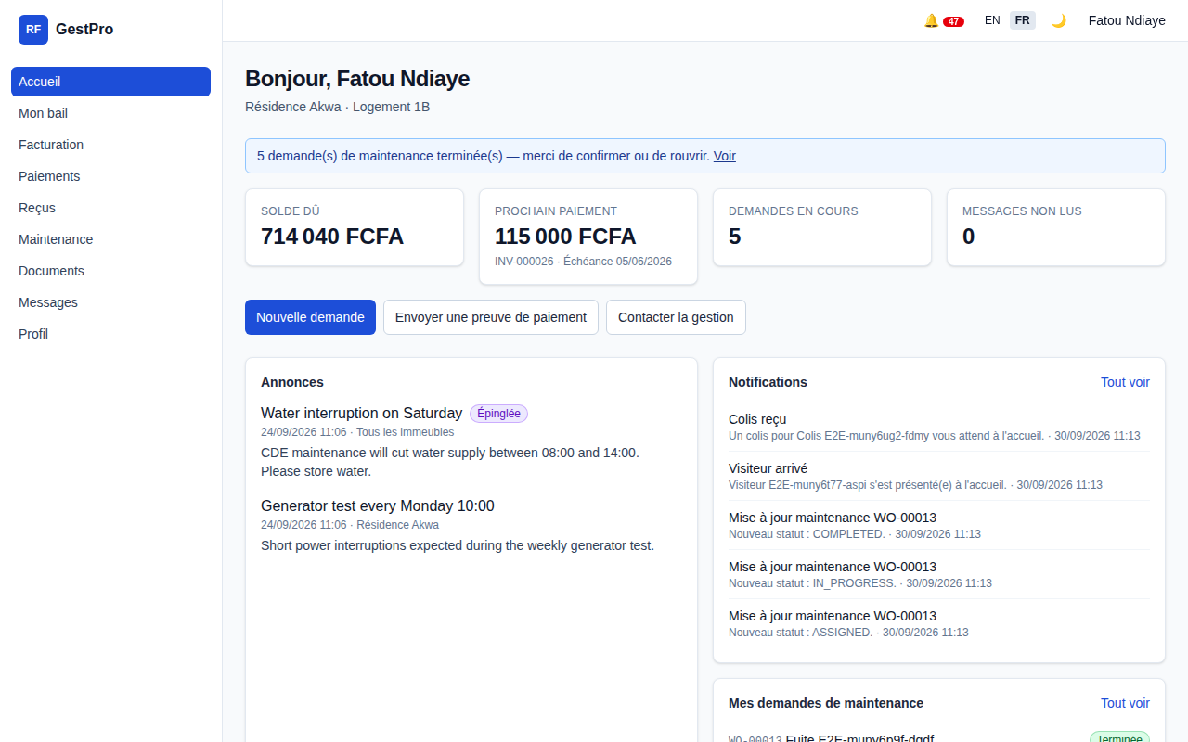
Maintenance, front desk and tenant portal
The daily life of a building, handled by the right people.
Maintenance
Concierge desk
Tenant portal
Work orders with priority and category, assigned to in-house technicians or outside vendors, followed until closure.
Visitor log, parcels awaiting collection, incidents, shift logs and key tracking for security staff.
Tenants see their invoices and payment history, download receipts and submit requests themselves.
Also included: announcements to residents, document library with expiry dates, utilities and meter readings.
GestPro | Bouquet Innovation
7

Slide 8
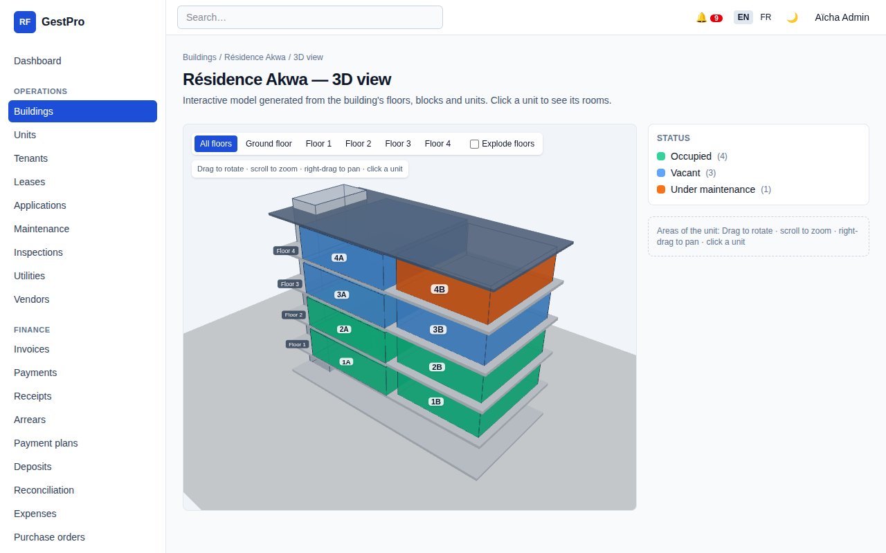
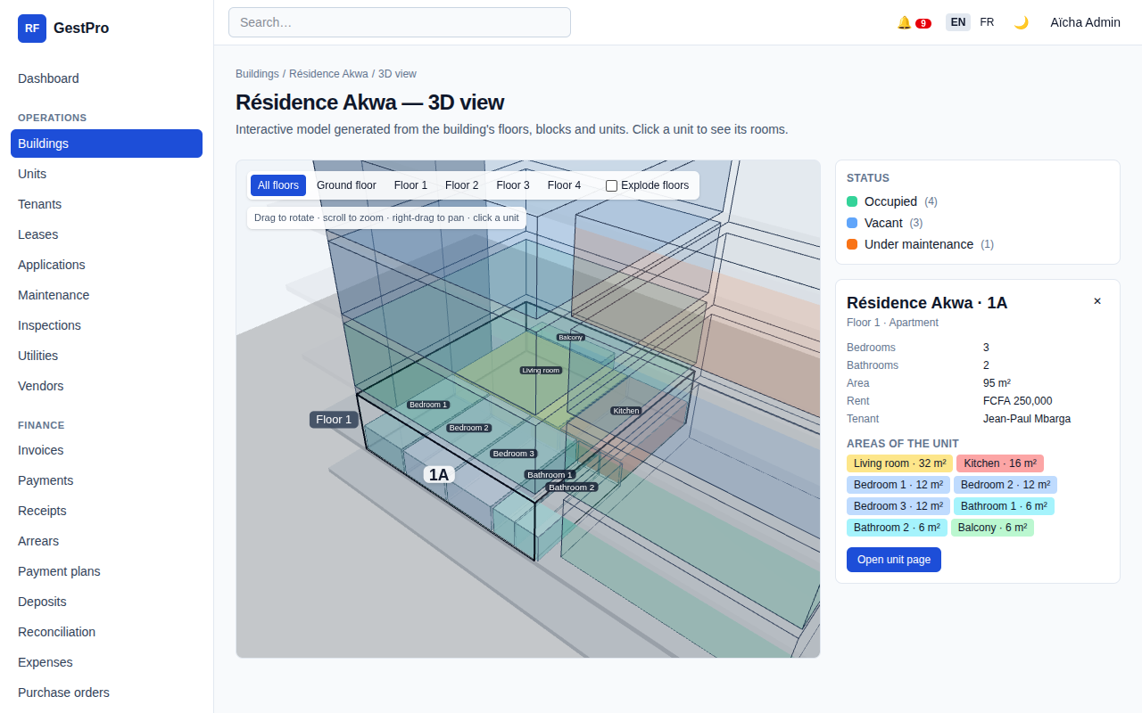
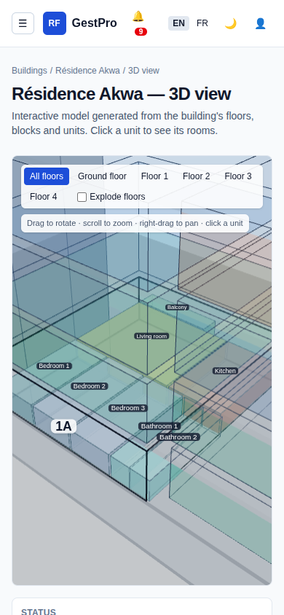
Walk through your building in 3D, from any device
GestPro draws each building from its own data: floors, blocks, units and their status colours. Click a unit to see its rooms.
Interactive 3D view
Unit detail with rooms
Occupied, vacant and under-maintenance units at a glance
Rooms and surface of each unit, rent and current tenant
Responsive on phone, tablet and PC, light and dark mode
Android and iOS apps being released, built on the same secure platform
On mobile
GestPro | Bouquet Innovation
8

Slide 9


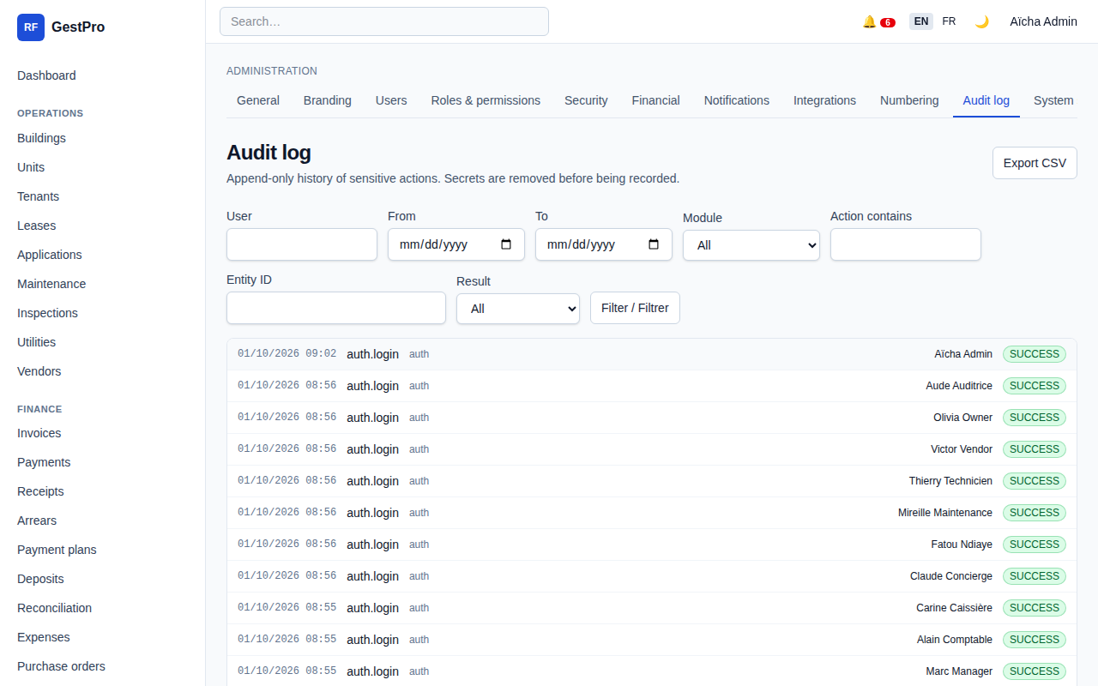


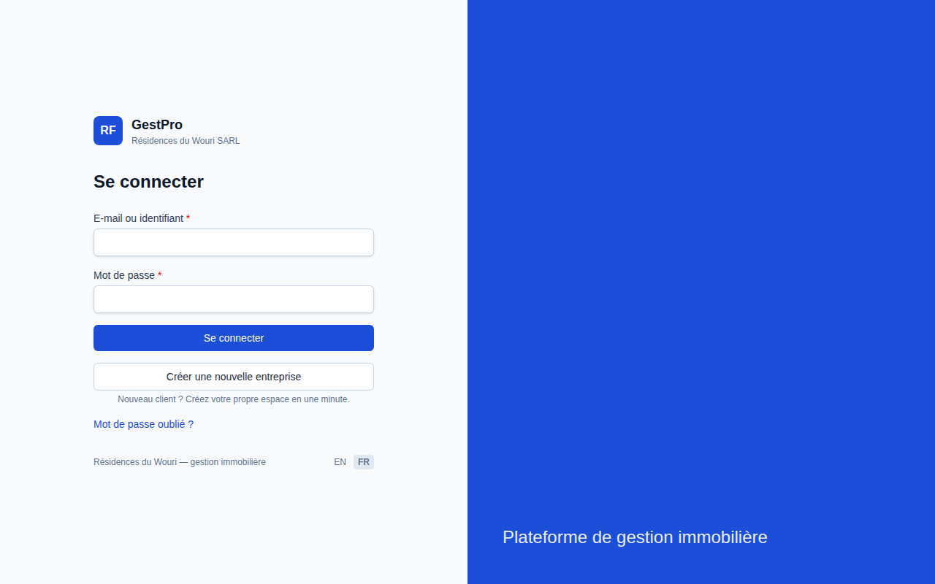


Built for trust
Your figures are protected, and every action can be traced back to a person.
Strong authentication
Controlled sessions
Strong password rules, two-factor authentication (TOTP) and account lockout after repeated failures.
Session control and re-authentication before sensitive actions such as reversals or role changes.
Full audit trail
Approved sign-up only
Every creation, change, payment and login is logged with who, when and from where.
A new enterprise space is opened only after approval by Bouquet Innovation, with a one-time code valid 20 minutes.
Audit log
Daily jobs and backups
Cloud hosted
Automated daily processing, regular backups and a tested restore procedure.
Deployed on Vercel with managed PostgreSQL. Nothing to install, nothing to maintain on your side.
GestPro | Bouquet Innovation
9

Slide 10
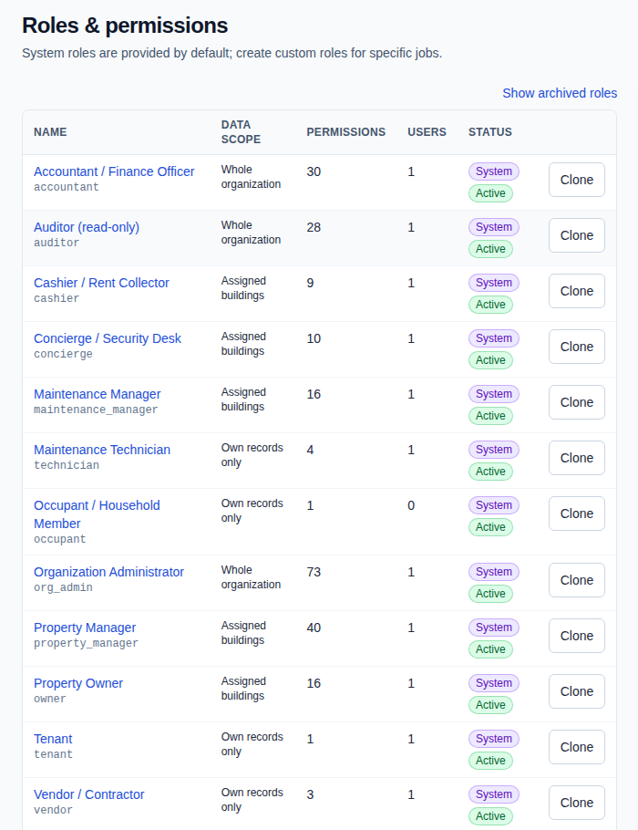
One space per company, a role for every person
Each enterprise works in its own isolated environment. Thirteen roles with fine-grained permissions decide who sees and does what.
Platform admin
Organization admin
Property manager
Accountant
Cashier
Concierge / Security
Maintenance manager
Technician
Vendor
Owner (read-only)
Auditor
Tenant portal
Support
Owners see their own buildings only. Cashiers record payments but cannot reverse them. Custom roles can be cloned from any system role.
Roles and permissions
GestPro | Bouquet Innovation
10

Slide 11
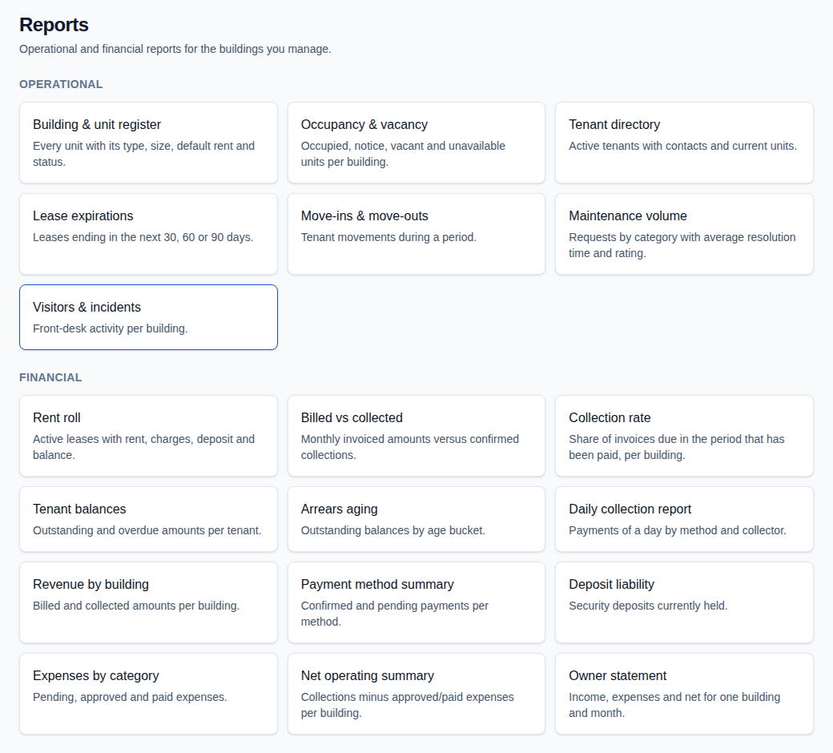
Reports your accountant and your owners will actually use
Operational and financial reports, exportable to CSV, plus dashboards that update themselves.
OPERATIONAL
FINANCIAL
Occupancy and vacancy
Lease expirations
Move-ins and move-outs
Maintenance volume
Visitors and incidents
Collections and collection rate
Arrears ageing
Revenue by building
Expenses by category
Deposit liability and owner statement
Report catalogue
GestPro | Bouquet Innovation
11

Slide 12
From first call to first receipt in days, not months
We stay with you at every step.
1
2
3
4
5
Request access
Approval
Setup in minutes
Training
Ongoing support
Tell us about your portfolio. We confirm the fit and the package.
Bouquet Innovation approves your enterprise and sends a one-time sign-up code.
Create your company, buildings, units and users. Import tenants and leases.
Hands-on sessions for managers, cashiers and front-desk staff, in French or English.
Email support, regular updates and backups included.
GestPro | Bouquet Innovation
12

Slide 13
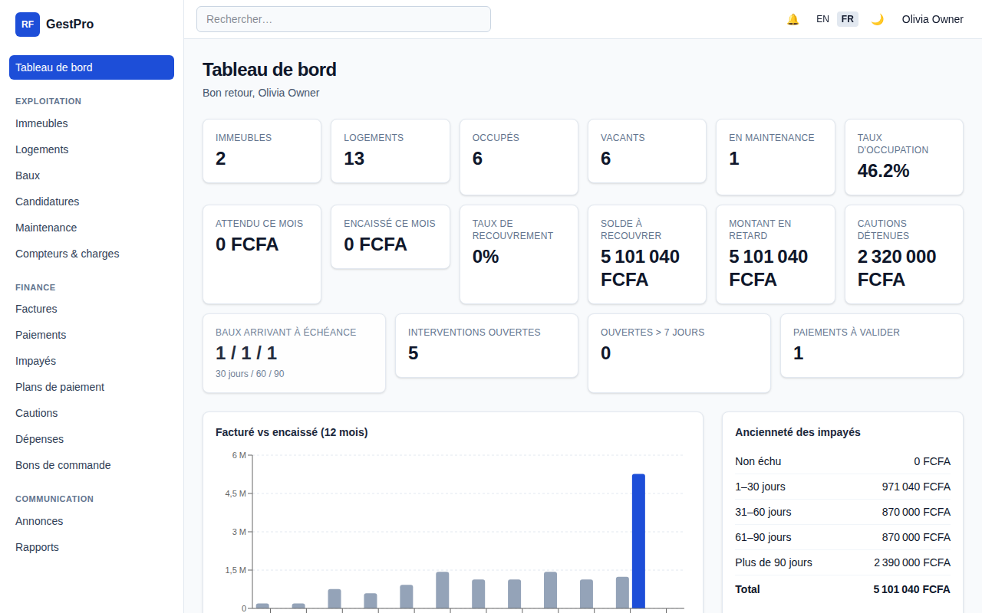


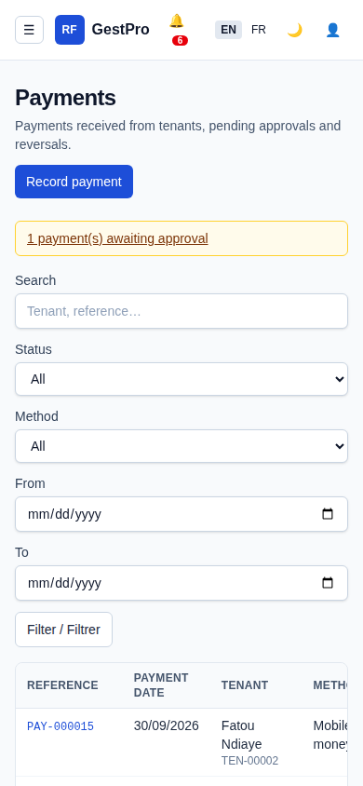


Who GestPro is for
From a single building to a managed portfolio.
Private landlords
Property managers
Keep track of tenants and rent without a full-time manager, from your phone.
Run several owners' buildings with clear statements and audited cash handling.
Real-estate agencies
Residences and compounds
Owner view (read-only)
Rental applications, leases, collections and reporting for a growing client base.
Front desk, visitors, parcels, incidents and maintenance alongside rent management.
GestPro | Bouquet Innovation
13

Slide 14






Why teams choose GestPro
Bilingual
XAF native
Works on phone
French and English, switchable per user.
FCFA amounts, Africa/Douala time, mobile money and cash built in.
Responsive web app today, Android and iOS apps rolling out.
Audit trail
Cloud
2FA security
Every action logged. Receipts that cannot be altered.
Accessible from any browser, backed up daily.
Two-factor login, lockout, session control, approved sign-up.
GestPro | Bouquet Innovation
14

Slide 15
Packaging
Three packages, priced on request according to the size of your portfolio.
Starter
Business
Enterprise
Private landlords and small portfolios
Property managers and agencies
Residences, groups and multi-site operators
Buildings, units, tenants and leases
Automatic invoices and numbered receipts
Payments: cash, mobile money, transfer, cheque
Arrears tracking and reminders
Standard dashboard and reports
Email support
Everything in Starter
Work orders, technicians and vendors
Concierge module and tenant portal
Deposits, payment plans, late fees, utilities
Expenses, purchase orders, reconciliation
Owner read-only access and 3D building view
Training for your team
Everything in Business
All 13 roles and custom roles
Two-factor authentication enforced, audit exports
Multi-enterprise organisation
Priority support and onboarding assistance
Mobile apps when released
Price on request
Price on request
Price on request
GestPro | Bouquet Innovation
15

Slide 16
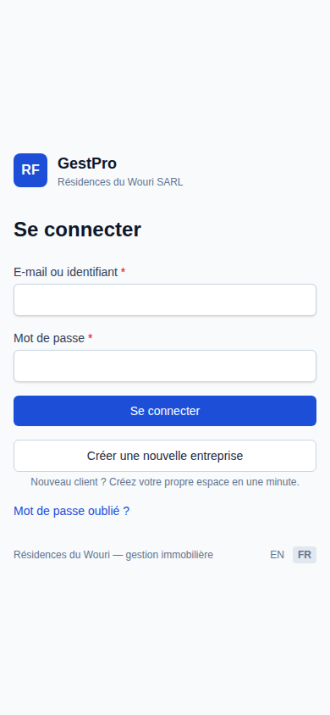
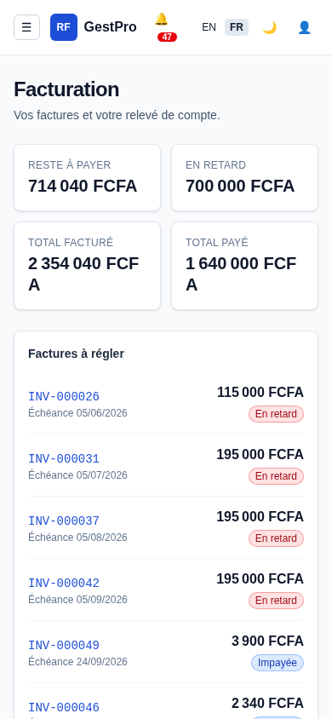
Let's put your portfolio in order
1
Book a 30-minute demo on your own buildings
2
Receive your sign-up code once approved
3
Go live with your team in days
support@bouquet-innovation.net
Bouquet Innovation | Douala, Cameroon
Thank you

