Slide 1
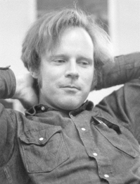
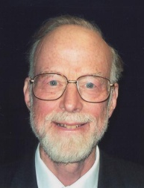


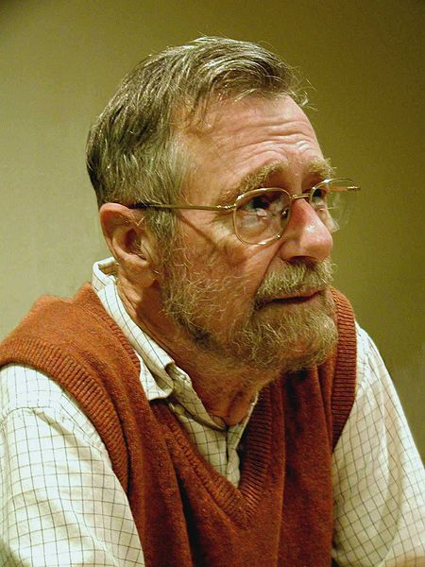

JACK
ESC/Java2
Jive
Floyd Hoare
Dijkstra
TIMsort
1969
1967
1976
2000
2010
2015

