Slide 1
BBEACONS
Thomas Van Raemdonck & Wouter Vande Velde

Slide 2
Table of contents
What?
Mobile Application
Website
Database
Trilateration

Slide 3
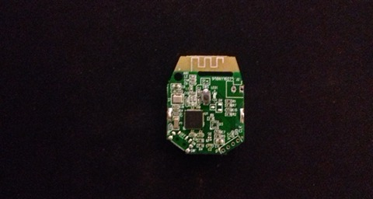
What?
Indoor navigation
Bluetooth beacons
Website
Database
Mobile Application

Slide 4
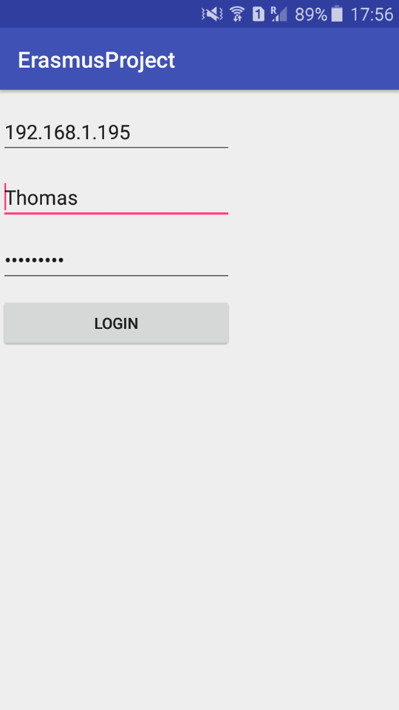
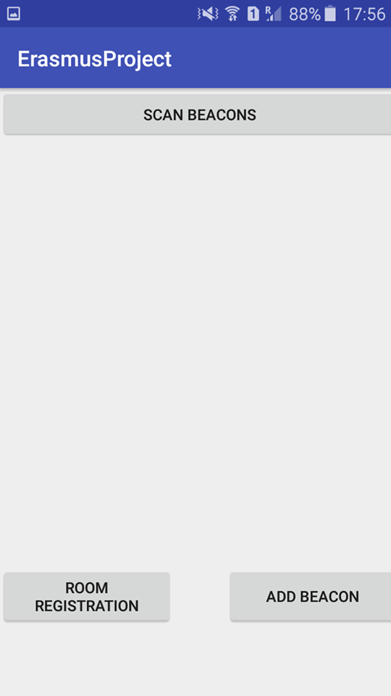
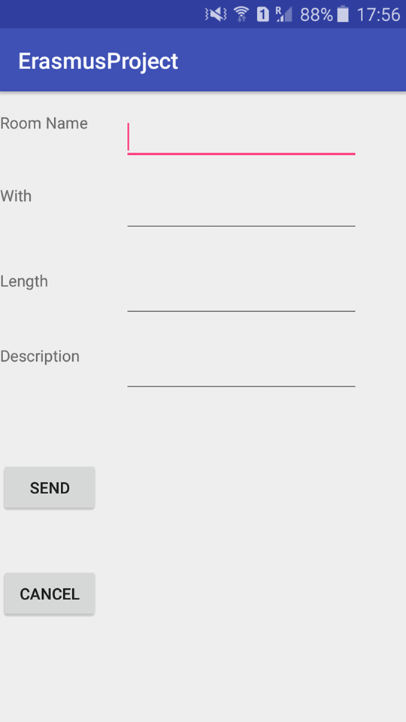
Mobile Application
Android Studio
Login
Add beacon
Add room
Scanning beacons
Heatmap

Slide 5
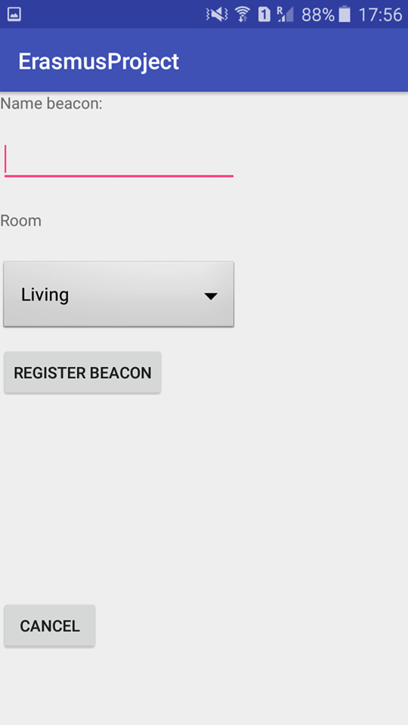
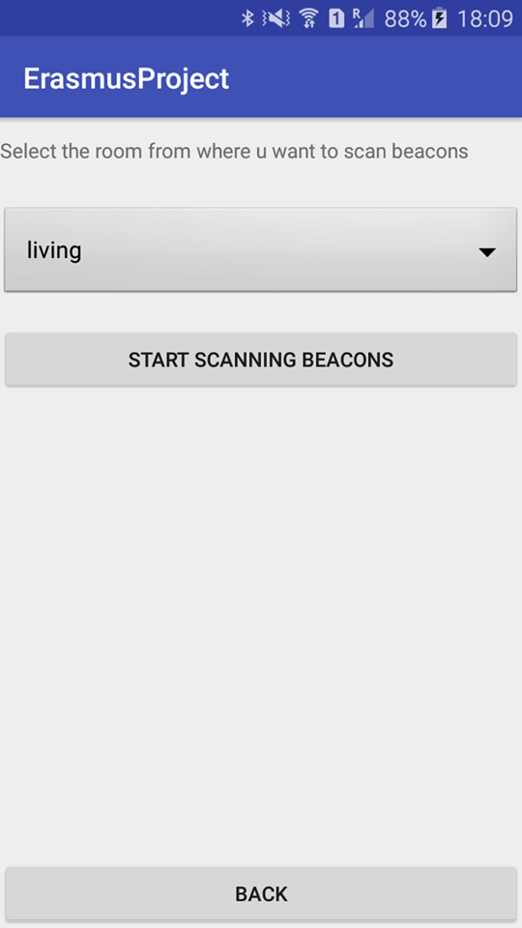
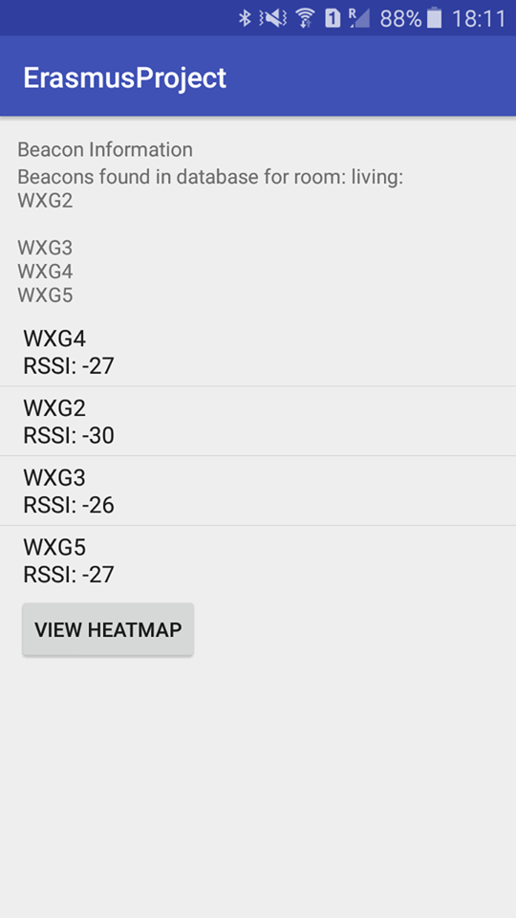
Mobile Application

Slide 6
Website
Shows raw data
Rooms
Localhost
Wamp

Slide 7
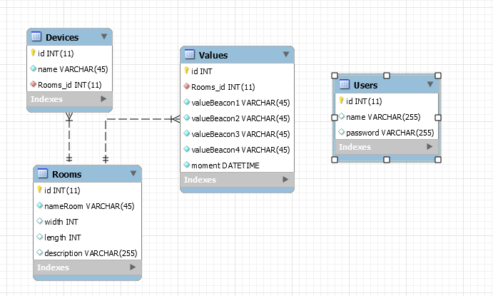
Database
Mysql
Local server
phpmyadmin
User table -> connection

Slide 8
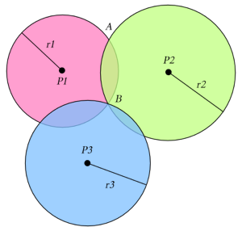
Indoor navigation
How?
Trilateration
3 Beacons in a room
Distance from the 3 beacons

Slide 9
Demo

Slide 10
The end
Questions?

