Slide 1
BBEACONS
Thomas Van Raemdonck & Wouter Vande Velde

Slide 2
Table of contents
What?

Slide 3
What?
Indoor navigation
Bluetooth beacons
Website
Database
Mobile Application

Slide 4
Bluetooth Beacons

Slide 5
Mobile Application
Android Studio
Login
Add beacon
Add room
Scanning beacons
Heatmap

Slide 6
Website
Shows data
Rooms

Slide 7
Database
Mysql
Local server

Slide 8
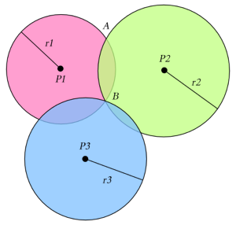
Indoor navigation
How?
Trilateration

