Slide 1
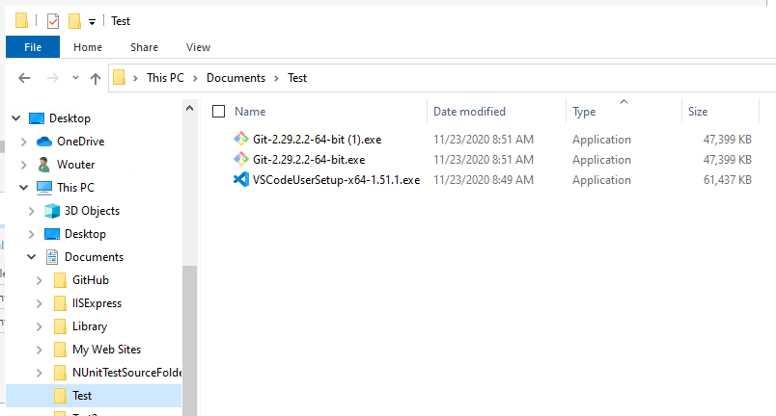
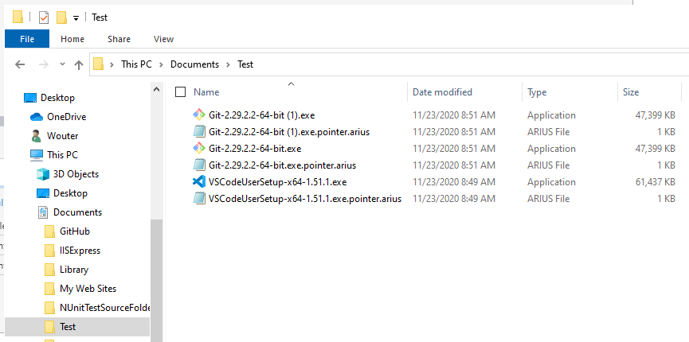
After running arius archive

Slide 2
Local File System
Blob Storage
Manifests Container
Cool tier
Chunks Container
Archive tier
Local File
SHA hash ‘xyz’
Pointer File
Manifest File for SHA hash ‘xyz’
Chunk File
Chunk File
Chunk File

Slide 3
Arius 4
Local File System
Blob Storage
Manifests Container
Cool tier
Chunks Container
Archive tier
Local File
SHA hash ‘xyz’
Duplicate
Local File
SHA hash ‘xyz’
Chunk File
Pointer File
Manifest File for SHA hash ‘xyz’
To manifest for hash ‘xyz’
Chunk File
Local File
SHA hash ‘abc’
Chunk File
Pointer File
Manifest File for SHA hash ‘abc’
To manifest for hash ‘abc’
Chunk File

Slide 4
Arius 5
Local File System
Blob Storage
Pointers
Table Storage
Manifests
Blob Container (Cool Tier)
Chunks Container
Blob Container (Archive Tier)
Local File 1.exe
Local File 1.exe.pointer.arius
Entry for
“Local File 1.exe”
SHA hash: “xyz”
Contents: ‘xyz’
“Local File 1 – Copy.exe”
Local File 1 – Copy.exe.pointer.arius
Entry for
“Local File 1 – Copy.exe”
Chunk 1
SHA hash: “xyz”
Contents: ‘xyz’
“xyz” =
Chunk 1 +
Chunk 2 +
Chunk 3
Chunk 2
“Local File 2.pdf”
Local File 2.pdf.pointer.arius
Entry for
“Local File 2.pdf”
Chunk 3
SHA hash: “abc”
Contents: ‘abc’
“abc” =
Chunk 3 +
Chunk 4
Chunk 4
A local file
=
A sparse local representation
+
Metadata (Path, Modified Date, Size, …)
+
List of Binary Content
+
Binary Content in Archive tier

Slide 5
Local File System
Blob Storage
1
report v1.doc
6
BinaryFileMetadata
Table Storage
2
report v1.doc.pointer.arius
arius archive
binaryhash1
BinaryHash | OriginalLength | ArchivedLength | ChunkCount
binaryhash1 | 20 KB | 15 KB | 3
binaryhash2 | 24 KB | 17 KB | 3
binaryhash3 | 5 MB | 5 MB | 1
chunkhash1
3
chunkhash2
12
binaryhash1
chunkhash3
8
report v1 (copy).doc
report v1 (copy).doc.pointer.arius
BinaryManifests
Blob Container (Cool Tier)
Chunks Container
Blob Container (Archive Tier)
arius archive
binaryhash1
binaryhash1
4
chunkhash3.gz.aes
5
chunkhash1 chunkhash2 chunkhash3
chunkhash5.gz.aes
4
chunkhash1.gz.aes
binaryhash1
binaryhash2
10
report v2.doc
report v2.doc.pointer.arius
chunkhash1 chunkhash2 chunkhash4
binaryhash2
4
chunkhash2.gz.aes
arius archive
chunkhash1
binaryhash3
chunkhash5
11
chunkhash4.gz.aes
chunkhash2
binaryhash2
chunkhash4
movie.mp4
movie.mp4.pointer.arius
PointerFileEntries
Table Storage
binaryhash2
arius archive
BinaryHash | RelativeName | Version
binaryhash1 | report v1.doc.pointer.arius | 01/10/2021
binaryhash1 | report v1 (copy).doc.pointer.arius | 02/10/2021
binaryhash2 | report v2.doc.pointer.arius | 01/10/2021
binaryhash3 | movie.mp4.pointer.arius | 01/10/2021
7
9
binaryhash3
chunkhash5

Slide 6


As picture

Slide 7
 | BinaryFile | PointerFile | PointerFileEntry | Chunks
0 | N | N | N | N
1 | N | N | N | A
2 | N | N | N | C
3 | N | N | Y | N
4 | N | N | Y | A
5 | N | N | Y | C
6 | N | Y | N | N
7 | N | Y | N | A
8 | N | Y | N | C
9 | N | Y | Y | N
10 | N | Y | Y | A
11 | N | Y | Y | C
12 | Y | N | N | N
13 | Y | N | N | A
14 | Y | N | N | C
15 | Y | N | Y | N
16 | Y | N | Y | A
17 | Y | N | Y | C
18 | Y | Y | N | N
19 | Y | Y | N | A
20 | Y | Y | N | C
21 | Y | Y | Y | N
22 | Y | Y | Y | A
23 | Y | Y | Y | C

