Slide 1
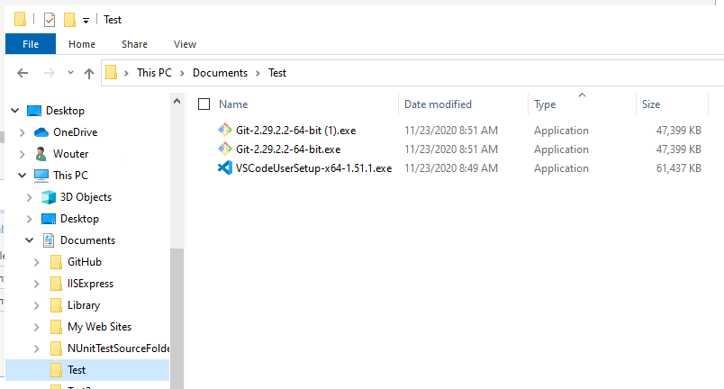
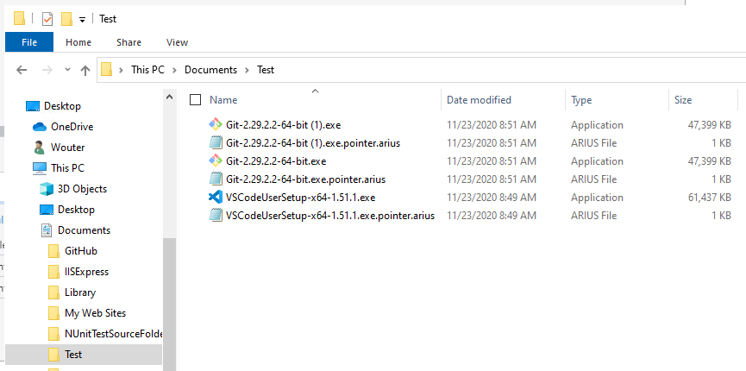
After running arius archive

Slide 2
Local File System
Blob Storage
Manifests Container
Cool tier
Chunks Container
Archive tier
Local File
SHA hash ‘xyz’
Pointer File
Manifest File for SHA hash ‘xyz’
Chunk File
Chunk File
Chunk File

Slide 3
Arius 4
Local File System
Blob Storage
Manifests Container
Cool tier
Chunks Container
Archive tier
Local File
SHA hash ‘xyz’
Duplicate
Local File
SHA hash ‘xyz’
Chunk File
Pointer File
Manifest File for SHA hash ‘xyz’
To manifest for hash ‘xyz’
Chunk File
Local File
SHA hash ‘abc’
Chunk File
Pointer File
Manifest File for SHA hash ‘abc’
To manifest for hash ‘abc’
Chunk File

Slide 4
Arius 5
Local File System
Blob Storage
Pointers
Table Storage
Manifests
Blob Container (Cool Tier)
Chunks Container
Blob Container (Archive Tier)
Local File 1.exe
Local File 1.exe.pointer.arius
Entry for
“Local File 1.exe”
SHA hash: “xyz”
Contents: ‘xyz’
“Local File 1 – Copy.exe”
Local File 1 – Copy.exe.pointer.arius
Entry for
“Local File 1 – Copy.exe”
Chunk 1
SHA hash: “xyz”
Contents: ‘xyz’
“xyz” =
Chunk 1 +
Chunk 2 +
Chunk 3
Chunk 2
“Local File 2.pdf”
Local File 2.pdf.pointer.arius
Entry for
“Local File 2.pdf”
Chunk 3
SHA hash: “abc”
Contents: ‘abc’
“abc” =
Chunk 3 +
Chunk 4
Chunk 4
A local file
=
A sparse local representation
+
Metadata (Path, Modified Date, Size, …)
+
List of Binary Content
+
Binary Content in Archive tier

Slide 5
Local File System
Blob Storage
1
report v1.doc
6
BinaryFileMetadata
Table Storage
2
report v1.doc.pointer.arius
arius archive
binaryhash1
chunkhash1
BinaryHash | OriginalLength | ArchivedLength | ChunkCount
binaryhash1 | 20 KB | 15 KB | 3
binaryhash2 | 24 KB | 17 KB | 3
binaryhash3 | 5 MB | 5 MB | 1
5
chunkhash2
12
binaryhash1
chunkhash3
8
report v1 (copy).doc
9
report v1 (copy).doc.pointer.arius
BinaryManifests
Blob Container (Cool Tier)
Chunks Container
Blob Container (Archive Tier)
arius archive
binaryhash1
4
binaryhash1
3
chunkhash3.gz.aes
chunkhash1 chunkhash2 chunkhash3
chunkhash5.gz.aes
3
chunkhash1.gz.aes
binaryhash1
14
binaryhash2
movie.mp4
movie.mp4.pointer.arius
chunkhash1 chunkhash2 chunkhash4
chunkhash2.gz.aes
binaryhash3
3
arius archive
binaryhash3
chunkhash5
13
chunkhash4.gz.aes
binaryhash3
PointerFileEntries
Table Storage
chunkhash5
11
report v2.doc
12
15
report v2.doc.pointer.arius
BinaryHash | RelativeName | Version
binaryhash1 | report v1.doc.pointer.arius | 01/10/2021
binaryhash1 | report v1 (copy).doc.pointer.arius | 01/10/2021
binaryhash2 | report v2.doc.pointer.arius | 02/10/2021
binaryhash3 | movie.mp4.pointer.arius | 01/10/2021
arius archive
binaryhash2
chunkhash1
7
10
chunkhash2
16
binaryhash2
chunkhash4

Slide 6


As picture

Slide 7
 | BinaryFile | PointerFile | PointerFileEntry | Chunks
0 | N | N | N | N
1 | N | N | N | A
2 | N | N | N | C
3 | N | N | Y | N
4 | N | N | Y | A
5 | N | N | Y | C
6 | N | Y | N | N
7 | N | Y | N | A
8 | N | Y | N | C
9 | N | Y | Y | N
10 | N | Y | Y | A
11 | N | Y | Y | C
12 | Y | N | N | N
13 | Y | N | N | A
14 | Y | N | N | C
15 | Y | N | Y | N
16 | Y | N | Y | A
17 | Y | N | Y | C
18 | Y | Y | N | N
19 | Y | Y | N | A
20 | Y | Y | N | C
21 | Y | Y | Y | N
22 | Y | Y | Y | A
23 | Y | Y | Y | C

