Slide 1
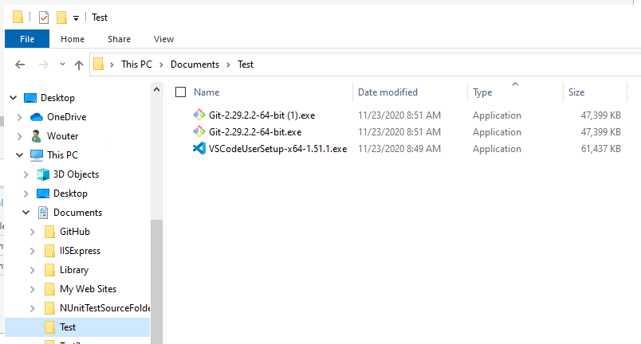
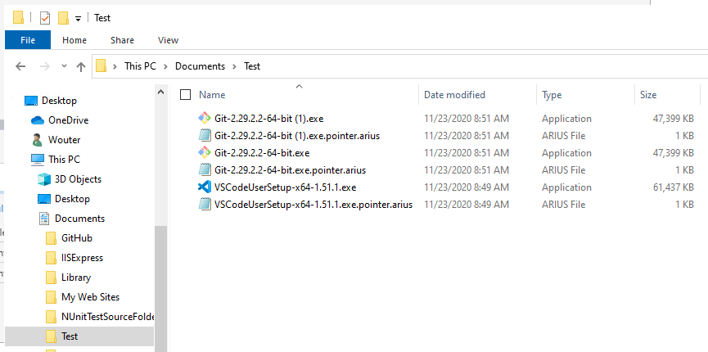
After running arius archive

Slide 2
Local File System
Blob Storage
Manifests Container
Cool tier
Chunks Container
Archive tier
Local File
SHA hash ‘xyz’
Pointer File
Manifest File for SHA hash ‘xyz’
Chunk File
Chunk File
Chunk File

Slide 3
Local File System
Blob Storage
Manifests Container
Cool tier
Chunks Container
Archive tier
Local File
SHA hash ‘xyz’
Duplicate
Local File
SHA hash ‘xyz’
Chunk File
Pointer File
Manifest File for SHA hash ‘xyz’
To manifest for hash ‘xyz’
Chunk File
Local File
SHA hash ‘abc’
Chunk File
Pointer File
Manifest File for SHA hash ‘abc’
To manifest for hash ‘abc’
Chunk File

Slide 4
