Slide 1
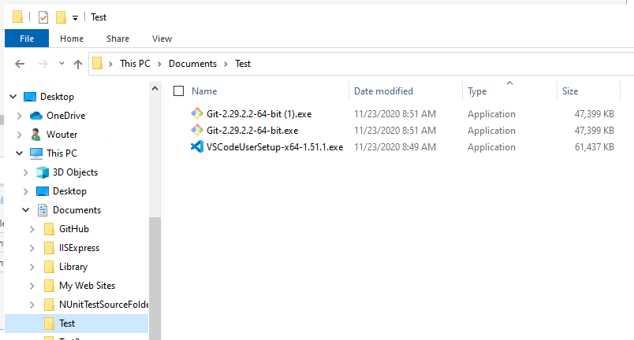
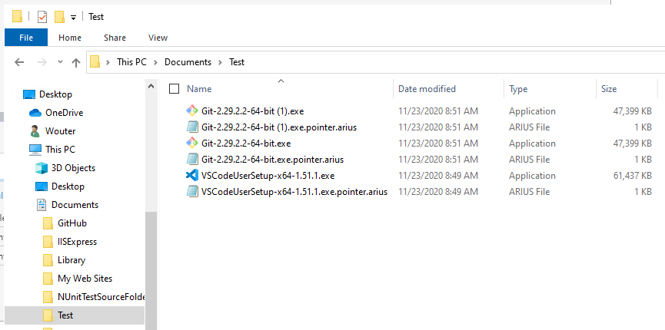
After running arius archive

Slide 2
Local File System
Blob Storage
Manifests Container
Cool tier
Chunks Container
Archive tier
Local File
SHA hash ‘xyz’
Pointer File
Manifest File for SHA hash ‘xyz’
Chunk File
Chunk File
Chunk File

Slide 3
Arius 4
Local File System
Blob Storage
Manifests Container
Cool tier
Chunks Container
Archive tier
Local File
SHA hash ‘xyz’
Duplicate
Local File
SHA hash ‘xyz’
Chunk File
Pointer File
Manifest File for SHA hash ‘xyz’
To manifest for hash ‘xyz’
Chunk File
Local File
SHA hash ‘abc’
Chunk File
Pointer File
Manifest File for SHA hash ‘abc’
To manifest for hash ‘abc’
Chunk File

Slide 4
Arius 5
Local File System
Blob Storage
Pointers
Table Storage
Manifests
Blob Container (Cool Tier)
Chunks Container
Blob Container (Archive Tier)
Local File 1.exe
Local File 1.exe.pointer.arius
Entry for
“Local File 1.exe”
SHA hash: “xyz”
Contents: ‘xyz’
“Local File 1 – Copy.exe”
Local File 1 – Copy.exe.pointer.arius
Entry for
“Local File 1 – Copy.exe”
Chunk 1
SHA hash: “xyz”
Contents: ‘xyz’
“xyz” =
Chunk 1 +
Chunk 2 +
Chunk 3
Chunk 2
“Local File 2.pdf”
Local File 2.pdf.pointer.arius
Entry for
“Local File 2.pdf”
Chunk 3
SHA hash: “abc”
Contents: ‘abc’
“abc” =
Chunk 3 +
Chunk 4
Chunk 4
A local file
=
A sparse local representation
+
Metadata (Path, Modified Date, Size, …)
+
List of Binary Content
+
Binary Content in Archive tier

Slide 5


As picture

Slide 6
 | BinaryFile | PointerFile | PointerFileEntry | Chunks
0 | N | N | N | N
1 | N | N | N | A
2 | N | N | N | C
3 | N | N | Y | N
4 | N | N | Y | A
5 | N | N | Y | C
6 | N | Y | N | N
7 | N | Y | N | A
8 | N | Y | N | C
9 | N | Y | Y | N
10 | N | Y | Y | A
11 | N | Y | Y | C
12 | Y | N | N | N
13 | Y | N | N | A
14 | Y | N | N | C
15 | Y | N | Y | N
16 | Y | N | Y | A
17 | Y | N | Y | C
18 | Y | Y | N | N
19 | Y | Y | N | A
20 | Y | Y | N | C
21 | Y | Y | Y | N
22 | Y | Y | Y | A
23 | Y | Y | Y | C

