Slide 1
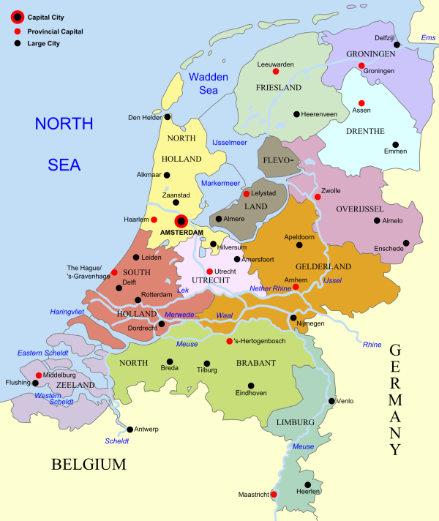

Let’s Blink a LED (in C++, of course)
Wouter van Ooijen
wouter.vanooijen@hu.nl, wouter@voti.nl
Lecturer Computer Science, HBO-ICT, Hogeschool Utrecht, Netherlands
Occasional speaker (Meeting C++, EmBo++, CoreHard, Accu, …)
Embedded C++ promoter (both the embedded and C++ worlds seem to need convincing)
Code, sheets etc. at www.github.com/wovo/talk-gpio-abstractions
Warning: there will be code….
HBO-ICT
1/23

Slide 2
Why blink a LED*?
“Hello world” of mico-controller programming
Illustrates low-level abstraction (that is: how to pass a GPIO pin)
*LED: a Light Emitting Diode; a thingy that lights up if you pass the right amount of current through it in the right direction.
2/23

Slide 3
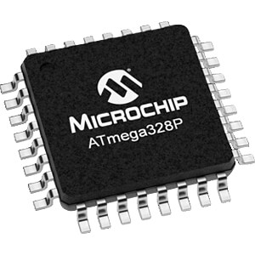
What is a micro-controller?
Single-chip computer: CPU, code memory, data memory, I/O
Programmed without a traditional OS (Linux doesn’t fit, yet)
IDE and build on a PC/laptop
Download to target micro-controller, (debug), run
Very wide range:
 | Price | Flash | RAM | MIPS
Ultra-low cost | 0.03 | 256 b | 16 b | 1
‘standard’ 8-bit | 0.50 | 16 Kb | 2 Kb | 16
Cortex 32-bit | 2.00 | 1 Mb | 100 Kb | 100
3/23

Slide 4
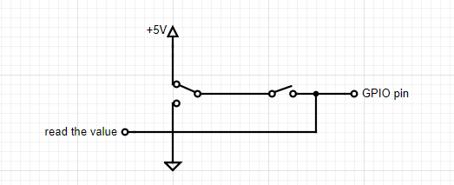
What is a GPIO pin?
General Purpose Input Output pin
Electrical connection (pin) under direct application control
Can be used as input, or as output
Operations:
Make it an input
Read the value (pushbutton)
Make it an output
Write a value to it (LED)
Connects to the world outside the micro-controller
Up after write( 1 )
Low after write( 0 )
Open for input,
Closed for output
4/23

Slide 5
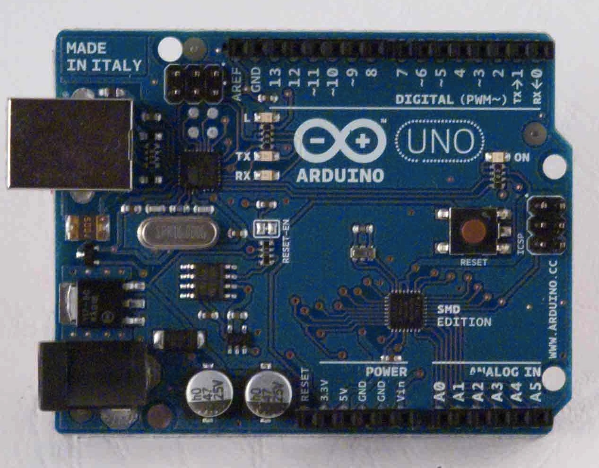
Blink a LED
Using the Arduino Uno
AtMega328 micro-controller
Atmel, now Microchip (imagine Pepsi buying Coca Cola)
AVR8 CPU, 16 MIPS
8 bit CPU, 16 bit address range
Harvard architecture: separate data and instruction memories
8k Flash, 2K ROM
C++20 compiler: https://github.com/CrustyAuklet/avr-libstdcxx/releases
Onboard LED
USB connection for download and (debug) logging
Extremely cheap, well-doucmented, and widely available
Has its own libraries and IDE (which I both hate)
5/23

Slide 6
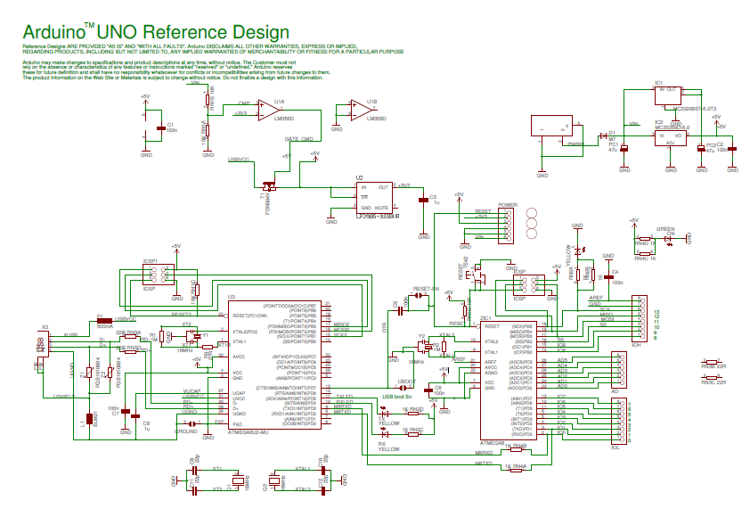
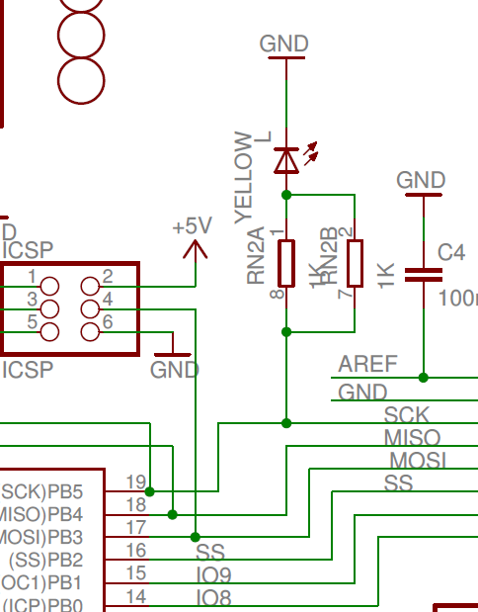
Arduino Uno onboard LED
Connected to PB5 = PORT B, pin 5
6/23

Slide 7
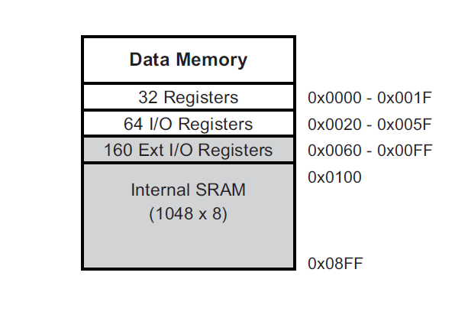
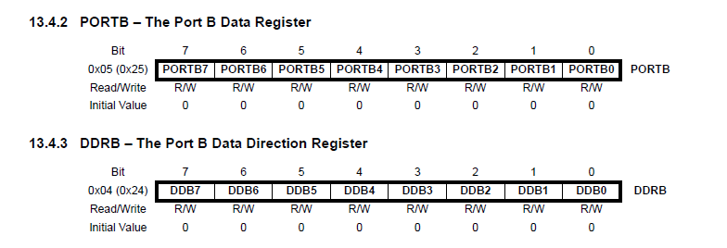
Memory mapped I/O
Data memory contains RAM, but also hardware registers
AtMega328P datasheet (294 pages):
7/23

Slide 8
Acessing memory-mapped registers
LED at PORT B, pin 5 ➔ DDRB, PORTB, bit 5
DDRB at 0x24
PORTB at 0x25
Cast the values to const pointers
Must be volatile
AFAIK, by the C++ standard, this is UB*
// pointer to the Data Direction Register for port B
auto const DDRB = reinterpret_cast< volatile uint8_t * >( 0x24 );
// pointer to the Data Register for port B
auto const PORTB = reinterpret_cast< volatile uint8_t * >( 0x25 );
*Luckily the toolchains choose to do the reasonable thing.
8/23

Slide 9
Changing (only) bit 5
Value with only bit 5 set: 0b0010’0000
But I prefer ( 0b01 << 5 )
Make a bit high (1): | operator
Make a bit low (0): & operator with inverted value (~ operator)
( ~ 0b0010’0000 ) = 0b1101’1111
Compound assignments ( |= and &= operators ) on a volatile are deprecated in C++20 (might be rectified in C++23: p2327r0.pdf)
// make PORTB pin 5 high
*PORTB = *PORTB | ( 0b01 << 5 );
// make PORTB pin 5 low
*PORTB = *PORTB & ~ ( 0b01 << 5 );
9/23

Slide 10
Wait some time
Loop a (large) number of times
Beware: the int type on an AVR8 is only 16 bits
There must be something that prevents optimizing the loop away (in this case the asm( “nop” ) )
// wait a while
for( uint32_t i = 0; i < 500'000; ++i ){
asm( "nop" );
}
10/23

Slide 11
Full blink code
#include <cstdint>
// pointers to DDRB and PORTB
auto const DDRB = reinterpret_cast< volatile uint8_t * >( 0x24 );
auto const PORTB = reinterpret_cast< volatile uint8_t * >( 0x25 );
int main( void ){
*DDRB = *DDRB | ( 0b01 << 5 ); // make PORTB pin 5 an output
for(;;){
*PORTB = *PORTB | ( 0b01 << 5 ); // make PORTB pin 5 high
for( uint32_t i = 0; i < 500'000; ++i ){ asm( "nop" ); }
*PORTB = *PORTB & ~ ( 0b01 << 5 ); // make PORTB pin 5 low
for( uint32_t i = 0; i < 500'000; ++i ){ asm( "nop" ); }
}
}
11/23

Slide 12
C style: derefenced pointer macro
#include <cstdint>
#define DDRB ( * (volatile uint8_t *) 0x24 )
#define PORTB ( * (volatile uint8_t *) 0x25 )
int main( void ){
DDRB = DDRB | ( 0b01 << 5 );
for(;;){
PORTB = PORTB | ( 0b01 << 5 );
for( uint32_t i = 0; i < 500'000; ++i ){ asm( "nop" ); }
PORTB = PORTB & ~( 0b01 << 5 );
for( uint32_t i = 0; i < 500'000; ++i ){ asm( "nop" ); }
}
}
12/23

Slide 13
Who wants to type in all those addresses?
#include <cstdint>
#include "avr/io.h"
int main( void ){
DDRB = DDRB | ( 0b01 << 5 );
for(;;){
PORTB = PORTB | ( 0b01 << 5 );
for( uint32_t i = 0; i < 500'000; ++i ){ asm( "nop" ); }
PORTB = PORTB & ~( 0b01 << 5 );
for( uint32_t i = 0; i < 500'000; ++i ){ asm( "nop" ); }
}
}
Use the manufactur-supplied header
13/23

Slide 14
Abstraction
Let’s write a blink function!
- But how do we pass the pin?
As a global definition
As an integer, enum, or another ‘closed’ value (C style)
As an object (OO)
As an NTTP (Non Type Template Parameter)
14/23

Slide 15
Using (global) macros
#define LED_DDR DDRB
#define LED_PORT PORTB
#define LED_MASK ( 0b01 << 5 )
void blink(){
LED_DDR = LED_DDR | LED_MASK;
for(;;){
LED_PORT = LED_PORT | LED_MASK;
for( uint32_t i = 0; i < 500'000; ++i ){ asm( "nop" ); }
LED_PORT = LED_PORT & ~ LED_MASK;
for( uint32_t i = 0; i < 500'000; ++i ){ asm( "nop" ); }
}
}
Yes, ugly! But this is often used in Arduino libraries that need to be fast.
15/23

Slide 16
Using an identifing value
enum class pin {
b0, b1, b2, b3, b4, b5, b6, b7,
c0, c1, c2, c3, c4, c5, c6, c7
};
void blink( pin p ){
pin_mode_output( p );
for(;;){
pin_write( p, 1 );
for( uint32_t i = 0; i < 500'000; ++i ){ asm( "nop" ); }
pin_write( p, 0 );
for( uint32_t i = 0; i < 500'000; ++i ){ asm( "nop" ); }
}
}
int main( void ){
blink( pin::b5 );
}
Widely used (Arduino wiring library)
16/23

Slide 17
Using an identifing value - implementation
struct single_pin_info {
volatile uint8_t & direction;
volatile uint8_t & data;
uint8_t mask;
};
const single_pin_info pin_info [] = {
{ DDRB, PORTB, ( 0b01 << 0 ) },
...
{ DDRC, PORTC, ( 0b01 << 7 ) }
};
void pin_mode_output( pin p ){
auto info = pin_info[ static_cast< int >( p ) ];
info.direction = info.direction | info.mask;
}
void pin_write( pin p, bool value ){
auto info = pin_info[ static_cast< int >( p ) ];
if( value ){
info.data = info.data | info.mask;
} else {
info.data = info.data & ~ info.mask;
}
}
17/23

Slide 18
Using an object
void blink( gpio & p ){
p.mode_output();
for(;;){
p.write( 1 );
for( uint32_t i = 0; i < 500'000; ++i ){ asm( "nop" ); }
p.write( 0 );
for( uint32_t i = 0; i < 500'000; ++i ){ asm( "nop" ); }
}
}
int main( void ){
auto led = gpio_atmega328( pin::b5 );
blink( led );
}
Much less common (not C)
18/23

Slide 19
Using an object - implementation
class gpio {
public:
virtual void mode_output() = 0;
virtual void write( bool value ) = 0;
};
class atmega328_gpio : public gpio {
private:
const single_pin_info & info;
public:
atmega328_gpio( pin p ): info( pin_info[ static_cast< int >( p ) ] ) {}
void mode_output() override {
info.direction = info.direction | info.mask;
}
void write( bool value ) override {
if( value ){
info.data = info.data | info.mask;
} else {
info.data = info.data & ~ info.mask;
}
}
};
19/23

Slide 20
Using an object – behind the scenes
struct gpio_vtable {
void ( * mode_output )( void * this);
void ( * write )( void * this, bool value );
};
class gpio {
gpio_vtable * vtable;
. . .
};
gpio_vtable atmega328_gpio_table(
atmega328_gpio::mode_output,
atmega328_gpio::write
);
class atmega328_gpio : public gpio {
atmega328_gpio( pin p ): vtable( atmega328_gpio_table ) {
. . . }
void mode_output() . . .
void write( bool value ) . . .
};
void blink( gpio & p ){
p.write( 1 );
}
void blink( gpio & p ){
p->vtable->write( p, 1 );
}
20/23

Slide 21
Using a class
template< is_gpio P >
void blink(){
P::mode_output();
for(;;){
P::write( 1 );
for( uint32_t i = 0; i < 500'000; ++i ){ asm( "nop" ); }
P::write( 0 );
for( uint32_t i = 0; i < 500'000; ++i ){ asm( "nop" ); }
}
}
int main( void ){
blink< gpio< pin::b5 > >();
}
Much like an object, but everything is static.
21/23

Slide 22
Using a class - implementation
template< pin P >
class gpio {
private:
static constexpr const single_pin_info & info =
pin_info[ static_cast< int >( P ) ];
public:
static const bool gpio_marker = true;
static inline void mode_output() {
info.direction = info.direction | info.mask;
}
static inline void write( bool value ){
if( value ){
info.data = info.data | info.mask;
} else {
info.data = info.data & ~ info.mask;
}
}
};
template< typename T >
concept is_gpio = requires { T::gpio_marker; };
22/23

Slide 23
Comparing GPIO passing mechanisms
Pass as | Blink code size | Write speed | Style | Used | Extensible | 0 overhead | Run-time flexible | Dangling ref risk
macro | 218 | 0.125 ms | C | Ugly, but often used when speed is required | No $ | Yes | No | No
identifier | 394 | 2.625 ms | C | Standard for non-OO | No | No * | Yes | No
object | 434 | 2.750 ms | C++, objects | Standard for OO | Yes | No * | Yes | Yes
class | 218 | 0.167 ms | C++, templates | Only used by some (Odin Holmes, Wouter van Ooijen, Roboterclub Aachen …) | Yes | Yes | No | No
$ Depends on the macro abstraction
* LTO might or might not remove the differences.
23/23

Slide 24

Q so far, you might even get an A?
24/23

