Slide 1



C++ Meetup 2019-07-25 @ Blender
10 degrees + 10 degrees
or
WTF is a torsor?
Wouter van Ooijen MSc (ir)
Hogeschool Utrecht, Netherlands,
senior lecturer Computer Engineering
SG14 member
wouter.vanooijen@hu.nl
Notes:
Wouter van Ooijen, if too difficult Woooter will do
Backgroundf Computer Science, passion electronics and hardware/software borderland
Polytechnics
Technical Informatics, small specialization~30-50 std annually
I am NOT working in industry, I guide the next generations into inductry. I hope well prepared

Slide 2


HBO-ICT

Slide 3
What is 10 degrees + 10 degrees?
temperatures, or angles?
20 degrees
293 degrees
10 degrees
meaningless

Slide 4
What is 10 degrees + 10 degrees?
10 + 10 = 20 : 20 degrees
10C = 283K, 283K+283K = 566K : 293 degrees (Celcius)
Two small lumps at 10 degrees = one big lump at 10 degrees
you can’t add temperatures : meaningless

Slide 5
Measurement scales
Scale | Example | Operations
Nominal | colors | v == v
Ordinal | bad, average, good, excellent | v < v
Interval | moment in time (date/time) | v - v
Ratio | length (in m) | v + v
Result?

Slide 6


Slide 7
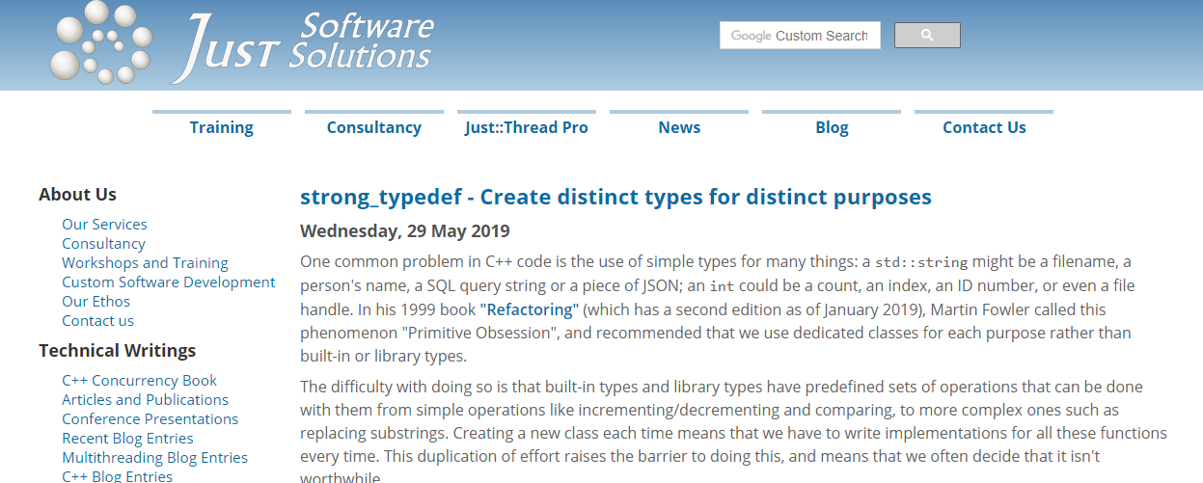

Slide 8

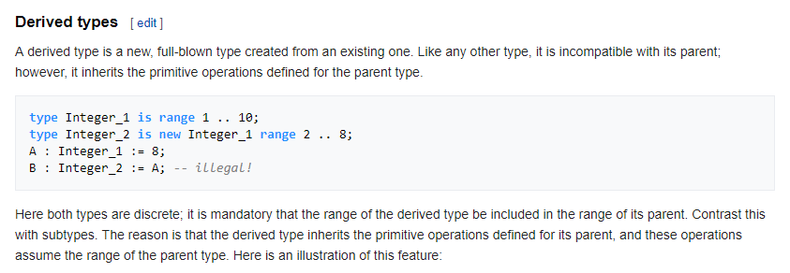

Slide 9

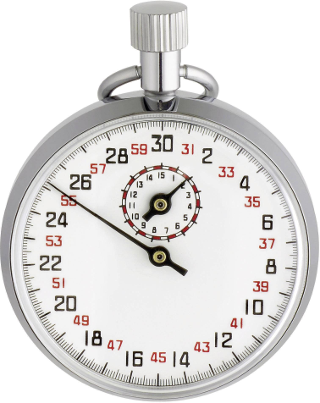
units
+
➔
X
+
➔
+
➔
/
➔
apple rate
1
This is ‘solved’
(boost::units, and many other attempts)
/
➔

Slide 10

torsors
+
➔
+
➔
is a torsor of
-
➔
This is known (e.g. std::chrono), but not solved in general
X
+
➔

Slide 11
A torsor library (simplified)
class torsor {
int value;
public:
constexpr torsor(): value( 0 ){}
constexpr torsor( torsor right ) ...
torsor & operator=( torsor right ) ...
constexpr torsor operator+( int right ) const ...
constexpr int operator-( torsor right ) const ...
// likewise: +=, -=, reverse +, monadic +
constexpr auto operator==( torsor right ) const ...
// likewise: !=, <, <=, >, >=
friend cout & operator<<( cout & cout, torsor right ) ...
};

Slide 12
user-choosen base type
template< typename T >
class torsor {
T value;
public:
constexpr torsor():value( 0 ){}
constexpr torsor( const torsor & right ) ...
torsor & operator=( const torsor & right ) ...
constexpr torsor operator+( const T & right )
constexpr T operator-( const torsor & right ) const ...
// likewise: +=, -=, reverse +, monadic +
constexpr auto operator==( const torsor & right ) const ...
// likewise: !=, <, <=, >, >=
friend cout & operator<<( cout & cout, const torsor & right ) ...
};

Slide 13
mixed-mode arithmetic
template< typename T >
class torsor {
T value;
public:
constexpr torsor():value( 0 ){}
template ... constexpr torsor( const torsor< U > & right ) ...
template ... torsor & operator=( const torsor < U > & right ) ...
template ... constexpr torsor< ? > operator+( const U & right )
template ... constexpr auto operator-( const torsor< U > & right ) ...
// likewise: +=, -=, reverse +, monadic +
template ... constexpr auto operator==( const torsor<U > & right ) ...
// likewise: !=, <, <=, >, >=
friend cout & operator<<( cout & cout, const torsor & right ) ...
};

Slide 14
Embedded-friendly <<
template< typename T >
class torsor {
T value;
public:
constexpr torsor():value( 0 ){}
template ... constexpr torsor( const torsor< U > & right ) ...
template ... torsor & operator=( const torsor< U > & right ) ...
template ... constexpr torsor< ? > operator+( const U & right )
template ... constexpr auto operator-( const torsor< U > & right ) ...
// likewise: +=, -, -=, reverse + and -, monadic +
template ... constexpr auto operator==( const torsor< U > & right ) ...
// likewise: !=, <, <=, >, >=
template ... friend U & operator<<( U & cout, const torsor & right ) ...
};

Slide 15
Mixed-mode arithmetic
template< typename T >
class torsor {
T value;
public:
template< typename U >
__attribute__((always_inline))
constexpr auto operator+( const U & right ) const {
return torsor< decltype( value + right ) >( value + right );
}
};

Slide 16
Prevent deep-template errors
concept bool can_be_added_with_value = requires ( V v, W w ) {
( v + w );
};
template< typename T >
class torsor {
T value;
public:
template< typename U >
requires torsor_concepts::can_be_added_with_value< T, U >
__attribute__((always_inline))
constexpr auto operator+( const U & right ) const {
return ::torsor< decltype( value + right ) >( value + right );
}
};

Slide 17
Test what is NOT allowed
torsor< int > _torsor;
int _int;
ALLOWED( _torsor = _torsor )
ERROR( _torsor = _int )
ALLOWED( _torsor + _int )
ALLOWED( _torsor = _torsor + _int )
ALLOWED( _torsor = _int + _torsor )
ERROR( _torsor = _int + _int )

Slide 18
Use a concept to detect validity
// Check if EXP is legal by using it in the requires clause
// of the first f() template ( the one that returns 1):
// if EXP turns out to be illegal the fallback is selected,
// which returns 0.
template< typename T >
requires requires { ( EXP ); }
bool f(){ return 1; }
template< typename T >
bool f(){ return 0; }

Slide 19
But the compiler must be fooled
struct dummy_multiply {
template< typename T >
const T & operator * ( const T & x ){ return x; }
template< typename T >
const T & operator * ( const T & x ){ return x; }
};
struct test {
template< typename T >
requires requires( T x ) { ( x * EXP ); }
bool f(){ return 1; }
template< typename T >
bool f(){ return 0; }
};
test().f< dummy_multiply >() }

Slide 20
How long is this line?
struct xy { int x, int y; }
line ( xy a, xy );
line( xy( 1, 1 ), xy( 2, 2 ) );
sqrt( 2 ) ?
sqrt( 8 ) ?
end point?
size?

Slide 21
Make it explicit in the type
struct xy { int x, int y; }
using position = torsor< xy >;
auto const origin = position();
line( xy_position, xy_position );
line( xy_position, xy_size );
line( origin + xy( 1, 1 ), origin + xy( 2, 2 ) );
line( origin + xy( 1, 1 ), xy( 2, 2 ) );

Slide 22
Multiple interfaces
class duration { ... };
using moment = torsor< duration >;
moment now();
const duration us = ...;
// do something
wait( 1’000 * us );
auto then = now() + 1’000 * us;
// do something
wait( then );

Slide 23

What is the purpose of a library?
To make more things possible!
To make less things possible!

Slide 24

A distance is not a position
You can (and should) test what a library makes impossile
https:://www.github.com/wovo/torsor

