Slide 1
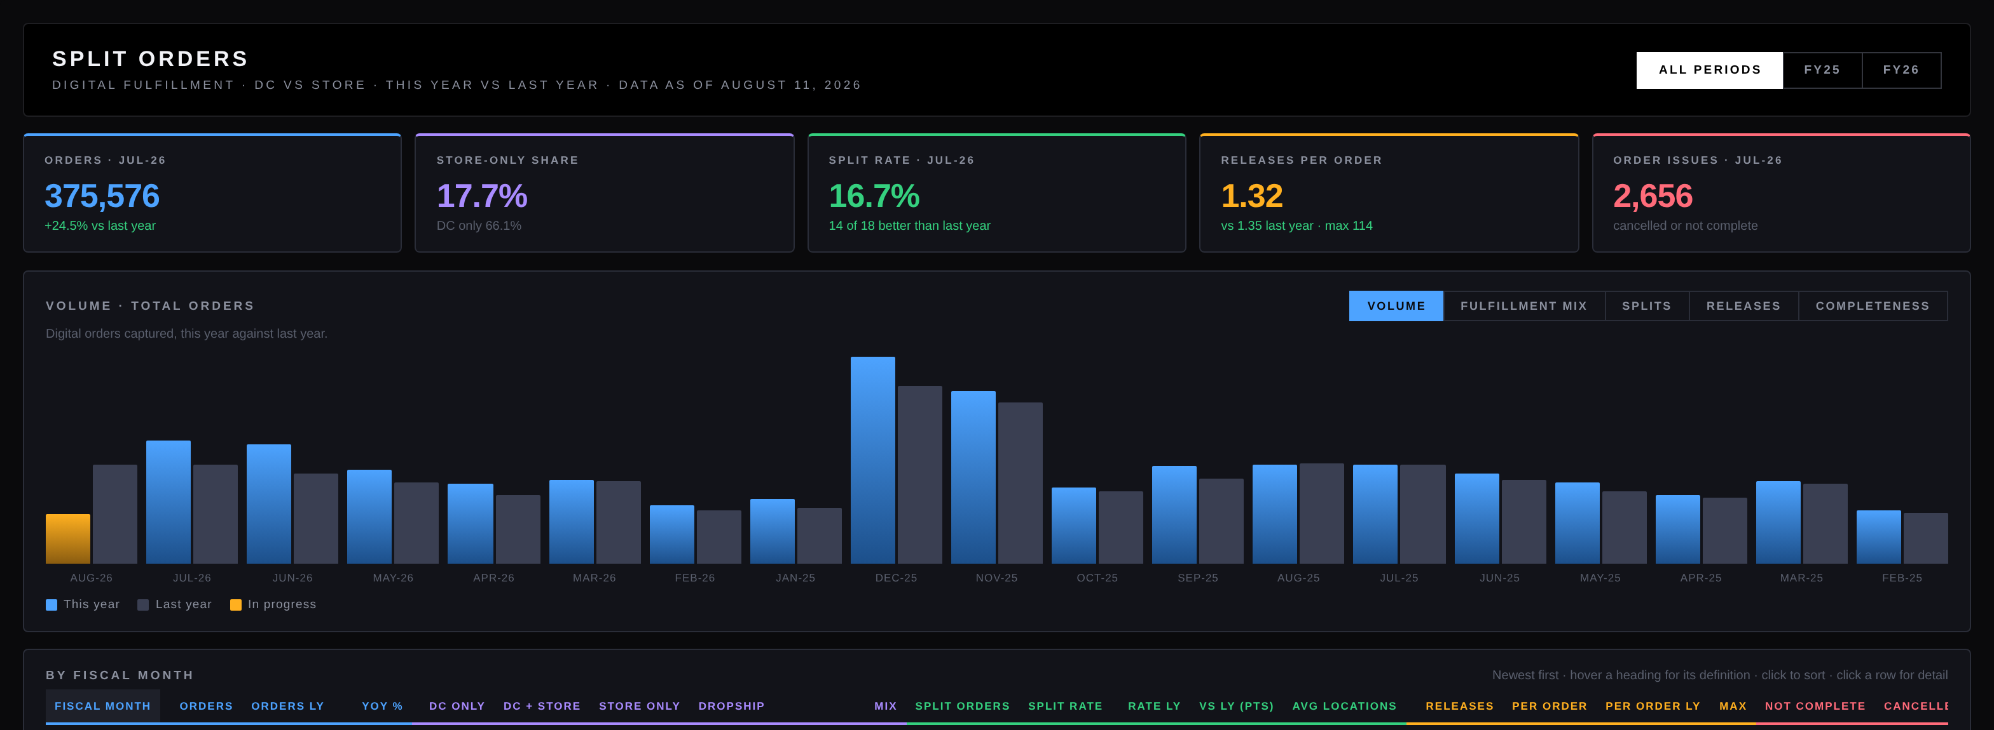
Will Wagner
Senior Analytics Engineer
Closing the loop between what a campaign costs and what it earns
Interactive fulfillment analysis tool I built and shipped to production
SQL · Python · Snowflake · BigQuery · AWS · Google Cloud
Notes:
Twenty-five years building the data behind operational decisions. Eight of those years inside the ad marketplace at Yahoo.

Slide 2
I have worked all three sides of this problem
Advertiser, publisher, and now the buyer who owns the revenue
SELL SIDE
SUPPLY SIDE
BUY SIDE
Yahoo, advertisers
Yahoo, publishers
Where Netflix sits
Owned campaign reporting for the Creative Strategists and Account Managers running advertiser accounts. Pacing against monthly allowance, daily spend rate, click through and conversion, video completion, keyword level cost per click.
Built the publisher side of the same reporting for network partners including WebMD and Mozilla. Two audiences, one set of models, neither side seeing the other.
On the sell side we could show advertisers everything except what the campaign actually earned them. Netflix buys the campaigns and owns the sales data, so that loop can finally close.
Notes:
The point: most analytics engineers have seen one side of the ad marketplace. I have modeled all three positions.

Slide 3
What I build
Tools people use to decide something, not charts they screenshot
1
Models as the source of truth
Dimensional, normalized, and metadata driven models built as reusable entities that many downstream products share. Schemas that survive platform migrations.
2
Self service that holds up
Interactive applications with drill down, on demand comparison, and metric definitions surfaced in the interface, so nobody has to ask what a column means. Adoption is the measure I care about.
3
Engineering around the data
Version control, monitoring for freshness and platform health, idempotent loads, watermark based incremental extraction, and capture that repairs itself when jobs overlap.
4
Speed over perfection
I ship the version that answers the question this week and improve it next week. My archive framework, hourly demand pipeline, and recovery model all reached production while the alternative was still being scoped.
Notes:
Four things, in the order they matter for this role.

Slide 4
Split Orders
A single file interactive tool, built and running in production
Five switchable views · drill down on any row · definitions on hover · the in progress period shaded so an unfinished month is never read as a decline
Click the image, or open it live: wowagner2015.github.io/professionalprofile/split-orders.html
Volumes scaled by a constant for sharing. Rates and trends unchanged.
Notes:
Open the live version in the browser during the call rather than talking over the screenshot. Built in HTML and JavaScript rather than Plotly Dash, same idea: a custom analytical application, not a dashboard.

Slide 5
The engineering underneath
Three things I built at PacSun that were not on anyone’s roadmap
A time machine for data
Reports honest about failure
DataGINI
Source tables are overwritten continuously and native time travel keeps only days. I built a generic archive any table can join with one procedure call and a retention setting. It snapshots only on change, repairs itself when two jobs overlap, and returns data in the original layout.
A four tier recovery model reconstructs a missing hour from the best surviving source and labels every recovered value with its origin, so leadership sees a complete report and knows exactly which numbers were rebuilt.
My own ingest and orchestration framework, roughly 10,000 lines of Python, sole author. Declarative YAML catalog, connectors rather than engine edits, parameter inheritance across job groups. Runs in production against ERP, commerce, loyalty, and legacy systems.
Notes:
All three came from noticing a problem nobody had assigned me.

Slide 6
Track record
25+
4
1,000+
8
years modeling data for
operational decisions
patents as named inventor,
two issued
users on an analytics platform
I consolidated and governed
years inside the ad marketplace
at Yahoo
Named Yahoo Inventor of the Year, 2024
The award came from the Future Study Group, a volunteer group of inventors who did the work because we cared about the technology and the users, not because anyone assigned it.
Notes:
Keep this short. The numbers do the work.

Slide 7
The problem I want to work on
Campaign spend and the revenue it produced, in one model, close to real time.
At Yahoo we could show an advertiser every measure except the one they cared about most, which was what the campaign earned them. That number lived on the other side of a wall. Netflix sits on both sides: the campaign goes out and the demand comes back. Since campaigns launch exactly when the lift is needed, watching that loop next to demand rather than reading about it weeks later is the work I would most want to own.
Notes:
This is the slide to spend time on in conversation.

Slide 8
Will Wagner
will@heximind.com · (310) 270-5533 · Costa Mesa, California
linkedin.com/in/willwwagner
github.com/wowagner2015
wowagner2015.github.io/professionalprofile
Notes:
Close by asking what their biggest current data gap is.

