Slide 1
OptNet: Differentiable Optimization as a Layer in Neural Networks
2023 07 16

Slide 2

Problem & how to calculate differentials
Problem
$Q,q,A,b,G,and h$ are all the weight of the optimization layer
Lagrangian
KKT condition & Implicit Function
$$F\left(y^{k},y^{k+1}\right)=0$$

Slide 3
The differential of the KKT condition
Key rule
For example
rearrange

Slide 4
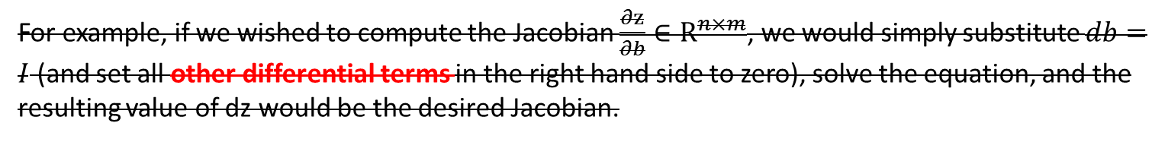
Here we use the implicit function theorem to guide our derivation
We not follow the way of differential procedures described in the original paper
Using these equations, we can form the Jacobians of $z^{⋆}$ with respect to any of the data parameters.
For example, if we wished to compute the Jacobian $\frac{∂z}{∂b}∈R^{n×m}$, we would simply substitute $db=I$ (and set all other differential terms in the right hand side to zero), solve the equation, and the resulting value of dz would be the desired Jacobian.

Slide 5
Derivatives of Matrix-to-Matrix and Vector-to-Vector
For example, according to Appendix B2 and B3, we have:
?
Matrix-to-Matrix
Kronecker product plays a very import role
Vector-to-Vector

Slide 6
Backpropagation and Implicit function theorem
Implicit function theorem
Using a new symbol to denote this part
Why we need transpose $\frac{∂l}{∂y}$, I guess the transposition will make the size of $\frac{∂l}{∂y}$ equal to that of $y$

Slide 7
Using properies of Kronecker product to simplify the derivatives
Final results

Slide 8
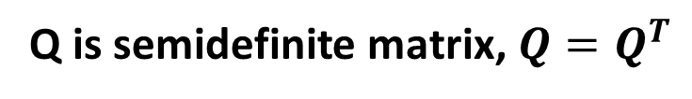
Why is $\frac{∂l}{∂vec^{T}(Q)}$ also equal to $\frac{1}{2}(zd_{z}^{T}+d_{z}z^{T})$?
Q is semidefinite matrix, $Q=Q^{T}$
This operation will deliver more stable numerical results

Slide 9

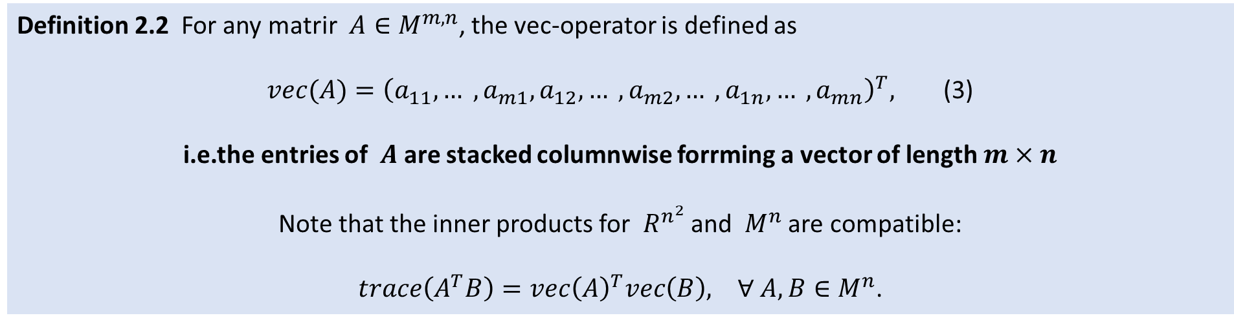

Appendix B1: Vectorization
Definition 2.2 For any matrir $A∈M^{m,n}$, the vec-operator is defined as
$vec(A)={\left(a_{11},… ,a_{m1},a_{12},… ,a_{m2},… ,a_{1n},… ,a_{mn}\right)}^{T},$ (3)
i.e.the entries of $A$are stacked columnwise forrming a vector of length $m×n$
Note that the inner products for $R^{n^{2}}$ and $M^{n}$ are compatible:
$trace\left(A^{T}B\right)=vec{\left(A\right)}^{T}vec\left(B\right), ∀ A,B∈M^{n}$.
1
n
Vectorization
m×n
$$A=$$
m
…
$$vec(A)=$$
…
columnwise

Slide 10
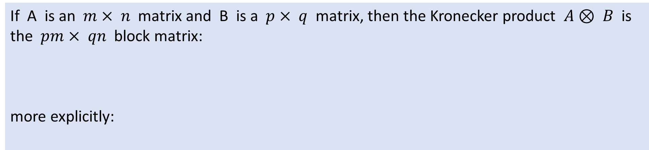
Appendix B1: Kronecker Product
If A is an $m× n$matrix and B is a $p× q$matrix, then the Kronecker product $A⊗ B$is the $pm× qn$block matrix:
more explicitly:

Slide 11

Appendix B2: Partial Derivative, Matrix-to-Matrix $\frac{∂ABC}{∂B}=\frac{∂vec(ABC)}{∂vec^{T}(B)}=C^{T}⊗A$
How to calculate $\frac{∂ABC}{∂B}=\frac{∂vec(ABC)}{∂vec^{T}(B)}$ ?

Slide 12
Appendix B2: Partial Derivative, Matrix-to-Matrix $\frac{∂ABC}{∂B}=\frac{∂vec(ABC)}{∂vec^{T}(B)}=C^{T}⊗A$
Given
We have

Slide 13
Appendix B2: Partial Derivative, Matrix-to-Matrix $\frac{∂ABC}{∂B}=\frac{∂vec(ABC)}{∂vec^{T}(B)}=C^{T}⊗A$

Slide 14
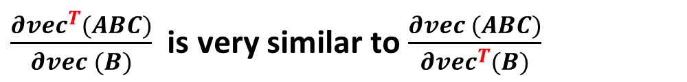

How to calculate $\frac{∂ABC}{∂B}=\frac{∂vec^{T}(ABC)}{∂vec (B)}$ ?
$\frac{∂vec^{T}(ABC)}{∂vec (B)}$ is very similar to $\frac{∂vec (ABC)}{∂vec^{T}(B)}$

Slide 15
Appendix B2: Partial Derivative, Matrix-to-Matrix $\frac{∂ABC}{∂B}=\frac{∂vec^{T}(ABC)}{∂vec (B)}=C{⊗A}^{T}$
$\frac{∂vec^{T}(V)}{∂vec(B)}$ and $\frac{∂vec (V)}{∂vec^{T}(B)}$ are transposed each other.

Slide 16
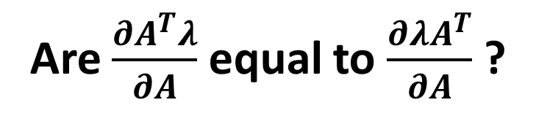
Are $\frac{∂A^{T}λ}{∂A}$ equal to $\frac{∂λA^{T}}{∂A}$ ?
Yeah, they are equal !!! But this conclusion may be only suitable for Vector-to-Matrix differentials
The details are showed in Appendix B3

Slide 17

Appendix B3: Partial Derivative, Vector-to-Matrix $∂A^{T}λ/∂A$
Caveat: $F(A)$is a row vector

Slide 18

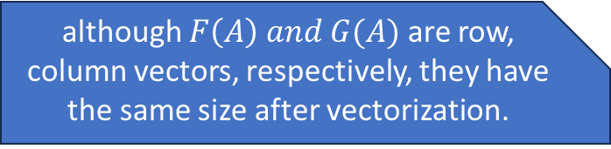
Appendix B3: Partial Derivative, Vector-to-Matrix $∂λ^{T}A/∂A$
Caveat: $G(A)$is a column vector
Noticeably, whether it is a column or row vector, we will have the same vectorization result.
although $F\left(A\right) and G(A)$are row, column vectors, respectively, they have the same size after vectorization.

Slide 19
Appendix B4: some useful properties of Kronecker product
A toy example to illustrate $\left(x⊗I\right)y=Vec\left(yx^{⊺}\right)$

Slide 20
Deprecated pages

Slide 21
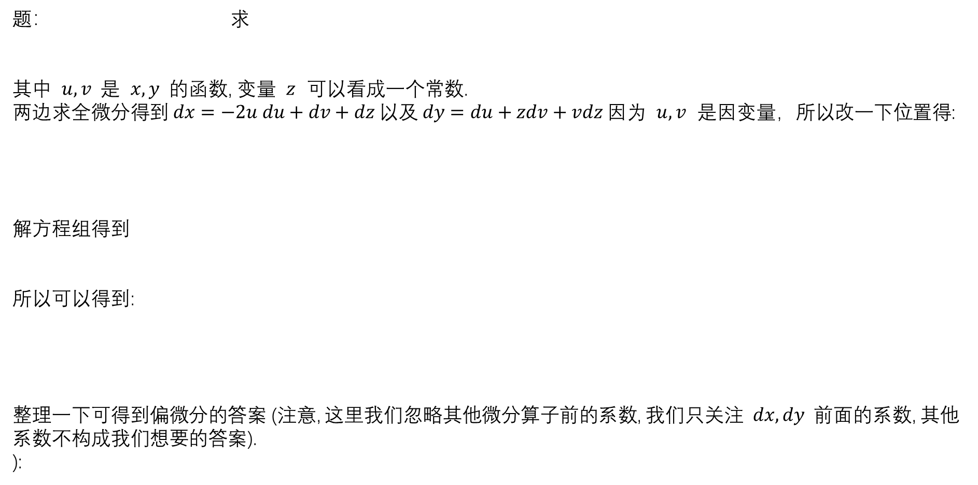
Appendix A的内容对之前的微分结果没有帮助
A toy example of how to calculate the differential if there are equations
可以看出, 对于有等式的微分, 我们得到微分等式后, 稍作整理, 自变量放在等式右侧
因变量放在等式左侧, 我们重点关注因变量的消元, 对于右侧自变量中求解无关的变量,可以直接消去,不用管他.
题： 求
其中 $u, v$是 $x, y$的函数, 变量 $z$ 可以看成一个常数.
两边求全微分得到 $dx=−2u du+dv+dz 以及 dy=du+zdv+vdz$因为 $u, v$ 是因变量，所以改一下位置得:
解方程组得到
所以可以得到:
整理一下可得到偏微分的答案 (注意, 这里我们忽略其他微分算子前的系数, 我们只关注 $dx, dy$前面的系数, 其他系数不构成我们想要的答案).
):

Slide 22
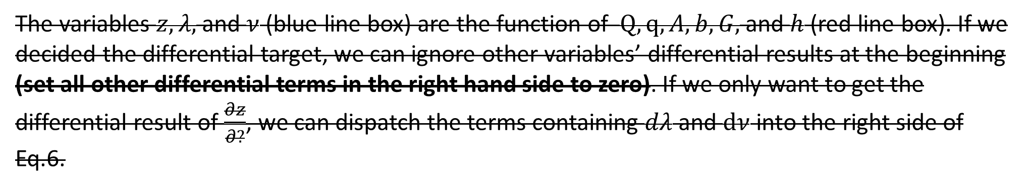
My understanding
The variables $z, λ,$ and $ν$ (blue line box) are the function of $Q,q,A, b, G,$ and $h$ (red line box). If we decided the differential target, we can ignore other variables’ differential results at the beginning (set all other differential terms in the right hand side to zero). If we only want to get the differential result of $\frac{∂z}{∂?}$, we can dispatch the terms containing $dλ$ and $dν$ into the right side of Eq.6.

