Slide 1
The rule of the matrix differential

Slide 2
Problem & how to calculate the differential
problem
are all the weight of the optimization layer
Lagrangian

Slide 3
KKT condition
Key rule
For example
The differential of the KKT condition
rearrange

Slide 4
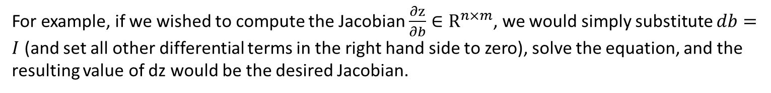
The way of calculating the differential described in the original paper
Using these equations, we can form the Jacobians of $z^{⋆}$ with respect to any of the data parameters.
For example, if we wished to compute the Jacobian $\frac{∂z}{∂b}∈R^{n×m}$, we would simply substitute $db=I$ (and set all other differential terms in the right hand side to zero), solve the equation, and the resulting value of dz would be the desired Jacobian.

Slide 5
Accelaration and reducing the memory: Matrix-vector product
I am stuck with the following Equation:

Slide 6
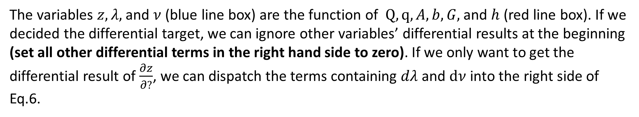
My understanding
The variables $z, λ,$ and $ν$ (blue line box) are the function of $Q,q,A, b, G,$ and $h$ (red line box). If we decided the differential target, we can ignore other variables’ differential results at the beginning (set all other differential terms in the right hand side to zero). If we only want to get the differential result of $\frac{∂z}{∂?}$, we can dispatch the terms containing $dλ$ and $dν$ into the right side of Eq.6.

Slide 7
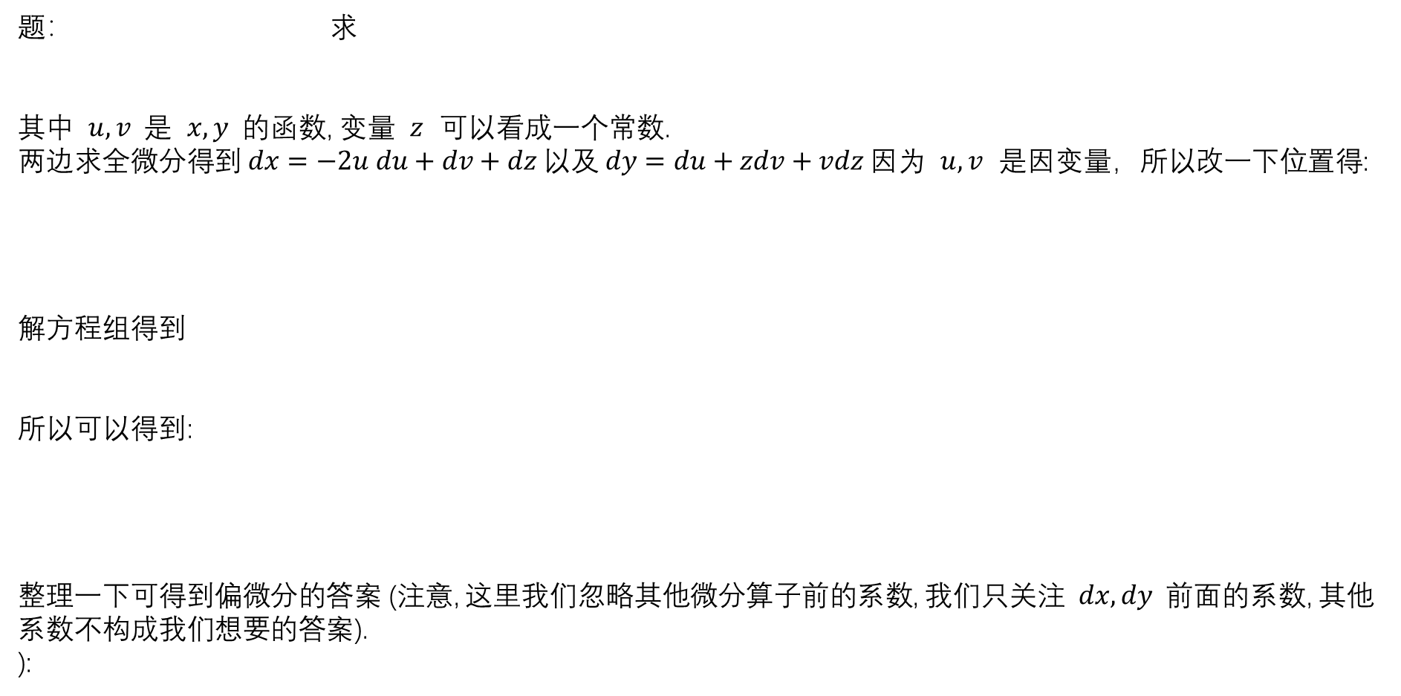
Appendix A的内容对之前的微分结果没有帮助
Appendix A: a toy example of how to calculate the differential if there are equations
可以看出, 对于有等式的微分, 我们得到微分等式后, 稍作整理, 自变量放在等式右侧
因变量放在等式左侧, 我们重点关注因变量的消元, 对于右侧自变量中求解无关的变量,可以直接消去,不用管他.
题： 求
其中 $u, v$是 $x, y$的函数, 变量 $z$ 可以看成一个常数.
两边求全微分得到 $dx=−2u du+dv+dz 以及 dy=du+zdv+vdz$因为 $u, v$ 是因变量，所以改一下位置得:
解方程组得到
所以可以得到:
整理一下可得到偏微分的答案 (注意, 这里我们忽略其他微分算子前的系数, 我们只关注 $dx, dy$前面的系数, 其他系数不构成我们想要的答案).
):

