Slide 1
A initial explore from the information perspective

Slide 2
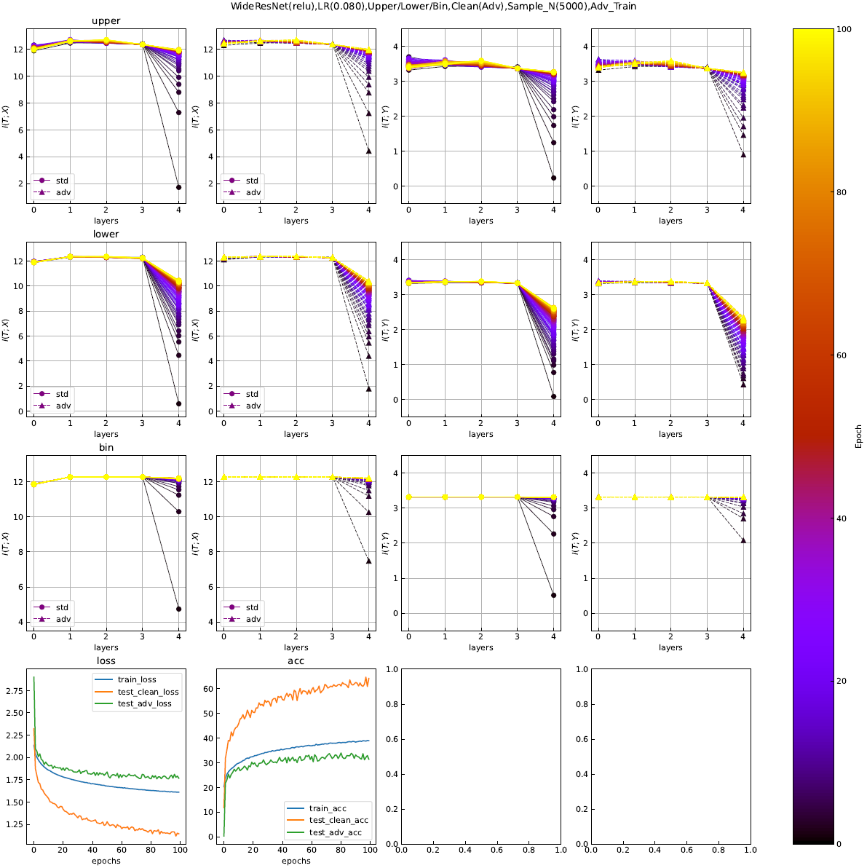
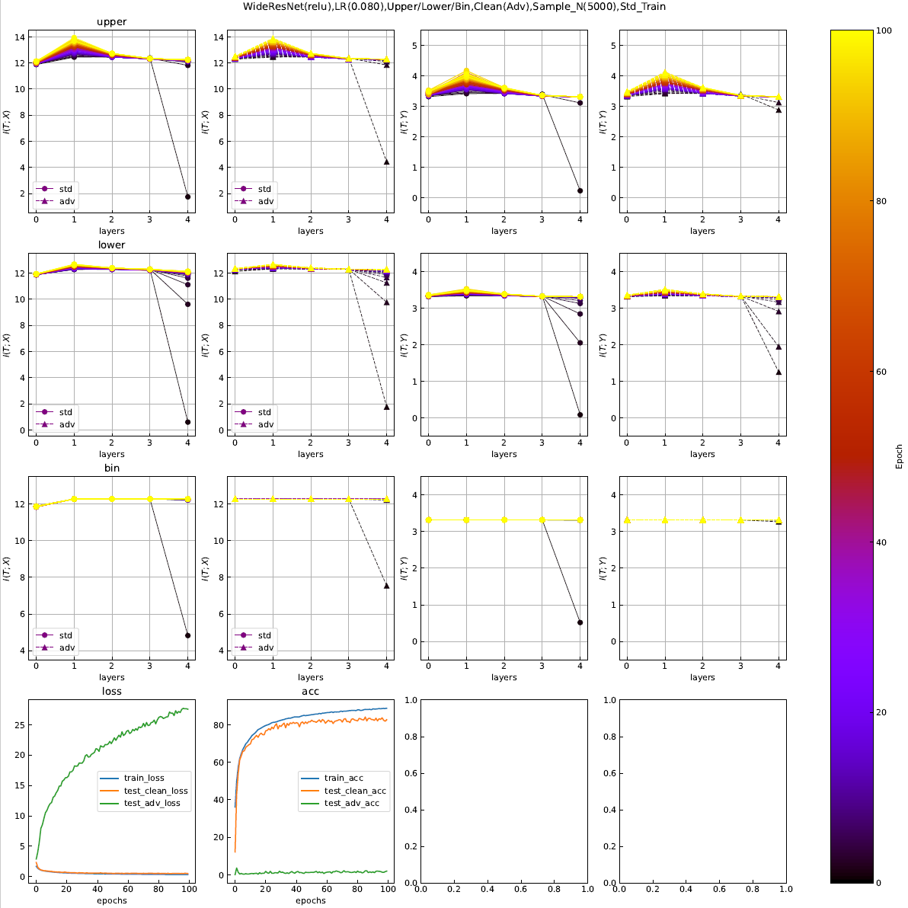

Slide 3
