Slide 1
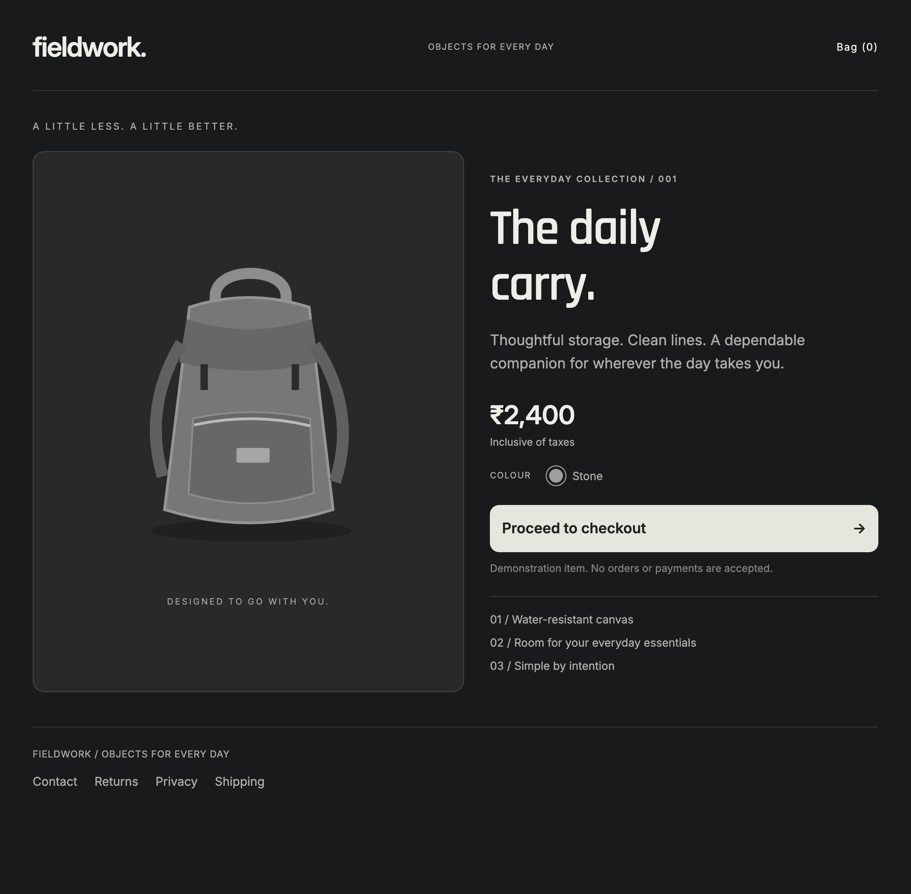
meadow
01 / 05
Would you buy
from this store?
A convincing storefront can hide
a reason to pause.
Local demonstration store
Notes:
0:00–0:30. Ask: “Would you buy from this store?” Pause briefly. “The design looks considered. But appearance tells us little about who controls the address or how the checkout handles sensitive information. Meadow gives the shopper a first check, inside the browser.” This screenshot shows our local demonstration store, not a real incident. Source: Meadow demo/public/store.html and tests/browser.mjs screenshot storefront-before.png, captured 8 October 2026. Do not claim that design proves fraud.

Slide 2
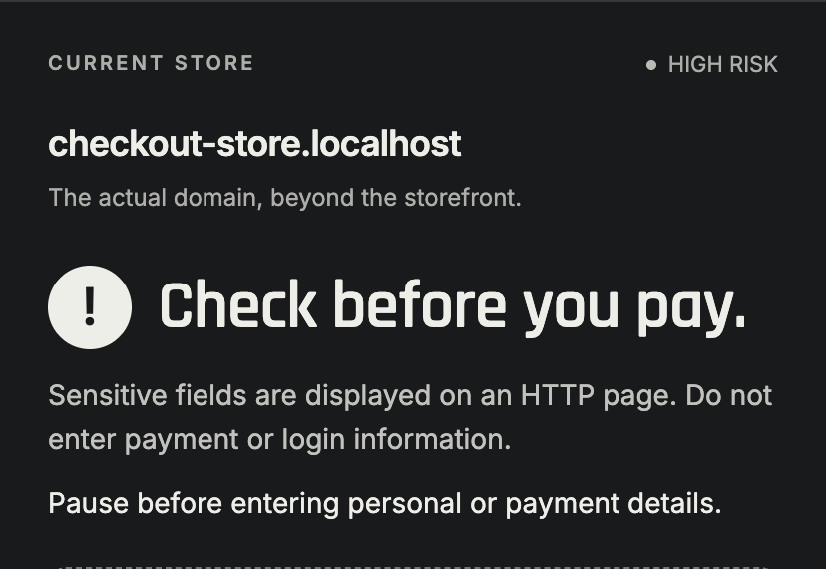
meadow
02 / 05
A warning with a reason
Sensitive fields on an
unencrypted page
Meadow flags the observed danger
and explains why it matters.
The decision stays with the shopper.
Actual output from a labelled local simulation
Notes:
0:30–1:10. “Here is a concrete reason to stop: the page displays sensitive fields over HTTP. Meadow does not need a model to recognize that condition. It reports the actual evidence and asks the person to pause before entering details. High risk describes what we observed. It does not prove who runs the store.” Source: extension/engine.js critical http-sensitive rule, extension/render.js, high-risk-summary.png captured from the built extension after the live checkout test. Local registration data is simulated. The HTTP form and DOM inspection are real. All inputs are disabled and no payment happens.

Slide 3
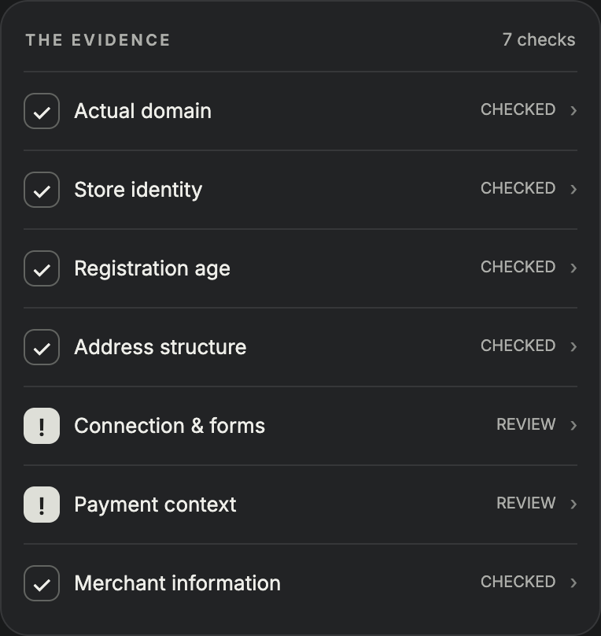
meadow
03 / 05
A check that fits
how people shop
Automatic inspection while browsing.
One click to read the reasons.
No account. No AI model.
Uncertainty stays visible.
Seven focused checks
Notes:
1:10–1:45. “Meadow checks the current page automatically. You open the toolbar popup for the reasons. We combine existing methods: domain parsing, a small brand catalogue, registration information and observable page checks. The design contribution is putting those checks in one readable, cautious workflow. We do not claim a new fraud detection algorithm. Weak clues such as a young domain alone do not justify a high-risk verdict.” RDAP registration lookup is optional and sends the domain plus network address to the registry. The rule engine and page inspection run locally. Source: extension/domain.js, data.js, registration.js, engine.js, inspect.js, content.js, popup.js. Screenshot is the actual evidence section of the extension, not a mockup.

Slide 4
meadow
04 / 05
The checkout test
What changes when the
payment form appears?
Live in Chrome
Then a new shop: does newness alone trigger high risk?
Notes:
1:45–2:00 setup, 2:00–4:00 live demo. “We will inspect a controlled store, reveal its checkout, and watch the evidence change. Then we will test a new independent shop.” Switch to Chrome at http://checkout-store.localhost:8765. Before clicking checkout, open the pinned Meadow Demo Lab extension and show REVIEW. Close popup. Click Proceed to checkout. Wait for the badge to change to !, open popup, show HIGH RISK and expand Connection & forms. Explain HTTP plus sensitive fields. Switch to http://new-store.localhost:8765, show REVIEW, open Registration age. Newness alone is not a fraud accusation. Both pages are labelled simulations. Age is a local fixture; all other checks inspect actual DOM. Main demo needs only local server, no external network. Projection preview belongs to the page and uses the same engine; always identify it as a preview and use the real toolbar popup at least once. Sources: demo/lab.js, demo-fixtures.js and current browser tests. Fallback: show saved screenshots in assets, explicitly call them screenshots rather than a live run.

Slide 5
meadow
05 / 05
meadow
A little clarity.
Before you buy.
A first check for an unfamiliar store,
with reasons you can understand.
First-pass screening. No guarantee of legitimacy or delivery.
Notes:
4:00–4:45 close. “The value is a visible reason to reconsider before entering details. A simple interface exposes concrete checks, without asking the shopper to become an investigator. Meadow is a first test for an unfamiliar store. It cannot establish that a seller is genuine or will deliver an order. Our controlled tests show the implemented behaviour, not a real-world detection accuracy rate. The contribution is the careful packaging: actual domain, readable evidence, conservative decisions and a repeatable demo.” Leave 15 seconds as a switching buffer. No statistics about fraud prevalence or accuracy are asserted. Source: current project code, evaluation/BRANDING-REVIEW.md and project coverage disclosures.

