Slide 1


Методы моделирования физических процессов
Лекция №4 (МКЭ-2)
Подготовил Захаров Юрий

Slide 2

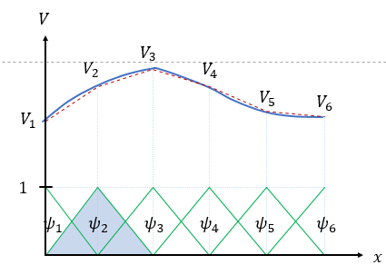
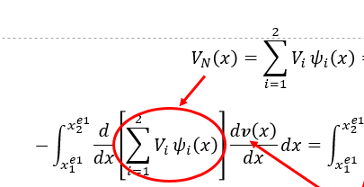
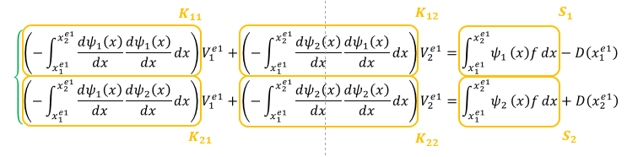
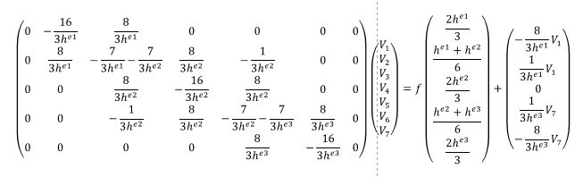

Этапы решения задачи МКЭ
Сильная форма ДУ -> Слабая форма ДУ
Ищем решение, как линейную комбинацию с базисными функциями
Подставляем базисную функцию в слабую форму
В качестве пробных функций берем базисные функции
Считаем матрицу жесткости одного элемента
-> решаем нелинейные уравения
Собираем глобальную матрицу жесткости
Подставляем граничные условия
Решаем СЛАУ

Slide 3











$$∇^{2}V(x,y)=f$$
$$y$$
$$V(x,H)=V_{up}$$
$$H$$
$$V(0,y)=Vl$$
$$V(W,y)=Vr$$
$$0$$
$$x$$
$$0$$
$$W$$
$$V(x,0)=V_{down}$$

Slide 4

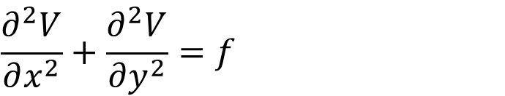


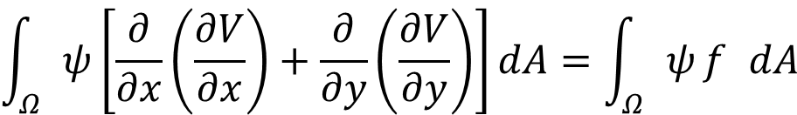
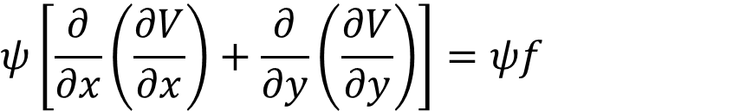

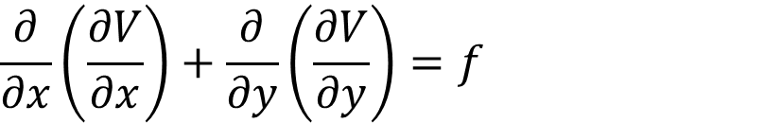

$$y$$
$$∇^{2}V=f$$
$$\frac{∂^{2}V}{∂x^{2}}+\frac{∂^{2}V}{∂y^{2}}=f$$
$$\frac{∂}{∂x}\left(\frac{∂V}{∂x}\right)+\frac{∂}{∂y}\left(\frac{∂V}{∂y}\right)=f$$
$$Ω^{e}$$
$$Γ^{e}$$
$$ψ\left[\frac{∂}{∂x}\left(\frac{∂V}{∂x}\right)+\frac{∂}{∂y}\left(\frac{∂V}{∂y}\right)\right]=ψf$$
$$x$$
$$\int_{Ω}{ψ}\left[\frac{∂}{∂x}\left(\frac{∂V}{∂x}\right)+\frac{∂}{∂y}\left(\frac{∂V}{∂y}\right)\right]dA=\int_{Ω}{ψ}f dA$$

Slide 5
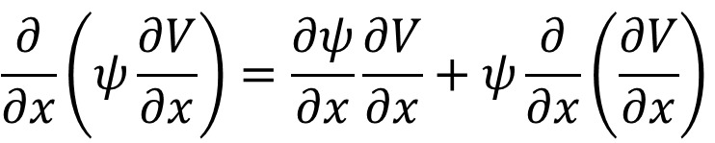
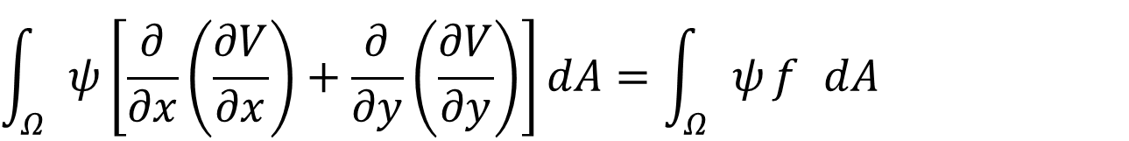
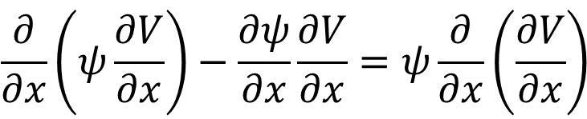
$$\int_{Ω}{ψ}\left[\frac{∂}{∂x}\left(\frac{∂V}{∂x}\right)+\frac{∂}{∂y}\left(\frac{∂V}{∂y}\right)\right]dA=\int_{Ω}{ψ}f dA$$
$$\frac{∂}{∂x}\left(ψ\frac{∂V}{∂x}\right)=\frac{∂ψ}{∂x}\frac{∂V}{∂x}+ψ\frac{∂}{∂x}\left(\frac{∂V}{∂x}\right)$$
$$\frac{∂}{∂x}\left(ψ\frac{∂V}{∂x}\right)−\frac{∂ψ}{∂x}\frac{∂V}{∂x}=ψ\frac{∂}{∂x}\left(\frac{∂V}{∂x}\right)$$
$$\int_{Ω}{\left[\frac{∂}{∂x}\left(ψ\frac{∂V}{∂x}\right)−\frac{∂ψ}{∂x}\frac{∂V}{∂x}+\frac{∂}{∂y}\left(ψ\frac{∂V}{∂y}\right)−\frac{∂ψ}{∂y}\frac{∂V}{∂y}\right]}dA=\int_{Ω}{ψ}f dA$$
$$\int_{Ω}{\left[\frac{∂}{∂x}\left(ψ\frac{∂V}{∂x}\right)+\frac{∂}{∂y}\left(ψ\frac{∂V}{∂y}\right)\right]}dA−\int_{Ω}{\left[\frac{∂ψ}{∂y}\frac{∂V}{∂y}+\frac{∂ψ}{∂x}\frac{∂V}{∂x}\right]}dA=\int_{Ω}{ψ}f dA$$

Slide 6
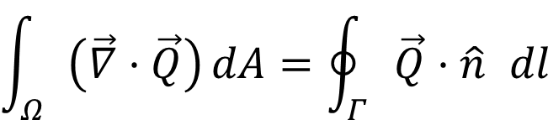
$$\int_{Ω}{\left[\frac{∂}{∂x}\left(ψ\frac{∂V}{∂x}\right)+\frac{∂}{∂y}\left(ψ\frac{∂V}{∂y}\right)\right]}dA−\int_{Ω}{\left[\frac{∂ψ}{∂x}\frac{∂V}{∂x}+\frac{∂ψ}{∂y}\frac{∂V}{∂y}\right]}dA=\int_{Ω}{ψ}f dA$$
$$\int_{Ω}{\left(\vec{∇}·\vec{Q}\right)}dA=\oint_{Γ}{\vec{Q}}·\hat{n} dl$$
Теорема грина
$$\oint_{Γ}{\left(\left(ψ\frac{∂V}{∂x}\right)n_{x}+\left(ψ\frac{∂V}{∂y}\right)n_{y}\right)}dl−\int_{Ω}{\left[\frac{∂ψ}{∂x}\frac{∂V}{∂x}+\frac{∂ψ}{∂y}\frac{∂V}{∂y}\right]}dA=\int_{Ω}{ψ}f dA$$
$$−\int_{Ω}{\left[\frac{∂ψ}{∂x}\frac{∂V}{∂x}+\frac{∂ψ}{∂y}\frac{∂V}{∂y}\right]}dA=\int_{Ω}{ψ}f dA−\oint_{Γ}{\left(\left(ψ\frac{∂V}{∂x}\right)n_{x}+\left(ψ\frac{∂V}{∂y}\right)n_{y}\right)}dl$$

Slide 7

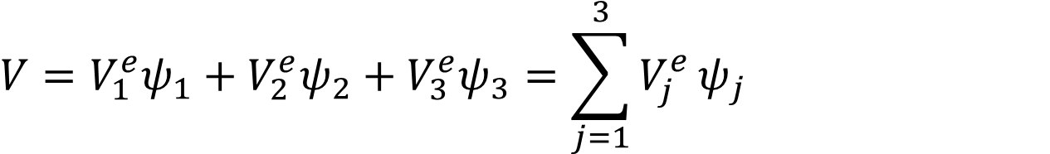


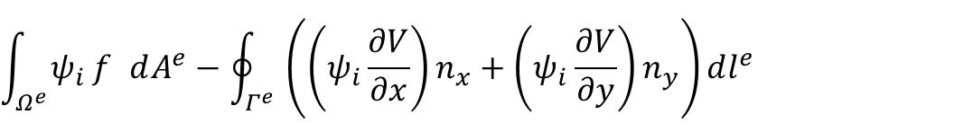

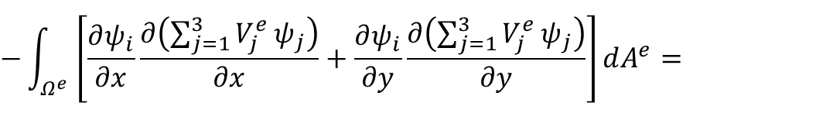

$$−\int_{Ω}{\left[\frac{∂ψ}{∂x}\frac{∂V}{∂x}+\frac{∂ψ}{∂y}\frac{∂V}{∂y}\right]}dA=\int_{Ω}{ψ}f dA−\oint_{Γ}{\left(\left(ψ\frac{∂V}{∂x}\right)n_{x}+\left(ψ\frac{∂V}{∂y}\right)n_{y}\right)}dl$$
$$V=V_{1}^{e}ψ_{1}+V_{2}^{e}ψ_{2}+V_{3}^{e}ψ_{3}=\sum_{j=1}^{3}{V_{j}^{e}}ψ_{j}$$
$$2$$
$$3$$
$$−\int_{Ω^{e}}{\left[\frac{∂ψ_{i}}{∂x}\frac{∂\left(\sum_{j=1}^{3}{V_{j}^{e}}ψ_{j}\right)}{∂x}+\frac{∂ψ_{i}}{∂y}\frac{∂\left(\sum_{j=1}^{3}{V_{j}^{e}}ψ_{j}\right)}{∂y}\right]}dA^{e}=$$
$$Ω^{e}$$
$$Γ^{e}$$
$$\int_{Ω^{e}}{ψ_{i}}f dA^{e}−\oint_{Γ^{e}}{\left(\left(ψ_{i}\frac{∂V}{∂x}\right)n_{x}+\left(ψ_{i}\frac{∂V}{∂y}\right)n_{y}\right)}dl^{e}$$
$$1$$

Slide 8
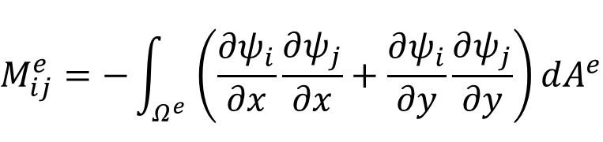
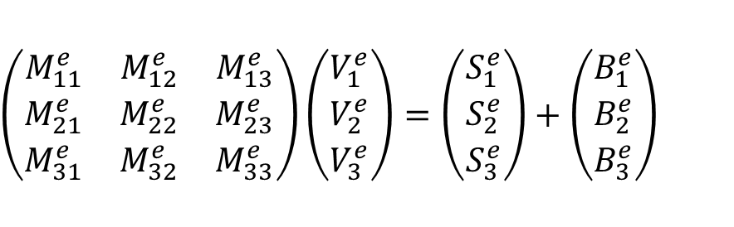
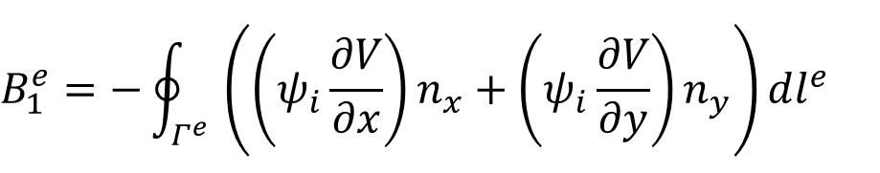
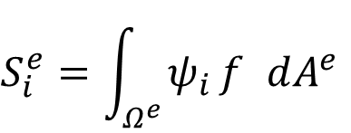
$$\left(\begin{matrix}M_{11}^{e} & M_{12}^{e} & M_{13}^{e} \\ M_{21}^{e} & M_{22}^{e} & M_{23}^{e} \\ M_{31}^{e} & M_{32}^{e} & M_{33}^{e}\end{matrix}\right)\left(\begin{matrix}V_{1}^{e} \\ V_{2}^{e} \\ V_{3}^{e}\end{matrix}\right)=\left(\begin{matrix}S_{1}^{e} \\ S_{2}^{e} \\ S_{3}^{e}\end{matrix}\right)+\left(\begin{matrix}B_{1}^{e} \\ B_{2}^{e} \\ B_{3}^{e}\end{matrix}\right)$$
$$M_{ij}^{e}=−\int_{Ω^{e}}{\left(\frac{∂ψ_{i}}{∂x}\frac{∂ψ_{j}}{∂x}+\frac{∂ψ_{i}}{∂y}\frac{∂ψ_{j}}{∂y}\right)}dA^{e}$$
$$2$$
$$3$$
$$S_{i}^{e}=\int_{Ω^{e}}{ψ_{i}}f dA^{e}$$
$$Ω^{e}$$
$$Γ^{e}$$
$$B_{1}^{e}=−\oint_{Γ^{e}}{\left(\left(ψ_{i}\frac{∂V}{∂x}\right)n_{x}+\left(ψ_{i}\frac{∂V}{∂y}\right)n_{y}\right)}dl^{e}$$
$$1$$

Slide 9













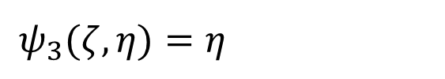



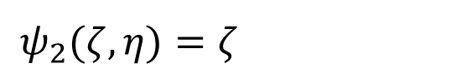






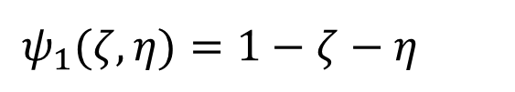





$$y$$
$$η$$
$$ψ_{1}(ζ,η)=1−ζ−η$$
$$3$$
$$(0,1)$$
$$3$$
$$ψ_{2}(ζ,η)=ζ$$
$$ψ_{3}(ζ,η)=η$$
$$1$$
$$2$$
$$x$$
$$1$$
$$2$$
$$ξ$$
$$(0,0)$$
$$(1,0)$$
$$V$$
$$V_{3}$$
$$V_{2}$$
$$V_{4}$$
$$V_{1}$$
$$V_{5}$$
$$V_{6}$$
$$1$$
$$ψ_{1}$$
$$ψ_{2}$$
$$ψ_{3}$$
$$ψ_{4}$$
$$ψ_{5}$$
$$ψ_{6}$$
$$x$$

Slide 10
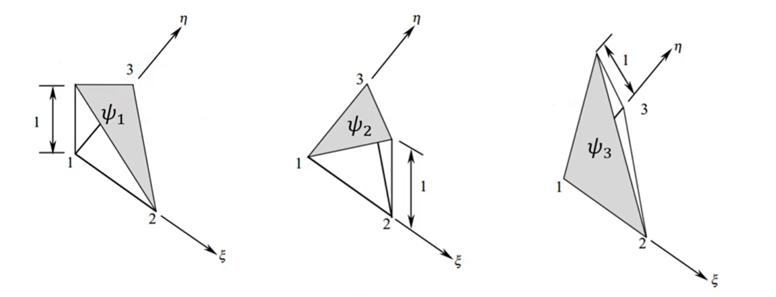



$$ψ_{1}(ζ,η)=1−ζ−η$$
$$ψ_{2}(ζ,η)=ζ$$
$$ψ_{3}(ζ,η)=η$$

Slide 11
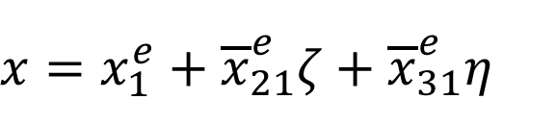
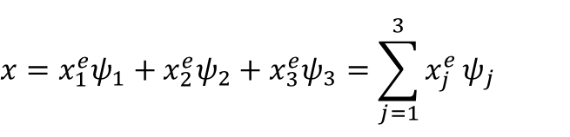

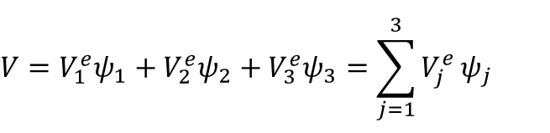


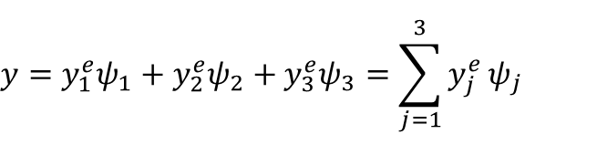
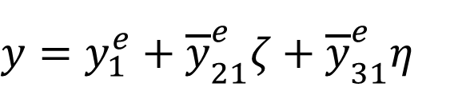
$$V=V_{1}^{e}ψ_{1}+V_{2}^{e}ψ_{2}+V_{3}^{e}ψ_{3}=\sum_{j=1}^{3}{V_{j}^{e}}ψ_{j}$$
$$ψ_{1}(ζ,η)=1−ζ−η$$
$$ψ_{2}(ζ,η)=ζ$$
$$x=x_{1}^{e}ψ_{1}+x_{2}^{e}ψ_{2}+x_{3}^{e}ψ_{3}=\sum_{j=1}^{3}{x_{j}^{e}}ψ_{j}$$
$$ψ_{3}(ζ,η)=η$$
$$y=y_{1}^{e}ψ_{1}+y_{2}^{e}ψ_{2}+y_{3}^{e}ψ_{3}=\sum_{j=1}^{3}{y_{j}^{e}}ψ_{j}$$
$$x=x_{1}^{e}+{\overline{x}}_{21}^{e}ζ+{\overline{x}}_{31}^{e}η$$
$$y=y_{1}^{e}+{\overline{y}}_{21}^{e}ζ+{\overline{y}}_{31}^{e}η$$

Slide 12
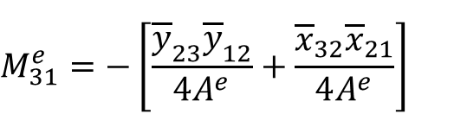
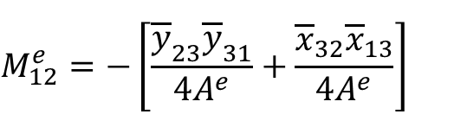
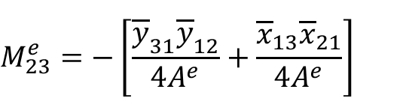
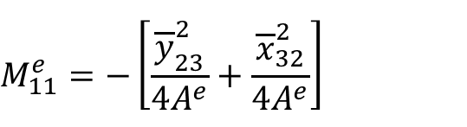
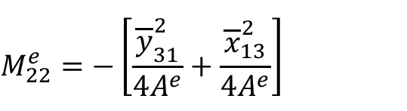
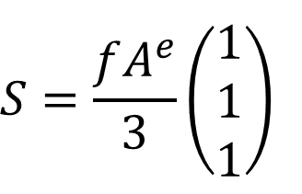
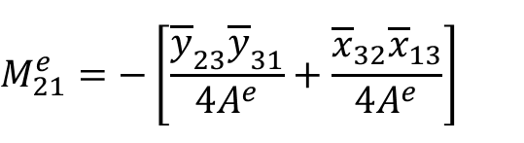
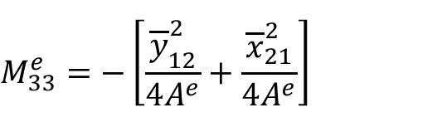
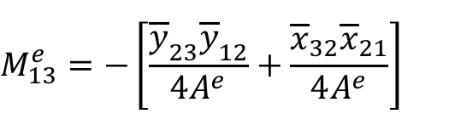
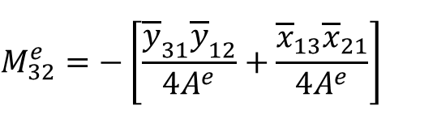
$$M_{11}^{e}=−\left[\frac{{\overline{y}}_{23}^{2}}{4A^{e}}+\frac{{\overline{x}}_{32}^{2}}{4A^{e}}\right]$$
$$M_{12}^{e}=−\left[\frac{{\overline{y}}_{23}{\overline{y}}_{31}}{4A^{e}}+\frac{{\overline{x}}_{32}{\overline{x}}_{13}}{4A^{e}}\right]$$
$$M_{13}^{e}=−\left[\frac{{\overline{y}}_{23}{\overline{y}}_{12}}{4A^{e}}+\frac{{\overline{x}}_{32}{\overline{x}}_{21}}{4A^{e}}\right]$$
$$M_{21}^{e}=−\left[\frac{{\overline{y}}_{23}{\overline{y}}_{31}}{4A^{e}}+\frac{{\overline{x}}_{32}{\overline{x}}_{13}}{4A^{e}}\right]$$
$$M_{22}^{e}=−\left[\frac{{\overline{y}}_{31}^{2}}{4A^{e}}+\frac{{\overline{x}}_{13}^{2}}{4A^{e}}\right]$$
$$M_{23}^{e}=−\left[\frac{{\overline{y}}_{31}{\overline{y}}_{12}}{4A^{e}}+\frac{{\overline{x}}_{13}{\overline{x}}_{21}}{4A^{e}}\right]$$
$$M_{31}^{e}=−\left[\frac{{\overline{y}}_{23}{\overline{y}}_{12}}{4A^{e}}+\frac{{\overline{x}}_{32}{\overline{x}}_{21}}{4A^{e}}\right]$$
$$M_{32}^{e}=−\left[\frac{{\overline{y}}_{31}{\overline{y}}_{12}}{4A^{e}}+\frac{{\overline{x}}_{13}{\overline{x}}_{21}}{4A^{e}}\right]$$
$$M_{33}^{e}=−\left[\frac{{\overline{y}}_{12}^{2}}{4A^{e}}+\frac{{\overline{x}}_{21}^{2}}{4A^{e}}\right]$$
$$S=\frac{fA^{e}}{3}\left(\begin{matrix}1 \\ 1 \\ 1\end{matrix}\right)$$

Slide 13










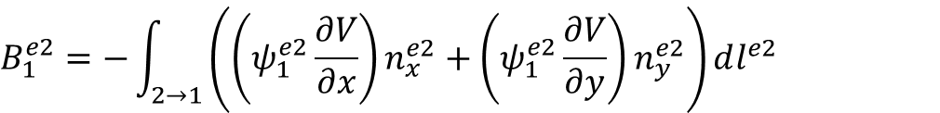





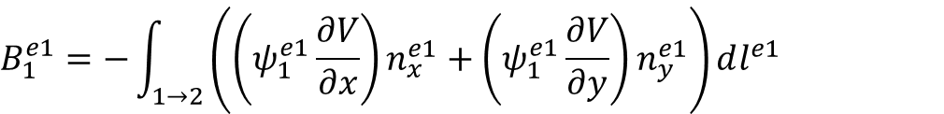



$$y$$
$$2$$
$${\hat{a}}_{n1}=−{\hat{a}}_{n2}$$
$$3$$
$$e_{2}$$
$$e_{2}$$
$$n_{x}^{e1}=−n_{x}^{e2}$$
$$2$$
$${\hat{a}}_{n2}$$
$$e_{1}$$
$$n_{y}^{e1}=−n_{y}^{e2}$$
$${\hat{a}}_{n1}$$
$$1$$
$$e_{1}$$
$$1$$
$$3$$
$$x$$
$$B_{1}^{e1}=−\int_{1→2}{\left(\left(ψ_{1}^{e1}\frac{∂V}{∂x}\right)n_{x}^{e1}+\left(ψ_{1}^{e1}\frac{∂V}{∂y}\right)n_{y}^{e1}\right)}dl^{e1}$$
$$B_{1}^{e1}+B_{1}^{e2}=0$$
$$B_{1}^{e2}=−\int_{2→1}{\left(\left(ψ_{1}^{e2}\frac{∂V}{∂x}\right)n_{x}^{e2}+\left(ψ_{1}^{e2}\frac{∂V}{∂y}\right)n_{y}^{e2}\right)}dl^{e2}$$

Slide 14



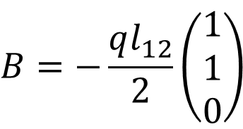



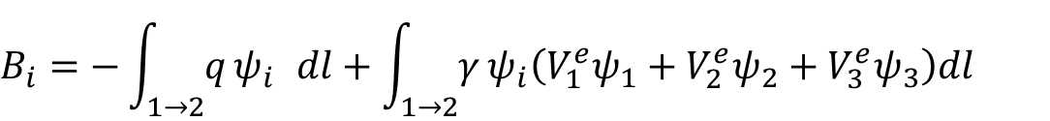









$$B=−\frac{ql_{12}}{2}\left(\begin{matrix}1 \\ 1 \\ 0\end{matrix}\right)$$
$$B_{i}=−\int_{1→2}{q}ψ_{i} dl+\int_{1→2}{γ}ψ_{i}\left(V_{1}^{e}ψ_{1}+V_{2}^{e}ψ_{2}+V_{3}^{e}ψ_{3}\right)dl$$
$$η$$
$$1$$
$$3$$
$$1$$
$$2$$
$$Γ$$
$$e$$
$$y$$
$$1$$
$$2$$
$$x$$
$$3$$
$$0$$
$$1$$
$$ξ$$

Slide 15
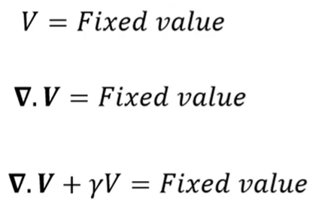
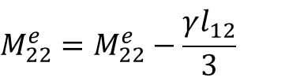
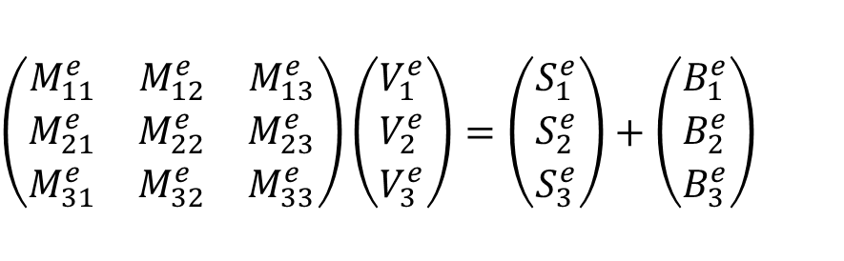
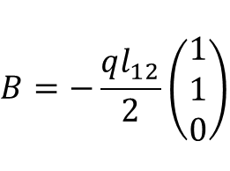
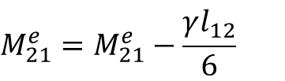
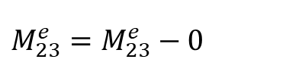
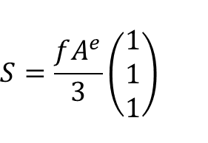
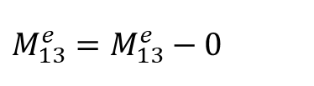






$$S=\frac{fA^{e}}{3}\left(\begin{matrix}1 \\ 1 \\ 1\end{matrix}\right)$$
$$B=−\frac{ql_{12}}{2}\left(\begin{matrix}1 \\ 1 \\ 0\end{matrix}\right)$$
$$M_{11}^{e}=M_{11}^{e}−\frac{γl_{12}}{3}$$
$$M_{21}^{e}=M_{21}^{e}−\frac{γl_{12}}{6}$$
$$M_{21}^{e}=M_{21}^{e}−\frac{γl_{12}}{6}$$
Виды граничных условий
$$M_{12}^{e}=M_{12}^{e}−\frac{γl_{12}}{6}$$
$$M_{22}^{e}=M_{22}^{e}−\frac{γl_{12}}{3}$$
$$M_{22}^{e}=M_{22}^{e}−\frac{γl_{12}}{3}$$
$$M_{13}^{e}=M_{13}^{e}−0$$
$$M_{23}^{e}=M_{23}^{e}−0$$
$$M_{23}^{e}=M_{23}^{e}−0$$
$$\left(\begin{matrix}M_{11}^{e} & M_{12}^{e} & M_{13}^{e} \\ M_{21}^{e} & M_{22}^{e} & M_{23}^{e} \\ M_{31}^{e} & M_{32}^{e} & M_{33}^{e}\end{matrix}\right)\left(\begin{matrix}V_{1}^{e} \\ V_{2}^{e} \\ V_{3}^{e}\end{matrix}\right)=\left(\begin{matrix}S_{1}^{e} \\ S_{2}^{e} \\ S_{3}^{e}\end{matrix}\right)+\left(\begin{matrix}B_{1}^{e} \\ B_{2}^{e} \\ B_{3}^{e}\end{matrix}\right)$$
$$M_{e}V=S+B$$

Slide 16


Slide 17

Реализован набор встроенных математических моделей физических процессов
Редактор геометрических моделей
Сеточный генератор
Набор решателей ДУ
Встроенные элементы визуализации
Встроенная структура нейронных сетей для создания суррогатных моделей
Среда разработки приложений

Slide 18

панель инструментов
Дерево модели
Окно настройки
отображение объекта

