Slide 1

Smart Learning Platform
Group members: Feng Yuqing, Wang Yi, Li Sinuo, Zhang Fangxiao
2025.5.6

Slide 2
Overall & Current Milestone
CONTENTS
Current Implementation
Problems and Solutions
Upcoming Milestone

Slide 3
01
Overall & Current Milestone

Slide 4
Overall Milestone
Technical Selection:
Identify technical frameworks and tools required for project development, including front-end frameworks, back-end frameworks, database systems, etc.
Basic Functions Development:
Develop basic functions such as registration and login page, home page, title page, user page, etc., and realize the interaction function between users and the platform.
AI Q&A Function Development:
Analyze and select the appropriate AI Agent model to ensure that the model can provide accurate understanding and initial answers to common learning questions.
Recommendation Function Development:
A user-based collaborative filtering algorithm is used as the core to implement practice question recommendations.
Data Analysis Report Function Development: Present learning tracking data to users in a visual way, such as learning progress charts, learning behavior heat map, to help users intuitively understand their learning status.
Notes:
图片解释：
A typical CNN is not just the 3 layer structure mentioned above, but a multi-layer structure, such as the structure of LeNet-5 as shown below:
Convolutional layer-Pooling layer-Convolutional layer-Pooling layer-Convolutional layer-Fully connected layer

Slide 5
Current Milestone
User Analytics and AI Model Selection: Define the user's main requirements and choose the most suitable AI Agent model.
Main Functions Implementation: Complete the development of basic logic and key functions of AI Q&A.
Designing and optimising interactive interfaces:
Designing a user-friendly interaction flow to improve the ease of use of AI Q&A.
Notes:
图片解释：
A typical CNN is not just the 3 layer structure mentioned above, but a multi-layer structure, such as the structure of LeNet-5 as shown below:
Convolutional layer-Pooling layer-Convolutional layer-Pooling layer-Convolutional layer-Fully connected layer

Slide 6
02
Current Implementation

Slide 7
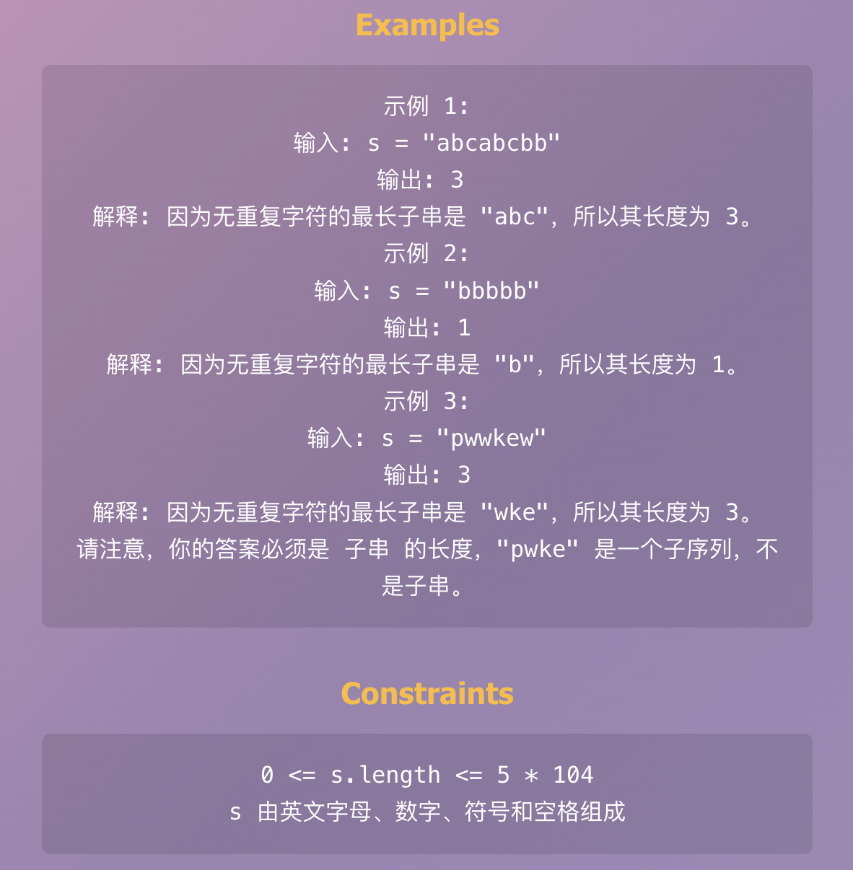
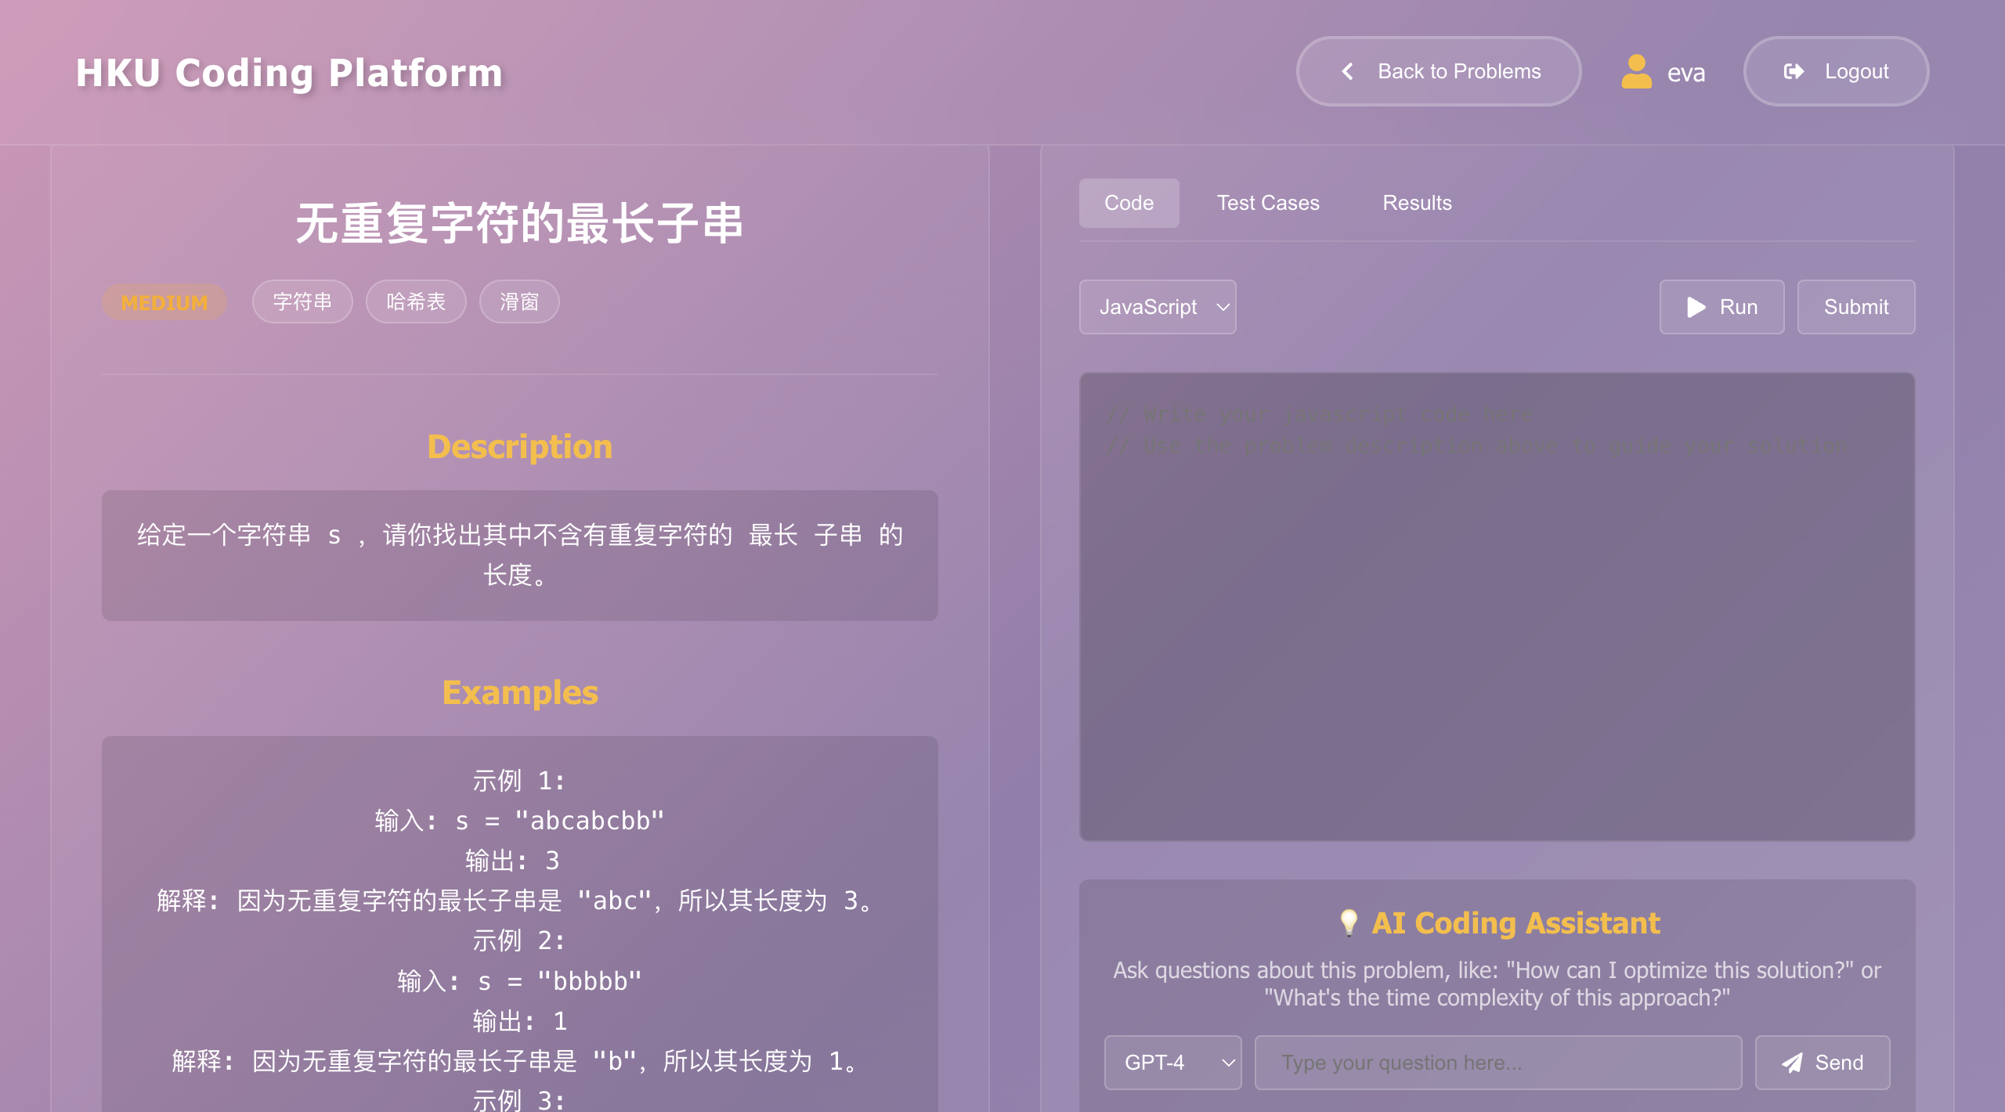
Current Implementation
Problem details page
Notes:
图片解释：
A typical CNN is not just the 3 layer structure mentioned above, but a multi-layer structure, such as the structure of LeNet-5 as shown below:
Convolutional layer-Pooling layer-Convolutional layer-Pooling layer-Convolutional layer-Fully connected layer

Slide 8
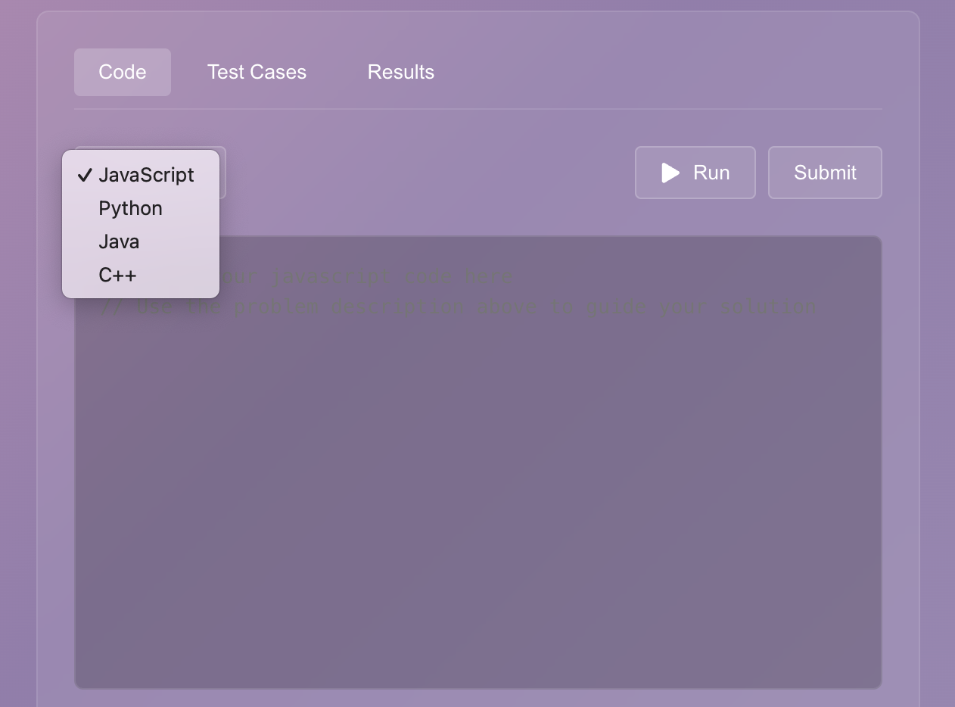
Current Implementation
Question Input Function
Notes:
图片解释：
A typical CNN is not just the 3 layer structure mentioned above, but a multi-layer structure, such as the structure of LeNet-5 as shown below:
Convolutional layer-Pooling layer-Convolutional layer-Pooling layer-Convolutional layer-Fully connected layer

Slide 9
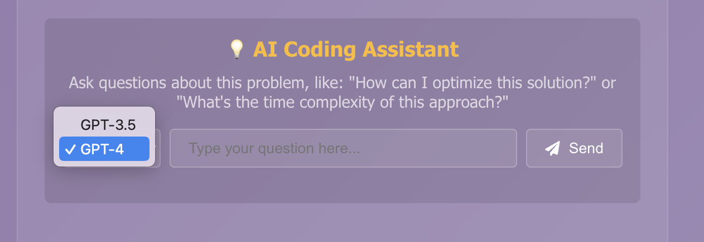
Current Implementation
AI Assistant Interface
Notes:
图片解释：
A typical CNN is not just the 3 layer structure mentioned above, but a multi-layer structure, such as the structure of LeNet-5 as shown below:
Convolutional layer-Pooling layer-Convolutional layer-Pooling layer-Convolutional layer-Fully connected layer

Slide 10
03
Problems and Solutions

Slide 11
Problems encountered and solutions
1. AI Model Integration and Performance Issues
Solution: Integrate AI models into the backend service and interact with the frontend through API calls
Reasons:
(1) Backend processing reduces client-side burden.
(2) It provides better security by avoiding model parameter exposure on the client side.
(3) It allows for unified API design, with the frontend only needing to call the model service through APIs.
Notes:
图片解释：
A typical CNN is not just the 3 layer structure mentioned above, but a multi-layer structure, such as the structure of LeNet-5 as shown below:
Convolutional layer-Pooling layer-Convolutional layer-Pooling layer-Convolutional layer-Fully connected layer

Slide 12
Problems encountered and solutions
2. Data Storage and Processing Efficiency
Solution: Implement a hybrid MySQL+Redis storage architecture
Reasons:
(1) Redis caching of frequently accessed data reduces database access pressure
(2) Long-term data reliability maintained in MySQL
Notes:
图片解释：
A typical CNN is not just the 3 layer structure mentioned above, but a multi-layer structure, such as the structure of LeNet-5 as shown below:
Convolutional layer-Pooling layer-Convolutional layer-Pooling layer-Convolutional layer-Fully connected layer

Slide 13
Problems to be solved in the future and envisioned solutions
1. Cold Start Problem
Solution: Adopt a hybrid recommendation strategy
Reasons:
(1) Combine content-based recommendations with collaborative filtering
(2) Initially use content-based recommendations for new users
(3) Gradually transition to more personalized collaborative filtering recommendations
Notes:
图片解释：
A typical CNN is not just the 3 layer structure mentioned above, but a multi-layer structure, such as the structure of LeNet-5 as shown below:
Convolutional layer-Pooling layer-Convolutional layer-Pooling layer-Convolutional layer-Fully connected layer

Slide 14
Problems to be solved in the future and envisioned solutions
2. Responsive Design Challenges
Solution: Adopt a responsive design pattern combining CSS Grid and Flexbox, and implement component-level adaptive logic
Reasons:
(1) Ensure layout flexibility while allowing customized adjustments for specific components
(2) Avoid the limitations of simple media queries
Notes:
图片解释：
A typical CNN is not just the 3 layer structure mentioned above, but a multi-layer structure, such as the structure of LeNet-5 as shown below:
Convolutional layer-Pooling layer-Convolutional layer-Pooling layer-Convolutional layer-Fully connected layer

Slide 15
04
Upcoming Milestone

Slide 16
Upcoming Milestone
Completed
Background Research, Technology Selection, Function Planning, Architecture Design | 3.10
Basic Framework for Online Practice Platform | 4.10
Full Functionality of the Online Practice Platform | 4.25
Implementation of the AI Q&A Module | 5.3
Upcoming
Implement Search and Recommendation System | 6.1
Develop Data Analytics and Visualization Dashboard | 6.16
Perform Functional and Stress Testing | 7.7
Prepare Final Report and Presentation | 7.20

Slide 17
Thank You
Group members: Feng Yuqing, Li Sinuo, Wang Yi, Zhang Fangxiao
2025.5.6

