Slide 1
DELETE THIS SLIDE ONCE YOU'RE SET UP
Make the wheels spin — three minutes, once
1
Type your residents' names
On slides 2 and 3, click any name on the wheel and type over it. The text boxes are already rotated — just replace the words. To change how many wedges there are, tell Claude and it will rebuild the wheel art.
2
Group each wheel
On slide 2, press Ctrl+A (Cmd+A on Mac), then Ctrl+Shift+G once to release any existing grouping, then click the pointer triangle and the white hub while holding Shift to DESELECT them. Group what's left with Ctrl+G. Repeat on slide 3. The pointer and hub must stay outside the group so they don't spin with it.
3
Add the spin
With the group selected: Animations tab → Add Animation → Emphasis → Spin. Then Animation Pane → double-click the effect → Timing tab → Duration 1 second, Repeat: Until Next Click. Uncheck "Rewind when done playing" on the Effect tab.
4
Run it
In Slide Show, click once to start the wheel spinning and click again to stop it. Where it lands depends on when you click, which is what makes it fair. Nobody can time it.
Prefer no setup?
The browser version (discussant-draw.html) needs no configuration, strikes off names so nobody is drawn twice in a cycle, and lets you bench whoever is post-call. Open it in a tab and share that window instead.
Notes:
PowerPoint cannot do a weighted or exclusion-aware draw. This is a spinner, nothing more. If fairness across the year matters, use the HTML version.

Slide 2

MORNING REPORT · FIRST PASS
PGY-1 discussant
0:07 — 4 MIN
Problem representation, three to four diagnoses, the can't-miss. Uninterrupted.
Hassan Iqbal
Aisha Rahman
Grace Lin
Ben Ortiz
PGY-1
Femi Adeyemi
Chloe Nguyen
Elena Sokolov
Devon Carter
Click once to spin, once more to stop. Draw the day before if you want the discussant to prepare from the one-liner.
Notes:
Replace the names by clicking each one and typing. Group everything except the hub and the pointer before adding the Spin animation.

Slide 3
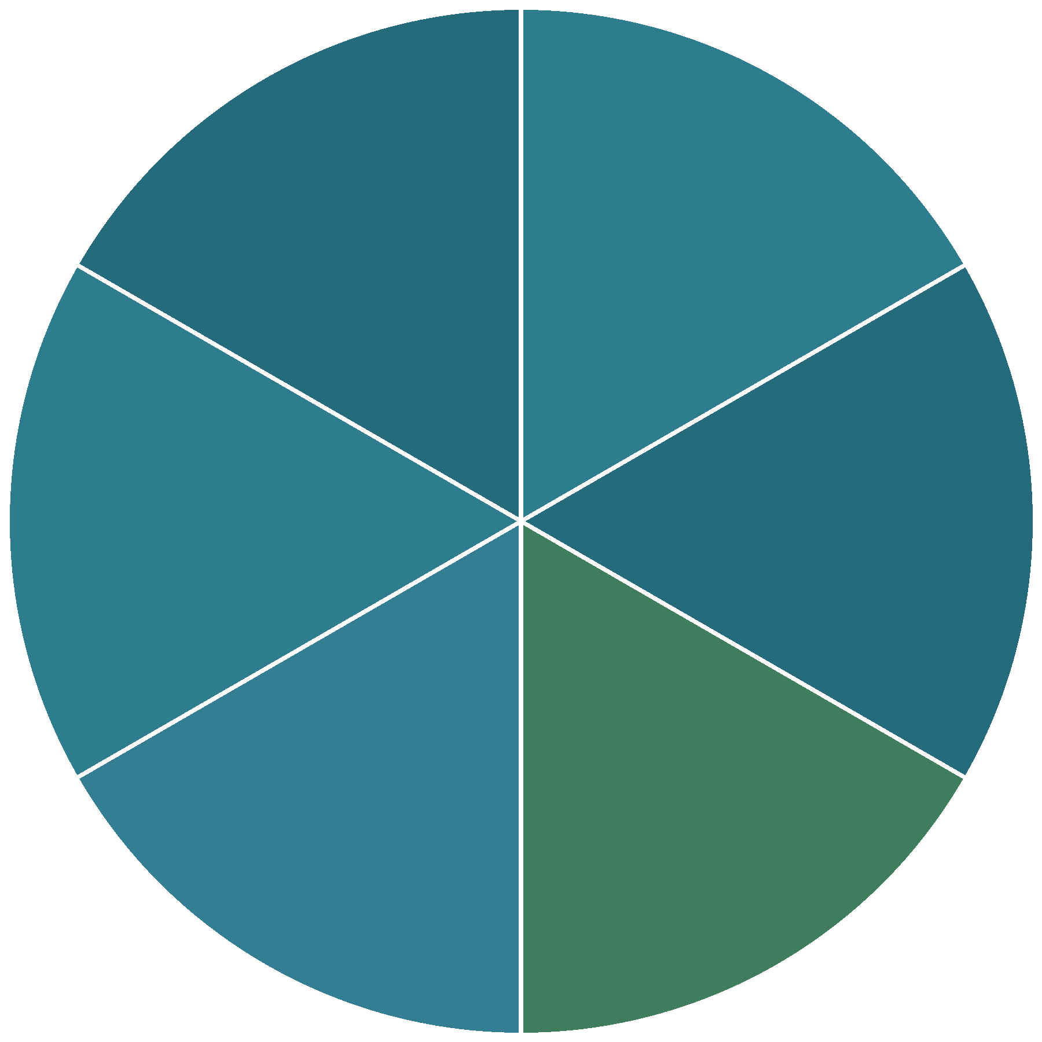
MORNING REPORT · SECOND PASS
Senior discussant
0:11 — 5 MIN
Framework, explicit pruning, the discriminating test, and what would change their mind.
Jonah Pierce
Priya Menon
SR
Nadia Haddad
Marcus Webb
Tobias Klein
Sofia Delgado
Click once to spin, once more to stop. Draw the day before if you want the discussant to prepare from the one-liner.
Notes:
Replace the names by clicking each one and typing. Group everything except the hub and the pointer before adding the Spin animation.

