Slide 1

Foundations of Software Testing
Chapter 3: Test Generation: Finite State Models
Aditya P. Mathur
Purdue University
These slides are copyrighted. They are for use with the Foundations of Software Testing book by Aditya Mathur. Please use the slides but do not remove the copyright notice.
Last update: September 3, 2007

Slide 2
Learning Objectives
What are Finite State Models?
The W method for test generation
The Wp method for test generation
© Aditya P. Mathur 2007

Slide 3
Where are FSMs used?
Conformance testing of communications protocols--this is where it all started.
Testing of any system/subsystem modeled as a finite state machine, e.g. elevator designs, automobile components (locks, transmission, stepper motors, etc), nuclear plant protection systems, steam boiler control, etc.)
Finite state machines are widely used in modeling of all kinds of systems. Generation of tests from FSM specifications assists in testing the conformance of implementations to the corresponding FSM model.
© Aditya P. Mathur 2007

Slide 4
Where are FSMs used?
Modeling GUIs, network protocols, pacemakers, Teller machines, WEB applications, safety software modeling in nuclear plants, and many more.
While the FSM’s considered in examples are abstract machines, they are abstractions of many real-life machines.
© Aditya P. Mathur 2007

Slide 5
What is an Finite State Machine? Quick review
A finite state machine, abbreviated as FSM, is an abstract representation of behavior exhibited by some systems.
An FSM is derived from application requirements. For example, a network protocol could be modeled using an FSM.
Not all aspects of an application’s requirements are specified by an FSM. Real time requirements, performance requirements, and several types of computational requirements cannot be specified by an FSM.
© Aditya P. Mathur 2007

Slide 6
FSM (Mealy machine, 1955): Definition
An FSM (Mealy) is a 6-tuple: (X, Y, Q, q₀, δ, O), where:,
X is a finite set of input symbols also known as the input alphabet.
Y is a finite set of output symbols also known as the output alphabet,
Q is a finite set states,
q₀ in Q is the initial state,
δ: Q x X→ Q is a next-state or state transition function, and
O: Q x X→ Y is an output function
© Aditya P. Mathur 2007

Slide 7
FSM (Moore machine, 1956): Definition
An FSM (Moore) is a 7-tuple: (X, Y, Q, q_{0,} δ, O, F), where:,
X , Y, Q, q₀, and δ are the same as in FSM (Mealy)
O: Q → Y is an output function
F∈Q is the set of final or accepting or terminating states.
© Aditya P. Mathur 2007

Slide 8
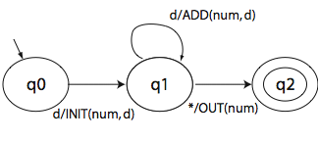
State Diagram Representation of FSM
Nodes: States; Labeled Edges: Transitions
Example: Machine to convert a sequence of decimal digits to an integer
(a) Notice ADD, INIT, ADD,OUT actions.
(b) INIT: Initialize num. ADD: Add to num. OUT: Output num.
© Aditya P. Mathur 2007

Slide 9
Tabular representation of FSM
A table is often used as an alternative to the state diagram to represent the state transition function δ and the output function O.
The table consists of two sub-tables that consist of one or more columns each. The leftmost sub table is the output or the action sub-table. The rows are labeled by the states of the FSM. The rightmost sub-table is the next state sub-table.
© Aditya P. Mathur 2007

Slide 10
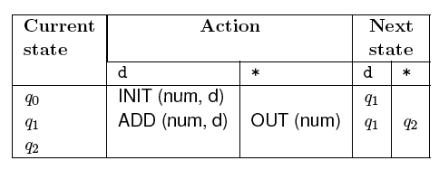
Tabular representation of FSM: Example
The table given below shows how to represent functions δ and O for the DIGDEC machine.
© Aditya P. Mathur 2007

Slide 11
Properties of FSM
Completely specified: An FSM M is said to be completely specified if from each state in M there exists a transition for each input symbol.
Strongly connected: An FSM M is considered strongly connected if for each pair of states (q_{i} q_{j}) there exists an input sequence that takes M from state q_{i} to q_{j}.
© Aditya P. Mathur 2007

Slide 12
Properties of FSM: Equivalence
V-equivalence: Let
M₁=(X, Y, Q₁, m¹₀, T₁, O₁) and M₂=(X, Y, Q₂, m²₀, T₂, O₂)
be two FSMs. Let V denote a set of non-empty strings over the input alphabet X i.e. V⊆ X⁺.
Let q_{i} and q_{j}, be two states of machines M₁ and M₂, respectively. q_{i} and q_{i} are considered V-equivalent if
O₁(q_{i}, s)=O₂(q_{j}, s) for all s in V.
© Aditya P. Mathur 2007

Slide 13
Properties of FSM: Distinguishability
Stated differently, states q_{i} and q_{j} are considered V-equivalent if M₁ and M₂ , when excited with an element of V in states q_{i} and q_{j}, respectively, yield identical output sequences.
States q_{i} and q_{j} are said to be equivalent if O₁(q_{i}, r)=O₂(q_{j}, r) for any set V. If q_{i} and q_{j} are not equivalent then they are said to be distinguishable. This definition of equivalence also applies to states within a machine. Thus machines M₁ and M₂ could be the same machine.
© Aditya P. Mathur 2007

Slide 14
Properties of FSM: k-equivalence
k-equivalence: Let
M₁=(X, Y, Q₁, m¹₀, T₁, O₁) and M₂=(X, Y, Q₂, m²₀, T₂, O₂)
be two FSMs.
States q_{i}ε Q₁ and q_{j}ε Q₂ are considered k-equivalent if, when excited by any input of length k, yield identical output sequences.
© Aditya P. Mathur 2007

Slide 15
Properties of FSM: k-equivalence (contd.)
States that are not k-equivalent are considered k-distinguishable.
Once again, M₁ and M₂ may be the same machines implying that k-distinguishability applies to any pair of states of an FSM.
It is also easy to see that if two states are k-distinguishable for any k>0 then they are also distinguishable for any n≥ k. If M₁ and M₂ are not k-distinguishable then they are said to be k-equivalent.
© Aditya P. Mathur 2007

Slide 16
Properties of FSM: Machine Equivalence
Machine equivalence: Machines M₁ and M₂ are said to be equivalent if (a) for each state σ in M1 there exists a state σ ' in M₂ such that σ and σ ' are equivalent and (b) for each state σ in M₂ there exists a state σ ' in M₁ such that σ and σ ' are equivalent.
Machines that are not equivalent are considered distinguishable.
Minimal machine: An FSM M is considered minimal if the number of states in M is less than or equal to any other FSM equivalent to M.
© Aditya P. Mathur 2007

Slide 17

Faults Targeted
© Aditya P. Mathur 2007

Slide 18
Faults in implementation
An FSM serves to specify the correct requirement or design of an application. Hence tests generated from an FSM target faults related to the FSM itself.
What faults are targeted by the tests generated using an FSM?
© Aditya P. Mathur 2007

Slide 19
Fault model
a/1
a/0
q0
q0
q0
a/1
a/1
a/1
b/1
a/1
b/1
b/1
q1
q1
q1
b/0
b/0
b/0
Correct design
Operation error
Transfer error
© Aditya P. Mathur 2007

Slide 20
Fault model (contd.)
a/1
b/0
a/0
b/1
q0
q0
q2
a/1
a/1
q1
b/0
Extra state error
Missing state error
© Aditya P. Mathur 2007

Slide 21
Fault model (contd.)
a/1
b/0
a/0
b/1
q0
q0
q2
a/1
a/1
q1
b/0
Extra state error
Missing state error
© Aditya P. Mathur 2007

Slide 22
Test generation using Chow’s method
© Aditya P. Mathur 2007

Slide 23
Assumptions for test generation
M is Completely specified, minimal, connected, and deterministic.
M starts in a fixed initial state.
M and IUT (Implementation Under Test) have the same input alphabet.
© Aditya P. Mathur 2007

Slide 24
Overall algorithm used in Chow’s method
Step 1: Estimate the maximum number of states (m) in the correct implementation of the given FSM M.
Step 2: Construct the characterization set W for M.
Step 3: (a) Construct the testing tree for M and (b) generate the transition cover set P from the testing tree.
Step 4: Construct set Z from W and m.
Step 5: Desired test set=P.Z
© Aditya P. Mathur 2007

Slide 25
Step 1: Estimation of m
This is based on a knowledge of the implementation.
In the absence of any such knowledge,
let m=number of states in M.
© Aditya P. Mathur 2007

Slide 26
Step 2: Construction of W. What is W?
Let M=(X, Y, Q, q1, δ, O) be a minimal and complete FSM.
W is a finite set of input sequences that distinguish the behavior of any pair of states in M. Each input sequence in W is of finite length.
Given states qi and qj in Q, W contains a string s such that:
O(qi, s)≠O(qj, s)
© Aditya P. Mathur 2007

Slide 27
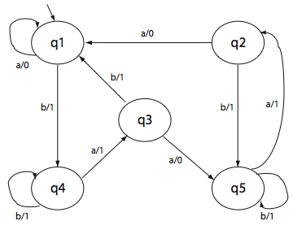
Example of W
W={baaa,aa,aaa}
O(baaa,q1)=1101
O(baaa,q2)=1100
Thus baaa distinguishes state q1 from q2 as O(baaa,q1) ≠ O(baaa,q2)
© Aditya P. Mathur 2007

Slide 28
Steps in the construction of W
Step 1: Construct a sequence of k-equivalence partitions of Q denoted as P1, P2, …Pm, m>0.
Step 2: Traverse the k-equivalence partitions in reverse order to obtain distinguishing sequence for each pair of states.
© Aditya P. Mathur 2007

Slide 29
What is a k-equivalence partition of Q?
A k-equivalence partition of Q, denoted as P_{k}, is a collection of n finite sets Σ_{k1}, Σ_{k2 …} Σ_{kn} such that
∪^{n}_{i=1} Σ_{ki} =Q
States in Σ_{ki} are k-equivalent.
If state u is in Σ_{ki} and v in Σ_{kj} for i≠j, then u and v are k-distinguishable.
© Aditya P. Mathur 2007

Slide 30
How to construct a k-equivalence partition?
Given an FSM M, construct a 1-equivalence partition, start with a tabular representation of M.
Current state | Output |  | Next state
 | a | b | a | b
q1 | 0 | 1 | q1 | q4
q2 | 0 | 1 | q1 | q5
q3 | 0 | 1 | q5 | q1
q4 | 1 | 1 | q3 | q4
q5 | 1 | 1 | q2 | q5
© Aditya P. Mathur 2007

Slide 31
Construct 1-equivalence partition
Group states identical in their Output entries. This gives us 1-partition P₁ consisting of Σ₁={q1, q2, q3} and Σ₂ ={q4, q5}.
Σ | Current state | Output |  | Next state
 |  | a | b | a | b
1 | q1 | 0 | 1 | q1 | q4
 | q2 | 0 | 1 | q1 | q5
 | q3 | 0 | 1 | q5 | q1
2 | q4 | 1 | 1 | q3 | q4
 | q5 | 1 | 1 | q2 | q5
© Aditya P. Mathur 2007

Slide 32
Construct 2-equivalence partition: Rewrite P₁ table
Rewrite P₁ table. Remove the output columns. Replace a state entry q_{i} by q_{ij} where j is the group number in which state q_{i} lies.
Σ | Current state | Next state
 |  | a | b
1 | q1 | q11 | q42
 | q2 | q11 | q52
 | q3 | q52 | q11
2 | q4 | q31 | q42
 | q5 | q21 | q52
P₁ Table
Group number
© Aditya P. Mathur 2007

Slide 33
Construct 2-equivalence partition: Construct P₂ table
Group all entries with identical second subscripts under the next state column. This gives us the P₂ table. Note the change in second subscripts.
Σ | Current state | Next state
 |  | a | b
1 | q1 | q11 | q43
 | q2 | q11 | q53
2 | q3 | q53 | q11
3 | q4 | q32 | q43
 | q5 | q21 | q53
P₂ Table
© Aditya P. Mathur 2007

Slide 34
Construct 3-equivalence partition: Construct P₃ table
Group all entries with identical second subscripts under the next state column. This gives us the P₃ table. Note the change in second subscripts.
Σ | Current state | Next state
 |  | a | b
1 | q1 | q11 | q43
 | q2 | q11 | q54
2 | q3 | q54 | q11
3 | q4 | q32 | q43
4 | q5 | q21 | q54
P₃ Table
© Aditya P. Mathur 2007

Slide 35
Construct 4-equivalence partition: Construct P₄ table
Continuing with regrouping and relabeling, we finally arrive at P₄ table.
Σ | Current state | Next state
 |  | a | b
1 | q1 | q11 | q44
2 | q2 | q11 | q55
3 | q3 | q55 | q11
4 | q4 | q33 | q44
5 | q5 | q22 | q55
P₄ Table
© Aditya P. Mathur 2007

Slide 36
k-equivalence partition: Convergence
The process is guaranteed to converge.
When the process converges, and the machine is minimal, each state will be in a separate group.
The next step is to obtain the distinguishing strings for each state.
© Aditya P. Mathur 2007

Slide 37
Finding the distinguishing sequences: Example
Let us find a distinguishing sequence for states q1 and q2.
Find tables P_{i} and P_{i+1} such that (q1, q2) are in the same group in P_{i} and different groups in P_{i+1}. We get P₃ and P₄.
Initialize z=ε. Find the input symbol that distinguishes q1 and q2 in table P3. This symbol is b. We update z to z.b. Hence z now becomes b.
© Aditya P. Mathur 2007

Slide 38
Finding the distinguishing sequences: Example (contd.)
The next states for q1 and q2 on b are, respectively, q4 and q5.
We move to the P₂ table and find the input symbol that distinguishes q4 and q5. _x000c_Let us select a as the distinguishing symbol. Update z which now becomes ba.
The next states for states q4 and q5 on symbol a are, respectively, q3 and q2. These two states are distinguished in P₁ by a and b. Let us select a. We update z to baa.
© Aditya P. Mathur 2007

Slide 39
Finding the distinguishing sequences: Example (contd.)
The next states for q3 and q2 on a are, respectively, q1 and q5.
Moving to the original state transition table we obtain a as the distinguishing symbol for q1 and q5
We update z to baaa. This is the farthest we can go backwards through the various tables. baaa is the desired distinguishing sequence for states q1 and q2. Check that o(q1,baaa)≠o(q2,baaa).
© Aditya P. Mathur 2007

Slide 40
Finding the distinguishing sequences: Example (contd.)
Using the same procedure used for q1 and q2, we can find the distinguishing sequence for each pair of states. This leads us to the following characterization set for our FSM.
W={a, aa, aaa, baaa}
© Aditya P. Mathur 2007

Slide 41
Chow’s method: where are we?
Step 1: Estimate the maximum number of states (m) in the correct implementation of the given FSM M.
Done
Step 2: Construct the characterization set W for M.
Step 3: (a) Construct the testing tree for M and (b) generate the transition cover set P from the testing tree.
Next (a)
Step 4: Construct set Z from W and m.
Step 5: Desired test set=P.Z
© Aditya P. Mathur 2007

Slide 42
Step 3: (a) Construct the testing tree for M
A testing tree of an FSM is a tree rooted at the initial state. It contains at least one path from the initial state to the remaining states in the FSM. Here is how we construct the testing tree.
State q0, the initial state, is the root of the testing tree. Suppose that the testing tree has been constructed until level k . The (k+1)th level is built as follows.
Select a node n at level k. If n appears at any level from 1 through k-1 , then n is a leaf node and is not expanded any further. If n is not a leaf node then we expand it by adding a branch from node n to a new node m if δ(n, x)=m for each x in X . This branch is labeled as x. This step is repeated for all nodes at level k.
© Aditya P. Mathur 2007

Slide 43
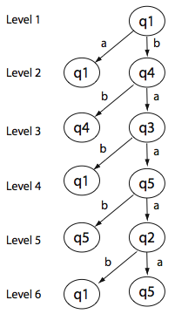
Example: Construct the testing tree for M
Start here, initial state is the root.
q1 becomes leaf, q4 can be expanded.
.
.
.
M
No further expansion possible
© Aditya P. Mathur 2007

Slide 44
Chow’s method: where are we?
Step 1: Estimate the maximum number of states (m) in the correct implementation of the given FSM M.
Done
Step 2: Construct the characterization set W for M.
Step 3: (a) Construct the testing tree for M and (b) generate the transition cover set P from the testing tree.
Next, (b)
Step 4: Construct set Z from W and m.
Step 5: Desired test set=P.Z
© Aditya P. Mathur 2007

Slide 45
Step 3: (b) Find the transition cover set from the testing tree
A transition cover set P is a set of all strings representing sub-paths, starting at the root, in the testing tree. Concatenation of the labels along the edges of a sub-path is a string that belongs to P. The empty string (ε) also belongs to P.
P={ε, a, b, bb, ba, bab, baa, baab, baaa, baaab, baaaa}
© Aditya P. Mathur 2007

Slide 46
Chow’s method: where are we?
Step 1: Estimate the maximum number of states (m) in the correct implementation of the given FSM M.
Done
Step 2: Construct the characterization set W for M.
Step 3: (a) Construct the testing tree for M and (b) generate the transition cover set P from the testing tree.
Done
Step 4: Construct set Z from W and m.
Next
Step 5: Desired test set=P.Z
© Aditya P. Mathur 2007

Slide 47
Step 4: Construct set Z from W and m
Given that X is the input alphabet and W the characterization set, we have:
    Z = X⁰.W ∪ X¹.W ∪ ….. X^{m-1-n}.W ∪ X^{m-n}.W
For m=n, we get
    Z = X⁰.W=W
For X={a, b}, W={a, aa, aaa, baaa}, m=6
    Z = W ∪ X¹.W ={a, aa, aaa, baaa} ∪ {a, b}.{a, aa, aaa, baaa}
    ={a, aa, aaa, baaa, aa, aaa, aaaa, abaaa, ba, baa, baaa, bbaaa}
© Aditya P. Mathur 2007

Slide 48
Chow’s method: where are we?
Step 1: Estimate the maximum number of states (m) in the correct implementation of the given FSM M.
Done
Step 2: Construct the characterization set W for M.
Step 3: (a) Construct the testing tree for M and (b) generate the transition cover set P from the testing tree.
Done
Step 4: Construct set Z from W and m.
Done
Next
Step 5: Desired test set=P.Z
© Aditya P. Mathur 2007

Slide 49
Step 5: Desired test set=P.Z
The test inputs based on the given FSM M can now be derived as:
T=P.Z
Do the following to test the implementation:
Find the expected response to each element of T.
Generate test cases for the application. Note that even though the application is modeled by M, there might be variables to be set before it can be exercised with elements of T.
Execute the application and check if the response matches. Reset the application to the initial state after each test.
© Aditya P. Mathur 2007

Slide 50
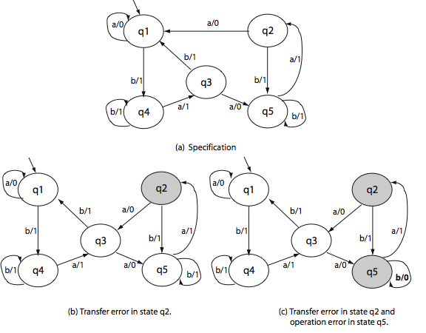
Example 1: Testing an erroneous application
Correct design
M(t1)=1101000
M
Error-revealing
test cases
M(t2)=11011
t1=baaaaaa
t2=baaba
M1(t1)=1101001
M2(t2)=11001
© Aditya P. Mathur 2007
M1
M2

Slide 51
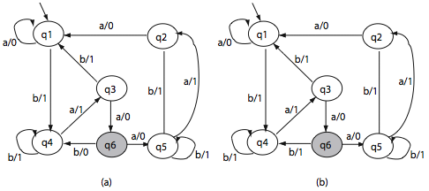
Example 2: Extra state. n=5, m=6.
M1
M2
t1=baaba M(t1)=11011 M1(t1)=11001
t2=baaa M(t2)=1101 M2(t2)=1100
© Aditya P. Mathur 2007

Slide 52
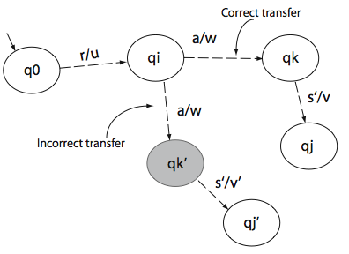
Error detection process
Given m=n, each test case t is of the form r.s where r is in P and s in W. r moves the application from initial state q0 to state qj. Then, s=as’ takes it from qi to state qj or qj’.
© Aditya P. Mathur 2007

Slide 53
The Partial W (Wp) method
© Aditya P. Mathur 2007

Slide 54
The partial W (Wp) method
Tests are generated from minimal, complete, and connected FSM.
Size of tests generated is generally smaller than that generated using the W-method.
Test generation process is divided into two phases:
Phase 1: Generate a test set using the state cover set (S) and the characterization set (W).
Phase 2: Generate additional tests using a subset of the transition cover set and state identification sets.
What is a state cover set? A state identification set?
© Aditya P. Mathur 2007

Slide 55
State cover set
Given FSM M with input alphabet X, a state cover set S is a finite
non-empty set of strings over X* such that, for each state qi in Q,
there is a string in S that takes M from its initial state to qi.
S={ε, b, ba, baa, baaa}
S is always a subset of the transition cover set P.
S is not necessarily unique.
© Aditya P. Mathur 2007

Slide 56
State identification set
Given an FSM M with Q as the set of states, an identification set W_{i} for state qi∈Q has the following properties:
(a) W_{i}⊆ W , 1≤ i≤n [Identification set is a subset of W.]
O(qi, s)≠ O(qj, s) , for 1≤j≤ n , j≠ i , s∈ W_{i}
[For each state other than qi, there is a string in Wi that distinguishes qi from qj.]
(c) No subset of W_{i} satisfies property (b). [W_{i} is minimal.]
© Aditya P. Mathur 2007

Slide 57
State identification set: Example
Last element of the output string
Si | Sj | x | O(Si,x) | O(Sj,x)
1 | 2 | baaa | 1 | 0
 | 3 | aa | 0 | 1
 | 4 | a | 0 | 1
 | 5 | a | 0 | 1
2 | 3 | aa | 0 | 1
 | 4 | a | 0 | 1
 | 5 | a | 0 | 1
3 | 4 | a | 0 | 1
 | 5 | a | 0 | 1
4 | 5 | aaa | 1 | 0
W₁=W₂={baaa, aa, a}
W₃={a, aa} W₄=W₅={a, aaa}
© Aditya P. Mathur 2007

Slide 58
Wp method: Example:
Step 1: Compute S, P, W, Wi,W
S={ε, b, ba, baa, baaa}
P={ε, a, b, bb, ba, bab, baa, baab, baaa, baaab, baaaa}
W₁=W₂={baaa, aa, a}
W₃={a, aa} W₄=W₅={a, aaa}
W={a, aa, aaa, baaa}
W={W1, W2, W3, W4, W5}
© Aditya P. Mathur 2007

Slide 59
Wp method: Example:
Step 2: Compute T1 [m=n]
T1 = S.W = {ε, b, ba, baa, baaa}.{a, aa, aaa, baaa}
Elements of T1 ensure that the each state of the FSM is covered and distinguished from the remaining states.
© Aditya P. Mathur 2007

Slide 60
Wp method: Example:
Step 3: Compute R and δ (we assume m=n)
R = P - S = {ε, a, b, bb, ba, bab, baa, baab, baaa, baaab, baaaa}
- {ε, b, ba, baa, baaa}
= {a, bb, bab, baab, baaab, baaaa}
Let each element of R be denoted as r_{i1}, r_{i2},…,r_{ik}
And let δ(q₀ , r_{ij})=q_{ij}
© Aditya P. Mathur 2007

Slide 61
Wp method: Example:
Step 4: Compute T2 [m=n]
T2=R⊗W=∪^{k}_{j=1} ({r_{ij}}.W_{ij} ),
where W_{ij} is the identification set for state q_{ij}.
δ(q1, a)=q1 δ(q1, bb)=q4 δ(q1, bab)=q1
δ(q1, baab)=q5 δ(q1, baaab)=q5 δ(q1, baaaa)=q1
T2 = ({a}.W₁ ) ∪ ({bb}.W₄ ) ∪ ({bab}.W₁ ) ∪ ({baab}.W₅ ) ∪ ({baaab}.W₅ ) ∪ ({baaaa}.W₁ )
= {abaaa, aaa, aa} ∪ {bba, bbaaa} ∪ {babbaaa, babaa, baba} ∪
{baaba, baabaaa} ∪ {baaaba, baaabaaa} ∪
{baaaabaaa, baaaaaa, baaaaa}
© Aditya P. Mathur 2007

Slide 62
Wp method: Example: Savings
Test set size using the W method = 44
Test set size using the Wp method = 34 (20 from T1 + 14 from T2)
© Aditya P. Mathur 2007

Slide 63
Testing using the Wp method
Testing proceeds in two phases.
Tests from T1 are applied in phase 1. Tests from T2 are applied in phase 2.
While tests from phase 1 ensure state coverage, they do not ensure all transition coverage.
© Aditya P. Mathur 2007

Slide 64
Wp method when m > n
Sets T1 and T2 are computed a bit differently, as follows:
T1 = S.X[m-n].W, where X[m-n] is the set union of X^{i} , 1 ≤ i ≤ (m-n)
T2 = R.X[m-n] ⊗W
© Aditya P. Mathur 2007

Slide 65
Summary
Behavior of a large variety of applications can be modeled using finite state machines (FSM). GUIs can also be modeled using FSMs
The W and the Wp methods are automata theoretic methods to generate tests from a given FSM model.
Tests so generated are guaranteed to detect all operation errors, transfer errors, and missing/extra state errors in the implementation given that the FSM representing the implementation is complete, connected, and minimal. What happens if it is not?
The size of tests sets generated by the W method is larger than that generated by the Wp method while their fault detection effectiveness are the same.
© Aditya P. Mathur 2007

