Slide 1
COMMUNICATION
Compiled by Dr. Renu Girotra

Slide 2
DISTORTION IN NEGOTIATION COMMUNICATION
Distortion can happen at any part/ element of communication process:
Individual communicators (Sender/ receiver)
Message
Encoding
Decoding: Reception, Interpretation
Channels / Media

Slide 3

What Is Communicated During Negotiations
Offers- counter offers- motives
Information about alternatives
Information about outcomes
Social accounts
Communication about process

Slide 4
Communication In Negotiation
Characteristics of language: polarised, verbal immediacy, language intensity, lexical diversity, high power language style, Linguistic patterns
Non-verbal communication: Eye contact, adjusting body position, non-verbally encouraging or discouraging what the other says, selection of communication channel

Slide 5
Biases That May Happen In Online Or Virtual Negotiation
Temporal synchrony
Burned bridge bias
Squeaky wheel bias
Sinister attribution
Notes:
Temporal synchrony: Behaving as if they are insane on email though they may not be over face to face can give an offer where both sides can talk at length
Burned bridge bias: Different behaviour on face to face and email can be more rowdy react negatively
Squeaky wheel bias: Using negative emotional style to achieve goals
Sinister attribution: When one mistakenly assumes that another’s behaviour is caused by a personality flaws while overlooking the role of situational factors lack of trust dissimilarity between parties and shortage of Repo that may exist via email may lead another to project deceitful motives

Slide 6
Improving Communication In Negotiation
Filter: Ask /use of questions:
distinguish/ choose between manageable/ unmanageable, open /closed ended, impulsive, reflective, tricky, loaded , heated questions, planned, cooling, directive, treating, gauging questions
Listen:
passive listening, acknowledgement, active listening
Watch/ Observe
Role reversal

Slide 7
Avoiding fatal mistakes
Achieving closure

Slide 8
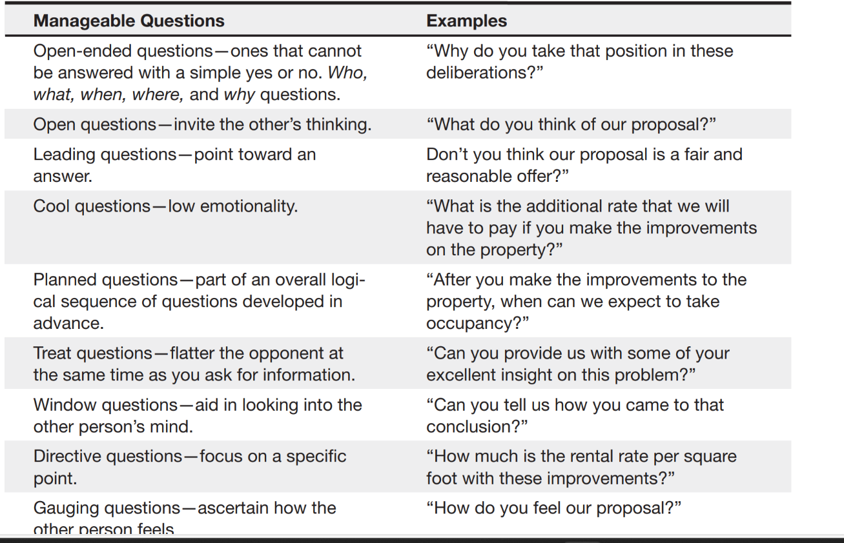

Slide 9
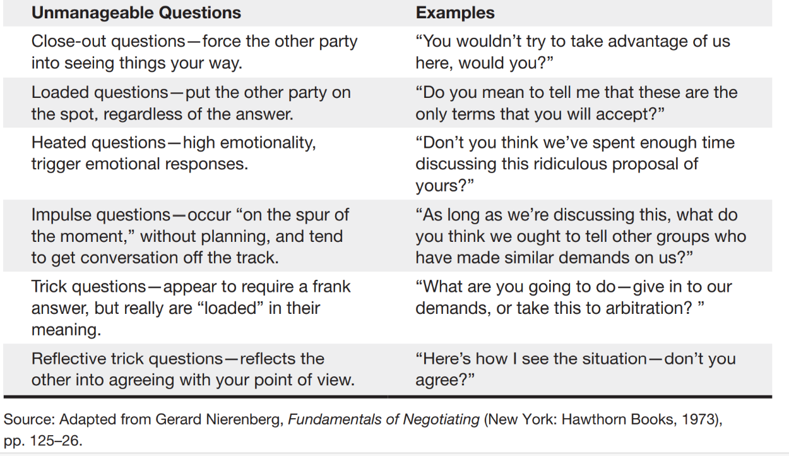

Slide 10
Cross Culture Negotiation
External Environment
Political and Legal Pluralism
International Economics
Foreign Governments and Bureaucrats
Instability
Ideology
Culture
External Stakeholders

Slide 11
Immediate Context
Relative Bargaining Power
Levels of conflict
Relationship between negotiators
Desired Outcomes
Immediate Stakeholders

Slide 12
Has impact on :
Negotiation Process
Information Exchange
Negotiator Cognition
Ethics and Tactics
Outcomes

Slide 13
Hofstede’s Model of Cultural Dimensions
Individualism/ Collectivism
Power Distance
Uncertainty Avoidance
Masculinity/ Feminity
Long-term/ Short-term Orientation

Slide 14
Other Important Dimensions
High/ Low communication context
Time
Space
Benevolence
Tradition/ Conformity
Openness to change
Self-direction

Slide 15
Culture consideration for Negotiation
Definition/ Meaning of Negotiation
Negotiation Opportunity
Selection of Negotiators
Protocol (formal vs informal / balanced)
Communication
Time sensitivity
Risk propensity
Groups vs Individuals
Nature of agreements
Emotionalism

Slide 16
Culture in International Negotiation
As Learned behavior
As Shared Values
As Dialectic
In context

Slide 17
Strategies (Responsive strategies based on familiarity)
Low Familiarity
Employ agents/ advisors
Bring in Mediator
Induce the opponent/ the other negotiator to use your approach
Moderate Familiarity
Adapt to other negotiator’s approach
Coordinate Adjustment
High Familiarity
Embrace other negotiator’s approach
Improvise an approach
Effect Symphony

Slide 18
References
Negotiation by Roy J Lewicki, Bruce Barry & David M Saunders , 6th edition
Conflict Management: A practical guide to developing Negotiation Strategies by Budjac Corvette, Barbara A , first edition

Slide 19
THANK YOU

