Slide 1


Blockchainspace
By:
Shivam Yadav
Samir Jumade

Slide 2
Agenda
Introduction to blockchainspace.
Project mission and vision.
Functionality with screenshots.
Data Sources.

Slide 3
Introduction to blockchainspace
BlockchainSpace serves as a comprehensive platform dedicated to the analysis, education, and exploration of blockchain technologies, aiming to demystify the complexities inherent in this space.
With the rapid emergence of decentralized applications and cryptocurrencies, blockchain analysis is crucial to navigate investment opportunities, assess risk factors, and foster regulatory compliance
Tailored for a diverse audience, BlockchainSpace addresses the needs of developers seeking tooling, investors eyeing opportunities, and enthusiasts eager to deepen their understanding of blockchain technologies.

Slide 4
Project mission & vision
Mission Statement: Informed Decision-Making
Founded on the principle of transparency
Our mission is to equip users with actionable insights
Helping users make sound, informed decisions in the blockchain ecosystem
Emphasis on Trust & Blockchain Foundations
Trust is the bedrock of blockchain communities
BlockchainSpace fosters a transparent and credible environment
We provide essential tools and data to build confidence among participants

Slide 5
Project mission & vision
Vision for the Future of Blockchain Technology
We envision blockchain as a core pillar of digital interaction
Empowering trustless transactions and user ownership
Driving a future where users have control over their digital assets

Slide 6
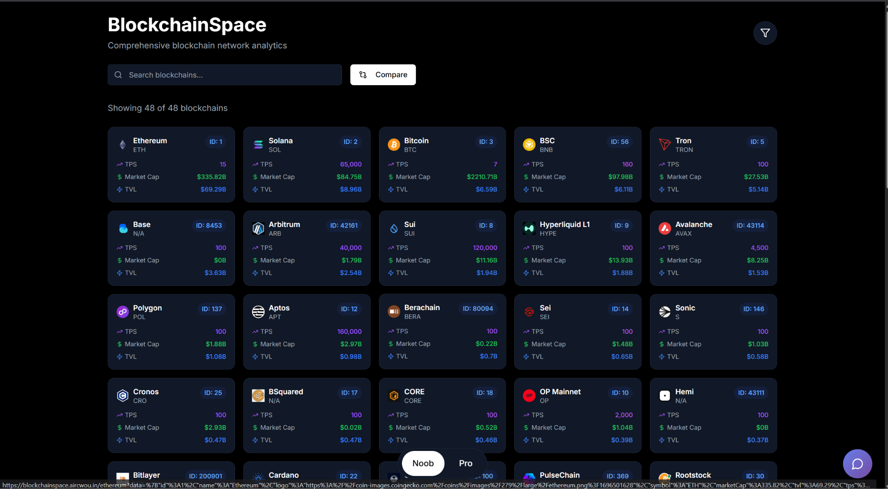
Functionality with screenshots
This is the simple version called “Noob”, were people with little knowledge of blockchain can compare multiple blockchains.

Slide 7
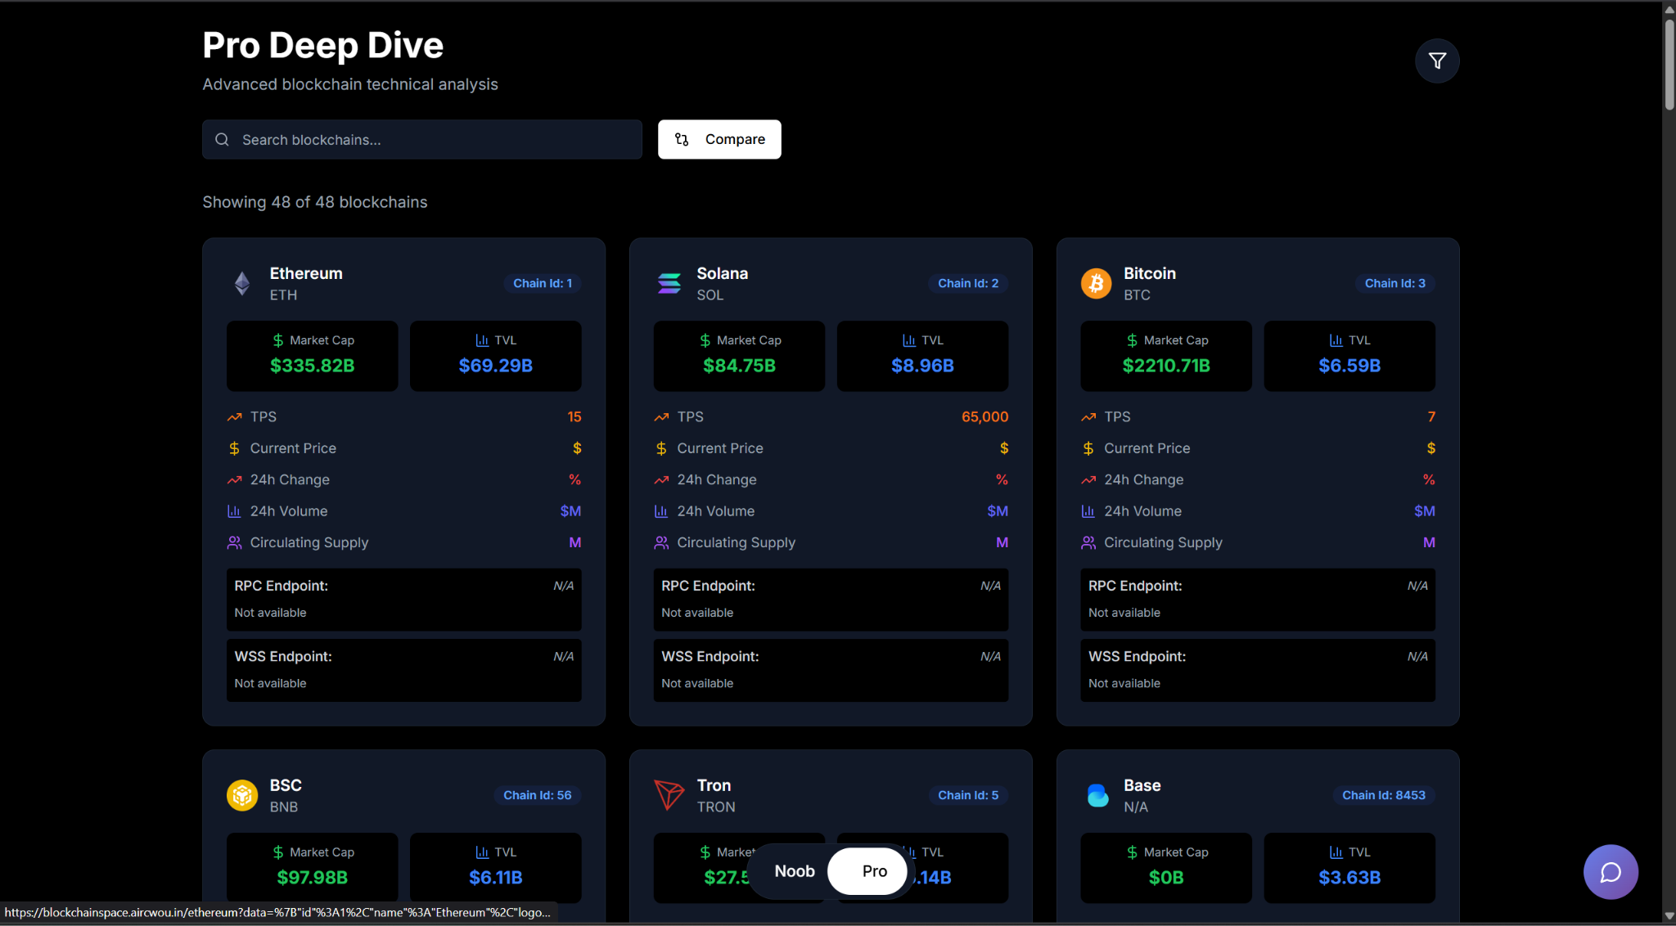
Functionality with screenshots
This is more complex version called “Pro”, were people who understand blockchain can compare multiple blockchains.

Slide 8
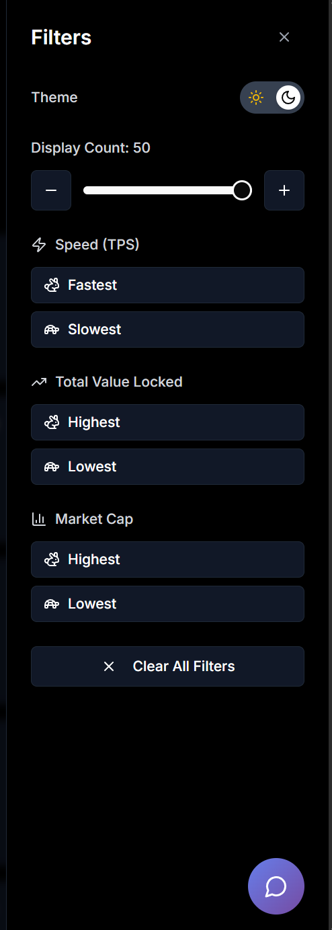
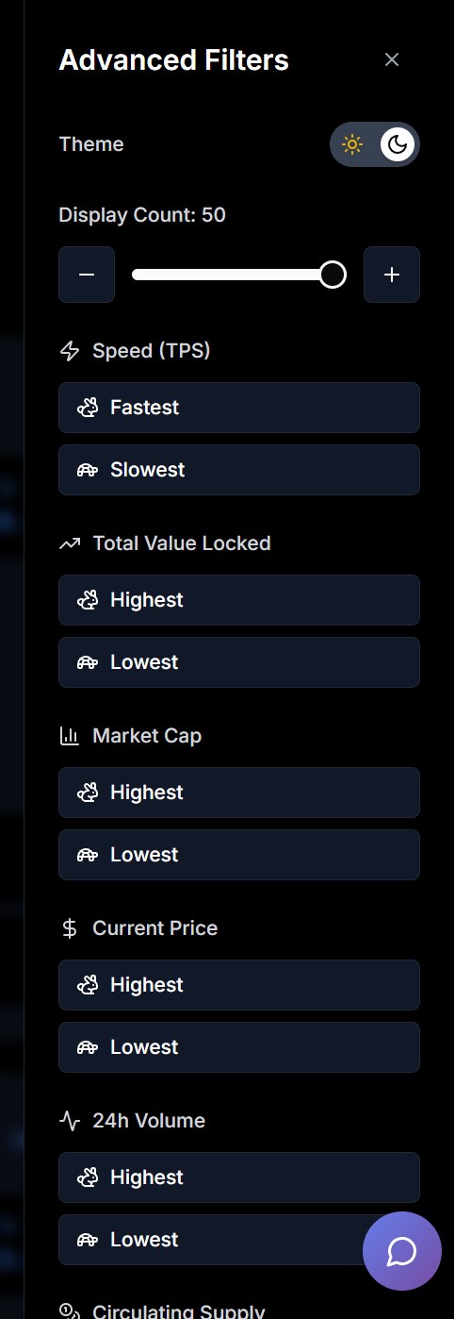
Functionality with screenshots
Filters has been provided for both “Noob” and “Pro” to align the blockchains on there priority basis

Slide 9
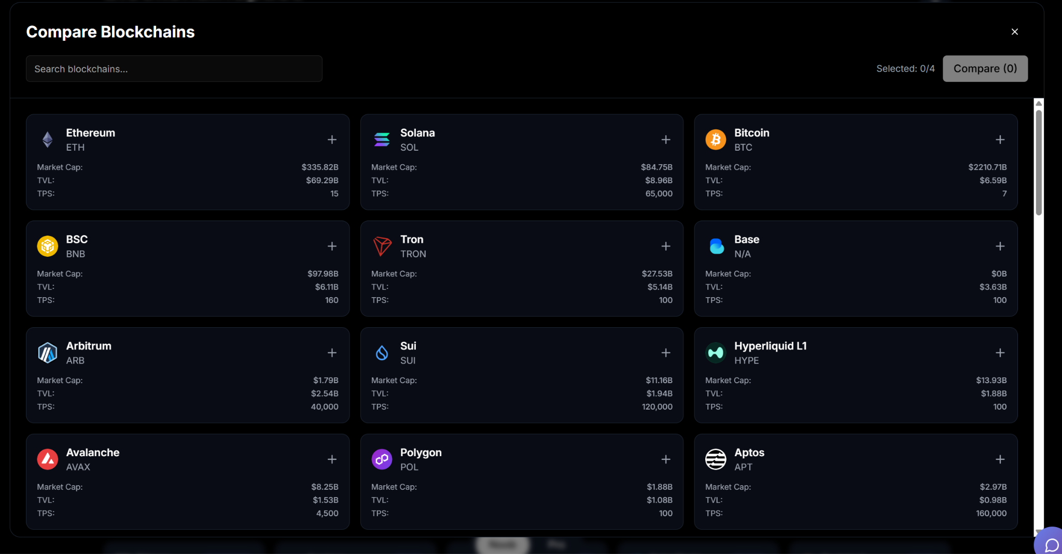
Functionality with screenshots
A compare functionality is provided so users can compare min 2 and max 4 blockchains side by side.

Slide 10
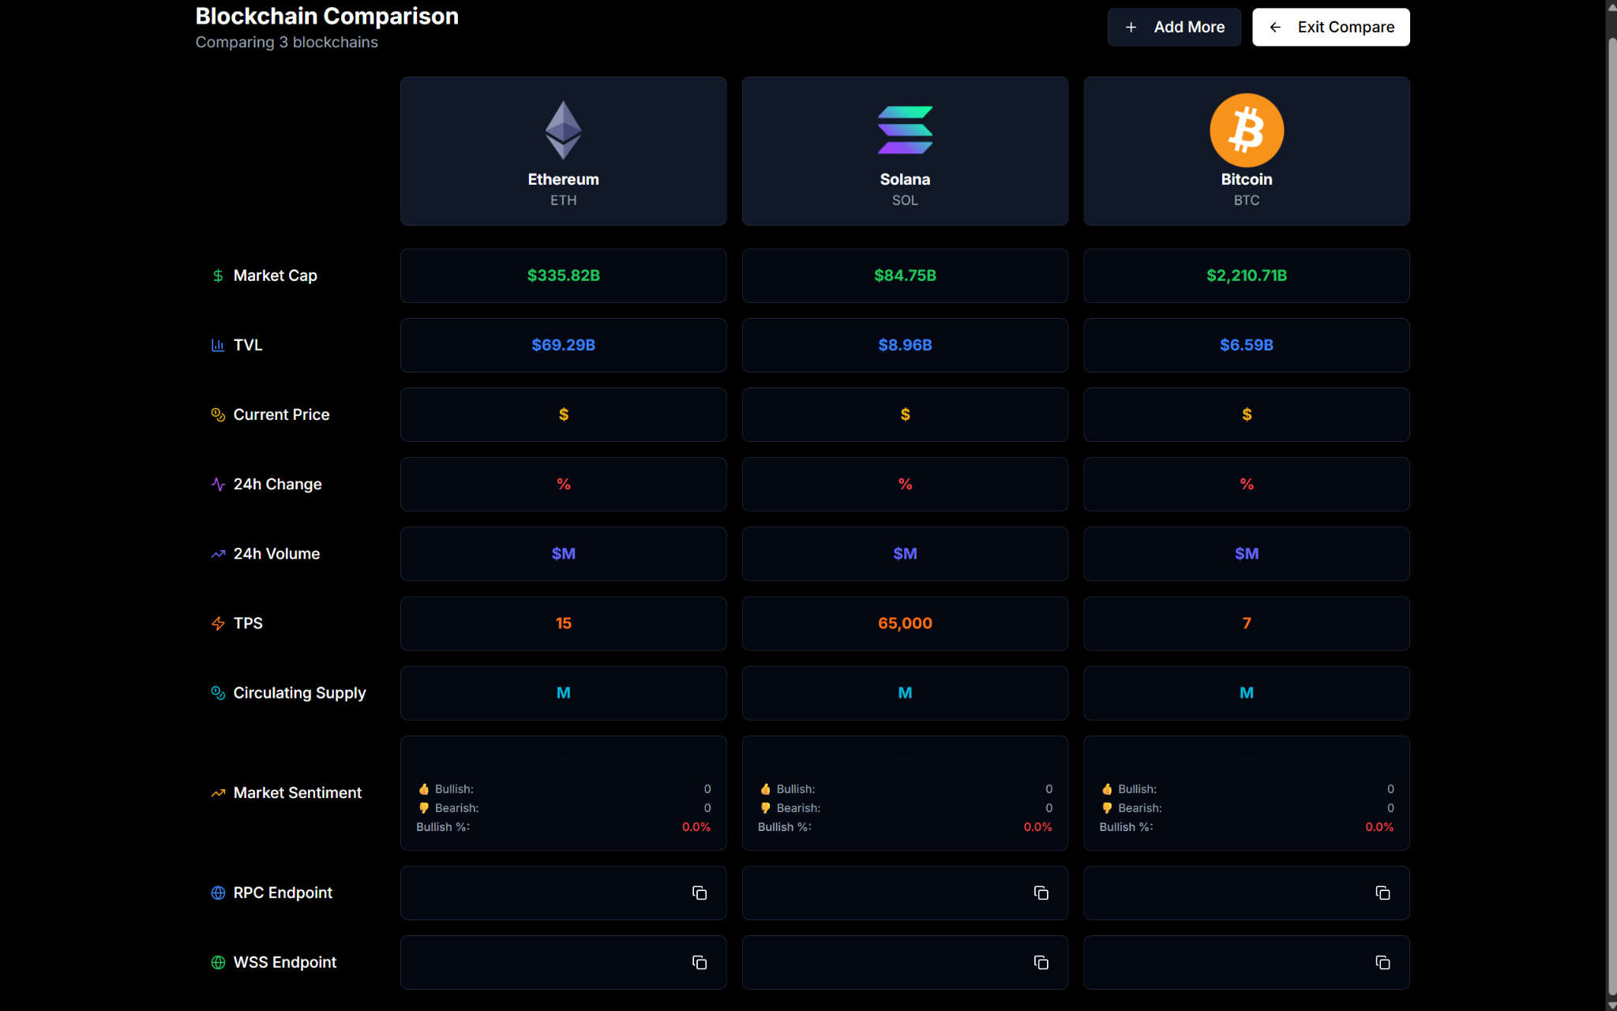
Functionality with screenshots
Here you can see how it will look like when comparing 3 blockchains side by side.

Slide 11
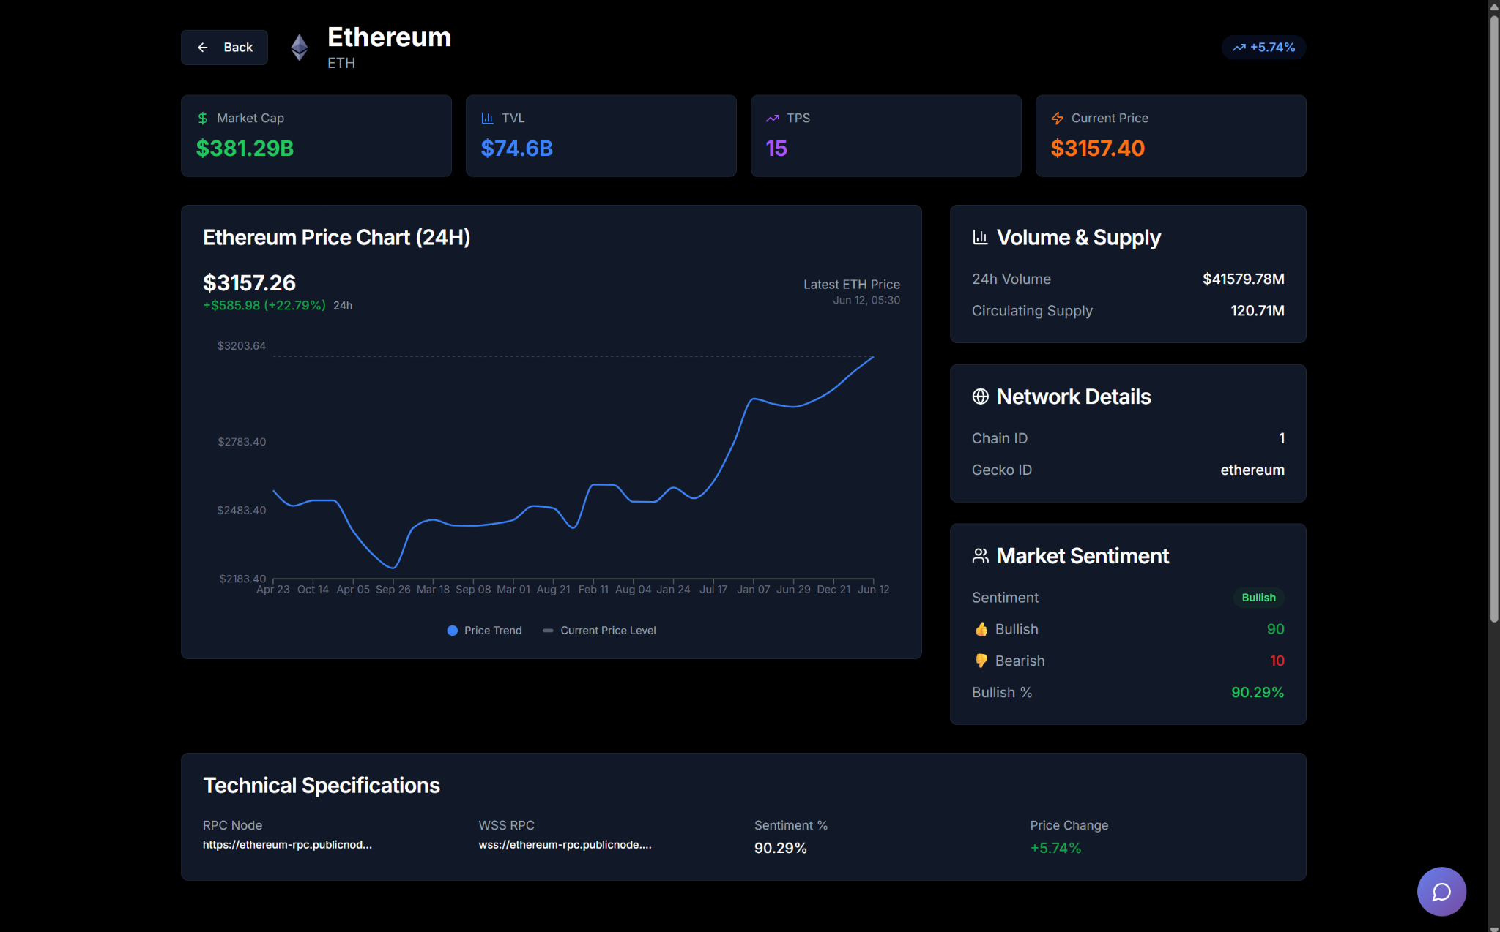
Functionality with screenshots
Click on any blockchain to get a detailed view about that blockchain.

Slide 12
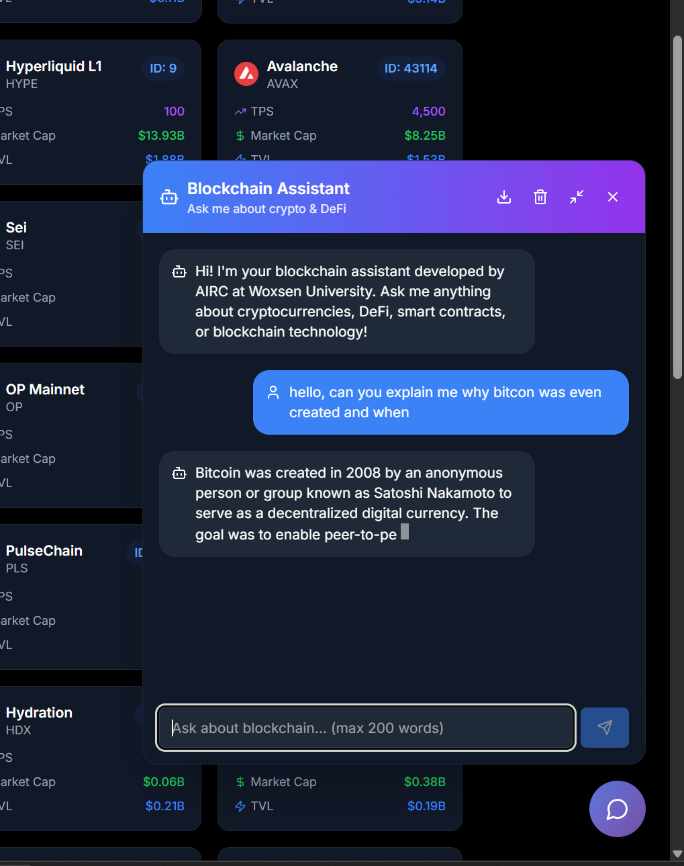
Functionality with screenshots
An AI chatbot has been integrated into the platform so user can ask any questions regarding blockchain.
User can either download the chat on his machine or delete it. The chat will persist for an hour on machine.

Slide 13
Data sources
We aggregate data from essential resources like DeFiLlama and CoinGecko, instrumental in providing users with comprehensive market analysis and up-to-date financial information.

