Slide 1
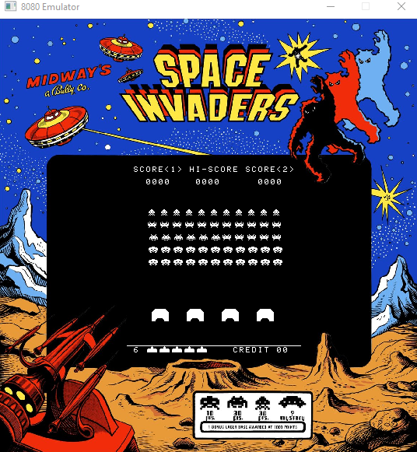
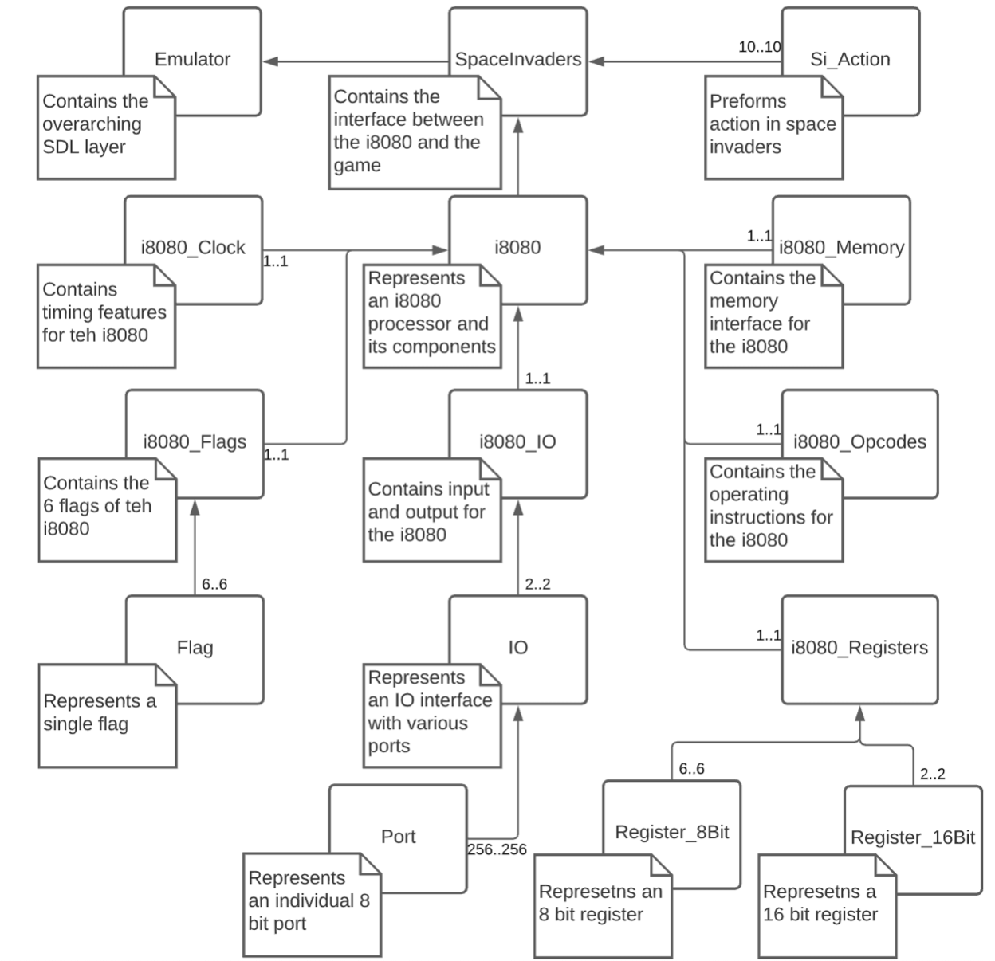
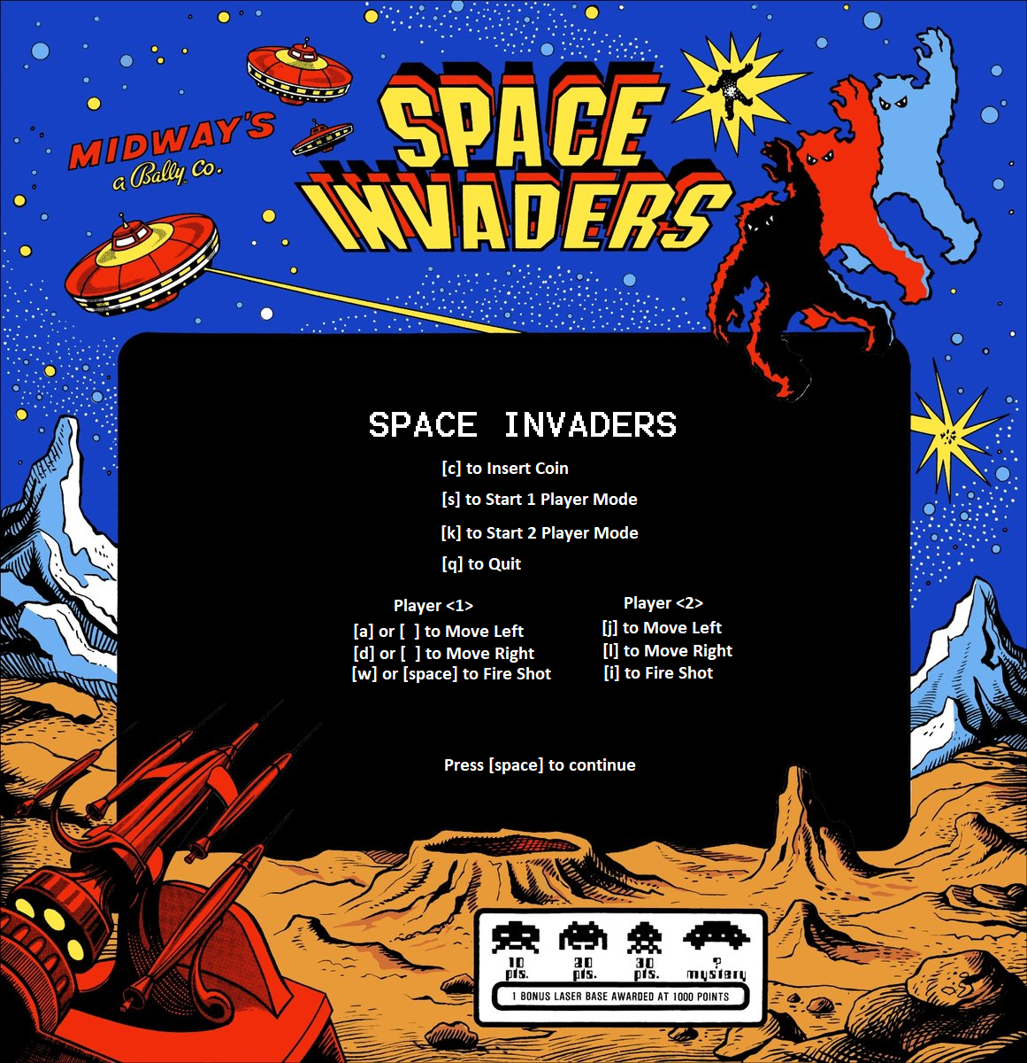
Intel 8080 Emulator Space Invaders
FINAL PROJECT CS476
woym@oregonstate.edu| matthewm@oregonstate.edu| sanduler@oregonstate.edu
BACKGROUND
Madison Woy | Michael Matthews | Ruben Sanduleac
In general terms, our program is an emulator that is built on C++. The user is given the chance to load the space invaders game inside the built environment to be run on modern hardware.
The GUI is built to run on Windows, yet SDL2 can be compiled on any device. This project introduced us to a slew of new frameworks and the C/C++ language. Our project used a heavy amount of version control, and object-oriented programming.
There were many steep learning curves where we had to design the GUI using SDL2 library, sharpening our skills with C++ and understanding the assembly language. On many occasions there were days of debugging and research.
https://github.com/woym97/i8080_Emulator
Class Structure for i8080 Emulator
IMPLEMENTATION
We decided to use the Simple DirectMedia Layer as our frontend graphical interface. It was a perfect fit for our project because it is a cross-platform programming library that uses OpenGL and Direct3D. In addition, it provided us with low-level access to your audio, keyboard, mouse, joystick, and graphics hardware. This was crucial because we wanted the ability to connect controllers such as an Xbox controller.
Another important tool that was very helpful in both building and testing the opcodes was Microsoft Excel. We were able to automate many opcode functions and create a solid skeleton code using Microsoft Excel. Later it was transferred into our code where the functions were fully implemented and tested.
GitHub repository to keep track of all our work and have a strong version control in case of any accidents. The overall result was 173 commits to Master, 24 pull requests, and many branches have been made.
Inno Setup with Visual Studio allows us to create a setup file for the release candidate. The script was written so the user will only have to click the setup and the program will install all the necessary files needed to run the emulator.
Outcome
The emulator has the ability to to play the Space invaders with two people.
Controller input is available.
Controls are shown above
We were able to create a fully functional Intel 8080 emulator in C/C++ that is centered around object orientated programing. Every single file is independent and capable to be maintained for future development.
Created a GUI interface for the emulator was created using SDL2.
The i8080 emulator is capable of running and decrypting the assembly code from the Space Invaders game. The original rom files are used to run the game.
Controller support was added for the users who would like to use them them to play the game in addition to keyboard inputs.
The i8080 emulator is capable of outputting the sound for the rom file of Space Invaders using SDL2 Mixer.

