Slide 1
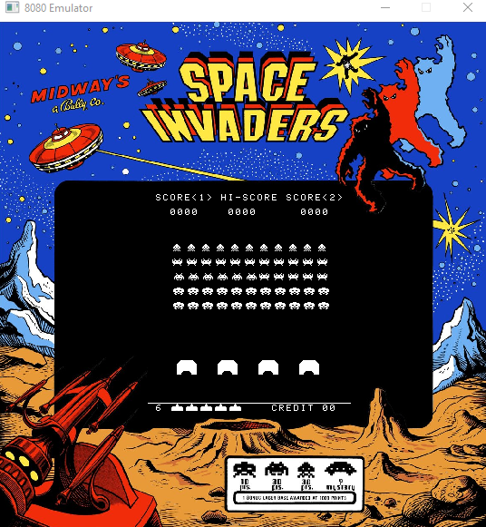
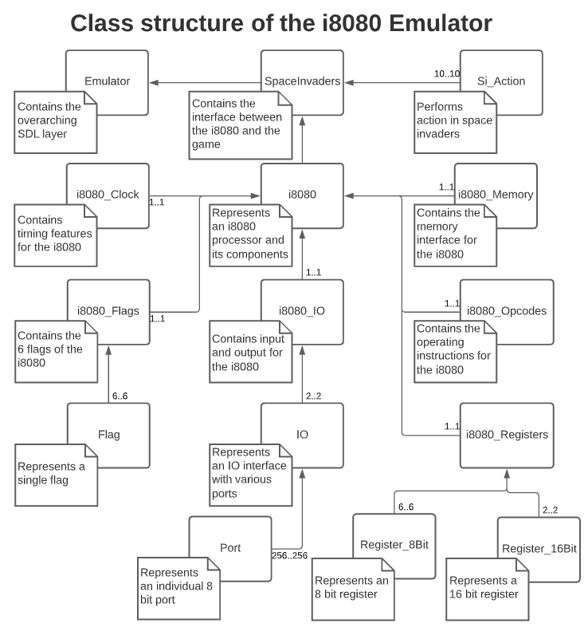
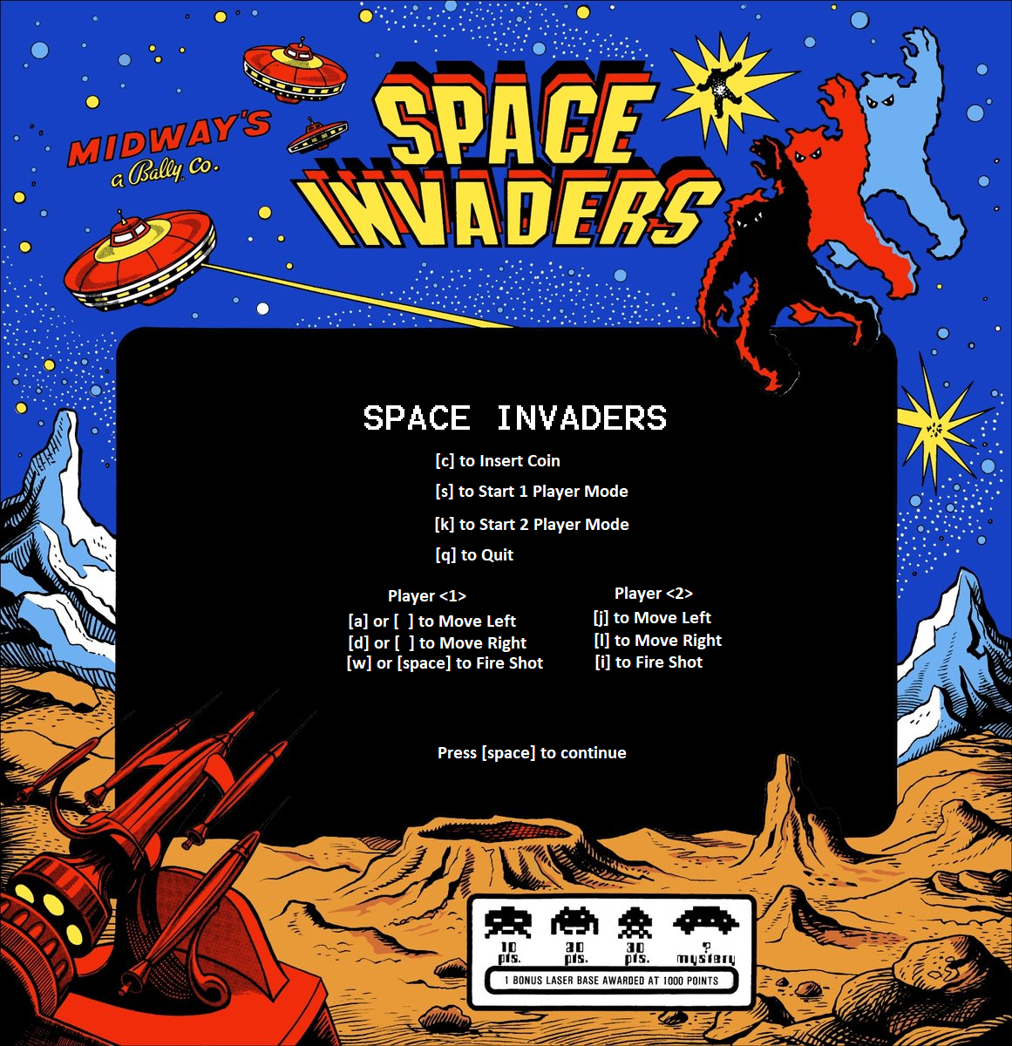
Intel 8080 Emulator Space Invaders
BACKGROUND
FINAL PROJECT CS476
woym@oregonstate.edu| matthewm@oregonstate.edu| sanduler@oregonstate.edu
In general terms, our program is an emulator that is built on C++. The user is given the chance to load the Space Invaders game inside a virtual processor environment to be run on modern hardware.
The GUI is built to run on Windows, yet SDL2 can be compiled on any device. This project introduced us to and gave us more experience with a slew of new frameworks and the C/C++ language. Our project used a heavy amount of version control and object-oriented programming.
There were many steep learning curves where we had to design the GUI using the SDL2 library, sharpen our skills with C++, understanding the assembly language and architecture of the Intel 8080 processor. On many occasions there were days of debugging and research.
Madison Woy | Michael Matthews | Ruben Sanduleac
https://github.com/woym97/i8080_Emulator
Class Structure for i8080 Emulator
IMPLEMENTATION
We decided to use the Simple DirectMedia Layer as our frontend graphical interface. It was a perfect fit for our project because it is a cross-platform programming library that uses OpenGL and Direct3D. In addition, it provided us with low-level access to the audio, keyboard, mouse, joystick, and graphics hardware. This was crucial because we wanted the ability to connect controllers such as an XBox controller.
Another important tool that was very helpful in both building and testing the opcodes was Microsoft Excel. We were able to automate many opcode functions and create a solid skeleton code using Microsoft Excel. Later it was transferred into our code where the functions were then fully implemented and tested.
A GitHub repository was used to keep track of all our work and to have a strong version control in case of any accidents. The overall result was 173 commits to Master, 24 pull requests, and many branches have been made.
Inno Setup with Visual Studio allowed us to create a setup file for the release candidate. The script was written so the user will only have to click the setup and the program will install all the necessary files needed to run the emulator.
The emulator runs the original ROM as it would have in an arcade.
It has the ability to run Space Invaders for two players.
Controller input is available.
Controls are shown above
Outcome
We were able to create a fully functional Intel 8080 emulator in C/C++ that is centered around object orientated programing. Every single file is independent and capable to be maintained for future development.
Created a GUI interface for the emulator that was created using SDL2.
The i8080 emulator is capable of running and decrypting the assembly code from the Space Invaders game. The original ROM files are used to run the game.
Controller support was added for the users who would like to use them them to play the game in addition to keyboard inputs.
The i8080 emulator is capable of outputting the sound for the rom file of Space Invaders using SDL2 Mixer.

