Slide 1
Effects of Wildfire on Snow Melt and Stream Discharge
Sam Wozniak, Craig Woodruff, and John dodd

Slide 2
Problem Statement
Wildfires remove vegetation that provides shading (slows snow melt), aids in infiltration, and slows runoff
Does the rate and timing of snow melt in an area change after a wildfire?
How does do these changes affect stream discharge?
Effectively looking at effect of the removal of vegetation (by fire) on snow melt, runoff/discharge
Disclaimer—case study/proof of concept

Slide 3
Study Site
Elk and Pony Complexes burned a combine ____ acres
Burned ___ acres within South Fork Boise watershed
Insert map watershed, and wildfires

Slide 4
Sources of Data
Wildfire Boundaries:
Snow Cover:
Streamflow: downloaded mean daily stream discharge at Neal Bridge and Anderson Dam stream gages on the South Fork Boise River from USGS National Water Information System
INSERT MAP OF STUDY AREA

Slide 5
Methods
1. Clipped wildfire shapefiles to watershed
2. Snow melt–
3. Stream Discharge
plotted discharge at two stream gages
Plotted difference between gages, and resulting cumulative discharge
Overlayed snow melt regression on stream gage graphs

Slide 6
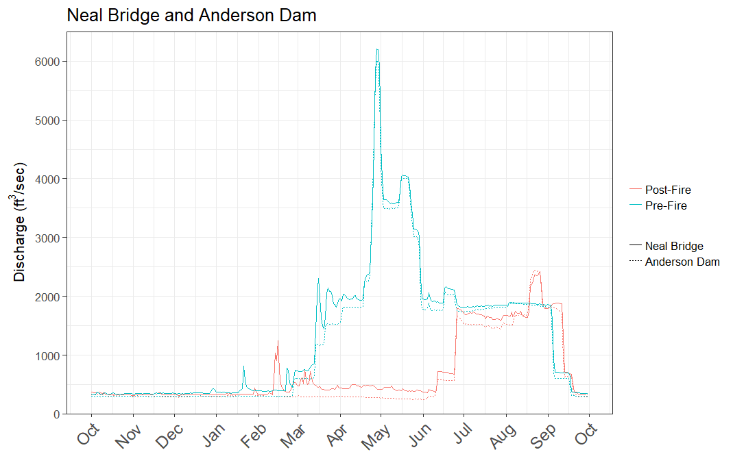
Results: Stream Discharge

Slide 7
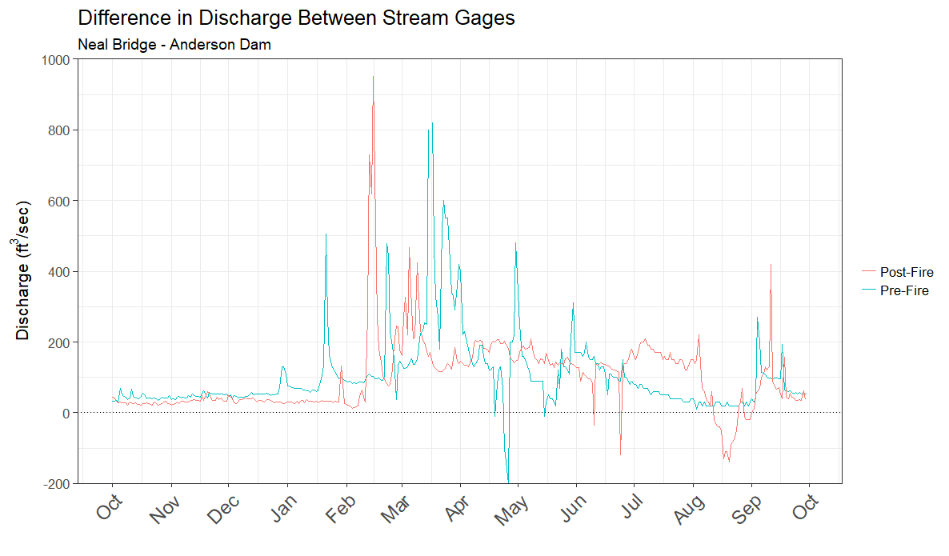
Results: Stream Discharge Difference
Key Assumption: change in snow cover in drainage between Anderson Dam and Neal Bridge stream gages is about the same as the change in snow cover for the South Fork Boise River Watershed
Peak Discharge:
Pre-fire: 3/16/2012
Post-fire: 2/15/2014

Slide 8
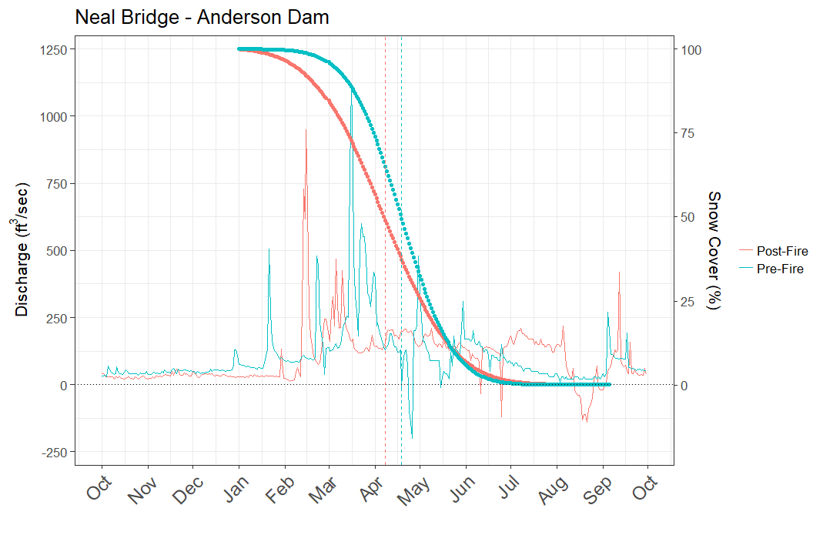
Results: Snow melt
50% snow melt 11 days earlier post-fire:
Pre-fire: 4/19/2012
Post-fire: 4/08/2014

Slide 9
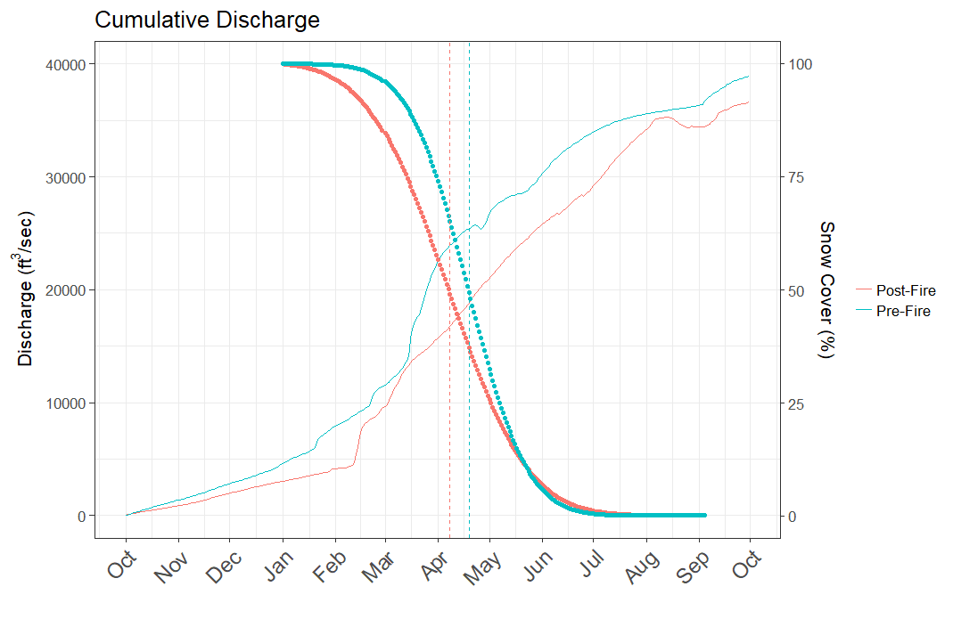
Results: Cumulative Discharge
At time of 50% snowmelt, cumulative discharge (very) roughly 50%
Discharge is a function of snow melt and rain

Slide 10
Conclusion
Snow melts 11 days earlier after fire than before fire
50% Cumulative discharge
Negative affects of earlier cumulative discharge→ water availability/flow throughout summer?
Water temp?
Climate change → earlier snowmelt -> earlier cumulative discharge
Climate change -> more frequent, large fires -> earlier post-fire snowmelt → earlier cumulative discharge
Additive or multiplicative effects of the two?

Slide 11
Literature Cited
Clow, D. (2010). Changes in the Timing of Snowmelt and Streamflow in Colorado: A Response to Recent Warming. Journal of Climate, 23(9), 2293-2306.

