Slide 1
Effect of Wildfire on Snow Melt and Stream Discharge
Sam Wozniak, Craig Woodruff, and John dodd

Slide 2
South Fork Boise Watershed
Insert Map 1: State of Idaho, Boise, South Fork Boise Watershed.

Slide 3
Wildfires
Elk and Pony Complexes burned a combine ____ acres
Burned ___ acres within South Fork Boise watershed
Insert map watershed, and wildfires

Slide 4
Methods
Clipped wildfire shapefiles to watershed
Snow melt–
Stream Discharge– downloaded stream discharge at Neal Bridge and Anderson Dam stream gages

Slide 5
Map Two
Map 2: Watershed, Fires, 2 Stream Gages

Slide 6
Snow Melt

Slide 7
Stream Discharge
Insert Graphs at Neal Bridge and Anderson Dam

Slide 8
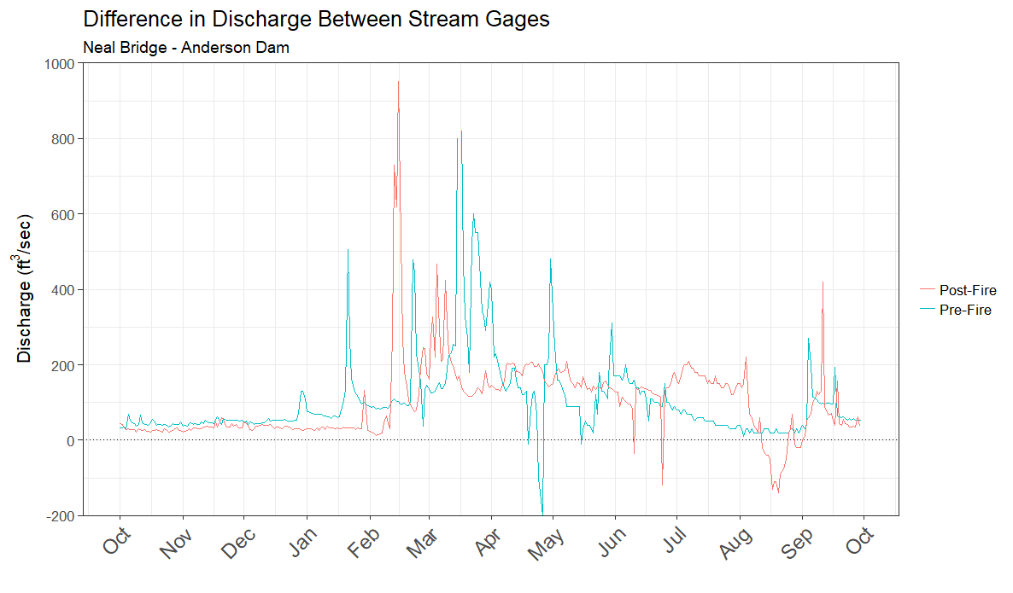
Stream Discharge Difference

