Slide 1
Bitcoin/Crypto Analysis
By Thomas Wasnidge
Updated: 30/05/2022

Slide 2
Table of Contents
1. Title Page
2. Table of Contents
3. Questions asked
4. Key Terms
5-6 The Data
7-8 Time to Invest
9-10 Price vs Supply
11. Market Cap
12-14 Comparison with Other Coins
15-17 Conclusions
18. Thanks

Slide 3
What are we looking for?
What is the best time of year to invest in Bitcoin? Is there a certain time of year where the price may be lower consistently?
Is there any relationship between the price of the coin and the Circulating Supply?
Is the price always at its highest when the Market Cap is at its highest
How is Bitcoin performing in comparison to other popular coins such as Ethereum and Litecoin

Slide 4
Key Terms
Crypto Currency: a digital currency in which transactions are verified and records maintained by a decentralized system using cryptography, rather than by a centralized authority
Market Cap: Crypto market capitalization is the total value of a cryptocurrency
Circulating Supply: Circulating Supply is the total number of coins or tokens that are actively available for trade and are being used in the market and in general public

Slide 5
The Data
As we haven’t been provided a dataset for this piece of analysis, I’ve had to source the data myself. To achieve this, I designed a web Scraper using some python software called Scrapy, this allowed me to download a dataset of Crypto Prices from the website www.coinmarketcap.com

Slide 6
Data After Cleaning
The data cleaning process was done using the Pandas library with Python, it was also done on a Jupyter Notebook which will be attached to this presentation. A couple of steps in the data cleaning were
Remove text from the data column and format the number as a date
Sort the values so the coins appear concurrently instead of in any order
Save a separate dataset for each coin with over a 52 weeks worth of data, this is for further analysis and will be attached
Formatted date | Name | Symbol | Price($) | Market Cap ($) | Circulating Supply
28/04/2013 | Bitcoin | BTC | 134.21 | 1488566972 | 11091325
05/05/2013 | Bitcoin | BTC | 115.91 | 1288693216 | 11118050
12/05/2013 | Bitcoin | BTC | 115 | 1281982625 | 11147675
19/05/2013 | Bitcoin | BTC | 121.99 | 1363205020 | 11174725
26/05/2013 | Bitcoin | BTC | 133.48 | 1495292967 | 11202375
02/06/2013 | Bitcoin | BTC | 122.29 | 1373839383 | 11234075
09/06/2013 | Bitcoin | BTC | 100 | 1126642500 | 11266425

Slide 7
Is there a good time of year to invest in Bitcoin?
I thought the best way to answer this question was through a simple Line Graph plotting the price of Bitcoin against the time of year. I think this chart shows the price of Bitcoin is very volatile, however it does appear that most of the major rises occur around the 4th quarters, further investigation would be required to determine if this is the case though.

Slide 8
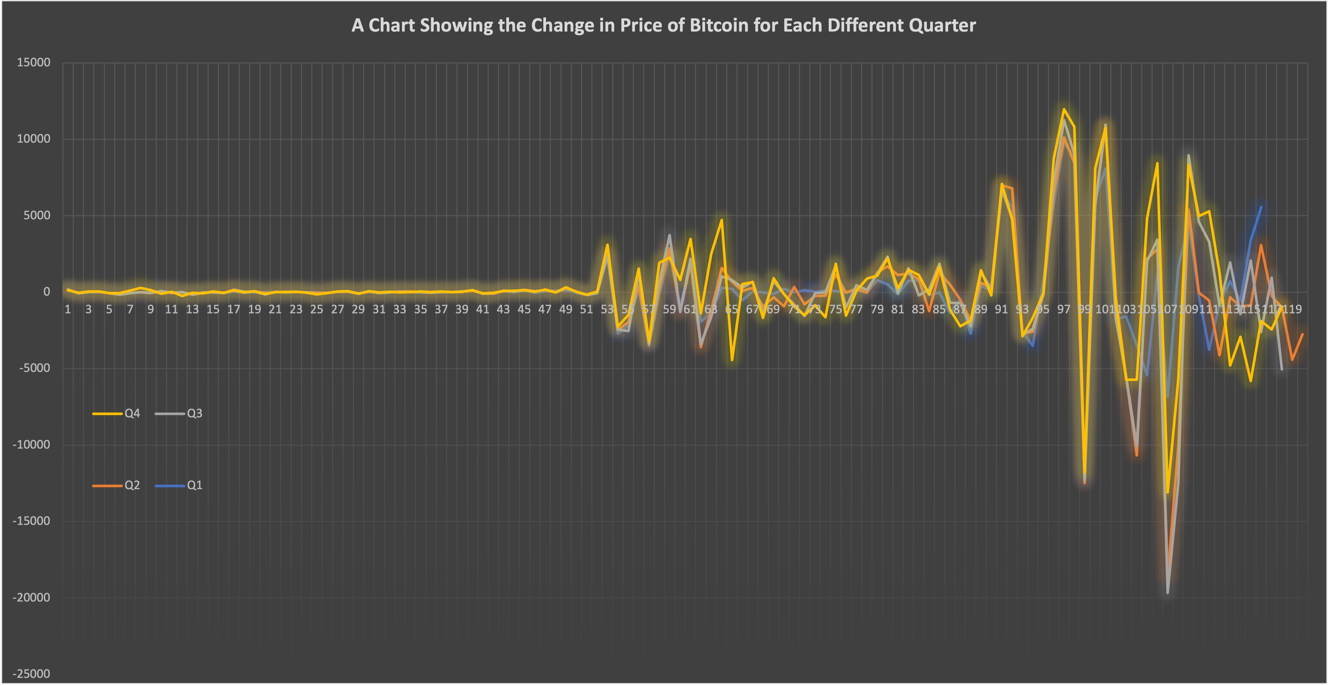
Further Investigation
This line graph shows us the different price changes for each quarter, I think the numbers in the table and the line chart tell us that if you were going to invest in Bitcoin, then just before the 4th quarter may be the best time to do it, it has the highest average change and highest sum of changes, also from the chart it looks like Q4 has the highest highs but not the lowest lows.
 | Average Changes | Sum of Changes
Q1 | 159.3344828 | 18482.8
Q2 | -227.24425 | -27269.31
Q3 | 74.52355932 | 8793.78
Q4 | 264.0985593 | 31163.63

Slide 9
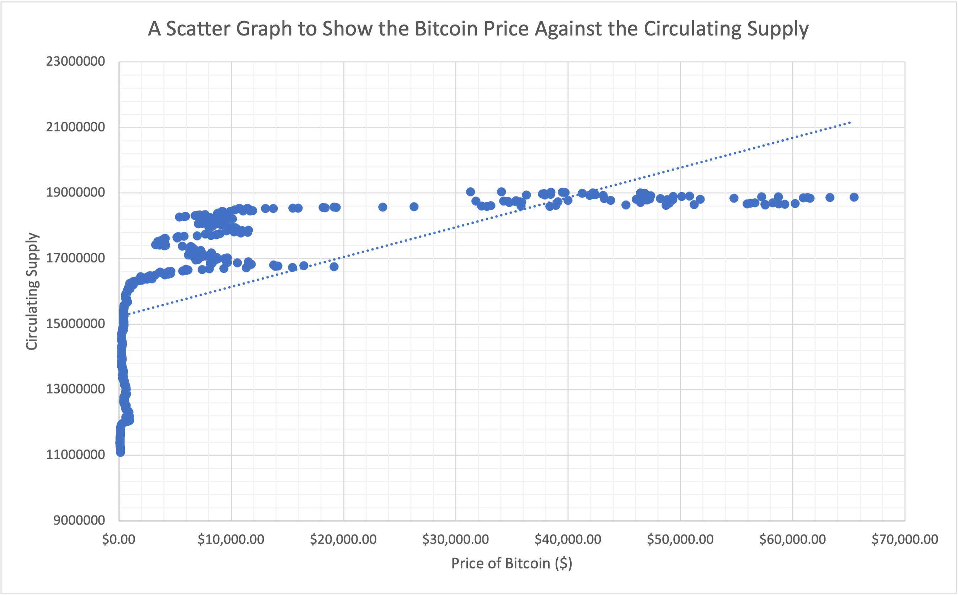
Price Vs Supply
This is a chart plotting the Price of Bitcoin against the Circulating Supply with a trend line cutting through it. Note that the Y-axis doesn’t start at 0, this is because the minimum value for the supply is 10000000 and starting at 0 would have wasted a lot of space, to get a better idea of the relationship between these two characteristics, I have edited the chart, so the price increases on a logarithmic scale, allowing us to see more clearly when the price of the coin is lower.

Slide 10
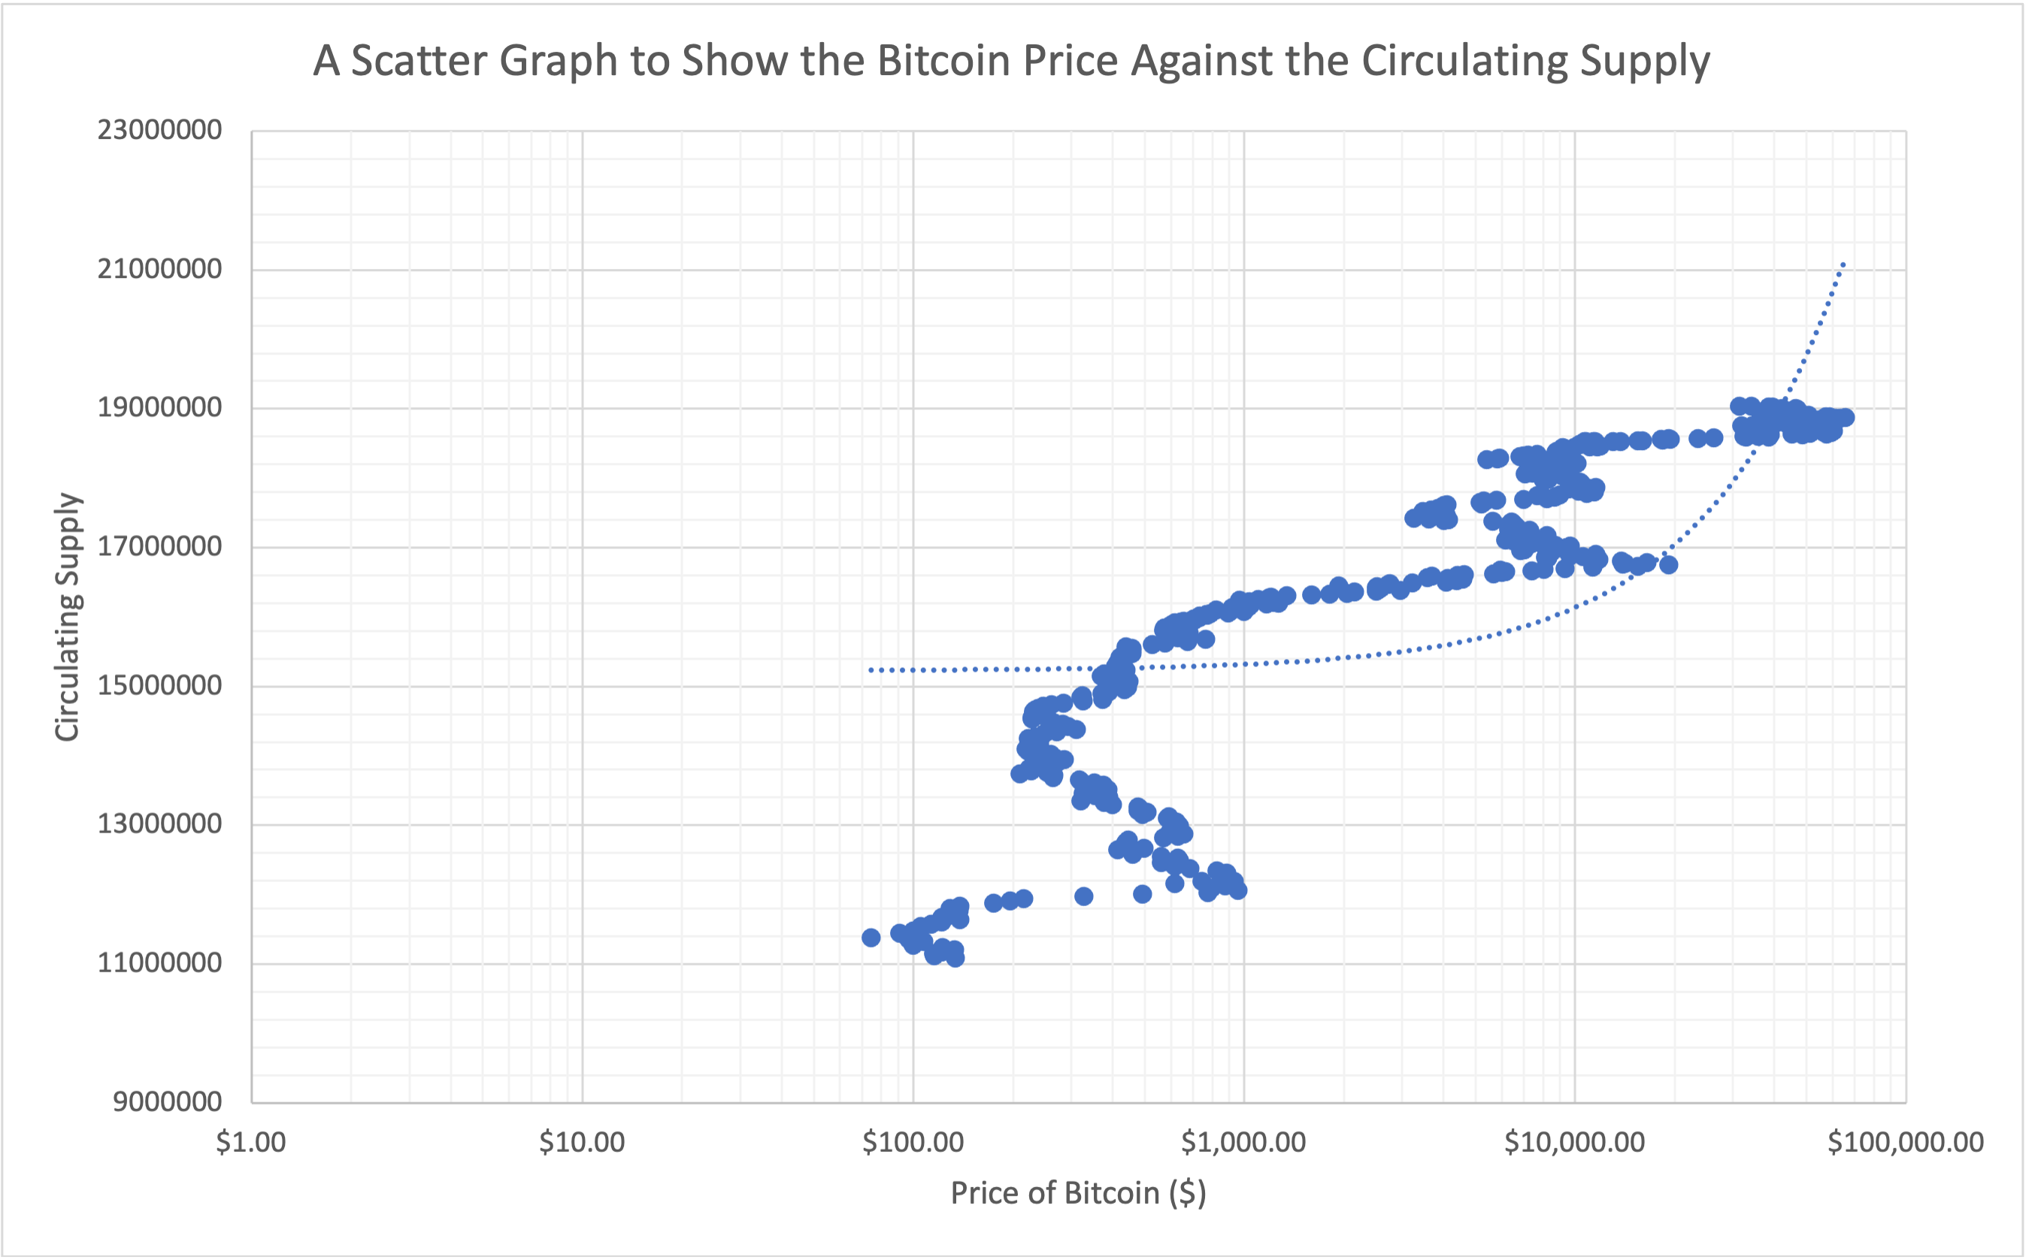
Price v Supply Correlation
This scatter chart has a lot more clarity at the lower end of the price scale, note that the Y-axis starts at 9 million again. We do see that there is a positive trend between the price of the coin and the circulating supply, this is also shown by our working of the correlation coefficient below the chart, a result of 0.634 tells us there is a positive correlation between these two figures, however the chart tells us that when the price drops the supply doesn’t, suggesting only correlation and not causation.
Correlation Coefficient | 0.634409092

Slide 11
Is the Price the Highest when Market Cap is Highest?
 |  | Date
Max Change | £9,813.85 | 14/02/2021
Min Change | -£12,402.17 | 28/02/2021
Average Price Change |  | $66.04
Highest Price | £65,466.84 | 14/11/2021
Lowest Price | £74.56 | 07/07/2013
Average Price |  | $10,395.53
Max Market Cap | £1,235,580,000,000.00 | 14/11/2021
Min Market Cap | £848,838,935.60 | 07/07/2013
This table shows that the highest market cap occurs while the price is at its highest.
This is also the case for the lowest figures.

Slide 12
How is Bitcoin Performing in Comparison to Other Popular Coins
Row Labels | Count of Name | Average of Price($)
Bitcoin | 473 | £10,395.53
XRP | 459 | £0.30
Litecoin | 459 | £57.09
Ethereum | 354 | £749.26
Monero | 346 | £63.85
Stellar | 326 | £0.12
Dash | 305 | £121.64
Dogecoin | 257 | £0.05
Tether | 251 | £1.00
Cardano | 241 | £0.49
Bitcoin Cash | 222 | £545.89
Binance Coin | 196 | £118.02
Ethereum Classic | 191 | £13.44
Row Labels | Count of Name | Average of Price($)
Solana | 1 | £58.81
Wrapped Bitcoin | 1 | £31,259.19
TRON | 1 | £0.07
Bitcoin | 1 | £31,305.11
Binance USD | 1 | £1.00
Cardano | 1 | £0.60
Tether | 1 | £1.00
Dogecoin | 1 | £0.09
USD Coin | 1 | £1.00
Ethereum | 1 | £2,145.71
XRP | 1 | £0.45
Litecoin | 1 | £71.53
Polkadot | 1 | £11.80
The pivot table on the left was created to show us which coins we were able to get the most data on, these are the more popular coins.
The table on the right has been created to check whether we have up to date data on the coins, the date set at the time was the 15th of May 2022

Slide 13
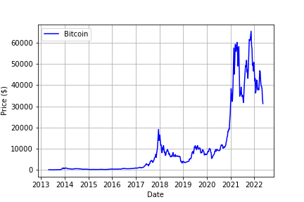
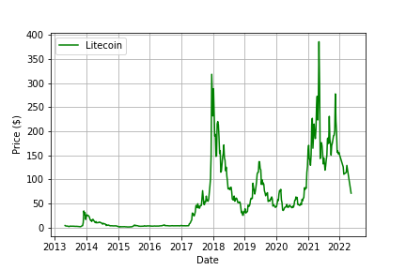
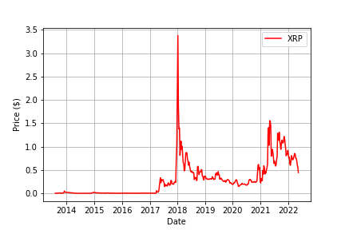
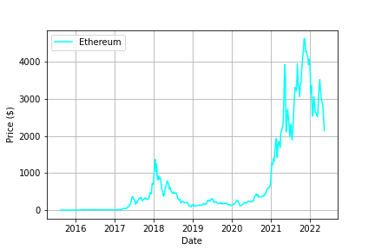
Line Graphs to show the Price of Crypto Coins
These line graphs all show the price of the coins against the dates, due to the vast difference in prices make sure to check the y axes as they all differ, what these charts do show us though is that all these cryptos follow a similar pattern, with all of them having a high in 2018, and again in 2021, with them all dropping in 2022

Slide 14
Correlation Coefficient Matrix
 | Bitcoin | XRP | Litecoin | Ethereum
Bitcoin | 1 | 0.66642808 | 0.79916143 | 0.93313531
XRP | 0.66642808 | 1 | 0.87186758 | 0.71065561
Litecoin | 0.79916143 | 0.87186758 | 1 | 0.75411305
Ethereum | 0.93313531 | 0.71065561 | 0.75411305 | 1
The table above gives us the Pearson Correlation Coefficients of each of these crypto currencies plotted against each other.
The Pearson Correlation Coefficient measures the strength and direction of the linear relationship between each variable.
As there isn’t a value in the matrix below 0.6, we can determine that all these Crypto prices generally head in the same direction, however it seems that the relationship between the price of Bitcoin and Ethereum is very strong, meaning that if one is rising then the other probably will be too.

Slide 15
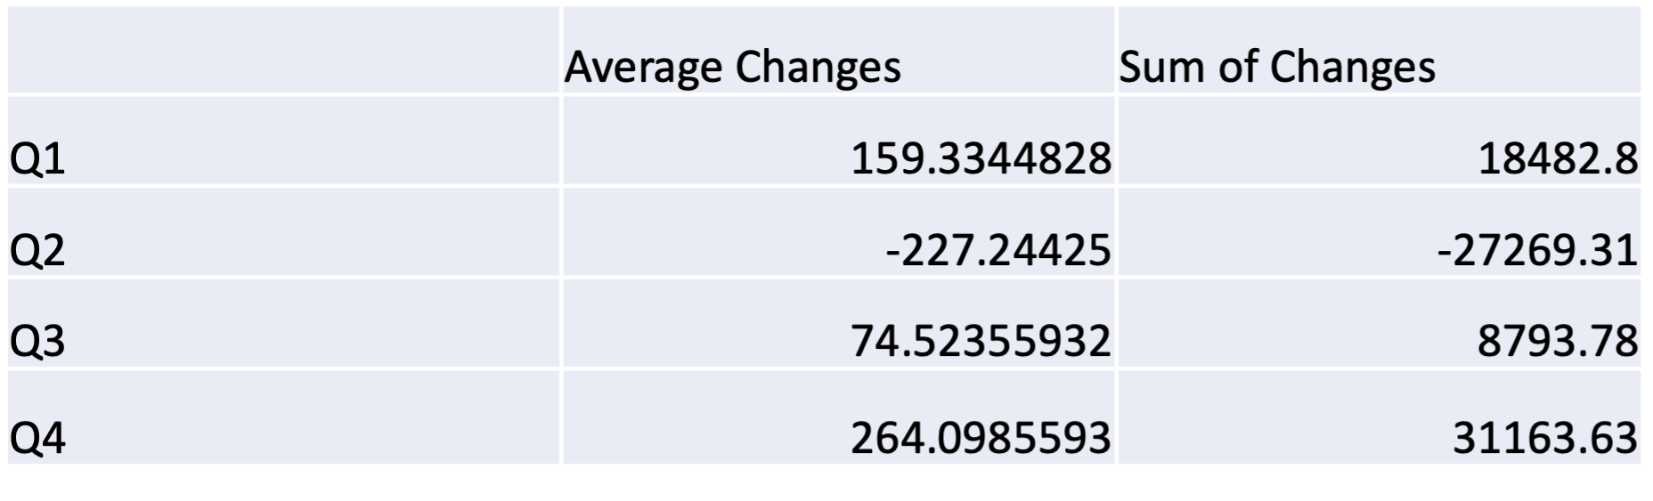
Conclusions
Is one time of year better to invest than another?
The best time to invest in Bitcoin would appear to be the beginning of the fourth quarter, as this is where the biggest rises in profit occur.
The worst time would be at the start of the second quarter, this is the only quarter with net overall losses, I don’t know why this could be

Slide 16
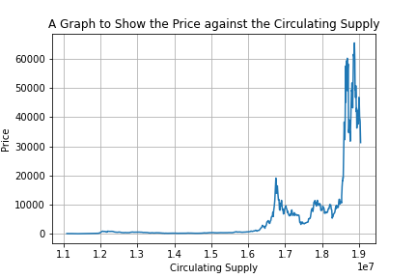
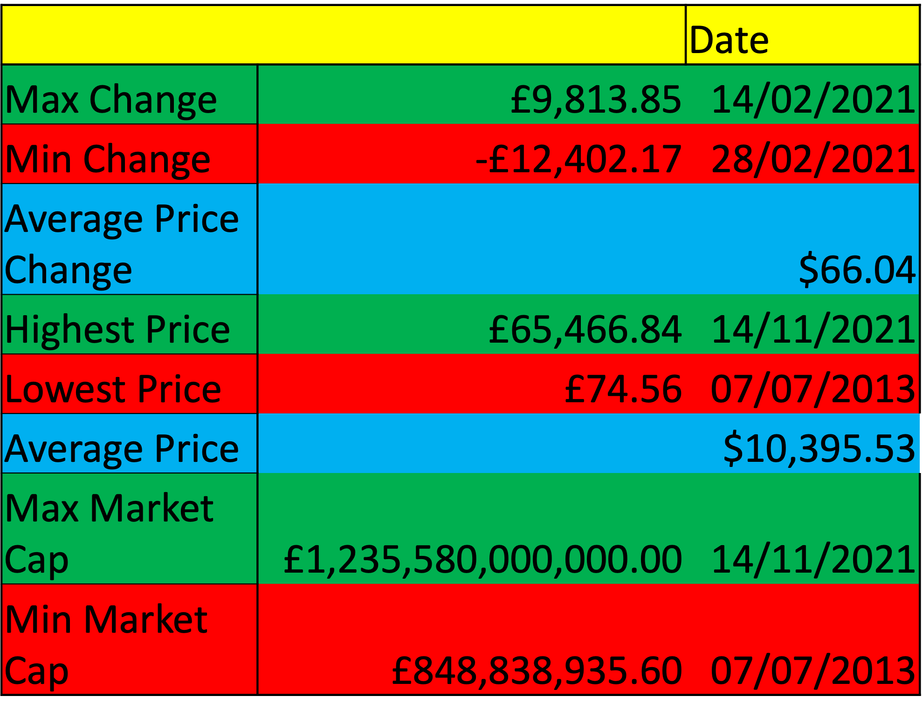
Correlation Coefficient | 0.634409092
Is the market capitalization highest when the price is at the highest?
With a correlation coefficient of 0.63, there does seem to be some sort of linear relationship between these two characteristics, however the circulating supply doesn’t drop and keeps rising when the price drops
Yes, it is.
Is there a relationship between the price of the coin and the circulating supply?

Slide 17
Performance against other Crypto Coins
From the information we have, I would say that Bitcoin is performing similarly well to the other currencies explored, with the information we have I wouldn’t specifically be able to recommend a different coin though

Slide 18
Thankyou for paying attention!
This report was made using Excel, Word, Python, Pandas, Numpy and Powerpoint!
A report by Thomas Wasnidge

