Slide 1
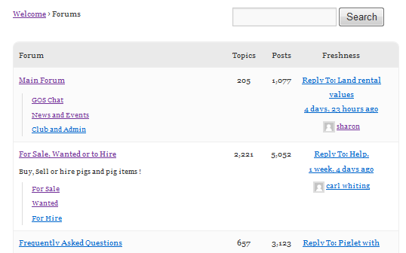
1
5
4
3 or 12*
3 or 13*
3
2
3 or 9*
5
6
9
12
13
1
7
10
8
1
11
2
* 3 will be used unless 9,12 or 13 are set respectively

Slide 2
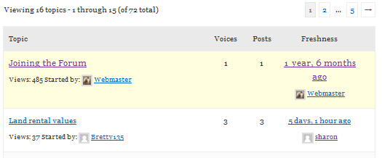
2
2
2
2
2
1
2
3
4
2
7
5
6

Slide 3
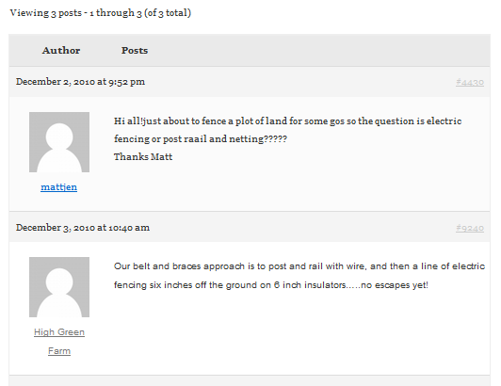
2
5
2
8
6
1
3
7
4
1
3
4

Slide 4
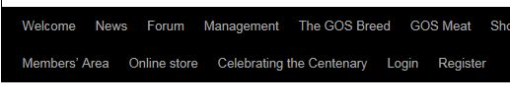


Slide 5
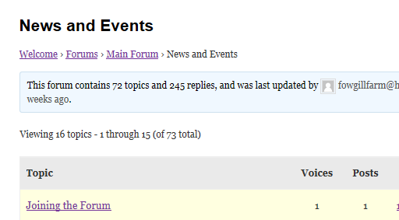
Home
Root
Current
Breadcrumbs

Slide 6
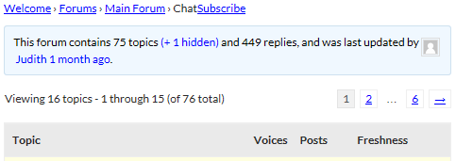
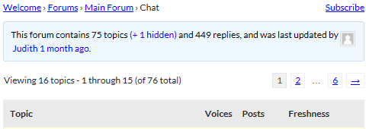

Slide 7

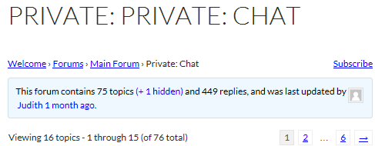
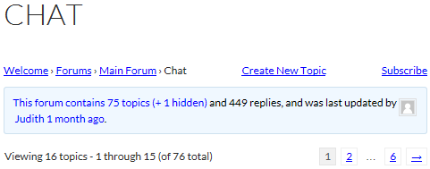

Slide 8
