Slide 1
Ordenando
William V. Paredes

Slide 2
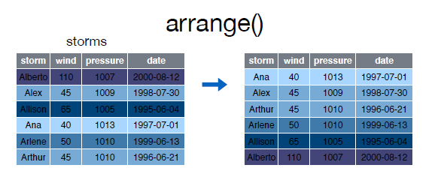
Ordenando

Slide 3
Bullets
When you click the Render button a document will be generated that includes:
Content authored with markdown
Output from executable code

Slide 4
Code
When you click the Render button a presentation will be generated that includes both content and the output of embedded code. You can embed code like this:
[1] 2

