Slide 1
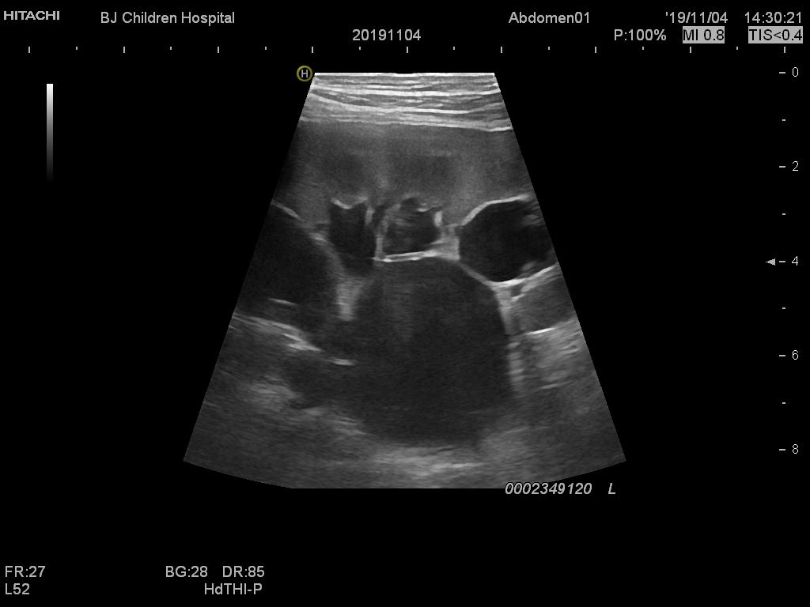
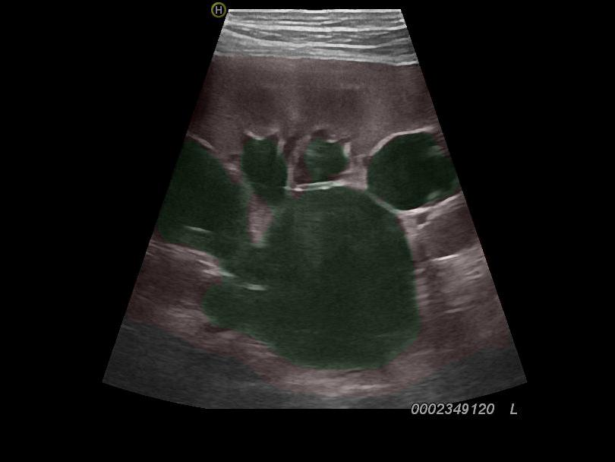

SFU_0-2
Semantic segmentation
Image processing
Classifier
SFU_3
SFU_4

Slide 2
Pyramid Scene Parsing
[5,5]
[10,10]
[15,15]
[30,30]
Input
[3,473,473]
[2048,30,30]
Ouput
[3,473,473]
Feature extraction
a
b
[2048,30,30]
Resize
d
c
.
Concatenate
[4096,30,30]
.
.
Predict
b
f
b
e

Slide 3
Features
Bottleneck
Conv
Bottleneck
BatchNorm
Conv
ReLU
Resize
Dropout
Predict&Color

Slide 4

















Input
(3,224,224)
Conv => (64,112,112)
BN&ReLU
$$W_{ψ,}^{H}W_{ψ,}^{V}W_{ψ}^{D}$$
$$W_{φ}$$
DWT
Concatenate
[192,56,56]
[64,56,56]
Concatenate
[1024,7,7]
b
a
Average pooling
Full connection
Output
(num_classes)

Slide 5
Features
identity
Conv
BN&ReLU
Conv
Conv
BN
BN
ReLU
Output

Slide 6

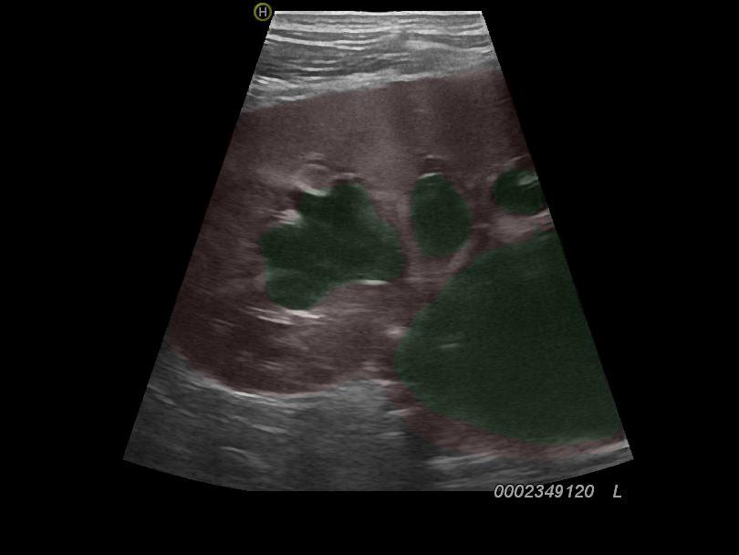
Original Image
Segmentation Ouput
Image Processing
Ouput

Slide 7
 | P | N
P | True Positive (TP) | False Negative (TN)
N | True Positive(TP) | True Negative (TN)

Slide 8
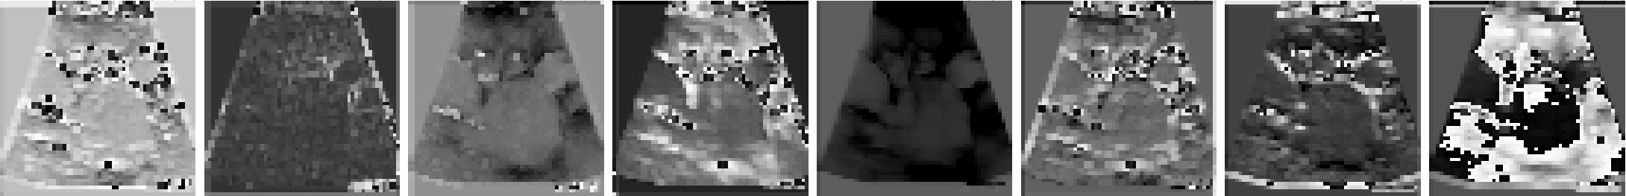



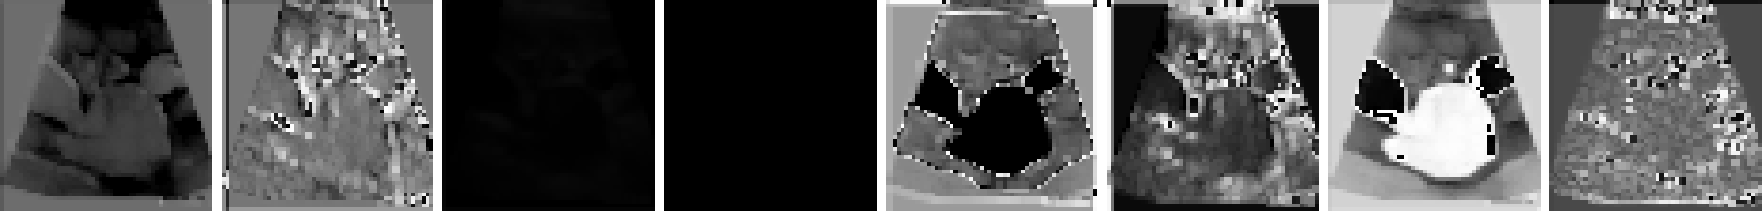
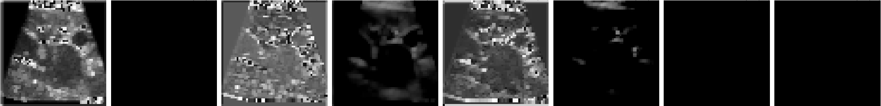
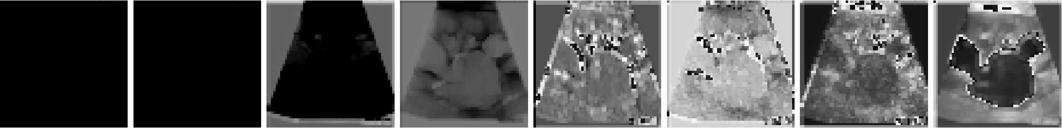


Slide 9
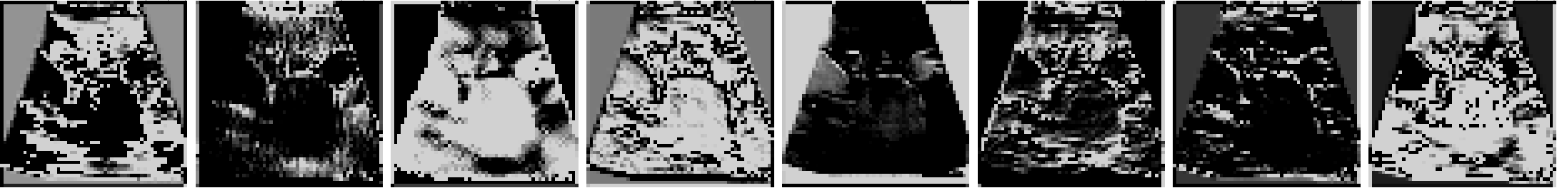
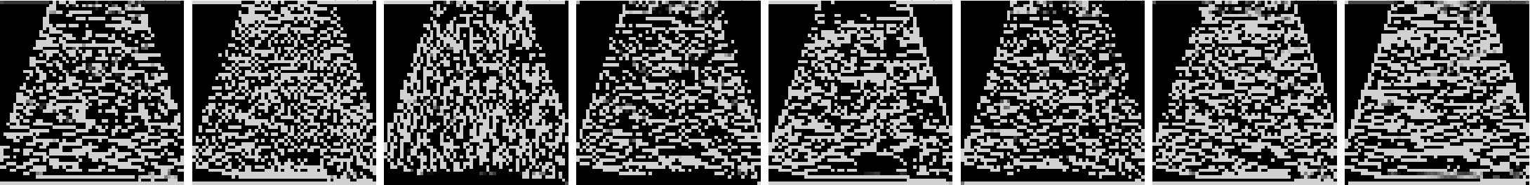






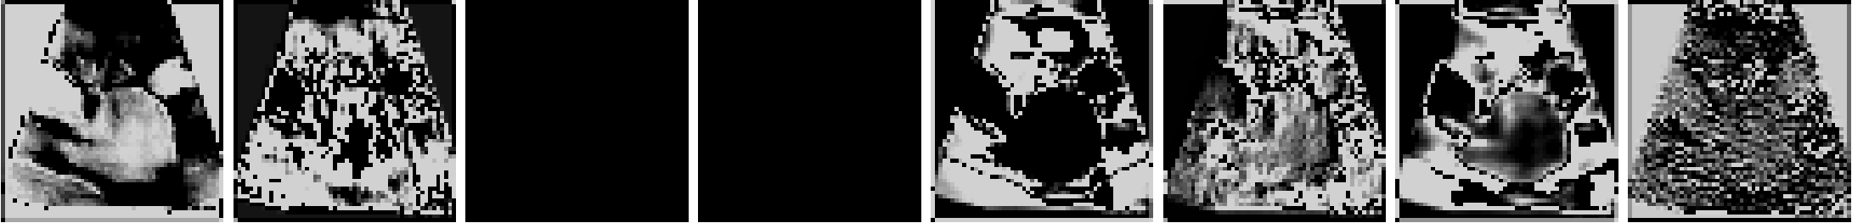
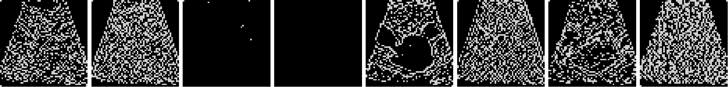



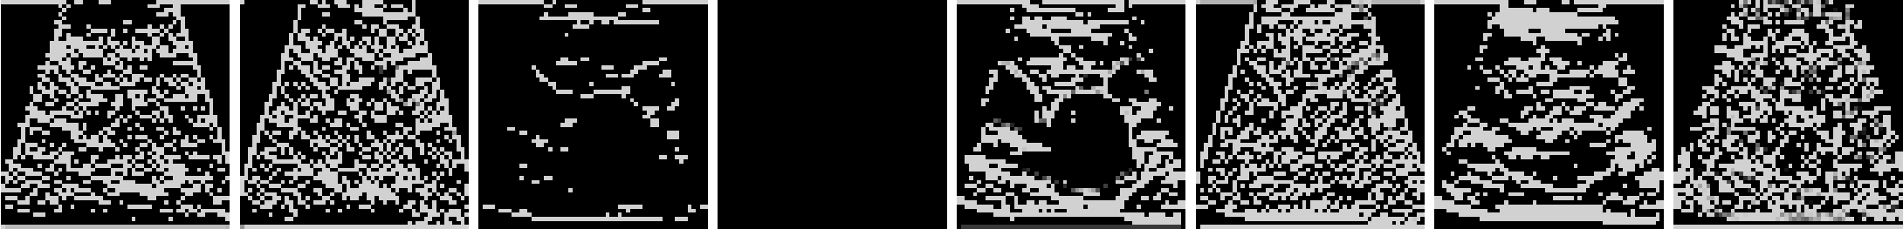


a
b

Slide 10
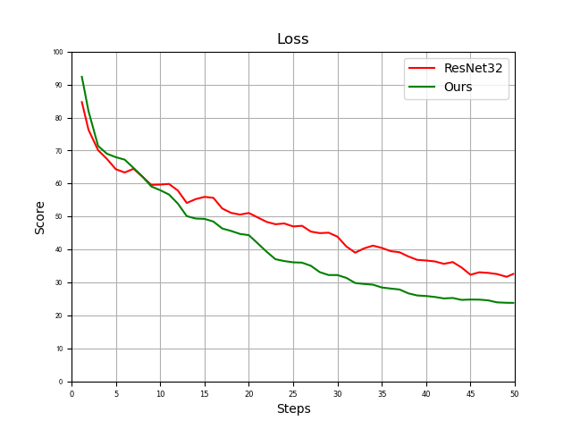
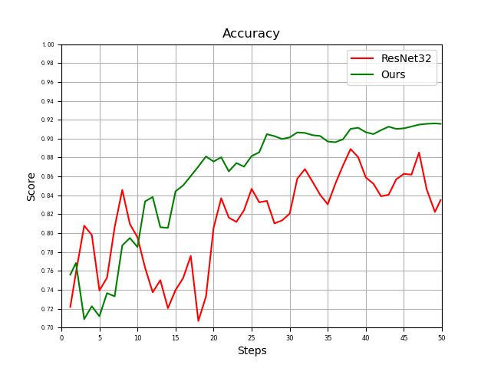

Slide 11
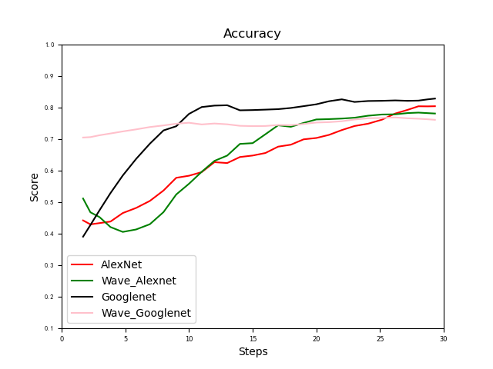

Slide 12



Patients
Medical Institution
DAI

Slide 13
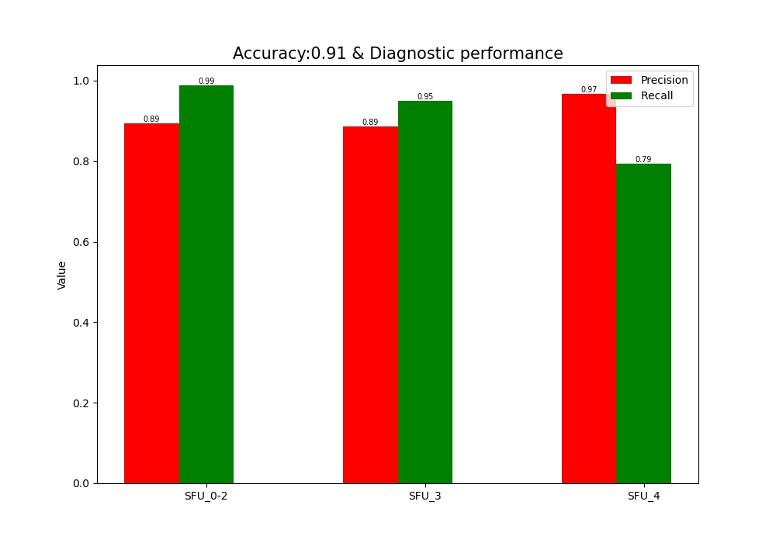

Slide 14
Identity
Generating peer node identity information through the S/Kademlia protocol
Network
ICE NAT traversal framework that integrates STUN, TURN and other types of NAT protocols
Routing
Formulating routing rules through the S/Kademlia protocol
Exchange
Managing the distribution of data blocks with Bitswap
Object
Object exists in the structure of Merkle DAG, which can be addressed and cannot be tampered with.
File
Git-like version file control system
Naming
With SFS (Self-Verifying File System)
Application
Runnig on the IPFS to provide efficiency, service, and cost reduction

