Slide 1
Hacking Rasters with Canvas for Quicker Queries
Wyatt Pearsall
Department of Water Resources

Slide 2
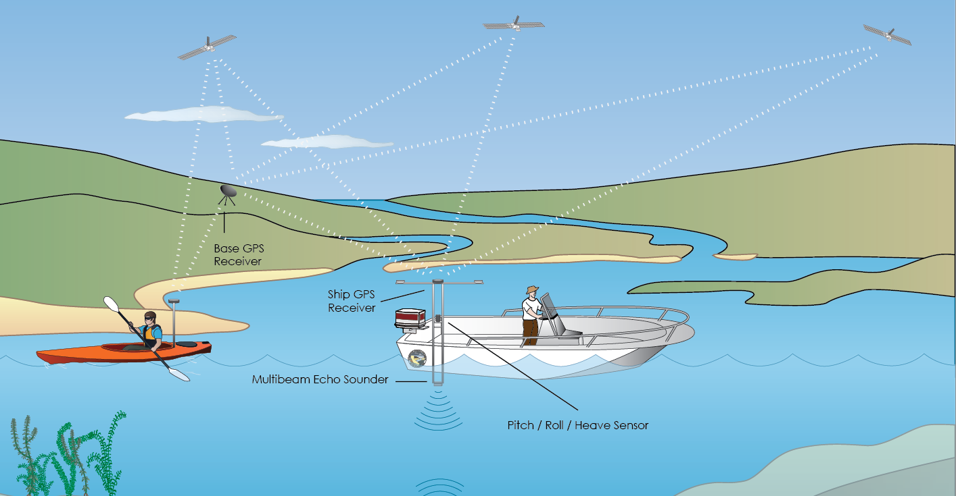
Bathymetry

Slide 3
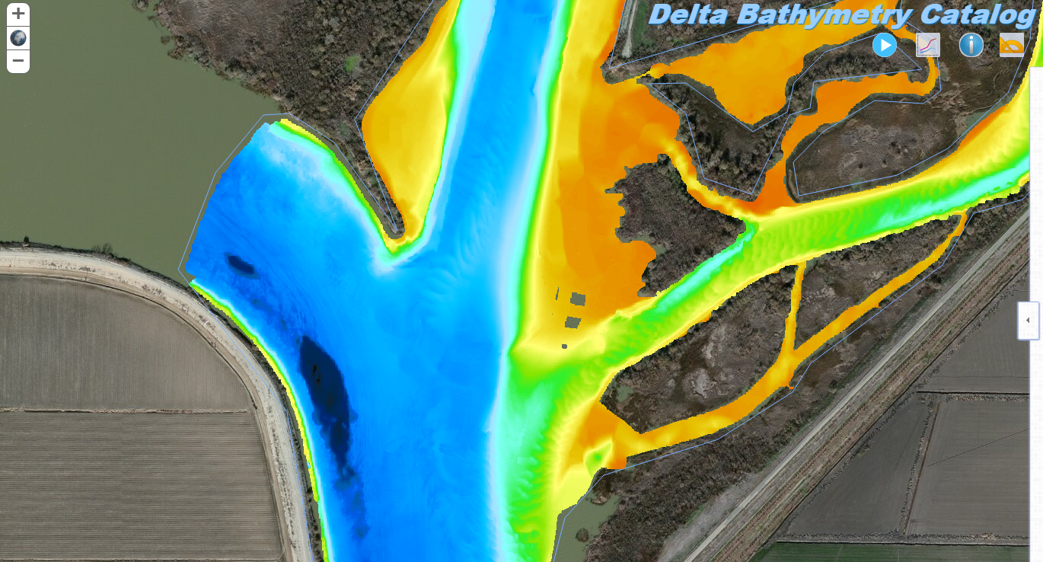
Bathymetry

Slide 4
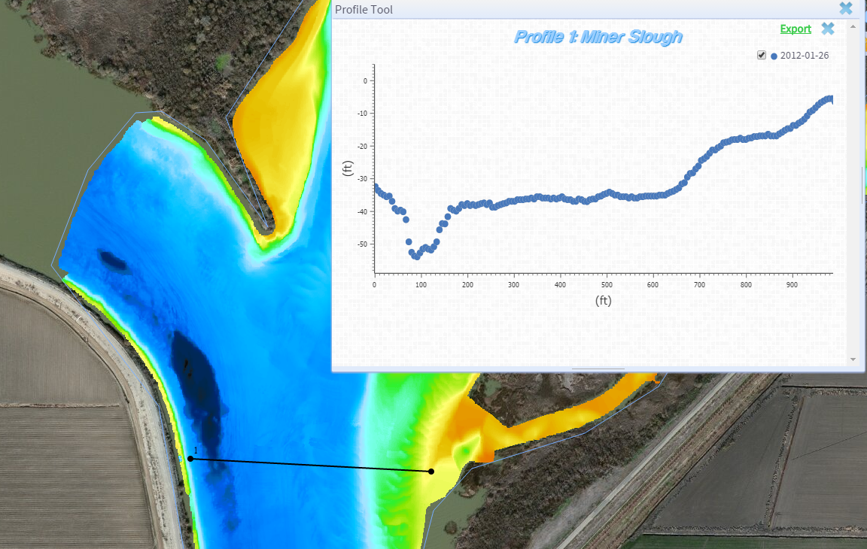
Quest for a Profile

Slide 5
Quest for a Profile

