Slide 1
Hacking Rasters with Canvas for Quicker Queries
Wyatt Pearsall
Department of Water Resources

Slide 2
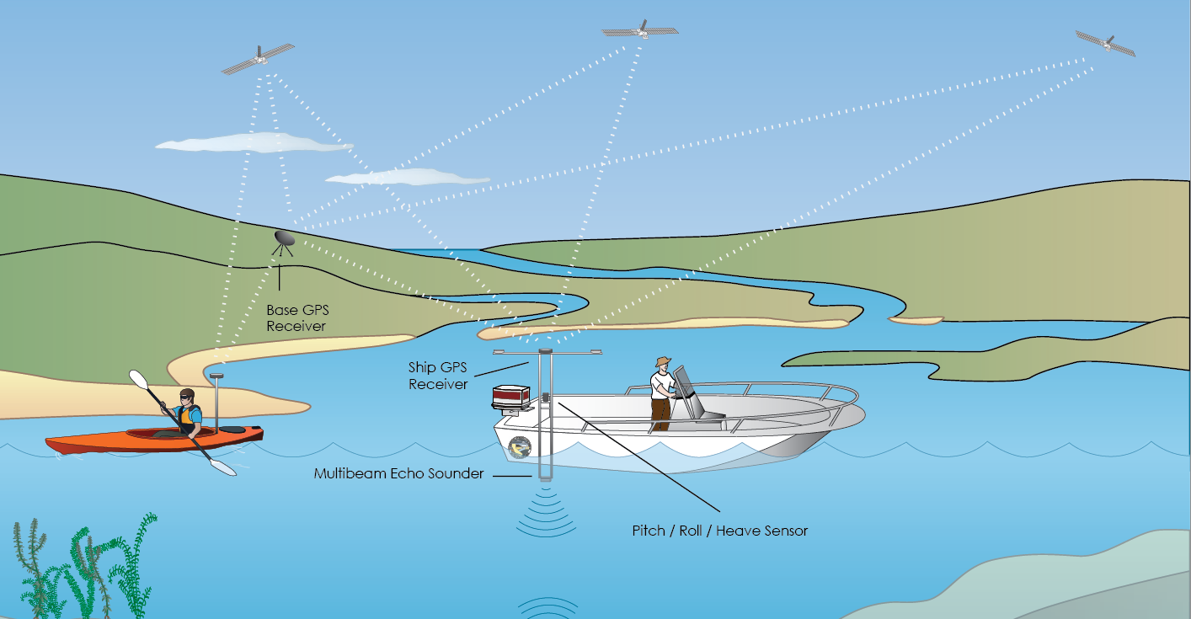
Bathymetry

Slide 3
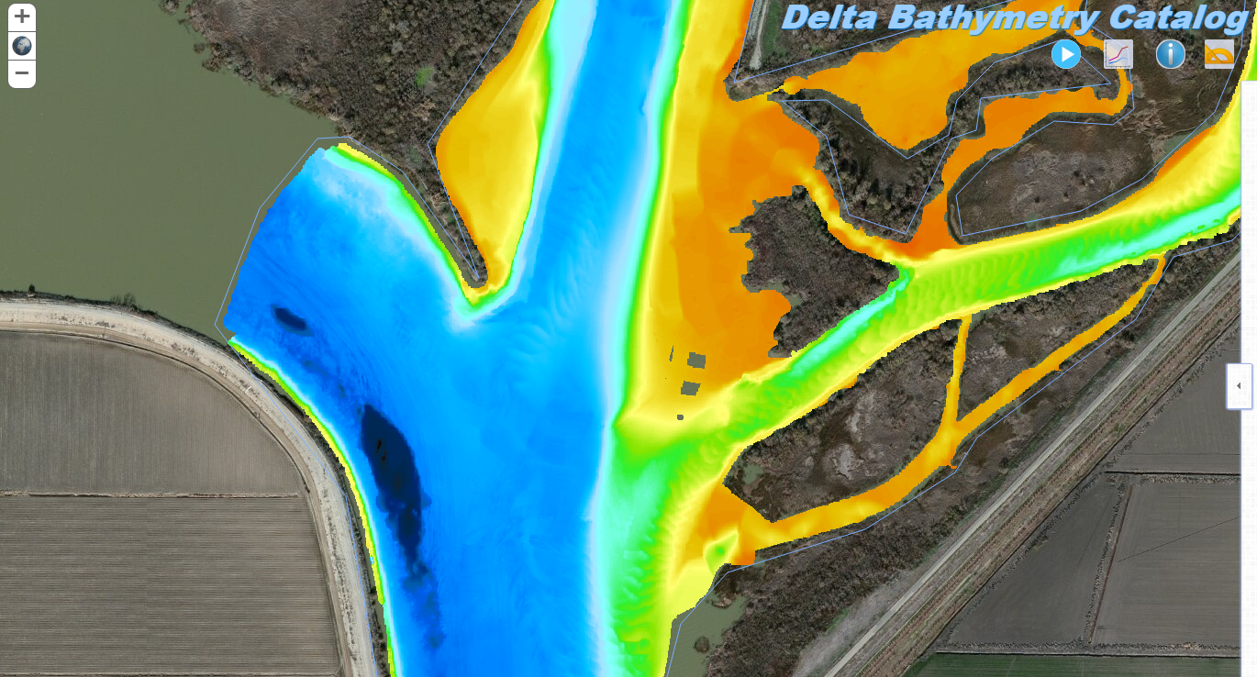
Bathymetry

Slide 4
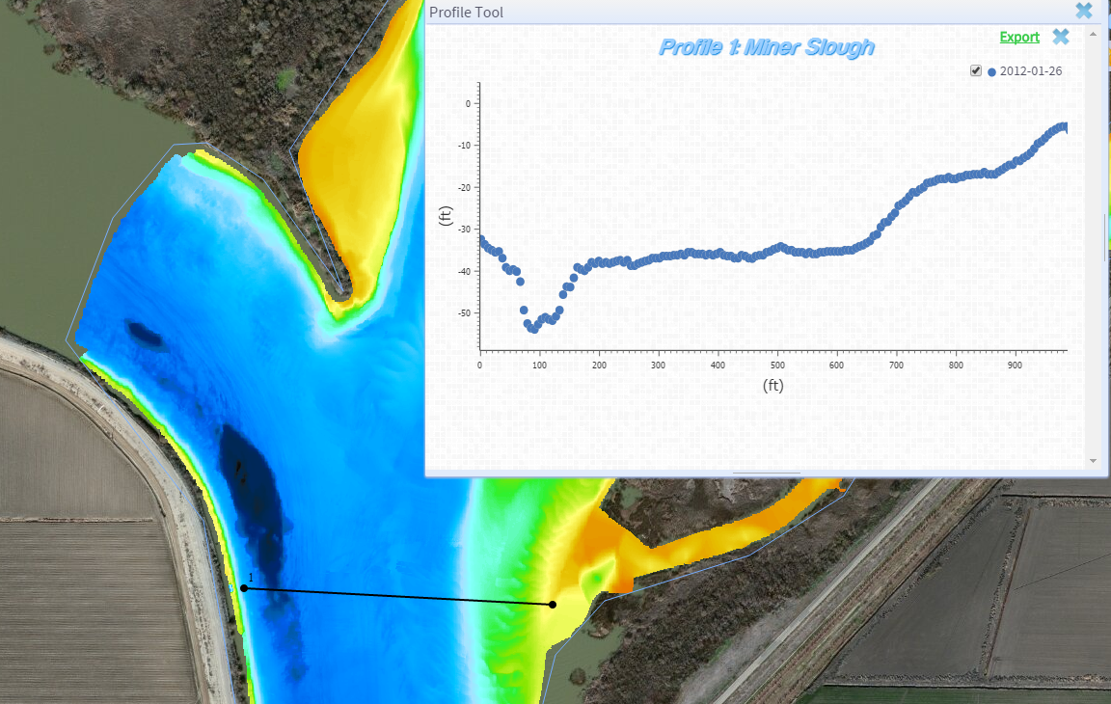
Quest for a Profile

Slide 5
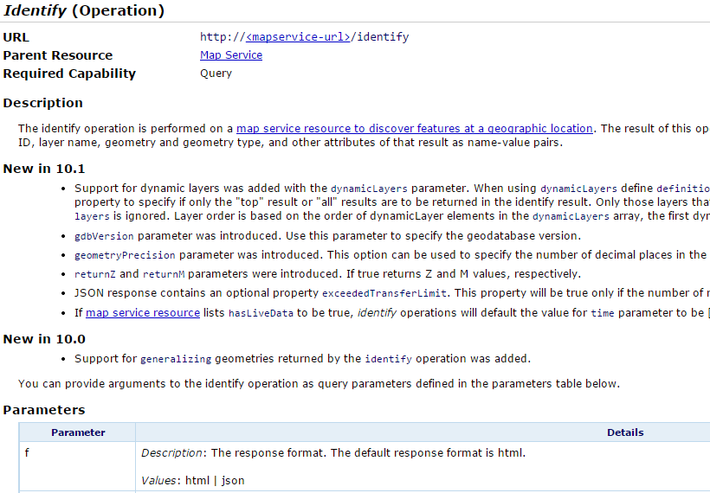
So... Identify?

Slide 6
So... Identify?
Pass in geometry of query in a given extent
What happens with a raster?

Slide 7
So... Identify?
Pass in geometry of query in a given extent
What happens with a point on a raster?
Pixel value

Slide 8
So... Identify?
Pass in geometry of query in a given extent
What happens with a point on a raster?
Pixel value
What happens with a multipoint on a raster?

Slide 9
So... Identify?
Pass in geometry of query in a given extent
What happens with a point on a raster?
Single pixel value
What happens with a multipoint on a raster?
Single pixel value

Slide 10
So... Identify?
Pass in geometry of query in a given extent
What happens with a point on a raster?
Single pixel value
What happens with a multipoint on a raster?
Single pixel value
We need an identify for every point

Slide 11
This works!

Slide 12
This works!
…slowly.

Slide 13
This works!
…slowly.
Many requests, all at once
Convoluted code to stagger requests
Spikey server interactions
Need to increase minimum number of instances
~4 seconds for a profile, on a connection

Slide 14
A better way?
Rasters represent values via their color ramp
By displaying a color at a pixel, the application is inherently answering a query about its elevation
If we could speak the language of the color ramp, we wouldn’t have to talk to the server at all

Slide 15
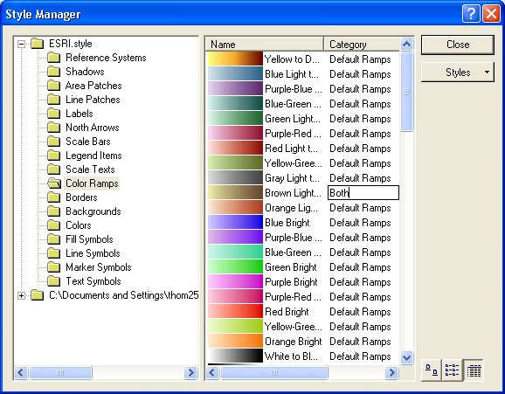
Color ramps

Slide 16
Color ramps
Contain 256 colors.
Finer precision is binned
Resolution of color ramp depends on range of values

Slide 17
Color ramps
Contain 256 colors.
Finer precision is binned
Resolution of color ramp depends on range of values
We have values ranging from 5ft to -68ft
Resolution is ~0.25ft… acceptable!

Slide 18
How to query from a color ramp?
DynamicMapServiceLayer
When you pan/zoom you are requesting a PNG rendered by the server for the given extent

Slide 19
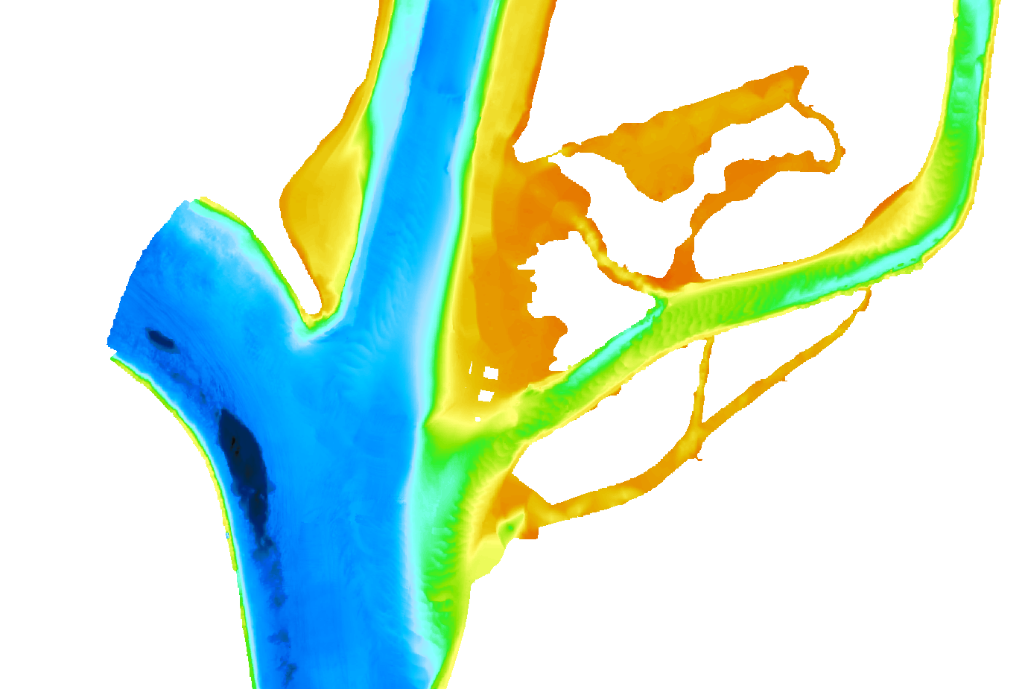
How to query from a color ramp?
DynamicMapServiceLayer
When you pan/zoom you are requesting a PNG rendered by the server for the given extent

Slide 20
How to query from a color ramp?
DynamicMapServiceLayer
When you pan/zoom you are requesting a PNG rendered by the server for the given extent
https://gis.water.ca.gov/arcgis/rest/services/Public/bathymetry_rasters/MapServer/export?dpi=96&transparent=true&format=png8&layers=show%3A-1%2C7&bbox=-13545324.217514684%2C4611867.454746921%2C-13543685.598720958%2C4612972.208671261&bboxSR=102100&imageSR=102100&size=1372%2C925&f=image

Slide 21
We can track these parameters to have access to the current image (or monkey patch the DMS layer to call our code when it updates)

Slide 22
What do we do with the image?
…Canvas!

Slide 23
What do we do with the image?
…Canvas!
Get a 2d context and call
context.drawImage(rasterPng,0,0)

Slide 24
What do we do with the image?
…Canvas!
Get a 2d context and call
context.drawImage(rasterPng,0,0)
For any x,y point can get pixel value with
context.getImageData(x,y,1,1)

Slide 25
What good is this?

Slide 26
What good is this?
Preprocessing!

Slide 27
What good is this?
Preprocessing!
Generate a raster with every possible elevation and systematically run identify and getImageData calls

Slide 28
What good is this?
Preprocessing!
Generate a raster with every possible elevation and systematically run identify and getImageData calls
Map every color in the color ramp to a depth and save in an object

Slide 29
To draw a profile, get the start and end x,y coordinates, generate intermediate coordinates, get the pixel value for each point, and look up its elevation in our color ramp object.

Slide 30
Results?
Generate profiles 10 – 1000 times faster.
Decrease server load and minimum instances
Happiness

Slide 31
Thanks! https://github.com/wpears/BathCat

