Slide 1
Making GIS web apps
(at DWR)

Slide 2
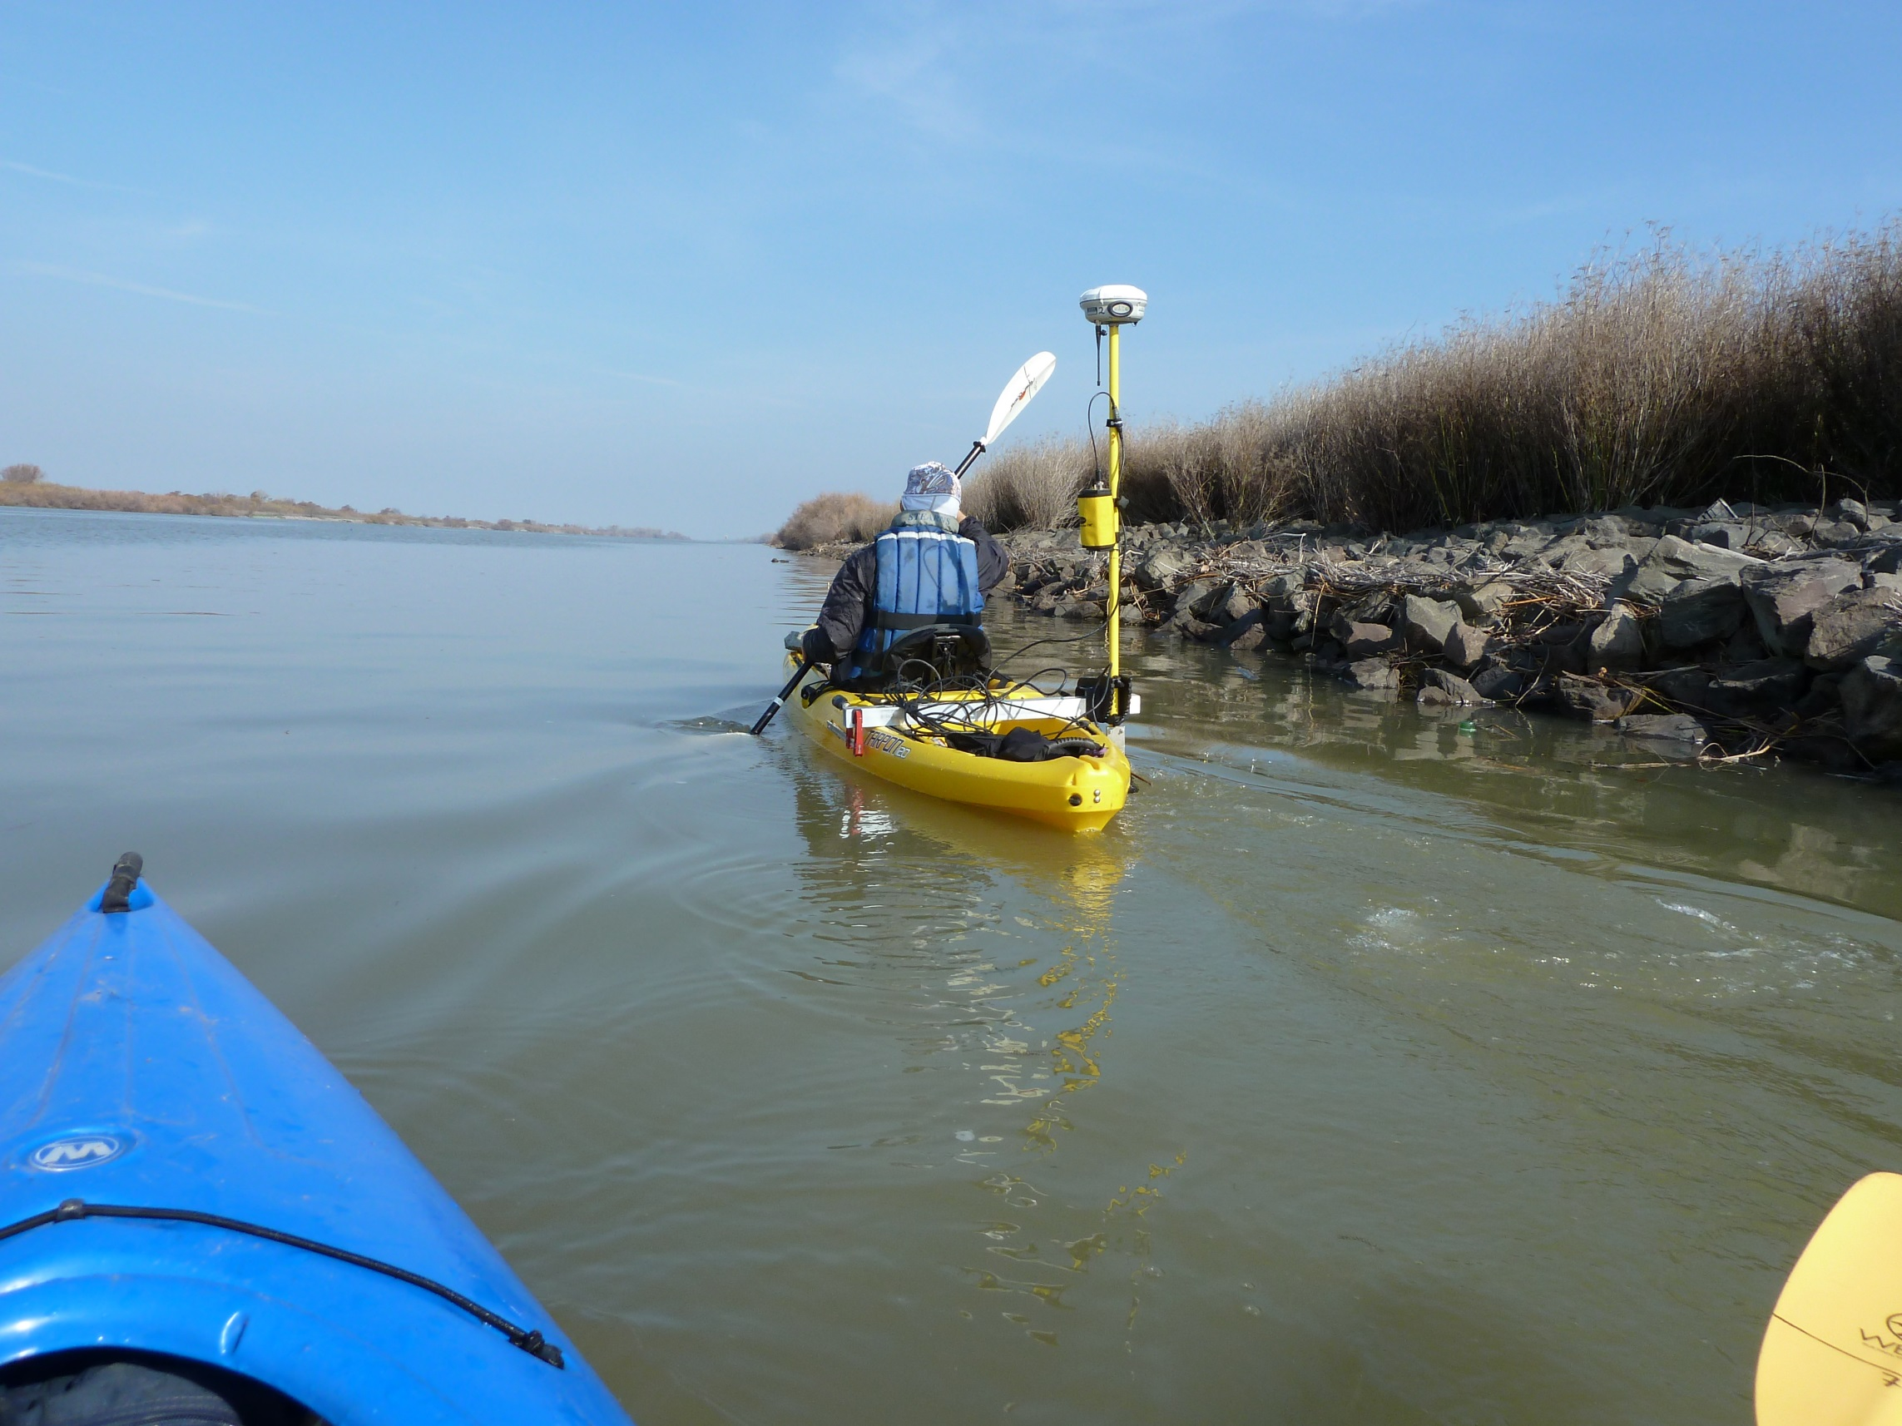
Who is this guy
Wyatt Pearsall
https://github.com/wpears

Slide 3
