Slide 1
MobFuzz: Adaptive Multi-objective Optimization in Gray-box Fuzzing
NDSS 2022
Gen Zhang, Pengfei Wang, Tai Yue, Xiangdong Kong, Shan Huang, Xu Zhou, Kai Lu
National University of Defense Technology
Contact: zhanggen@nudt.edu.cn
Notes:
Hello, everyone. I am Gen Zhang from NUDT. Today I am going to introduce our work: MobFuzz.

Slide 2
Content
1. Background
2. Motivation
3. Methods
4. Evaluations
5. Conclusion
Notes:
My presentation today is divided into these five parts.

Slide 3

1. Background
Coverage-guided gray-box fuzzing (CGF)
One of the most successful vulnerability detection techniques
Found numerous vulnerabilities in real-world programs
Easy for deployment and fast in speed
……
Notes:
Coverage-guided gray-box fuzzing (CGF) is one of the most successful vulnerability detection techniques.
It has found numerous vulnerabilities in real-world programs.
It is easy for deployment and fast in speed, and so on.

Slide 4
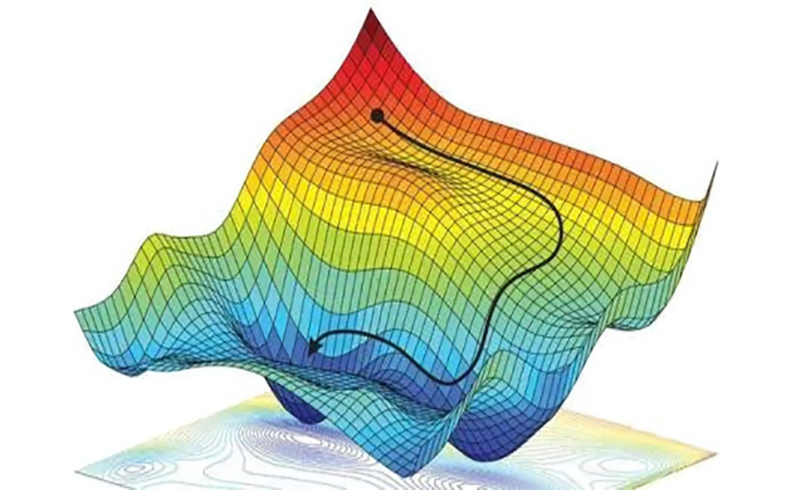
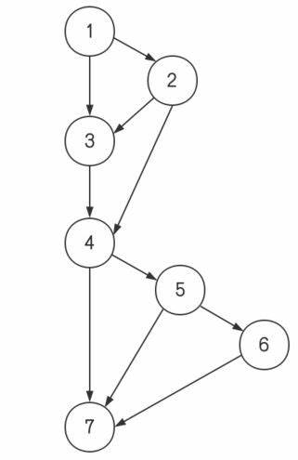
1. Background
Optimization problem
Searches the input space to find optimal solutions and optimize the objectives
Essentially, CGF is an optimization problem
The goal of CGF is to maximize its objective: code coverage
Existing CGFs use single-objective optimization
Notes:
An optimization problem is the process that searches the input space to find optimal solutions and optimize the objectives.
Essentially, CGF is an optimization problem.
The goal of CGF is to maximize its objective, which is code coverage.
However, existing CGFs use single-objective optimization.

Slide 5
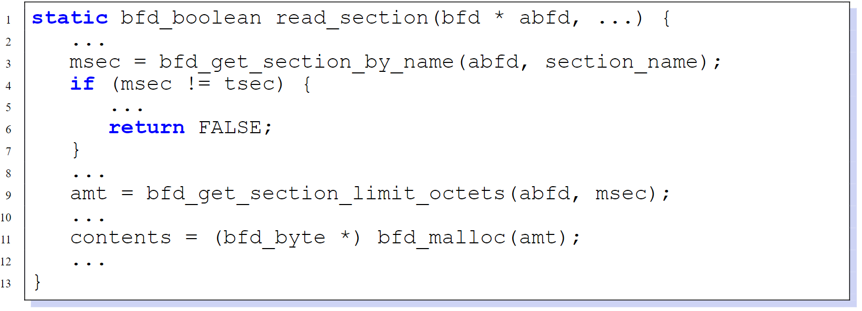
1. Background
Multi-objective optimization (MOO) is required
First objective: Line 4, solving more constraint bytes
Second objective: Line 11, allocating more memory
Finally triggers a real-world memory consumption bug
Binutils dwarf2.c
Notes:
In real-world vulnerability detection scenarios, multi-objective optimization (MOO) is required.
This code snippet demonstrates a real-world Linux binary utilities vulnerability.
Two objectives need to be optimized to trigger it.
The first objective is in Line 4, which is solving more constraint bytes in the if statement.
The second objective is in Line 11, which is allocating more memory.
Finally we can trigger a real-world memory consumption bug.

Slide 6
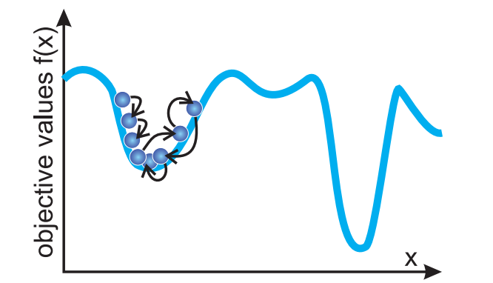
2. Motivation
No fuzzer solves the problem of multi-objective optimization in gray-box fuzzing
American fuzzy lop (AFL)
Optimizes 2 objectives: the execution time and input size
Favorable seeds that have a smaller product of these two objectives are selected
Will get stuck at local optimum, cannot really support MOO
MemLock (ICSE 2020)
Optimizes the objective of memory consumption
Based on AFL, but removes the (speed ∗size) objectives when optimizing memory consumption, cannot really support MOO
Notes:
However, no fuzzer solves the problem of multi-objective optimization in gray-box fuzzing.
For example, AFL optimizes 2 objectives, including the execution time and input size.
Favorable seeds that have a smaller product of these two objectives are selected.
But according to previous analysis, it will get stuck at local optimum, and cannot really support multi-objective optimization.
MemLock optimizes the objective of memory consumption.
It is based on AFL, but removes the original objectives of AFL when optimizing memory consumption.
Therefore it cannot really support multi-objective optimization.

Slide 7
2. Motivation
To properly optimize multiple objectives simultaneously in CGF, we have to overcome the following challenges
Challenge 1
Conflict effects among different objectives require adaptive objective selection
E.g., the number of satisfied comparison bytes ↑, fuzzing speed ↓
Challenge 2
Power schedule suitable for a multi-objective situation
E.g., the power schedule of AFLFast or EcoFuzz is not suitable in MOO
Challenge 3
Reducing performance overhead introduced by multi-objective optimization in fuzzing
Notes:
So, to properly optimize multiple objectives simultaneously in CGF, we have to overcome the following challenges.
Challenge one is that the conflict effects among different objectives require adaptive objective selection.
For example, pushing the number of satisfied comparison bytes to a large value to pass branch conditions will slow down the whole fuzzing process.
We have to select the best objective combination under the current fuzzing status.
Challenge two is the power schedule suitable for a multi-objective situation.
For example, the power schedule of AFLFast or EcoFuzz is not suitable in multi-objective optimization.
Challenge three is reducing performance overhead introduced by multi-objective optimization in fuzzing.

Slide 8
3. Methods
To solve the challenges, we propose adaptive multi-objective optimization in CGF
MPMAB
Initial seeds
Objective combination
selection
Obj values,
selections
Objective
combination
Seed pool
Power schedule
Energy
Mutation,
execution
Yes
New coverage?
NIC
Pareto
seeds
Seed
Cross, mut, exe
Need NIC?
Optimized
objectives
Update
obj values
Notes:
To solve the challenges, we propose adaptive multi-objective optimization in CGF.
This figure demonstrates the components of our proposed methods.
The uncolored parts are the procedures of AFL.
The colored parts are the new techniques we propose.

Slide 9
3. Methods
We implement prototype MobFuzz
Including MPMAB and NIC to solve the 3 challenges
Adaptive objective selection (Challenge 1)
Multi-player multi-arm bandit (MPMAB)
MobFuzz
Power schedule (Challenge 2)
Non-dominated sorting genetic algorithm in CGF (NIC)
Reducing performance overhead (Challenge 3)
Notes:
In order to solve adaptive objective selection (Challenge 1) and power schedule (Challenge 2), we propose multi-player multi-arm bandit (MPMAB).
To reduce performance overhead (Challenge 3), we propose non-dominated sorting genetic algorithm in CGF (NIC).
Based on MPMAB and NIC, we implement prototype MobFuzz.

Slide 10
3. Methods
MPMAB
Multi-player multi-arm bandit
MPMAB solves the following key problems
① Adaptively selects the best objective combination under the current fuzzing status
② Power schedule suitable for the multi-objective optimization
Notes:
One of the key components in MobFuzz is the MPMAB model.
It solves the following key problems.
First, MPMAB adaptively selects the best objective combination under the current fuzzing status.

Slide 11
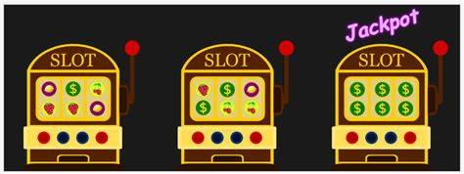
3. Methods
A classic MAB problem
To maximize benefits within finite trials
The key to MAB is the balance between exploration (trying reward unknown choices) and exploitation (choosing the currently best choice)
MPMAB is a variant of classic MAB
Each objective combination: a player with his specific goal playing the slot machine
For every player: similar to classic MAB
Notes:
Our proposed method is based on a classic MAB problem.
The goal of MAB is to maximize benefits within finite trials.
The key to an MAB problem is the balance between exploration (trying reward unknown choices) and exploitation (choosing the currently best choice).
MPMAB is a variant of classic MAB.
Each objective combination stands for a player with his specific goal playing the slot machine.
For every player, it is similar to a classic MAB problem.

Slide 12
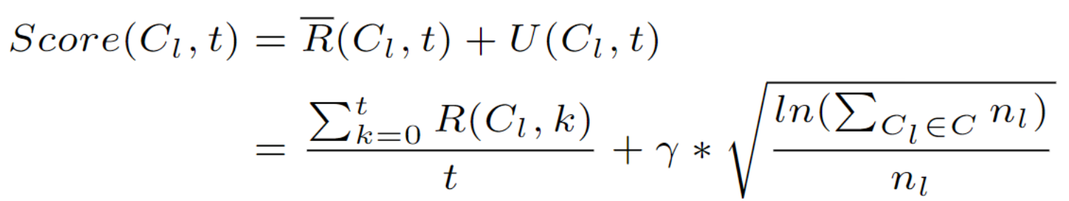
3. Methods
We use UCB1 to score the objective combination
R stands for historical reward (exploitation), and U stands for upper confidence bond (exploration), λ controls the balance between R and U
Notes:
To balance the exploration and exploitation in MPMAB, we use UCB1 algorithm to score the objective combination.
In the given equation, R stands for historical reward of objective combination, which means exploitation.
And U stands for upper confidence bond, which means exploration.
λ controls the balance between R and U.

Slide 13
3. Methods
MPMAB solves the following key problems
① Adaptively selects the best objective combination under the current fuzzing status
② Power schedule suitable for the multi-objective optimization
Still need to balance between exploration (allocate more energy to reword-unknown seeds) and exploitation (allocate more energy to the maximum-reword seeds)
Based on whether there is reward-unknown seeds, we divide the fuzzing process to 2 states
Unknown seeds: exploration
No unknown seeds: exploitation
Notes:
Next, MPMAB deals with the power schedule suitable for the multi-objective optimization.
In this part, we still need to balance between exploration (allocate more energy to reword-unknown seeds) and exploitation (allocate more energy to the maximum-reword seeds).
Based on whether there is reward-unknown seeds in the current fuzzing state, we divide the fuzzing process to 2 states.
If there is reward-unknown seeds, it is exploration state.
If there is no reward-unknown seeds, it is exploitation state.

Slide 14
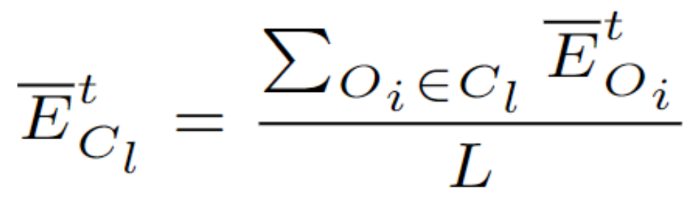
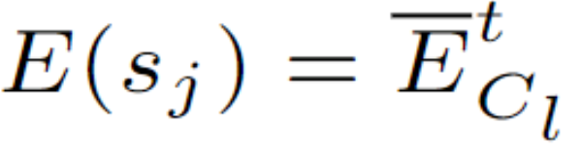
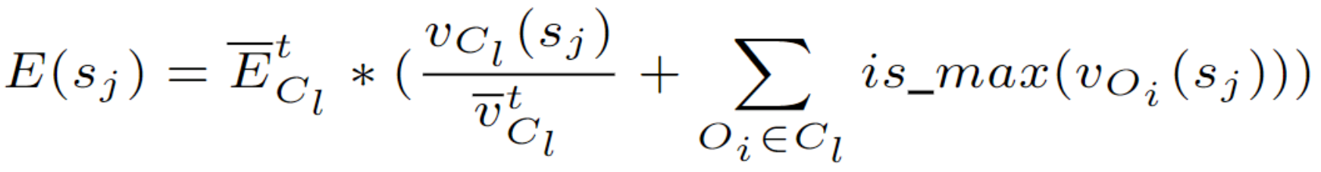
3. Methods
We define the average energy to reach a certain objective value
(The number of executions) ÷ (The value of an objective)
We consider it the minimum energy required to increase the objective value
In exploration state
There are currently reward-unknown seeds, and we need to try as many new seeds as possible
We allocate the minimum energy to seeds in this state as
In exploitation state
All the rewards of seeds are known, and choose the seed with the maximum reward
The more reward, the more energy for seeds, and we allocate energy as
Notes:
To calculate the energy, we define the average energy to reach a certain objective value as following.
ECL is the quotient of the number of executions and the value of an objective.
We consider it the minimum energy required to increase the objective value.
Exploration state implies that there are currently reward-unknown seeds, and we need to try as many new seeds as possible.
To increase objective values and save energy, we allocate the minimum energy to seeds in this state as this equation.
In exploitation state, all the rewards of seeds are known, and it is rational to choose the seed with the maximum reward.
The more reward, the more energy for seeds, and we define the energy in this state as this equation.

Slide 15
3. Methods
NIC
Non-dominated sorting genetic algorithm in CGF
NIC produces the optimal values of the selected objectives with low performance overhead
NIC
Pareto
seeds
Seed
Cross, mut, exe
Need NIC?
Optimized
objectives
Update
obj values
Notes:
The other key component of MobFuzz is the NIC algorithm.
NIC produces the optimal values of the selected objectives with low performance overhead.

Slide 16
3. Methods
NIC adopts the following key techniques
① Adaptive population size
Common genetic algorithms use fixed-size population
We design adaptive population size to select population according to the size of seeds
② Co-mutation operators with AFL
Previous genetic algorithms use inefficient mutation operators
We propose new mutation operators according to the design of AFL
③ Reducing performance overhead
The separation of genetic algorithm and fuzzing causes performance overhead
We design approaches to integrate genetic algorithm into fuzzing, e.g., a shared seed pool
Notes:
NIC adopts the following key techniques.
First, adaptive population size.
Common genetic algorithms use fixed-size population, which is not suitable for a fuzzing situation.
We design adaptive population size to select population according to the size of seeds in fuzzing.
Second, co-mutation operators with AFL.
Previous genetic algorithms use inefficient mutation operators.
We propose new mutation operators according to the design of AFL.
Third, reducing performance overhead.
The separation of genetic algorithm and fuzzing causes performance overhead.
We design approaches to integrate genetic algorithm into fuzzing, e.g., a shared seed pool.

Slide 17
4. Evaluations
Target programs
12 real-world programs
MAGMA data set
Baseline fuzzers
Real-world programs: AFL (speed), MemLock (memory consumption), and FuzzFactory (satisfied comparison bytes)
MAGMA: AFL, AFLFast, AFL++, FairFuzz, honggfuzz, MOPT, and SYMCC
Notes:
In evaluation, we select 2 types of target programs, including twelve real-world programs and the MAGMA data set.
As for baseline fuzzers, in real-world programs, we select AFL, MemLock, and FuzzFactory.
They are all single-objective optimization fuzzers, with the objective of execution speed, memory consumption, and satisfied comparison bytes.
In MAGMA data set, we select AFL, AFLFast, AFL plus plus, FairFuzz, honggfuzz, MOPT, and SYMCC
.

Slide 18
4. Evaluations
Research questions
RQ1: Does multi-objective optimization in MobFuzz outperform single-objective optimization in the baseline fuzzers?
RQ2: How does the objective combination selection adapt in the fuzzing process?
RQ3: How does our power schedule perform compared with the baseline fuzzers under the chosen objective combination?
RQ4: Does NIC optimize the objective values without introducing additional performance overhead?
Notes:
In evaluation, we are going to answer four research questions.
Research question one is that does multi-objective optimization in MobFuzz outperform single-objective optimization in the baseline fuzzers?

Slide 19
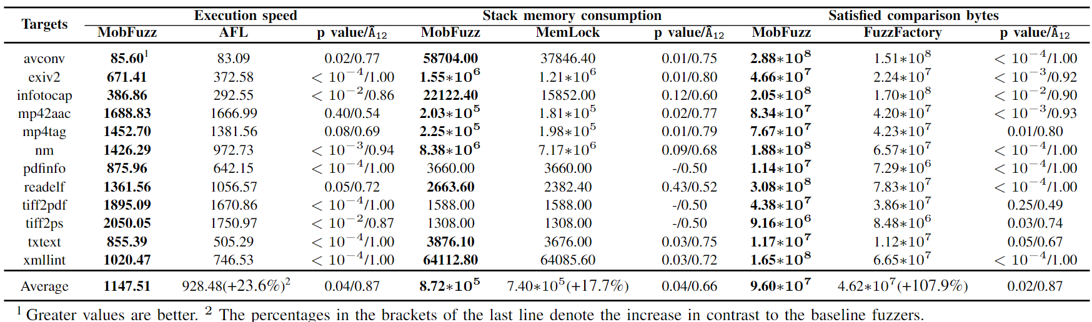
4. Evaluations
Results of objective values
The values of MobFuzz are greater than (33 out of 36) or equal to (3 out of 36) the compared values in all the comparisons
MobFuzz outputs higher values in the 3 objectives
Notes:
Here we show the results of objective values.
As we can see from the table, in thirty-three out of the thirty-six comparisons, the values of MobFuzz are greater than the compared values. In three out of the thirty-six comparisons, they are equal to the compared values.
Therefore, MobFuzz outputs higher values in the 3 objectives.

Slide 20
4. Evaluations
Answer to RQ1
Multi-objective optimization in MobFuzz outperforms every single-objective optimization simultaneously in the baseline fuzzers
Notes:
We can answer research question one that multi-objective optimization in MobFuzz outperforms every single-objective optimization simultaneously in the baseline fuzzers.

Slide 21
4. Evaluations
Research questions
RQ1: Does multi-objective optimization in MobFuzz outperform single-objective optimization in the baseline fuzzers?
RQ2: How does the objective combination selection adapt in the fuzzing process?
RQ3: How does our power schedule perform compared with the baseline fuzzers under the chosen objective combination?
RQ4: Does NIC optimize the objective values without introducing additional performance overhead?
Notes:
The second research question is that how does the objective combination selection adapt in the fuzzing process?

Slide 22
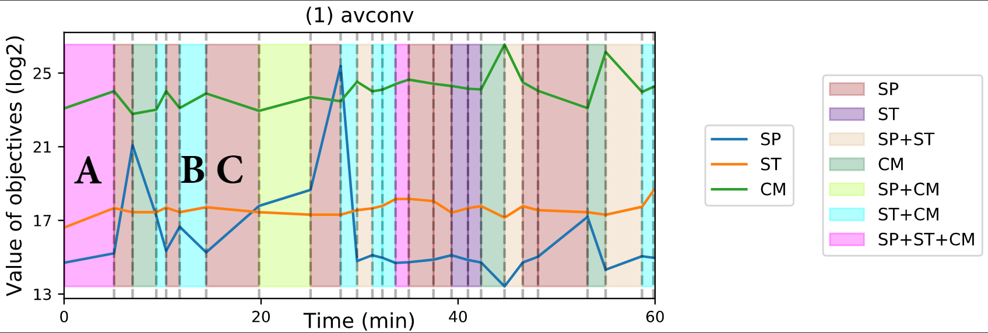
4. Evaluations
Selected objective combination affects objective values
Background colors: the chosen combination, lines: the objective values
Point A: 3 objectives are selected, all the values increase
Point B: The increasing of comparison bytes slows down the speed
Point C: Correction to the slowing down of speed
Notes:
This figure shows how the selected objective combination affects the objective values.
Background colors stand for the chosen combination, and lines are the objective values.
In Point A, 3 objectives are selected, and all the values increase.
In Point B, because of the conflict effects between objectives, the increasing of comparison bytes slows down the speed.
In Point C, the MPMAB model tries to correct the slowing down of speed. Therefore, it chooses speed as the objective to optimize in Point C.

Slide 23
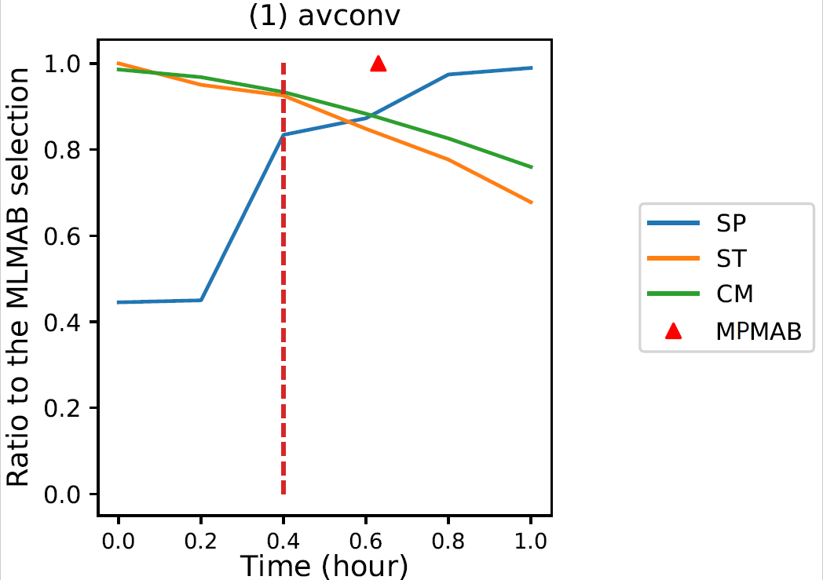
4. Evaluations
Does MPMAB select the best objective combination?
We set 6 other selection strategies (the X-axis)
Y-axis less than 1.0: MPMAB is better
MPMAB is better than other strategies
Notes:
In order to demonstrate MPMAB selects the best objective combination, we set six other selection strategies in the X-axis.
If the Y-axis is less than one point zero, MPMAB is better.
According to the figure, all the Y values are less than one.
Therefore, MPMAB is better than other strategies, and it can select the best objective combination.

Slide 24
4. Evaluations
Answer to RQ2
Our selection strategy can adaptively select the best objective combinations
Notes:
Therefore, we can answer research question two.
Our selection strategy can adaptively select the best objective combinations.

Slide 25
4. Evaluations
Research questions
RQ1: Does multi-objective optimization in MobFuzz outperform single-objective optimization in the baseline fuzzers?
RQ2: How does the objective combination selection adapt in the fuzzing process?
RQ3: How does our power schedule perform compared with the baseline fuzzers under the chosen objective combination?
RQ4: Does NIC optimize the objective values without introducing additional performance overhead?
Notes:
The third research question is that how does our power schedule perform compared with the baseline fuzzers under the chosen objective combination?

Slide 26
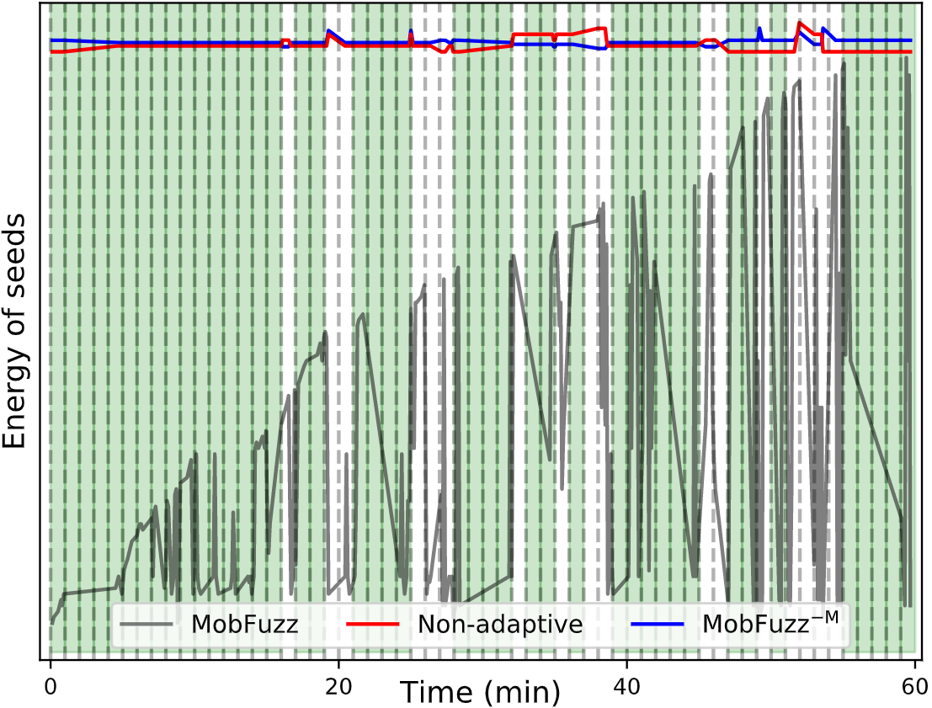
4. Evaluations
Comparison of our adaptive power schedule with non-adaptive and MobFuzz^(−M) (MobFuzz without MPMAB) schedules
Non-adaptive and MobFuzz^(−M) cannot adaptively allocate energy
MobFuzz can adaptively allocate energy under the selected combination
Notes:
This result shows the comparison of our adaptive power schedule with non-adaptive and MobFuzz without MPMAB schedules.
We can see that non-adaptive and MobFuzz minus M cannot adaptively allocate energy.
MobFuzz can adaptively allocate energy under the selected combination.

Slide 27
4. Evaluations
Answer to RQ3
Our power schedule can adaptively allocate energy according to the chosen objective combination
Notes:
So we can answer research question three.
Our power schedule can adaptively allocate energy according to the chosen objective combination.

Slide 28
4. Evaluations
Research questions
RQ1: Does multi-objective optimization in MobFuzz outperform single-objective optimization in the baseline fuzzers?
RQ2: How does the objective combination selection adapt in the fuzzing process?
RQ3: How does our power schedule perform compared with the baseline fuzzers under the chosen objective combination?
RQ4: Does NIC optimize the objective values without introducing additional performance overhead?
Notes:
The last research question is that does NIC optimize the objective values without introducing additional performance overhead?

Slide 29
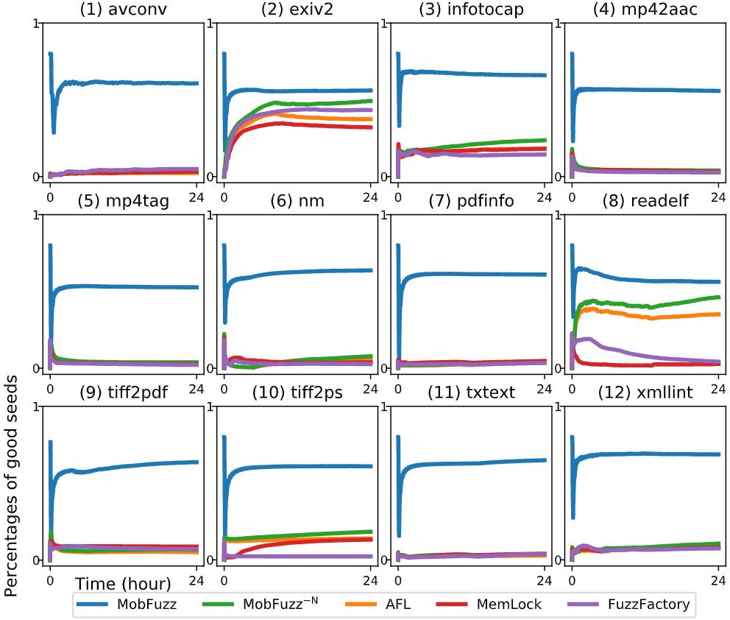
4. Evaluations
Results of good seeds
Good seeds: seeds that achieve greater objective values than the average in the selected objective combination
The percentages of good seeds in MobFuzz are greater.
Notes:
Here, we show the results of good seeds.
We define seeds that achieve greater objective values than the average in the selected objective combination as good seeds.
According to the result, the percentages of good seeds in MobFuzz are greater than those of the baseline fuzzers.

Slide 30
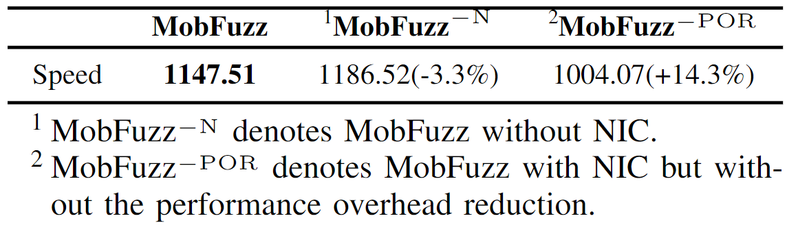
4. Evaluations
Performance overhead of NIC
The NIC algorithm in MobFuzz brings about 3.3% performance, which is acceptable
Notes:
Next result is the performance overhead of NIC.
The NIC algorithm in MobFuzz brings about three point three percent performance overhead to the fuzzing process, which is acceptable.

Slide 31
4. Evaluations
Answer to RQ4
NIC can produce the optimal objective values with low performance overhead
Notes:
Therefore, we can answer the fourth research question.
NIC can produce the optimal objective values with low performance overhead.

Slide 32
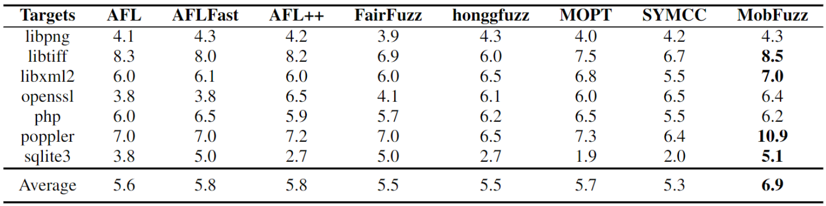
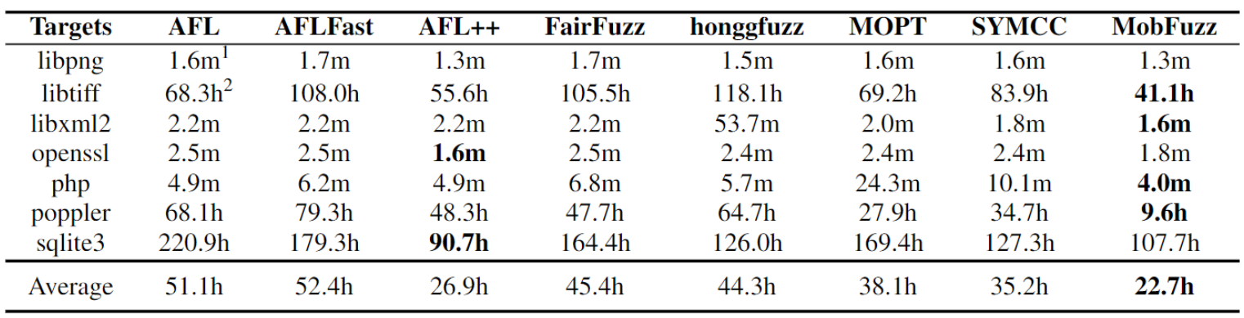
4. Evaluations
Evaluation on the MAGMA data set
Bug count
MobFuzz outperforms all the baseline fuzzers in 4 out of the 7 projects
On average, MobFuzz finds more bugs
Time to bug
MobFuzz outperforms all the baseline fuzzers in 4 out of the 7 projects
On average, MobFuzz triggers bugs with less time
Notes:
The second part of our evaluation is the MAGMA data set.
This part is divided into the results of bug count and the results of time to bug.
In bug count, MobFuzz outperforms all the baseline fuzzers in 4 out of the 7 projects.
On average, MobFuzz finds more bugs than the baselines.
In time to bug, MobFuzz outperforms all the baseline fuzzers in 4 out of the 7 projects.
On average, MobFuzz triggers bugs with less time than the baselines.

Slide 33
5. Conclusion
We propose MobFuzz: adaptive multi-objective optimization in gray-box fuzzing
Facing the 3 challenges of MOO in CGF
MPMAB adaptively selects the best combination and allocates energy
NIC outputs the optimal objective values with low performance overhead
We implement prototype MobFuzz
Evaluations show the effectiveness of our proposed techniques
Notes:
Finally, I will give today’s presentation a conclusion.
Our work deals with adaptive multi-objective optimization in gray-box fuzzing.
We solves the three challenges of multi-objective optimization in CGF.
We propose the MPMAB model to adaptively select the best combination and allocate energy.
And we design the NIC algorithm to output the optimal objective values with low performance overhead.
Based on these two key components, we implement prototype MobFuzz.
We conduct extensive evaluations, the results show the effectiveness of our proposed techniques.

Slide 34
Thanks for your listening! Q&A
MobFuzz: Adaptive Multi-objective Optimization in Gray-box Fuzzing
NDSS 2022
Gen Zhang, Pengfei Wang, Tai Yue, Xiangdong Kong, Shan Huang, Xu Zhou, Kai Lu
National University of Defense Technology
Contact: zhanggen@nudt.edu.cn
Notes:
Above is our today’s presentation.
Thanks for your listening.

